Slide 1
CS 61C: Great Ideas in Computer Architecture Thread-Level Parallelism (TLP) and OpenMP Intro
Instructors:
John Wawrzynek & Vladimir Stojanovic
http://inst.eecs.berkeley.edu/~cs61c/

Slide 2
Review
Amdahl’s Law: Serial sections limit speedup
Flynn Taxonomy
Intel SSE SIMD Instructions
Exploit data-level parallelism in loops
One instruction fetch that operates on multiple operands simultaneously
128-bit XMM registers
SSE Instructions in C
Embed the SSE machine instructions directly into C programs through use of intrinsics
Achieve efficiency beyond that of optimizing compiler

Slide 3


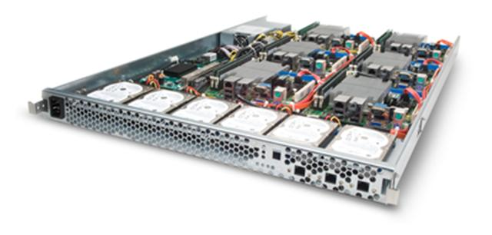
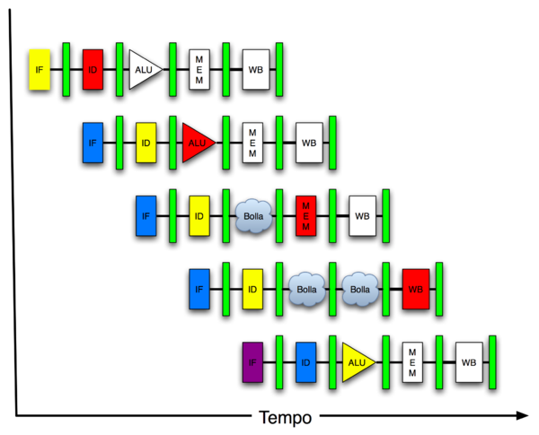
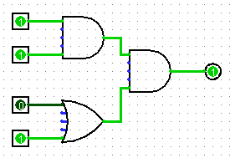
New-School Machine Structures (It’s a bit more complicated!)
Software Hardware
Parallel Requests
Assigned to computer
e.g., Search “Katz”
Parallel Threads
Assigned to core
e.g., Lookup, Ads
Parallel Instructions
>1 instruction @ one time
e.g., 5 pipelined instructions
Parallel Data
>1 data item @ one time
e.g., Add of 4 pairs of words
Hardware descriptions
All gates @ one time
Programming Languages
Warehouse Scale Computer
Smart Phone
Harness Parallelism &
Achieve High Performance
Computer
Core
…
Core
Memory (Cache)
Project 4
Input/Output
Core
Instruction Unit(s)
Functional
Unit(s)
A₀+B₀
A₁+B₁
A₂+B₂
A₃+B₃
Cache Memory
Logic Gates

Slide 4
Simple Multiprocessor
Processor 0
Control
Memory
Processor 0 Memory Accesses
Input
Datapath
PC
Registers
(ALU)
Bytes
Processor 1
Control
Processor 1 Memory Accesses
Datapath
Output
PC
Registers
(ALU)
I/O-Memory Interfaces

Slide 5
Multiprocessor Execution Model
Each processor has its own PC and executes an independent stream of instructions (MIMD)
Different processors can access the same memory space
Processors can communicate via shared memory by storing/loading to/from common locations
Two ways to use a multiprocessor:
Deliver high throughput for independent jobs via job-level parallelism
Improve the run time of a single program that has been specially crafted to run on a multiprocessor - a parallel-processing program
Use term core for processor (“Multicore”) because “Multiprocessor Microprocessor” too redundant

Slide 6
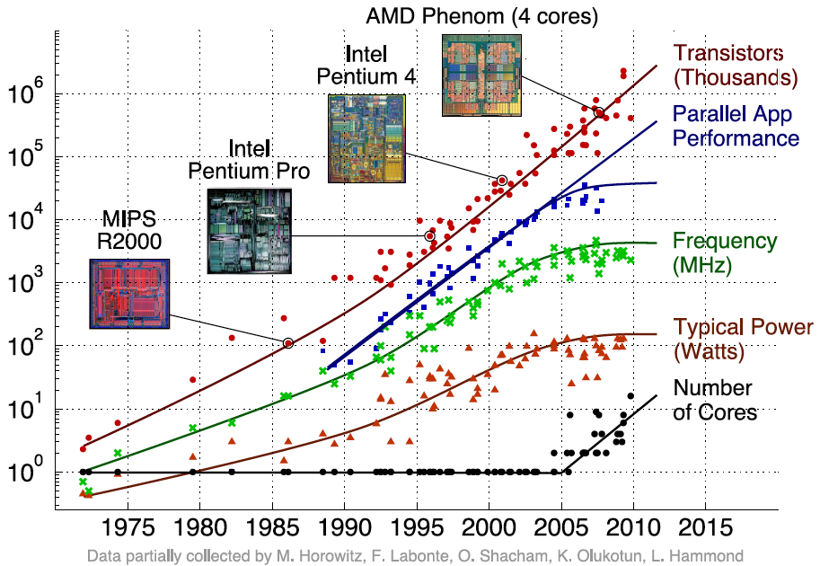
Transition to Multicore
Sequential App Performance

Slide 7
Parallelism the Only Path to Higher Performance
Sequential processor performance not expected to increase much, and might go down
If want apps with more capability, have to embrace parallel processing (SIMD and MIMD)
In mobile systems, use multiple cores and GPUs
In warehouse-scale computers, use multiple nodes, and all the MIMD/SIMD capability of each node

Slide 8
Multiprocessors and You
Only path to performance is parallelism
Clock rates flat or declining
SIMD: 2X width every 3-4 years
128b wide now, 256b 2011, 512b in 2014, 1024b in 2018?
MIMD: Add 2 cores every 2 years: 2, 4, 6, 8, 10, …
Key challenge is to craft parallel programs that have high performance on multiprocessors as the number of processors increase – i.e., that scale
Scheduling, load balancing, time for synchronization, overhead for communication
Project 4: fastest code on 8-core computers
2 chips/computer, 4 cores/chip

Slide 9
Potential Parallel Performance (assuming SW can use it)
Year | Cores | SIMD bits /Core | Core * SIMD bits | Peak DP FLOPs/Cycle
2003 | 2 | 128 | 256 | 4
2005 | 4 | 128 | 512 | 8
2007 | 6 | 128 | 768 | 12
2009 | 8 | 128 | 1024 | 16
2011 | 10 | 256 | 2560 | 40
2013 | 12 | 256 | 3072 | 48
2015 | 14 | 512 | 7168 | 112
2017 | 16 | 512 | 8192 | 128
2019 | 18 | 1024 | 18432 | 288
2021 | 20 | 1024 | 20480 | 320
MIMD
SIMD
MIMD *SIMD
+2/
2yrs
2X/
4yrs
2.5X
8X
20X

Slide 10
Threads
Thread: a sequential flow of instructions that performs some task
Each thread has a PC + processor registers and accesses the shared memory
Each processor provides one (or more) hardware threads (or harts) that actively execute instructions
Operating system multiplexes multiple software threads onto the available hardware threads

Slide 11
Operating System Threads
Give the illusion of many active threads by time-multiplexing software threads onto hardware threads
Remove a software thread from a hardware thread by interrupting its execution and saving its registers and PC into memory
Also if one thread is blocked waiting for network access or user input
Can make a different software thread active by loading its registers into a hardware thread’s registers and jumping to its saved PC

Slide 12
Hardware Multithreading
Basic idea: Processor resources are expensive and should not be left idle
Long memory latency to memory on cache miss?
Hardware switches threads to bring in other useful work while waiting for cache miss
Cost of thread context switch must be much less than cache miss latency
Put in redundant hardware so don’t have to save context on every thread switch:
PC, Registers
Attractive for apps with abundant TLP
Commercial multi-user workloads

Slide 13
Hardware Multithreading
Processor
Memory
Control
Input
Datapath
PC 0
PC 1
Registers 0
Registers 1
(ALU)
Bytes
Two copies of PC and Registers inside processor hardware
Looks like two processors to software (hardware thread 0, hardware thread 1)
Control logic decides which thread to execute an instruction from next
Output
I/O-Memory Interfaces

Slide 14
Multithreading vs. Multicore
Multithreading => Better Utilization
≈1% more hardware, 1.10X better performance?
Share integer adders, floating-point units, all caches (L1 I$, L1 D$, L2$, L3$), Memory Controller
Multicore => Duplicate Processors
≈50% more hardware, ≈2X better performance?
Share outer caches (L2$, L3$), Memory Controller
Modern machines do both
Multiple cores with multiple threads per core

Slide 15
Krste’s MacBook Air
/usr/sbin/sysctl -a | grep hw\.
hw.model = MacBookAir5,1
…
hw.physicalcpu: 2
hw.logicalcpu: 4
…
hw.cpufrequency = 2,000,000,000
hw.memsize = 8,589,934,592
hw.cachelinesize = 64
hw.l1icachesize: 32,768
hw.l1dcachesize: 32,768
hw.l2cachesize: 262,144
hw.l3cachesize: 4,194,304

Slide 16
Machines in (old) 61C Lab
/usr/sbin/sysctl -a | grep hw\.
hw.model = MacPro4,1
…
hw.physicalcpu: 8
hw.logicalcpu: 16
…
hw.cpufrequency = 2,260,000,000
hw.physmem = 2,147,483,648
hw.cachelinesize = 64
hw.l1icachesize: 32,768
hw.l1dcachesize: 32,768
hw.l2cachesize: 262,144
hw.l3cachesize: 8,388,608
Therefore, should try up to 16 threads to see if performance gain even though only 8 cores

Slide 17
Administrivia
MT2 is Tuesday, November 10:
Covers lecture material including the 10/29 lecture
TA Review Session:
Sunday 11/08, 5-8PM, will post location on Piazza
Guerrilla Section (caches + FP, Parallelism):
November 7, noon-2pm, 306 Soda
HKN Review Session: (info coming soon)

Slide 18
100s of (Mostly Dead) Parallel Programming Languages
ActorScript | Concurrent Pascal | JoCaml | Orc
Ada | Concurrent ML | Join | Oz
Afnix | Concurrent Haskell | Java | Pict
Alef | Curry | Joule | Reia
Alice | CUDA | Joyce | SALSA
APL | E | LabVIEW | Scala
Axum | Eiffel | Limbo | SISAL
Chapel | Erlang | Linda | SR
Cilk | Fortan 90 | MultiLisp | Stackless Python
Clean | Go | Modula-3 | SuperPascal
Clojure | Io | Occam | VHDL
Concurrent C | Janus | occam-π | XC

Slide 19
OpenMP
OpenMP is a language extension used for multi-threaded, shared-memory parallelism
Compiler Directives (inserted into source code)
Runtime Library Routines (called from your code)
Environment Variables (set in your shell)
Portable
Standardized
Easy to compile: cc –fopenmp name.c

Slide 20
Shared Memory Model with Explicit Thread-based Parallelism
Multiple threads in a shared memory environment, explicit programming model with full programmer control over parallelization
Pros:
Takes advantage of shared memory, programmer need not worry (that much) about data placement
Compiler directives are simple and easy to use
Legacy serial code does not need to be rewritten
Cons:
Code can only be run in shared memory environments
Compiler must support OpenMP (e.g. gcc 4.2)

Slide 21
OpenMP in CS61C
OpenMP is built on top of C, so you don’t have to learn a whole new programming language
Make sure to add #include <omp.h>
Compile with flag: gcc -fopenmp
Mostly just a few lines of code to learn
You will NOT become experts at OpenMP
Use slides as reference, will learn to use in lab
Key ideas:
Shared vs. Private variables
OpenMP directives for parallelization, work sharing, synchronization

Slide 22
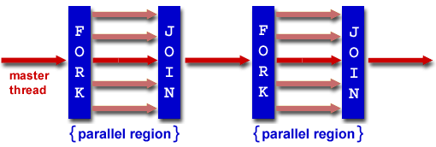
OpenMP Programming Model
Fork - Join Model:
OpenMP programs begin as single process (master thread) and executes sequentially until the first parallel region construct is encountered
FORK: Master thread then creates a team of parallel threads
Statements in program that are enclosed by the parallel region construct are executed in parallel among the various threads
JOIN: When the team threads complete the statements in the parallel region construct, they synchronize and terminate, leaving only the master thread

Slide 23
OpenMP Extends C with Pragmas
Pragmas are a preprocessor mechanism C provides for language extensions
Commonly implemented pragmas: structure packing, symbol aliasing, floating point exception modes (not covered in 61C)
Good mechanism for OpenMP because compilers that don't recognize a pragma are supposed to ignore them
Runs on sequential computer even with embedded pragmas

Slide 24
parallel Pragma and Scope
Basic OpenMP construct for parallelization:
#pragma omp parallel
{
/* code goes here */
}
Each thread runs a copy of code within the block
Thread scheduling is non-deterministic
OpenMP default is shared variables
To make private, need to declare with pragma:
#pragma omp parallel private (x)
This is annoying, but curly brace MUST go on separate line from #pragma

Slide 25
Thread Creation
How many threads will OpenMP create?
Defined by OMP_NUM_THREADS environment variable (or code procedure call)
Set this variable to the maximum number of threads you want OpenMP to use
Usually equals the number of cores in the underlying hardware on which the program is run

Slide 26
What Kind of Threads?
OpenMP threads are operating system (software) threads.
OS will multiplex requested OpenMP threads onto available hardware threads.
Hopefully each gets a real hardware thread to run on, so no OS-level time-multiplexing.
But other tasks on machine can also use hardware threads!
Be careful when timing results for project 4!

Slide 27
OMP_NUM_THREADS
OpenMP intrinsic to set number of threads:
omp_set_num_threads(x);
OpenMP intrinsic to get number of threads:
num_th = omp_get_num_threads();
OpenMP intrinsic to get Thread ID number:
th_ID = omp_get_thread_num();

Slide 28
Parallel Hello World
#include <stdio.h>
#include <omp.h>
int main () {
int nthreads, tid;
/* Fork team of threads with private var tid */
#pragma omp parallel private(tid)
{
tid = omp_get_thread_num(); /* get thread id */
printf("Hello World from thread = %d\n", tid);
/* Only master thread does this */
if (tid == 0) {
nthreads = omp_get_num_threads();
printf("Number of threads = %d\n", nthreads);
}
} /* All threads join master and terminate */
}

Slide 29
Data Races and Synchronization
Two memory accesses form a data race if from different threads to same location, and at least one is a write, and they occur one after another
If there is a data race, result of program can vary depending on chance (which thread first?)
Avoid data races by synchronizing writing and reading to get deterministic behavior
Synchronization done by user-level routines that rely on hardware synchronization instructions
(more later)

Slide 30
Analogy: Buying Milk
Your fridge has no milk. You and your roommate will return from classes at some point and check the fridge
Whoever gets home first will check the fridge, go and buy milk, and return
What if the other person gets back while the first person is buying milk?
You’ve just bought twice as much milk as you need!
It would’ve helped to have left a note…

Slide 31
Lock Synchronization (1/2)
Use a “Lock” to grant access to a region (critical section) so that only one thread can operate at a time
Need all processors to be able to access the lock, so use a location in shared memory as the lock
Processors read lock and either wait (if locked) or set lock and go into critical section
0 means lock is free / open / unlocked / lock off
1 means lock is set / closed / locked / lock on

Slide 32
Lock Synchronization (2/2)
Pseudocode:
Check lock
Set the lock
Critical section
(e.g. change shared variables)
Unset the lock
Can loop/idle here if locked

Slide 33
Possible Lock Implementation
Lock (a.k.a. busy wait)
Get_lock: # $s0 -> addr of lock
addiu $t1,$zero,1 # t1 = Locked value
Loop: lw $t0,0($s0) # load lock
bne $t0,$zero,Loop # loop if locked
Lock: sw $t1,0($s0) # Unlocked, so lock
Unlock
Unlock:
sw $zero,0($s0)
Any problems with this?

Slide 34
Possible Lock Problem
Thread 1
addiu $t1,$zero,1
Loop: lw $t0,0($s0)
bne $t0,$zero,Loop
Lock: sw $t1,0($s0)
Thread 2
addiu $t1,$zero,1
Loop: lw $t0,0($s0)
bne $t0,$zero,Loop
Lock: sw $t1,0($s0)
Time
Both threads think they have set the lock!
Exclusive access not guaranteed!

Slide 35
Hardware Synchronization
Hardware support required to prevent an interloper (another thread) from changing the value
Atomic read/write memory operation
No other access to the location allowed between the read and write
How best to implement in software?
Single instr? Atomic swap of register ↔ memory
Pair of instr? One for read, one for write
Notes:
Interloper thread can be from same core or another core.

Slide 36
Synchronization in MIPS
Load linked: ll rt,off(rs)
Store conditional: sc rt,off(rs)
Returns 1 (success) if location has not changed since the ll
Returns 0 (failure) if location has changed
Note that sc clobbers the register value being stored (rt)!
Need to have a copy elsewhere if you plan on repeating on failure or using value later
Notes:
Here using the Green Sheet convention of rs and rt for source register and target register.

Slide 37
Synchronization in MIPS Example
Atomic swap (to test/set lock variable)
Exchange contents of register and memory: $s4 ↔ Mem($s1)
try: add $t0,$zero,$s4 #copy value
ll $t1,0($s1) #load linked
sc $t0,0($s1) #store conditional
beq $t0,$zero,try #loop if sc fails
add $s4,$zero,$t1 #load value in $s4
sc would fail if another threads executes sc here

Slide 38
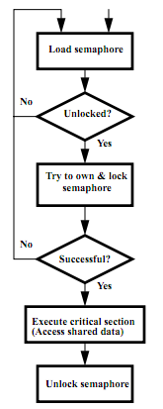
Test-and-Set
In a single atomic operation:
Test to see if a memory location is set (contains a 1)
Set it (to 1) if it isn’t (it contained a zero when tested)
Otherwise indicate that the Set failed, so the program can try again
While accessing, no other instruction can modify the memory location, including other Test-and-Set instructions
Useful for implementing lock operations

Slide 39
Test-and-Set in MIPS
Example: MIPS sequence for implementing a T&S at ($s1)
Try: addiu $t0,$zero,1
ll $t1,0($s1)
bne $t1,$zero,Try
sc $t0,0($s1)
beq $t0,$zero,try
Locked:
# critical section
Unlock:
sw $zero,0($s1)
Idea is that not for programmers to use this directly, but as a tool for enabling implementation of parallel libraries

Slide 40
Clickers: Consider the following code when executed concurrently by two threads.
What possible values can result in *($s0)?
# *($s0) = 100
lw $t0,0($s0)
addi $t0,$t0,1
sw $t0,0($s0)
A: 101 or 102
B: 100, 101, or 102
C: 100 or 101
D: 102
Notes:
- 102 if one thread starts executing after the other completely finishes.
- 101 if both threads execute the lw before either thread executes the sw. One thread will see “stale data”.

Slide 41
And in Conclusion, …
Sequential software is slow software
SIMD and MIMD only path to higher performance
Multithreading increases utilization, Multicore more processors (MIMD)
OpenMP as simple parallel extension to C
Threads, Parallel for, private, critical sections, …
≈ C: small so easy to learn, but not very high level and it’s easy to get into trouble

