Slide 1
CS 61C: Great Ideas in Computer Architecture Virtual Memory
Instructors:
John Wawrzynek & Vladimir Stojanovic
http://inst.eecs.berkeley.edu/~cs61c/

Slide 2
Review
Programmed I/O
Polling vs. Interrupts
Booting a Computer
BIOS, Bootloader, OS Boot, Init
Supervisor Mode, Syscalls
Base and Bounds
Simple, but doesn’t give us everything we want
Intro to VM

Slide 3
Traps/Interrupts/Execeptions: altering the normal flow of control
I_{i-1}
HI₁
trap
handler
program
I_{i}
HI₂
I_{i+1}
HI_{n}
An external or internal event that needs to be processed - by another program – the OS. The event is often unexpected from original program’s point of view.

Slide 4
Terminology
In CS61C (you’ll see other definitions in use elsewhere):
Interrupt – caused by an event external to current running program (e.g. key press, mouse activity)
Asynchronous to current program, can handle interrupt on any convenient instruction
Exception – caused by some event during execution of one instruction of current running program (e.g., bus error, illegal instruction)
Synchronous, must handle exception on instruction that causes exception
Trap – action of servicing interrupt or exception by hardware jump to “trap handler” code

Slide 5
Precise Traps
Trap handler’s view of machine state is that every instruction prior to the trapped one has completed, and no instruction after the trap has executed.
Implies that handler can return from an interrupt by restoring user registers and jumping back to interrupted instruction (EPC register will hold the instruction address)
Interrupt handler software doesn’t need to understand the pipeline of the machine, or what program was doing!
More complex to handle trap caused by an exception than interrupt
Providing precise traps is tricky in a pipelined superscalar out-of-order processor!
But handling imprecise interrupts in software is even worse.

Slide 6
Trap Handling in 5-Stage Pipeline
PC
Inst. Mem
D
Decode
E
M
Data Mem
W
+
PC address Exception
Illegal Opcode
Data address Exceptions
Overflow
Asynchronous Interrupts
How to handle multiple simultaneous exceptions in different pipeline stages?
How and where to handle external asynchronous interrupts?

Slide 7
Save Exceptions Until Commit
Commit Point
PC
Inst. Mem
D
Decode
E
M
Data Mem
W
+
Illegal Opcode
Overflow
Data address Exceptions
PC address Exception
Exc
D
Exc
E
Exc
M
Cause
PC
D
PC
E
PC
M
EPC
Select Handler PC
Asynchronous
Interrupts
Kill F Stage
Kill D Stage
Kill E Stage
Kill Writeback

Slide 8
Handling Traps in In-Order Pipeline
Hold exception flags in pipeline until commit point (M stage)
Exceptions in earlier instructions override exceptions in later instructions
Exceptions in earlier pipe stages override later exceptions for a given instruction
Inject external interrupts at commit point (override others)
If exception/interrupt at commit: update Cause and EPC registers, kill all stages, inject handler PC into fetch stage

Slide 9
Trap Pipeline Diagram
time
t0 t1 t2 t3 t4 t5 t6 t7 . . . .
(I₁) 096: ADD IF₁ ID₁ EX₁ MA₁ - overflow!
(I₂) 100: XOR IF₂ ID₂ EX₂ - -
(I₃) 104: SUB IF₃ ID₃ - - -
(I₄) 108: ADD IF₄ - - - -
(I₅) Trap Handler code IF₅ ID₅ EX₅ MA₅ WB₅

Slide 10
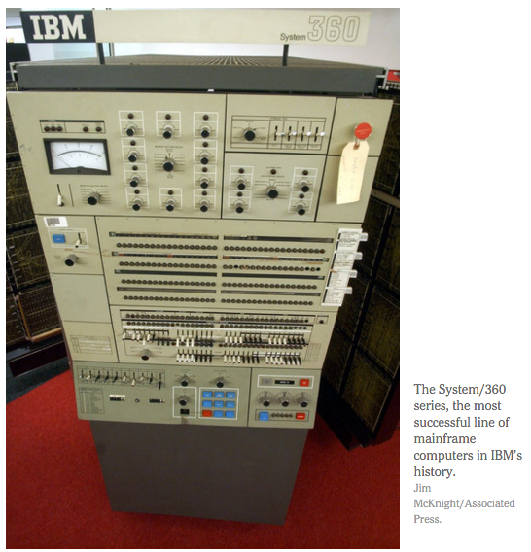
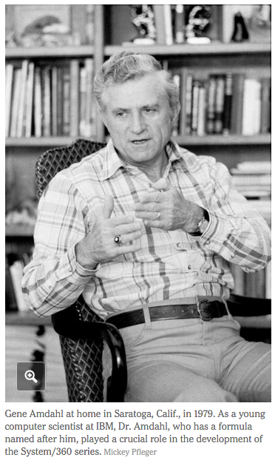
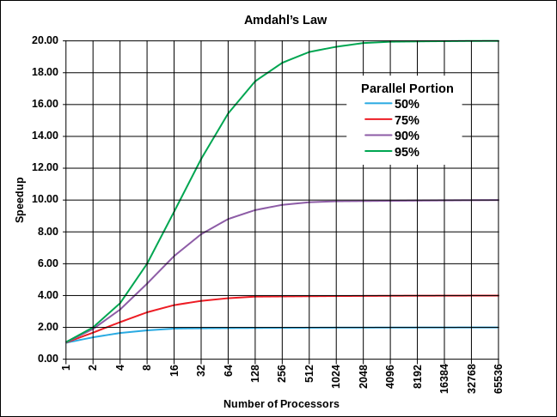
In the News …

Slide 11
Virtual Memory

Slide 12
“Bare” 5-Stage Pipeline
PC
Physical Address
D
E
M
Physical Address
W
Inst. Cache
Decode
Data Cache
+
Memory Controller
Physical Address
Physical Address
Physical Address
Main Memory (DRAM)
In a bare machine, the only kind of address is a physical address

Slide 13
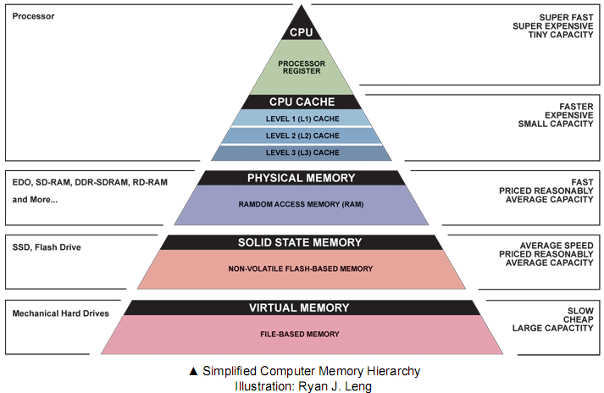
What do we need Virtual Memory for? Reason 1: Adding Disks to Hierarchy
Need to devise a mechanism to “connect” memory and disk in the memory hierarchy

Slide 14
What do we need Virtual Memory for? Reason 2: Simplifying Memory for Apps
Applications should see the straightforward memory layout we saw earlier ->
User-space applications should think they own all of memory
So we give them a virtual view of memory
~ 7FFF FFFF_{hex}
stack
heap
static data
code
~ 0000 0000_{hex}
Notes:
Location independent automatically

Slide 15
What do we need Virtual Memory for? Reason 3: Protection Between Processes
With a bare system, addresses issued with loads/stores are real physical addresses
This means any program can issue any address, therefore can access any part of memory, even areas which it doesn’t own
Ex: The OS data structures
We should send all addresses through a mechanism that the OS controls, before they make it out to DRAM - a translation mechanism

Slide 16
Address Spaces
The set of addresses labeling all of memory that we can access
Now, 2 kinds:
Virtual Address Space - the set of addresses that the user program knows about
Physical Address Space - the set of addresses that map to actual physical cells in memory
Hidden from user applications
So, we need a way to map between these two address spaces
Notes:
because the programs will issue virtual addresses, but we need physical addresses to access data in DRAM

Slide 17
Blocks vs. Pages
In caches, we dealt with individual blocks
Usually ~64B on modern systems
We could “divide” memory into a set of blocks
In VM, we deal with individual pages
Usually ~4 KB on modern systems
Now, we’ll “divide” memory into a set of pages
Common point of confusion: Bytes, Words, Blocks, Pages are all just different ways of looking at memory!

Slide 18
Bytes, Words, Blocks, Pages
Ex: 16 KiB DRAM, 4 KiB Pages (for VM), 128 B blocks (for caches), 4 B words (for lw/sw)
1 Page
1 Block
Block 31
Word 31
1 Memory
Page 3
Page 2
Page 1
Page 0
Can think of a page as:
- 32 Blocks
OR
- 1024 Words
Can think of memory as:
- 4 Pages
OR
- 128 Blocks
OR
- 4096 Words
16 KiB
Block 0
Word 0

Slide 19
Address Translation
So, what do we want to achieve at the hardware level?
Take a Virtual Address, that points to a spot in the Virtual Address Space of a particular program, and map it to a Physical Address, which points to a physical spot in DRAM of the whole machine
Virtual Address
Physical Address
Virtual Page Number | Offset
Physical Page Number | Offset

Slide 20
Address Translation
Virtual Address
Physical Address
Virtual Page Number | Offset
Address Translation
Copy Bits
Physical Page Number | Offset
The rest of the lecture is all about implementing
Notes:
Phys addr will then go to the cache just like before, cache will split that same addr into TIO. you can think of them completely separately for now. caches work just like before

Slide 21
Paged Memory Systems
Processor-generated address can be split into:
Virtual Page Number | Offset
A page table contains the physical address of the base of each page
1
0
0
0
1
1
Physical Memory
2
2
3
3
3
Address Space
of Program #1
Page Table
of Program #1
2
Page tables make it possible to store the pages of a program non-contiguously.
Notes:
Relaxes the contiguous allocation requirement.

Slide 22
Private (Virtual) Address Space per Program
Prog 1
OS
pages
VA1
Page Table
Prog 2
VA1
Page Table
Physical Memory
Prog 3
VA1
Page Table
free
Each prog has a page table
Page table contains an entry for each prog page
Physical Memory acts like a “cache” of pages for currently running programs. Not recently used pages are stored in secondary memory, e.g. disk (in “swap partition”)
Notes:
Pages are fixed sized chunks. So no fragmentation in terms of pages

Slide 23
Where Should Page Tables Reside?
Space required by the page tables (PT) is proportional to the address space, number of users, ...
⇒ Too large to keep in registers inside CPU
Idea: Keep page tables in the main memory
Needs one reference to retrieve the page base address and another to access the data word
⇒ doubles the number of memory references! (but we can fix this using something we already know about…)
Notes:
for each program, keep track of the PHYSICAL ADDRESS of the start of the page table inside the CPU

Slide 24
Page Tables in Physical Memory
PT Prog1
VA1
PT Prog2
Prog 1 Virtual Address Space
Physical Memory
VA1
Prog 2 Virtual Address Space

Slide 25
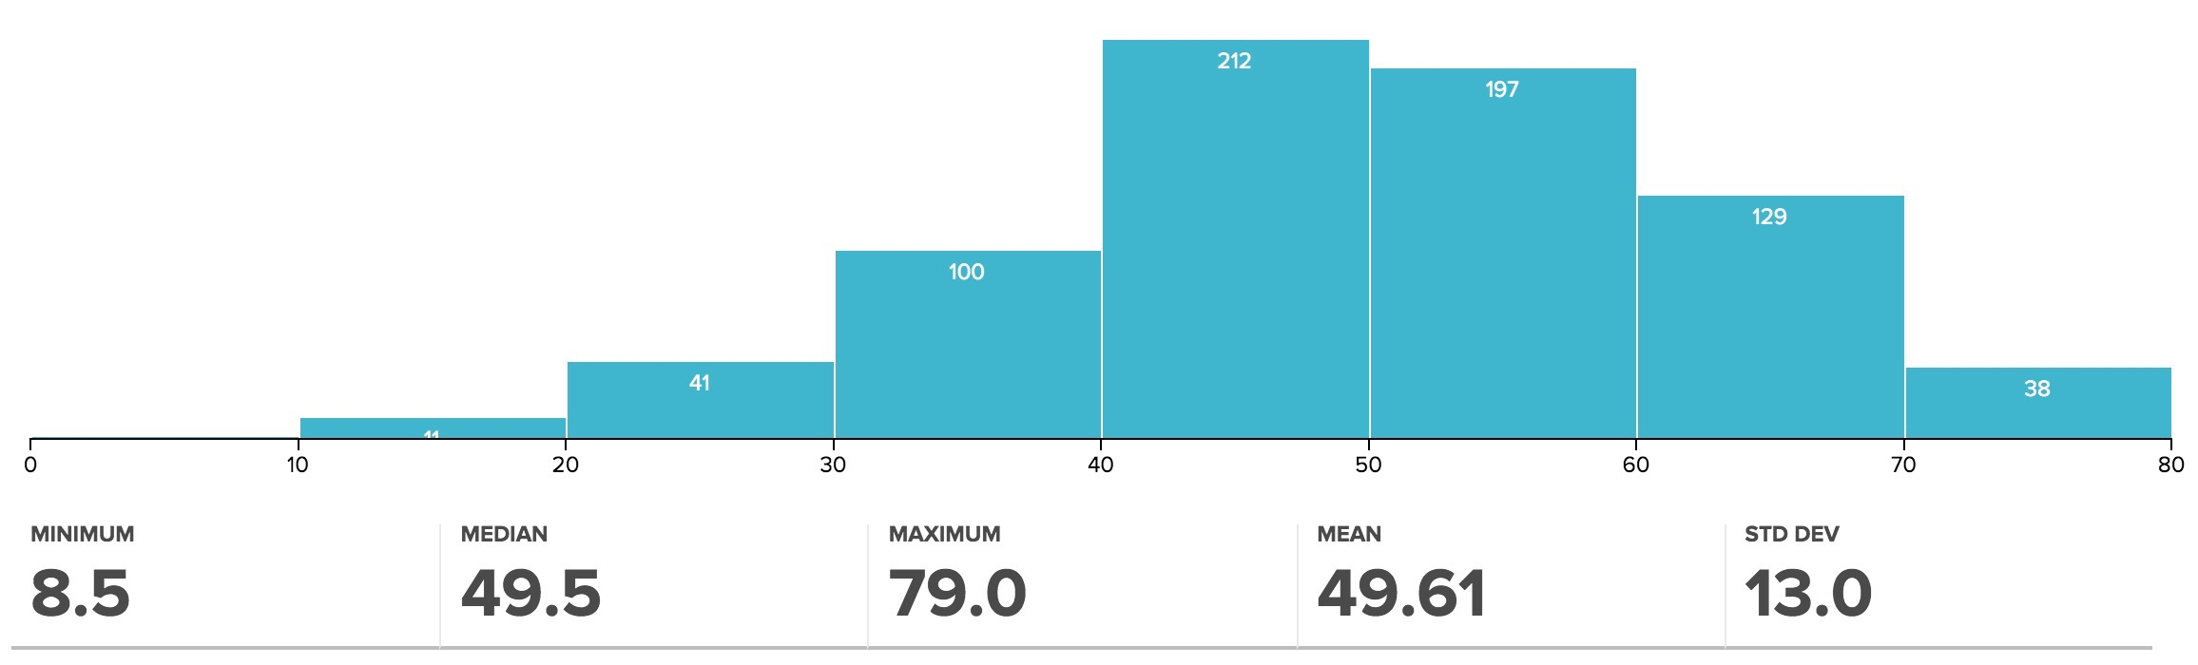
MT2 Grades Posted
62%

Slide 26
Administrivia
Upcoming Lecture Schedule
11/19: VM (today)
11/24: I/O: DMA, Disks, Networking
11/26: Thanksgiving Holiday (no class)
12/01: Dependability: Parity, ECC, RAID
Last day of new material
12/03: Summary, What’s Next? (+ HKN reviews)

Slide 27
Administrivia
Okay to turn-in HW4 today (without slip charge)
Project 4 programming competition rules posted.
Competition will end 11/30.
Last HW (5) Virtual Memory
Due 12/06 (Sunday after end of classes)
Last project (5): Spark
5-1: posted, due 11/24 (next Wednesday)
5-2: due 12/06 (Sunday after end of classes)
Final Exam is Friday (12/18)
7-10PM, RSF Field House
More info soon on review sessions, etc.

Slide 28
Linear (simple) Page Table
Page Table Entry (PTE) contains:
1 bit to indicate if page exists
And either PPN or DPN:
PPN (physical page number) for a memory-resident page
DPN (disk page number) for a page on the disk
Status bits for protection and usage (read, write, exec)
OS sets the Page Table Base Register whenever active user process changes
Data Pages
Page Table
PPN
PPN
DPN
PPN
Data word
Offset
DPN
PPN
PPN
DPN
DPN
VPN
DPN
PPN
PPN
PT Base Register
VPN
Offset
Virtual address

Slide 29
Suppose an instruction references a memory page that isn’t in DRAM?
We get a exception of type “page fault”
Page fault handler does the following:
If virtual page doesn’t yet exist, assign an unused page in DRAM, or if page exists …
Initiate transfer of the page we’re requesting from disk to DRAM, assigning to an unused page
If no unused page is left, a page currently in DRAM is selected to be replaced (based on usage)
The replaced page is written (back) to disk, page table entry that maps that VPN->PPN is marked as invalid/DPN
Page table entry of the page we’re requesting is updated with a (now) valid PPN

Slide 30
Size of Linear Page Table
With 32-bit memory addresses, 4-KB pages:
2³² / 2¹² = 2²⁰ virtual pages per user, assuming 4-Byte PTEs,
2²⁰ PTEs, i.e, 4 MB page table per user!
Larger pages?
Internal fragmentation (Not all memory in page gets used)
Larger page fault penalty (more time to read from disk)
What about 64-bit virtual address space???
Even 1MB pages would require 2⁴⁴ 8-Byte PTEs (35 TB!)
What is the “saving grace” ? Most processes only use a set of high address (stack), and a set of low address (instructions, heap)
Notes:
Virtual address space is large but only a small fraction of the
pages are populated. So we can use a sparse representation
of the table.

Slide 31
Hierarchical Page Table – exploits sparcity of virtual address space use
Virtual Address
31
22
21
12
11
0
p1 p2 offset
10-bit
L1 index
10-bit
L2 index
Root of the Current
Page Table
Physical Memory
p2
p1
(Processor
Register)
Level 1
Page Table
Level 2
Page Tables
page in primary memory
page in secondary memory
PTE of a nonexistent page
Data Pages

Slide 32
Address Translation & Protection
Virtual Address
Virtual Page No. (VPN)
offset
Kernel/User Mode
Read/Write
Protection
Check
Address
Translation
Exception?
Physical Address
Physical Page No. (PPN)
offset
Every instruction and data access needs address
translation and protection checks
A good VM design needs to be fast (~ one cycle) and space efficient

Slide 33
Translation Lookaside Buffers (TLB)
Address translation is very expensive!
In a two-level page table, each reference becomes several memory accesses
Solution: Cache some translations in TLB
TLB hit ⇒ Single-Cycle Translation
TLB miss ⇒ Page-Table Walk to refill
virtual address
VPN offset
V R W D tag PPN
(VPN = virtual page number)
(PPN = physical page number)
hit?
physical address
PPN offset
Notes:
3 memory references
2 page faults (disk accesses) + ..
Actually used in IBM before paged memory.

Slide 34
TLB Designs
Typically 32-128 entries, usually fully associative
Each entry maps a large page, hence less spatial locality across pages => more likely that two entries conflict
Sometimes larger TLBs (256-512 entries) are 4-8 way set-associative
Larger systems sometimes have multi-level (L1 and L2) TLBs
Random or FIFO replacement policy
“TLB Reach”: Size of largest virtual address space that can be simultaneously mapped by TLB
Example: 64 TLB entries, 4KB pages, one page per entry
TLB Reach = _____________________________________________?
Notes:
256 KiB mapped at once in the TLB

Slide 35
VM-related events in pipeline
PC
Inst TLB
Inst. Cache
D
Decode
E
M
Data TLB
Data Cache
W
+
TLB miss? Page Fault?
Protection violation?
TLB miss? Page Fault?
Protection violation?
Handling a TLB miss needs a hardware or software mechanism to refill TLB
usually done in hardware now
Handling a page fault (e.g., page is on disk) needs a precise trap so software handler can easily resume after retrieving page
Handling protection violation may abort process

Slide 36
Hierarchical Page Table Walk: SPARC v8
Virtual Address
Index 1 Index 2 Index 3 Offset
31 23 17 11 0
Context
Table
Register
Context Table
L1 Table
root ptr
Context
Register
L2 Table
PTP
L3 Table
PTP
PTE
31 11 0
Physical Address
PPN Offset
MMU does this table walk in hardware on a TLB miss

Slide 37
Page-Based Virtual-Memory Machine (Hardware Page-Table Walk)
Page Fault?
Protection violation?
Page Fault?
Protection violation?
Virtual Address
Virtual Address
Physical Address
Physical Address
PC
Inst. TLB
D
Decode
E
M
Data TLB
W
Inst. Cache
Data Cache
+
Miss?
Miss?
Page-Table Base Register
Hardware Page Table Walker
Physical Address
Memory Controller
Physical Address
Physical Address
Main Memory (DRAM)
Assumes page tables held in untranslated physical memory

Slide 38
Address Translation: putting it all together
Virtual Address
hardware
hardware or software
software
TLB
Lookup
miss
hit
Page Table
Walk
Protection
Check
the page is
∉ memory ∈ memory
denied
permitted
Page Fault
(OS loads page)
Update TLB
Protection
Fault
Physical
Address
(to cache)
Where?
SEGFAULT
Notes:
Need to restart instruction.
Soft and hard page faults.

Slide 39
Modern Virtual Memory Systems Illusion of a large, private, uniform store
Protection & Privacy
several users, each with their private address space and one or more shared address spaces
page table ≡ name space
Demand Paging
Provides the ability to run programs larger than the primary memory
Hides differences in machine configurations
The price is address translation on
each memory reference
OS
user_{i}
Swapping Store
(Disk)
Primary
Memory
VA
mapping
PA
TLB
Notes:
Portability on machines with different memory configurations.

Slide 40
Clicker Question
Let’s try to extrapolate from caches… Which one is false?
A. # offset bits in V.A. = log2(page size)
B. # offset bits in P.A. = log2(page size)
C. # VPN bits in V.A. = log2(# of physical pages)
D. # PPN bits in P.A. = log2(# of physical pages)
E. A single-level page table contains a PTE for every possible VPN in the system
Notes:
C. it’s the # of virtual pages, which is != to # of physical pages

Slide 41
Conclusion: VM features track historical uses
Bare machine, only physical addresses
One program owned entire machine
Batch-style multiprogramming
Several programs sharing CPU while waiting for I/O
Base & bound: translation and protection between programs (not virtual memory)
Problem with external fragmentation (holes in memory), needed occasional memory defragmentation as new jobs arrived
Time sharing
More interactive programs, waiting for user. Also, more jobs/second.
Motivated move to fixed-size page translation and protection, no external fragmentation (but now internal fragmentation, wasted bytes in page)
Motivated adoption of virtual memory to allow more jobs to share limited physical memory resources while holding working set in memory
Virtual Machine Monitors
Run multiple operating systems on one machine
Idea from 1970s IBM mainframes, now common on laptops
e.g., run Windows on top of Mac OS X
Hardware support for two levels of translation/protection
Guest OS virtual -> Guest OS physical -> Host machine physical
Also basis of Cloud Computing
Virtual machine instances on EC2 for Lab 13

