Slide 1
CS 61C: Great Ideas in Computer Architecture Dependability and RAID Lecture 25
Instructors: John Wawrzynek & Vladimir Stojanovic
http://inst.eecs.berkeley.edu/~cs61c/

Slide 2
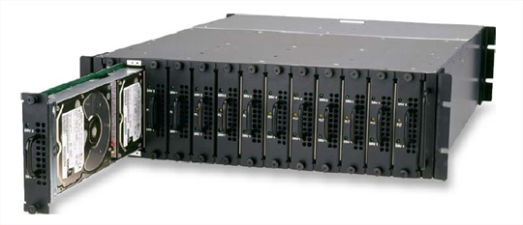
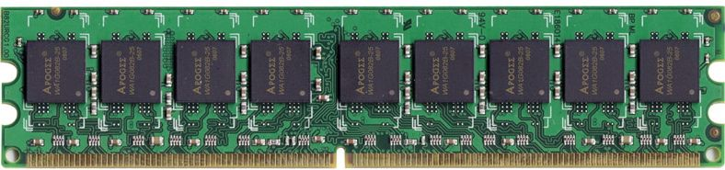
Great Idea #6: Dependability via Redundancy
Applies to everything from datacenters to memory
Redundant datacenters so that can lose 1 datacenter but Internet service stays online
Redundant routes so can lose nodes but Internet doesn’t fail
Redundant disks so that can lose 1 disk but not lose data (Redundant Arrays of Independent Disks/RAID)
Redundant memory bits of so that can lose 1 bit but no data (Error Correcting Code/ECC Memory)

Slide 3
Dependability via Redundancy: Time vs. Space
Spatial Redundancy – replicated data or check information or hardware to handle hard and soft (transient) failures
Temporal Redundancy – redundancy in time (retry) to handle soft (transient) failures

Slide 4
Dependability Measures
Reliability: Mean Time To Failure (MTTF)
Service interruption: Mean Time To Repair (MTTR)
Mean time between failures (MTBF)
MTBF = MTTF + MTTR
Availability = MTTF / (MTTF + MTTR)
Improving Availability
Increase MTTF: More reliable hardware/software + Fault Tolerance
Reduce MTTR: improved tools and processes for diagnosis and repair

Slide 5
Availability Measures
Availability = MTTF / (MTTF + MTTR) as %
MTTF, MTBF usually measured in hours
Since hope rarely down, shorthand is “number of 9s of availability per year”
1 nine: 90% => 36 days of repair/year
2 nines: 99% => 3.6 days of repair/year
3 nines: 99.9% => 526 minutes of repair/year
4 nines: 99.99% => 53 minutes of repair/year
5 nines: 99.999% => 5 minutes of repair/year

Slide 6
Reliability Measures
Another is average number of failures per year: Annualized Failure Rate (AFR)
E.g., 1000 disks with 100,000 hour MTTF
365 days * 24 hours = 8760 hours
(1000 disks * 8760 hrs/year) / 100,000 = 87.6 failed disks per year on average
87.6/1000 = 8.76% annual failure rate
Google’s 2007 study* found that actual AFRs for individual drives ranged from 1.7% for first year drives to over 8.6% for three-year old drives
*research.google.com/archive/disk_failures.pdf

Slide 7
Dependability Design Principle
Design Principle: No single points of failure
“Chain is only as strong as its weakest link”
Dependability Corollary of Amdahl’s Law
Doesn’t matter how dependable you make one portion of system
Dependability limited by part you do not improve

Slide 8
Error Detection/Correction Codes
Memory systems generate errors (accidentally flipped-bits)
DRAMs store very little charge per bit
“Soft” errors occur occasionally when cells are struck by alpha particles or other environmental upsets
“Hard” errors can occur when chips permanently fail
Problem gets worse as memories get denser and larger
Memories protected against failures with EDC/ECC
Extra bits are added to each data-word
Used to detect and/or correct faults in the memory system
Each data word value mapped to unique code word
A fault changes valid code word to invalid one, which can be detected

Slide 9
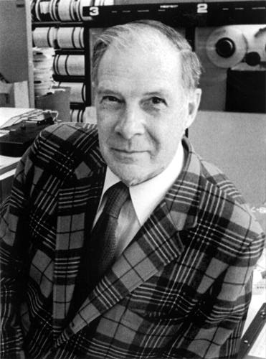
Block Code Principles
Hamming distance = difference in # of bits
p = 011011, q = 001111, Ham. distance (p,q) = 2
p = 011011, q = 110001, distance (p,q) = ?
Can think of extra bits as creating a code with the data
What if minimum distance between members of code is 2 and get a 1-bit error?
Richard Hamming, 1915-98
Turing Award Winner
Notes:
Distance is 3 of second case

Slide 10
Parity: Simple Error-Detection Coding
Each data value, before it is written to memory is “tagged” with an extra bit to force the stored word to have even parity:
Each word, as it is read from memory is “checked” by finding its parity (including the parity bit).
b₇b₆b₅b₄b₃b₂b₁b₀ p
b₇b₆b₅b₄b₃b₂b₁b₀
+
+
p
c
Minimum Hamming distance of parity code is 2
A non-zero parity check indicates an error occurred:
2 errors (on different bits) are not detected
nor any even number of errors, just odd numbers of errors are detected

Slide 11
Parity Example
Data 0101 0101
4 ones, even parity now
Write to memory: 0101 0101 0 to keep parity even
Data 0101 0111
5 ones, odd parity now
Write to memory: 0101 0111 1 to make parity even
Read from memory 0101 0101 0
4 ones => even parity, so no error
Read from memory 1101 0101 0
5 ones => odd parity, so error
What if error in parity bit?

Slide 12
Suppose Want to Correct 1 Error?
Richard Hamming came up with simple to understand mapping to allow Error Correction at minimum distance of 3
Single error correction, double error detection
Called “Hamming ECC”
Worked weekends on relay computer with unreliable card reader, frustrated with manual restarting
Got interested in error correction; published 1950
R. W. Hamming, “Error Detecting and Correcting Codes,” The Bell System Technical Journal, Vol. XXVI, No 2 (April 1950) pp 147-160.

Slide 13
Detecting/Correcting Code Concept
Space of possible bit patterns (2^{N})
Error changes bit pattern to
non-code
Sparse population of code words (2^{M} << 2^{N})
- with identifiable signature
Detection: bit pattern fails codeword check
Correction: map to nearest valid code word

Slide 14
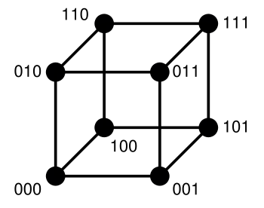
Hamming Distance: 8 code words

Slide 15
Hamming Distance 2: Detection Detect Single Bit Errors
Invalid
Codewords
No 1 bit error goes to another valid codeword
½ codewords are valid

Slide 16
Hamming Distance 3: Correction Correct Single Bit Errors, Detect Double Bit Errors
Nearest 111
(one 0)
Nearest 000
(one 1)
No 2 bit error goes to another valid codeword; 1 bit error near
1/4 codewords are valid

Slide 17
Administrivia
Final Exam
FRIDAY, DEC 18, 2015, 7-10P
Location: WHEELER
Must notify Fred/William of conflicts asap
THREE cheat sheets (MT1,MT2, post-MT2)
Normal OH during RRR Week, info about finals week to follow

Slide 18
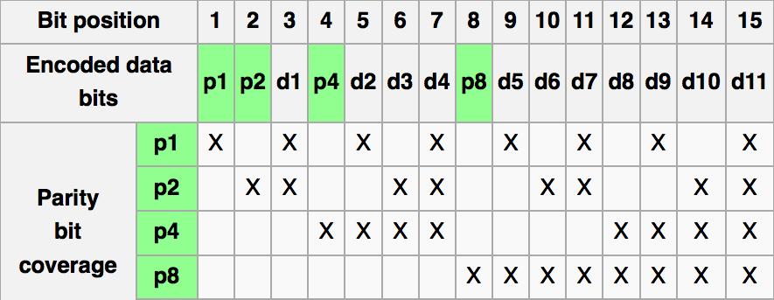
Graphic of Hamming Code
http://en.wikipedia.org/wiki/Hamming_code

Slide 19
Hamming ECC
Set parity bits to create even parity for each group
A byte of data: 10011010
Create the coded word, leaving spaces for the parity bits:
_ _ 1 _ 0 0 1 _ 1 0 1 0
1 2 3 4 5 6 7 8 9 a b c – bit position
Calculate the parity bits
Notes:
Do this on the white board

Slide 20
Hamming ECC
Position 1 checks bits 1,3,5,7,9,11: ? _ 1 _ 0 0 1 _ 1 0 1 0. set position 1 to a _:
Position 2 checks bits 2,3,6,7,10,11: 0 ? 1 _ 0 0 1 _ 1 0 1 0. set position 2 to a _:
Position 4 checks bits 4,5,6,7,12: 0 1 1 ? 0 0 1 _ 1 0 1 0. set position 4 to a _:
Position 8 checks bits 8,9,10,11,12: 0 1 1 1 0 0 1 ? 1 0 1 0. set position 8 to a _:
Notes:
Do this on white board.
Bit 1 is 0
Bit 2 is 1
Bit 4 is 1

Slide 21
Hamming ECC
Position 1 checks bits 1,3,5,7,9,11: ? _ 1 _ 0 0 1 _ 1 0 1 0. set position 1 to a 0: 0 _ 1 _ 0 0 1 _ 1 0 1 0
Position 2 checks bits 2,3,6,7,10,11: 0 ? 1 _ 0 0 1 _ 1 0 1 0. set position 2 to a 1: 0 1 1 _ 0 0 1 _ 1 0 1 0
Position 4 checks bits 4,5,6,7,12: 0 1 1 ? 0 0 1 _ 1 0 1 0. set position 4 to a 1: 0 1 1 1 0 0 1 _ 1 0 1 0
Position 8 checks bits 8,9,10,11,12: 0 1 1 1 0 0 1 ? 1 0 1 0. set position 8 to a 0: 0 1 1 1 0 0 1 0 1 0 1 0

Slide 22
Hamming ECC
Final code word: 011100101010
Data word: 1 001 1010
Notes:
Bit 8 set to 0

Slide 23
Hamming ECC Error Check
Suppose receive 011100101110 0 1 1 1 0 0 1 0 1 1 1 0

Slide 24
Hamming ECC Error Check
Suppose receive 011100101110

Slide 25
Hamming ECC Error Check
Suppose receive 011100101110 0 1 0 1 1 1 √ 11 01 11 X-Parity 2 in error 1001 0 √ 01110 X-Parity 8 in error
Implies position 8+2=10 is in error 011100101110

Slide 26
Hamming ECC Error Correct
Flip the incorrect bit … 011100101010

Slide 27
Hamming ECC Error Correct
Suppose receive 011100101010 0 1 0 1 1 1 √ 11 01 01 √ 1001 0 √ 01010 √

Slide 28
Hamming Error Correcting Code
Overhead involved in single error-correction code
Let p be total number of parity bits and d number of data bits in p + d bit word
If p error correction bits are to point to error bit (p + d cases) + indicate that no error exists (1 case), we need:
2^{p} >= p + d + 1,
thus p >= log₂(p + d + 1)
for large d, p approaches log₂(d)
8 bits data => d = 8, 2^{p} >= p + 8 + 1 => p >= 4
16b data => 5b parity, 32b data => 6b parity, 64b data => 7b parity

Slide 29
Hamming Single-Error Correction, Double-Error Detection (SEC/DED)
Adding extra parity bit covering the entire word provides double error detection as well as single error correction
1 2 3 4 5 6 7 8
p₁ p₂ d₁ p₃ d₂ d₃ d₄ p₄
Hamming parity bits H (p₁ p₂ p₃) are computed (even parity as usual) plus the even parity over the entire word, p₄:
H=0 p₄=0, no error
H≠0 p₄=1, correctable single error (odd parity if 1 error => p₄=1)
H≠0 p₄=0, double error occurred (even parity if 2 errors=> p₄=0)
H=0 p₄=1, single error occurred in p₄ bit, not in rest of word
Typical modern codes in DRAM memory systems:
64-bit data blocks (8 bytes) with 72-bit code words (9 bytes).

Slide 30
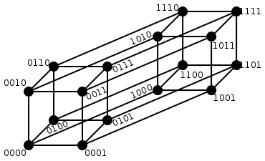
Hamming Single Error Correction + Double Error Detection
Hamming Distance = 4
1 bit error (one 0) Nearest 1111
2 bit error (two 0s, two 1s) Halfway Between Both
1 bit error (one 1) Nearest 0000
Notes:
1 bit error from 0000, all numbers with one 1
1 bit error from 1111, all numbers with one 0
2 bit error from 0000, all numbers with two 1s and two 0s
2 bit error from 1111, all numbers with two 1s and two 0s

Slide 31
What if More Than 2-Bit Errors?
Network transmissions, disks, distributed storage common failure mode is bursts of bit errors, not just one or two bit errors
Contiguous sequence of B bits in which first, last and any number of intermediate bits are in error
Caused by impulse noise or by fading in wireless
Effect is greater at higher data rates
Solve with Cyclic Redundancy Check (CRC), interleaving or other more advanced codes

Slide 32
iClicker Question
The following word is received, encoded with Hamming code:
0 1 1 0 0 0 1
What is the corrected data bit sequence?
A. 1 1 1 1
B. 0 0 0 1
C. 1 1 0 1
D. 1 0 1 1
E. 1 0 0 0
Notes:
Ans: D
0 x 1 x 0 x 1 - check
x 1 x 0 x 0 x - error in p2
x x x 0 0 0 1 - error in p4
Error in location 2+4 =6

Slide 33
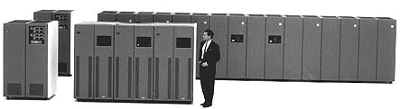
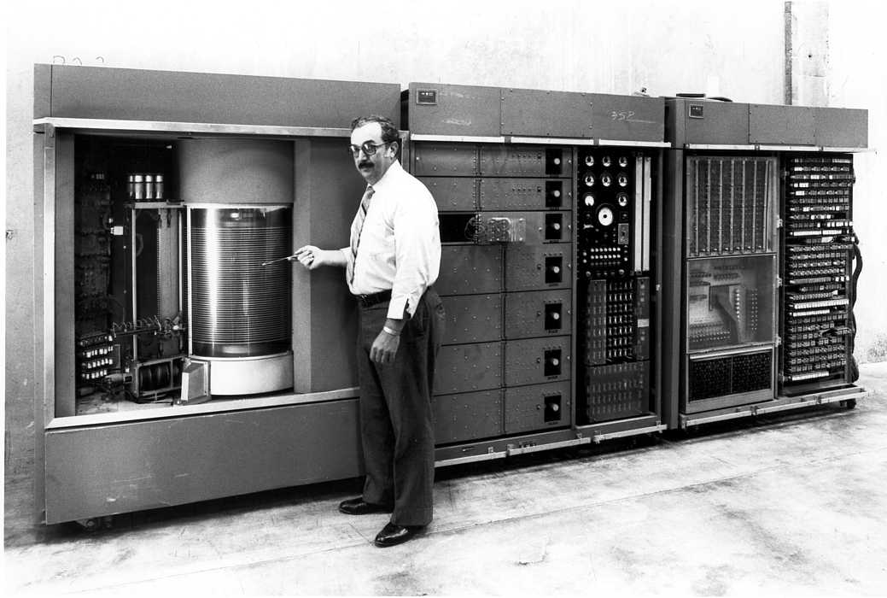
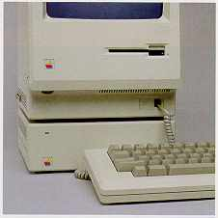
Evolution of the Disk Drive
IBM 3390K, 1986
IBM RAMAC 305, 1956
Apple SCSI, 1986

Slide 34
Arrays of Small Disks
Can smaller disks be used to close gap in performance between disks and CPUs?
Conventional: 4 disk designs
3.5”
5.25”
10”
14”
Low End
High End
Disk Array: 1 disk design
3.5”

Slide 35
Replace Small Number of Large Disks with Large Number of Small Disks! (1988 Disks)
IBM 3390K
20 GBytes
97 cu. ft.
3 KW
15 MB/s
600 I/Os/s
250 KHrs
$250K
IBM 3.5" 0061
320 MBytes
0.1 cu. ft.
11 W
1.5 MB/s
55 I/Os/s
50 KHrs
$2K
x70
23 GBytes
11 cu. ft.
1 KW
120 MB/s
3900 IOs/s
??? Hrs
$150K
Capacity
Volume
Power
Data Rate
I/O Rate
MTTF
Cost
9X
3X
8X
6X
Disk Arrays have potential for large data and I/O rates, high MB per cu. ft., high MB per KW, but what about reliability?

Slide 36
RAID: Redundant Arrays of (Inexpensive) Disks
Files are "striped" across multiple disks
Redundancy yields high data availability
Availability: service still provided to user, even if some components failed
Disks will still fail
Contents reconstructed from data redundantly stored in the array
⇒ Capacity penalty to store redundant info
⇒ Bandwidth penalty to update redundant info

Slide 37
Redundant Arrays of Inexpensive Disks RAID 1: Disk Mirroring/Shadowing
recovery
group
• Each disk is fully duplicated onto its “mirror”
Very high availability can be achieved
• Writes limited by single-disk speed
• Reads may be optimized
Most expensive solution: 100% capacity overhead

Slide 38
Redundant Array of Inexpensive Disks RAID 3: Parity Disk
10010011
11001101
10010011
. . .
P
1
0
1
0
0
0
1
1
1
1
0
0
1
1
0
1
1
0
1
0
0
0
1
1
1
1
0
0
1
1
0
1
logical record
Striped physical
records
P contains sum of
other disks per stripe mod 2 (“parity”)
If disk fails, subtract
P from sum of other disks to find missing information

Slide 39
Redundant Arrays of Inexpensive Disks RAID 4: High I/O Rate Parity
D0
D1
D2
D3
Increasing
Logical
Disk
Address
P
Insides of 5 disks
D4
D5
D6
D7
P
D8
D9
D10
D11
P
Example: small read D0 & D5, large write D12-D15
D12
D13
D14
D15
P
Stripe
D16
D17
D18
D19
P
D20
D21
D22
D23
P
.
.
.
.
.
.
.
.
.
.
.
.
.
.
.
Disk Columns

Slide 40
Inspiration for RAID 5
RAID 4 works well for small reads
Small writes (write to one disk):
Option 1: read other data disks, create new sum and write to Parity Disk
Option 2: since P has old sum, compare old data to new data, add the difference to P
Small writes are limited by Parity Disk: Write to D0, D5 both also write to P disk
D0
D1
D2
D3
P
D4
D5
D6
D7
P

Slide 41
RAID 5: High I/O Rate Interleaved Parity
D0
D1
D2
D3
P
Increasing
Logical
Disk
Addresses
Independent writes
possible because of
interleaved parity
D4
D5
D6
P
D7
D8
D9
P
D10
D11
D12
P
D13
D14
D15
P
D16
D17
D18
D19
Example: write to D0, D5 uses disks 0, 1, 3, 4
D20
D21
D22
D23
P
.
.
.
.
.
.
.
.
.
.
.
.
.
.
.
Disk Columns

Slide 42
Problems of Disk Arrays: Small Writes
RAID-5: Small Write Algorithm
1 Logical Write = 2 Physical Reads + 2 Physical Writes
D0'
D0
D1
D2
D3
P
new
data
old
data
old
parity
(1. Read)
(2. Read)
+
XOR
+
XOR
(3. Write)
(4. Write)
D0'
D1
D2
D3
P'

Slide 43
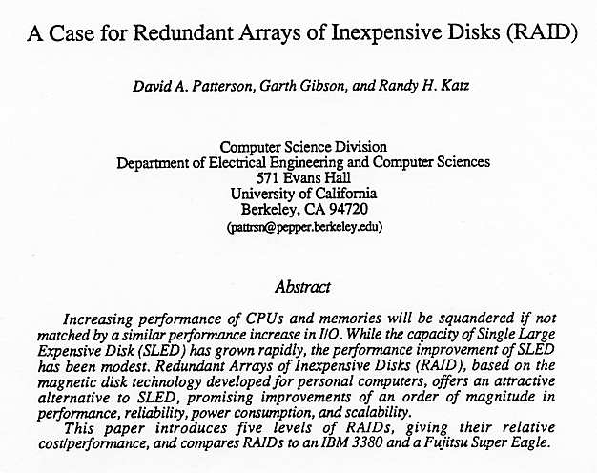
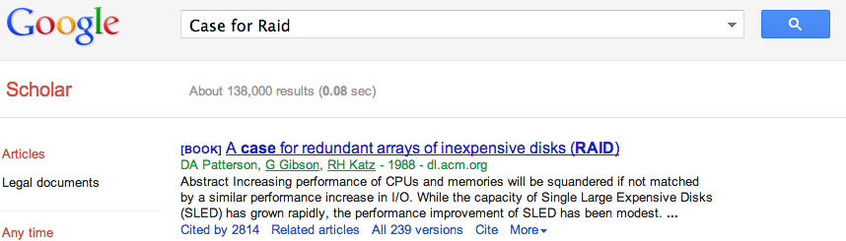
Tech Report Read ‘Round the World (December 1987)

Slide 44
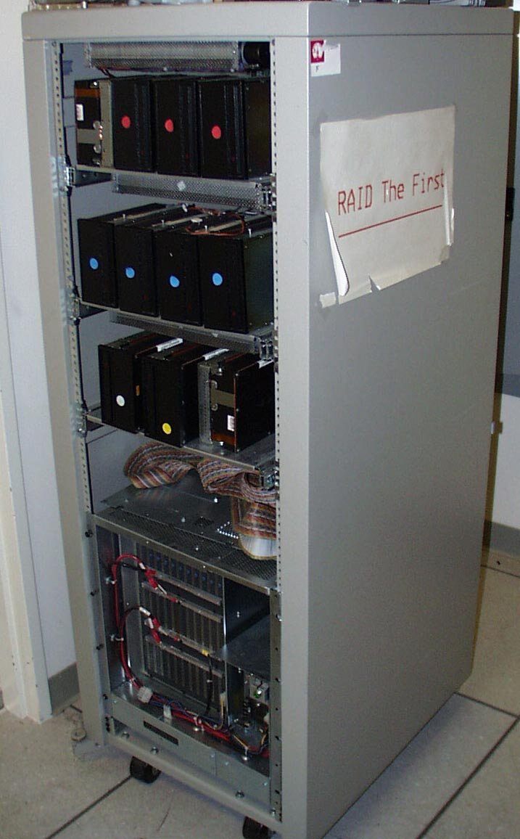
RAID-I
RAID-I (1989)
Consisted of a Sun 4/280 workstation with 128 MB of DRAM, four dual-string SCSI controllers, 28 5.25-inch SCSI disks and specialized disk striping software

Slide 45
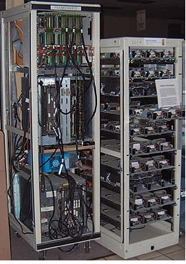
RAID II
1990-1993
Early Network Attached Storage (NAS) System running a Log Structured File System (LFS)
Impact:
$25 Billion/year in 2002
Over $150 Billion in RAID device sold since 1990-2002
200+ RAID companies (at the peak)
Software RAID a standard component of modern OSs

Slide 46
And, in Conclusion, …
Great Idea: Redundancy to Get Dependability
Spatial (extra hardware) and Temporal (retry if error)
Reliability: MTTF & Annualized Failure Rate (AFR)
Availability: % uptime (MTTF-MTTR/MTTF)
Memory
Hamming distance 2: Parity for Single Error Detect
Hamming distance 3: Single Error Correction Code + encode bit position of error
Treat disks like memory, except you know when a disk has failed—erasure makes parity an Error Correcting Code
RAID-2, -3, -4, -5: Interleaved data and parity

