Slide 1
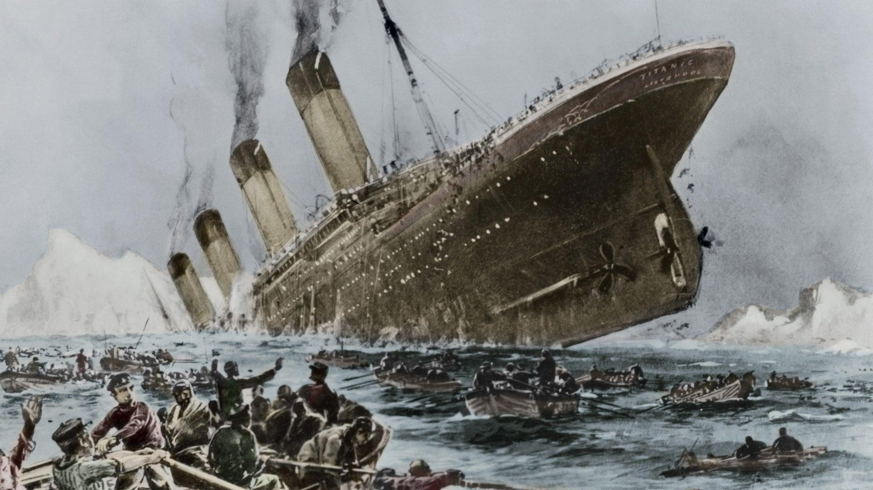
Titanic - Who will Survive?
Weituao Chen

Slide 2
Short Introduction
The Titanic was a British passenger liner that sank in 1912 after hitting an iceberg.
Over 2,224 passengers and crew were on board.
More than 1,500 people died, making it one of the deadliest maritime disasters.

Slide 3
before any analysis, we need clean data
- Remove Outliers: Identify and remove any outliers in the dataset that could skew the analysis.
- Handle Missing Values: Fill or drop missing values to ensure the dataset is complete.
- Convert Data Types: Ensure all data types are appropriate for analysis and modeling.
- Normalize and Scale Data: Normalize or scale the data if needed to prepare it for machine learning algorithms.
- Encode Categorical Features: Convert categorical features into numerical values using techniques like one-hot encoding or label encoding.

Slide 4
Missing Values:
Age: 177 missing entries
Cabin: 687 missing entries
Embarked: 2 missing entries
Number of Duplicates: 0
Data Types:
Numeric: PassengerId, Survived, Pclass, Age, SibSp, Parch, Fare
Categorical: Name, Sex, Ticket, Embarked

Slide 5
Handling Missing 'Age' Values
Approach:
Calculated median age for each passenger class (Pclass).
Filled missing 'Age' values with respective median age.
Median Age by Pclass:
Pclass 1: 37 years
Pclass 2: 29 years
Pclass 3: 24 years
Handling the 'Cabin' Column
Issue:
The 'Cabin' column has a significant number of missing values (687 out of 891 entries).
Missing data can impact analysis and modeling.
Dropped ‘Cabin’ column from the dataset.
Handling Missing 'Embarked' Values
Approach:
Identified 2 rows with missing 'Embarked' values.
Dropped these rows from the dataset.

Slide 6
Exploratory Data Analysis

Slide 7
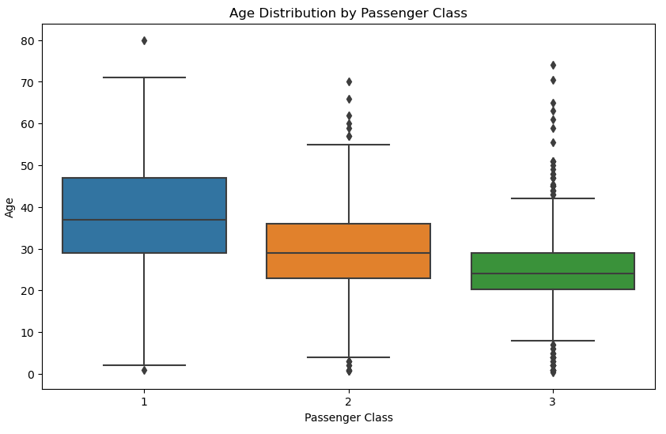
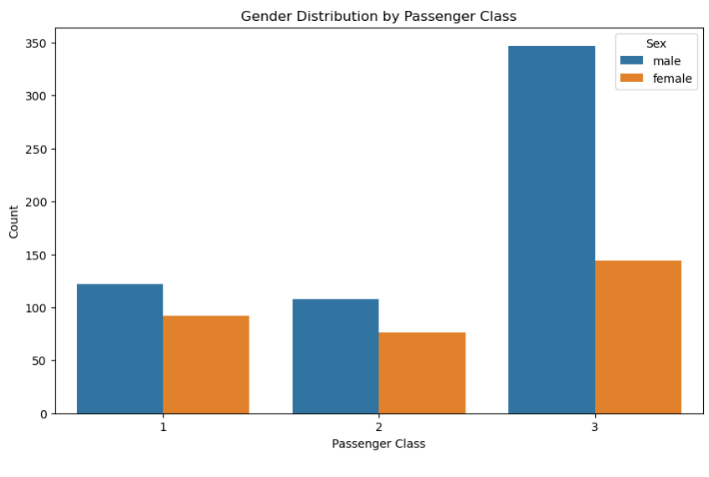
Explore the socio-economic status of passengers

Slide 8
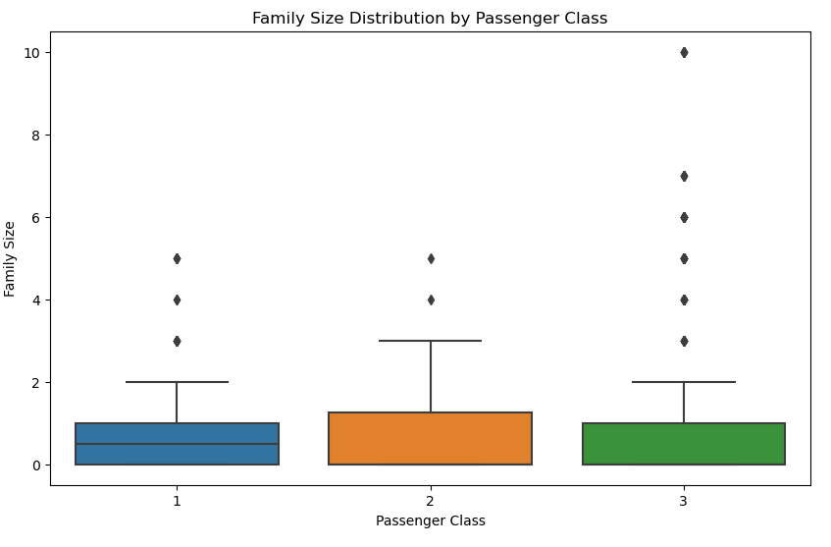
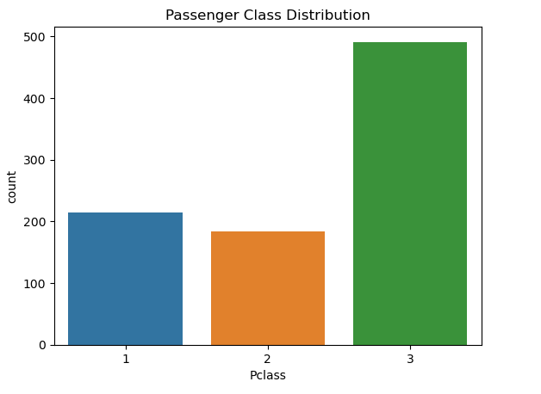
Explore the socio-economic status of passengers

Slide 9
Distribution of survival victims
Gender Distribution:
The plot illustrates a larger number of male passengers (over 500) compared to female passengers (over 300). This gender distribution is representative of the Titanic's demographics.
Survived Distribution
Blue bars depict passengers who did not survive ('Survived' = 0), totaling over 500 individuals.
Orange bars represent passengers who survived ('Survived' = 1), totaling over 300 individuals.
Survival rate by Gender:
There are more male passengers who did not survive compared to female passengers.
Conversely, a higher proportion of female passengers survived compared to male passengers.
Survival by Passenger Class:
Classes 1 and 2 show a relatively balanced survival rate between those who survived and those who did not.
Class 3, however, exhibits a significantly higher number of non-survivors compared to survivors, with the non-survival rate being nearly triple the survival rate.
Survival count by Gender:
The bar plot indicates a survival rate of approximately 20% for males and over 70% for females. This stark difference in survival rates highlights the prioritization given to female passengers during the Titanic disaster
Survival Rate by Passenger Class:
The bar plot depicts the survival rate for each passenger class. It provides insights into how socio-economic status influenced survival outcomes, showing that passengers in higher classes (1 and 2) had higher survival rates compared to those in the lower class (3)
Age Distribution of Survivors and Non-survivors:
The age distribution shows that younger passengers, particularly those in their mid-20s, have a higher likelihood of survival.
As age increases beyond the mid-20s, the number of survivors decreases.

Slide 10
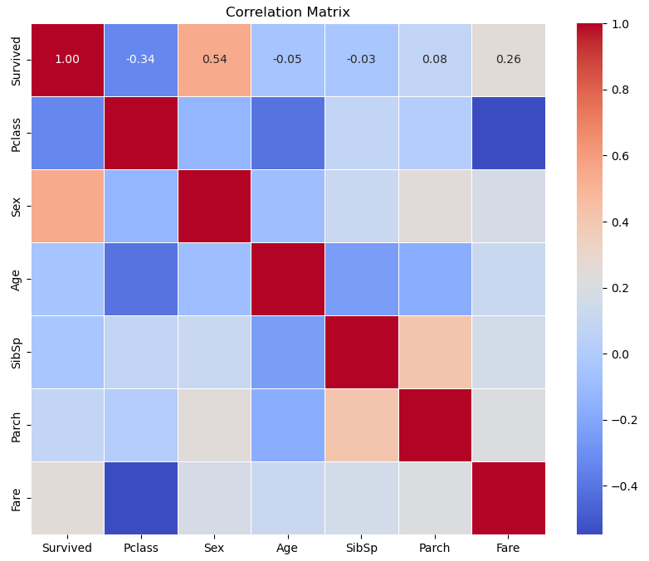
Correlation analysis
Survived vs Pclass:
Moderate negative correlation of approximately -0.338.
Indicates higher passenger class (lower Pclass values) correlates with higher survival rates.
Survived vs Sex:
Moderate positive correlation of about 0.543.
Shows females (Sex = 1) had higher survival rates compared to males (Sex = 0).
Survived vs Age:
Slight negative correlation coefficient of -0.077.
Suggests older passengers had slightly lower survival rates compared to younger ones.
Survived vs SibSp (Siblings/Spouses):
Weak negative correlation of -0.035.
Implies passengers with more siblings or spouses aboard had slightly lower survival rates.
Survived vs Parch (Parents/Children):
Weak positive correlation coefficient of 0.082.
Indicates passengers with more parents or children aboard had slightly higher survival rates.
Survived vs Fare:
Moderate positive correlation coefficient of 0.257.
Reflects that passengers who paid higher fares had a higher likelihood of survival, possibly indicating socio-economic status.

Slide 11
Extracting information from non-numerical features
Convert 'Embarked' to Numerical:
Maps categorical values ('C', 'Q', 'S') in the 'Embarked' column to numerical equivalents (0, 1, 2) using the map function.
Enables machine learning algorithms to process 'Embarked' as numerical data.
Drop 'Name' and 'Ticket' Columns:
Removes 'Name' and 'Ticket' columns from the DataFrame using drop function with axis=1 and inplace=True.
Eliminates non-essential textual data (name and ticket numbers) for machine learning models.
Summary:
Prepares the train DataFrame for machine learning tasks by converting categorical data ('Embarked') to numerical and removing unnecessary columns ('Name', 'Ticket').
Enhances DataFrame readiness for subsequent model training and analysis.
The dataset contains a total of 12 columns.
There are 889 entries (rows) in the dataset.
Among the columns:
Numeric Columns: PassengerId, Survived, Pclass, Sex, Age, SibSp, Parch, Fare, and FamilySize are of numeric types (int64 or float64).
Object Columns: Name, Ticket, and Embarked are of type object, indicating they contain non-numeric (likely string)g tasks.

Slide 12
Building and Training Models

Slide 13
Building and Training Models
The provided code segment prepares the Titanic dataset for machine learning:
- It uses `train.csv` after data cleaning and prepares `X` (features) and `y` (target).
- The dataset is split into(an 80/20 split) training and test sets (`X_train`, `X_test`, `y_train`, `y_test`).
- Three models—Logistic Regression, Random Forest, and Gradient Boosting—are initialized and trained on the training data.
- Predictions are made on the test set using each model to evaluate their performance in subsequent steps.

Slide 14
Exploratory Data Analysis After Splitting the Datasets
Pclass: Distribution across three classes (1, 2, 3) with an average around 2.32, indicating a slight skew towards lower classes.
Sex: Binary representation (0 for female, 1 for male) shows a male majority at approximately 66.4%.
Age: Mean age of approximately 29.15 years, with a standard deviation of about 13.37 years, indicating a wide age range.
SibSp and Parch: Average values of 0.55 and 0.38 respectively, suggesting predominantly single passengers or those with small families.
Fare: Mean fare of 32.06, ranging widely up to 512.33, indicating significant variation in ticket prices.
Embarked: Categorical variable (0, 1, 2) representing ports of embarkation, shows an average around 1.54, suggesting most passengers boarded from port 'S'.
FamilySize: Calculated from SibSp and Parch, with a mean of approximately 0.94, indicating mostly smaller family groups.
Survived: Binary outcome (0 for not survived, 1 for survived) with a mean survival rate of about 38.1%, indicating a higher proportion of non-survivors.

Slide 15
Three model of Choice
Logistic Regression: Logistic regression is a linear model used for binary classification, estimating probabilities using the logistic function.
Random Forest: Random Forest is an ensemble learning method that builds multiple decision trees and combines their predictions to improve accuracy and generalizability.
Gradient Boosting: Gradient Boosting is an ensemble technique that sequentially builds trees, each correcting errors of its predecessor, aiming to minimize the overall prediction error.

Slide 16
Performance Analysis

Slide 17
Performance Evaluation
Logistic Regression:
Accuracy: 0.7978
Precision: 0.7200
Recall: 0.7826
F1-score: 0.7500
Random Forest:
Accuracy: 0.8090
Precision: 0.7612
Recall: 0.7391
F1-score: 0.7500
Gradient Boosting:
Accuracy: 0.8202
Precision: 0.7681
Recall: 0.7681
F1-score: 0.7681

Slide 18
Factors Influencing Accuracy
Imbalanced Classes: Potential bias towards majority classes affecting recall and F1-score metrics.
Model Complexity: Overly complex models like Gradient Boosting may overfit data, affecting generalization.
Insufficient Data: Limited dataset size can hinder pattern recognition and accurate predictions.
Feature Engineering: Quality and relevance of features crucial for capturing meaningful data patterns.
Hyperparameter Tuning: Optimization essential for enhancing model performance.
Data Quality Issues: Preprocessing challenges such as missing values or outliers impacting model robustness.

Slide 19
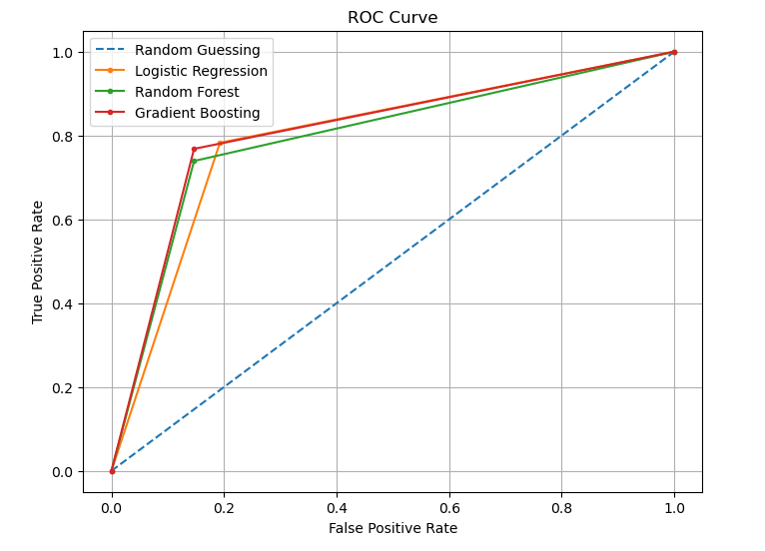
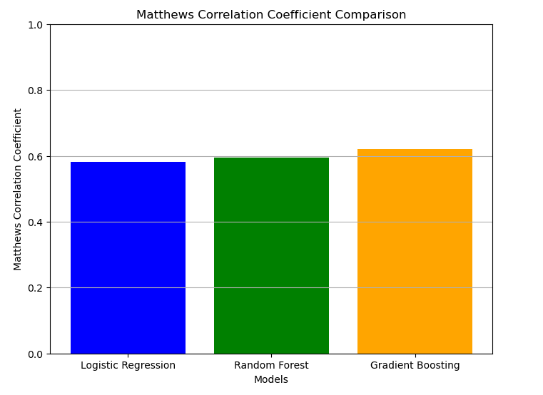
Additional Evaluation Metrics

Slide 20
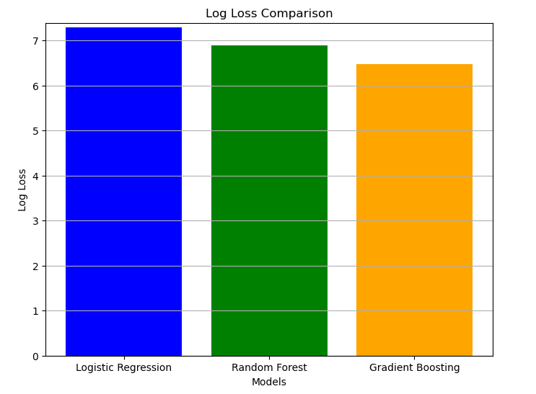
Additional Evaluation Metrics

Slide 21
Summary of Model Evaluation Metrics
- **Gradient Boosting** consistently shows competitive performance across all metrics evaluated, including ROC-AUC score, MCC, and log loss. It achieved the highest ROC-AUC score and MCC among the three models, indicating superior predictive capability and overall model reliability.
- **Logistic Regression** and **Random Forest** also performed well, with similar ROC-AUC scores and MCC values, although slightly lower than Gradient Boosting. Random Forest notably had the lowest log loss, indicating more confident predictions in terms of probability estimates.
- **Confusion matrices** provide insights into model performance in terms of true positives, true negatives, false positives, and false negatives. All models show reasonable performance in correctly predicting survival outcomes on the Titanic dataset.
In conclusion, while Gradient Boosting stands out with slightly superior metrics, all three models demonstrate competence in predicting survival outcomes, underscoring their suitability for this classification task.

Slide 22
Cross Validation Set
LogisticRegression Cross-Validation Scores:
Accuracy: 0.7749
Precision: 0.7448
Recall: 0.5673
F1-score: 0.6402
RandomForestClassifier Cross-Validation Scores:
Accuracy: 0.7751
Precision: 0.7208
Recall: 0.6473
F1-score: 0.6703
GradientBoostingClassifier Cross-Validation Scores:
Accuracy: 0.7616
Precision: 0.6718
Recall: 0.6455
F1-score: 0.6507

Slide 23
Analysis: Initial Model Performance and Impact of Cross-Validation
Initial Performance:
Logistic Regression, Random Forest, and Gradient Boosting initially showed strong predictive performance on the Titanic dataset, with Gradient Boosting leading with an initial F1-score of 0.7681.
Impact of Cross-Validation (CV):
After cross-validation, Logistic Regression and Random Forest maintained stable metrics, while Gradient Boosting saw a noticeable decline in precision, recall, and F1-score, suggesting potential overfitting and sensitivity to data variability.
Reasons for Performance Change:
Gradient Boosting's decrease post-CV indicates challenges in managing model complexity and variability across data folds, emphasizing the need for refined tuning and feature handling.
Conclusion:
While Gradient Boosting initially excelled, Logistic Regression and Random Forest demonstrated more consistent performance post-CV, highlighting their reliability and suggesting avenues for improving model stability and generalization.

Slide 24
END

