Slide 1




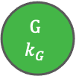





























Fig 1
Environmental model
A
Two-state model
B
Multi-state model
G
G
$$1$$
$$αk_{G}$$
G
$$2$$
$$αk_{G}$$
. . .
$$αk_{G}$$
G
$$k_{G}$$
1$−α$
1$−αk_{G}$
1$−αk_{G}$
1$−αk_{G}$
$$β$$
$$α$$
$$βk_{B}$$
$$αk_{G}$$
B
B
$$k_{B}$$
$$βk_{B}$$
B $k_{B}$-1
$$βk_{B}$$
$$βk_{B}$$
B
$$1$$
1$−β$
1$−βk_{B}$
. . .
1$−βk_{B}$
1$−βk_{B}$
Dormancy model
C
Two-state model
D
Multi-state model
I₁
. . .
I_{n}
$$i_{1}$$
$$x$$
$$x$$
$$d$$
$$d$$
$$i_{n}$$
A
$$d$$
D
A
$$d$$
D
$$r$$
∅
$$r$$
∅
$$y$$
$$y$$
Good environment
Bad environment

Slide 2
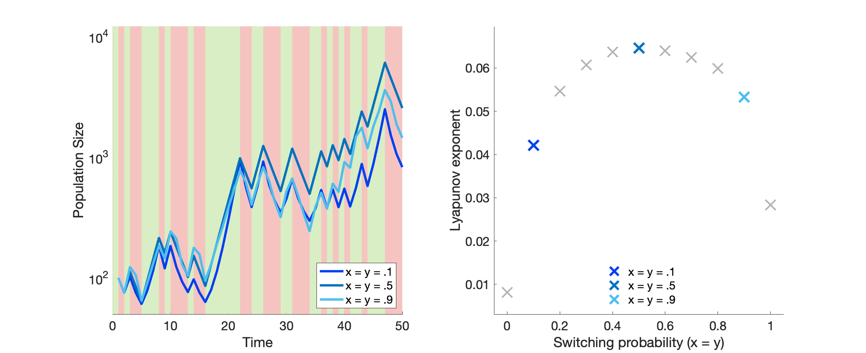
Fig 2 version 1
A
Good environment
Bad environment
B

Slide 3
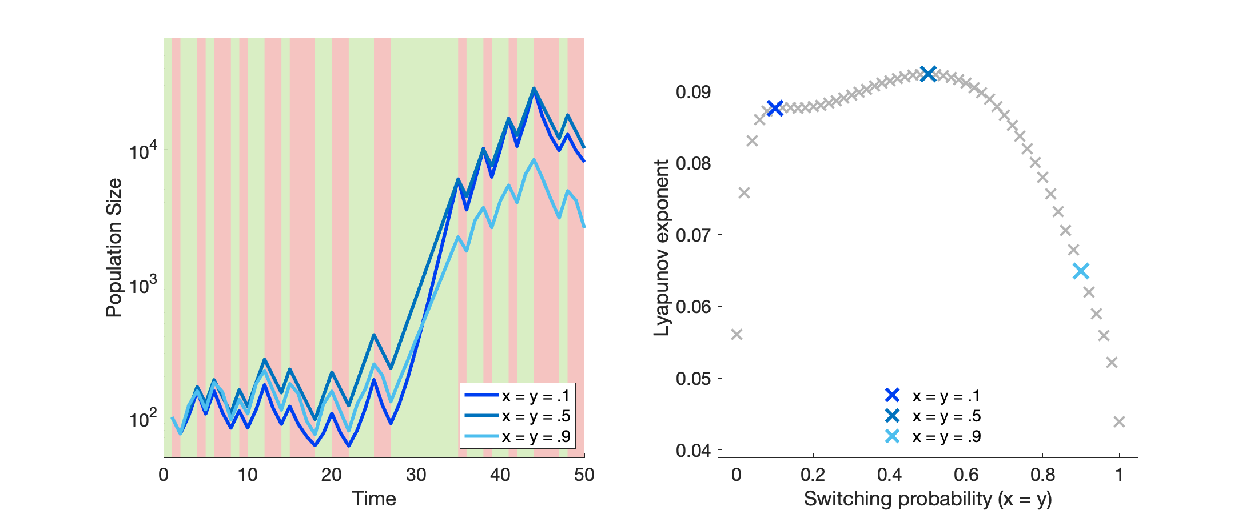
Fig 2 version 2
A
Good environment
Bad environment
B

Slide 4
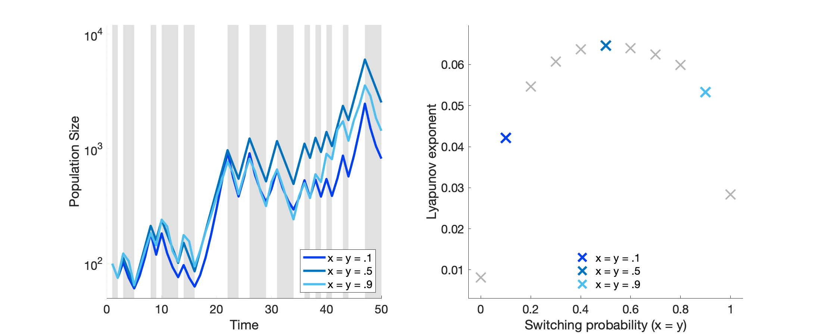
Fig 2 version 3
A
Good environment
Bad environment
B

Slide 5
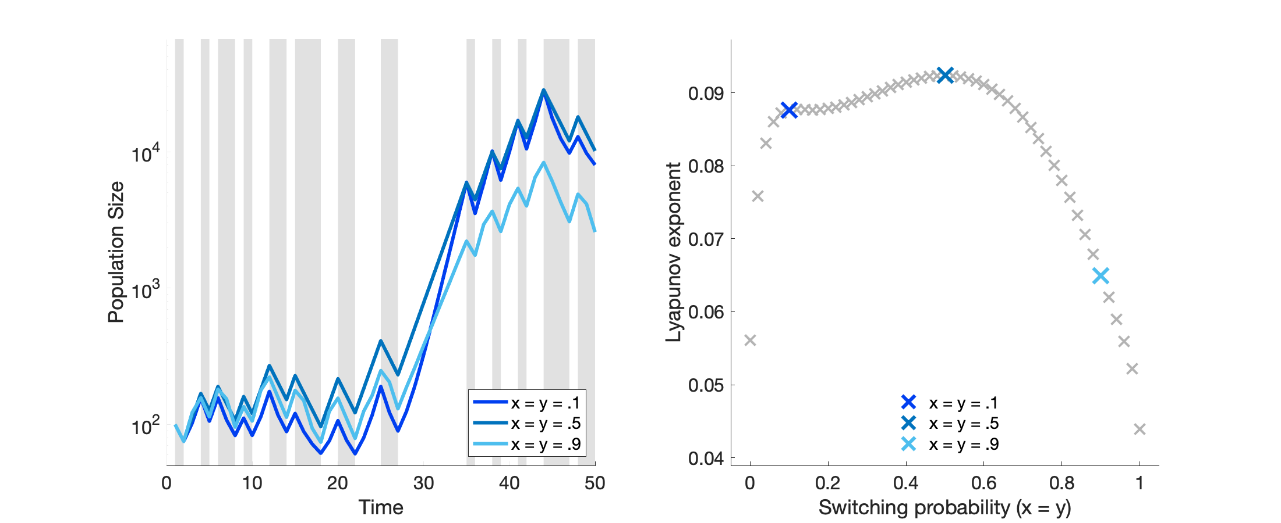
Fig 2 version 4
A
Good environment
Bad environment
B

Slide 6
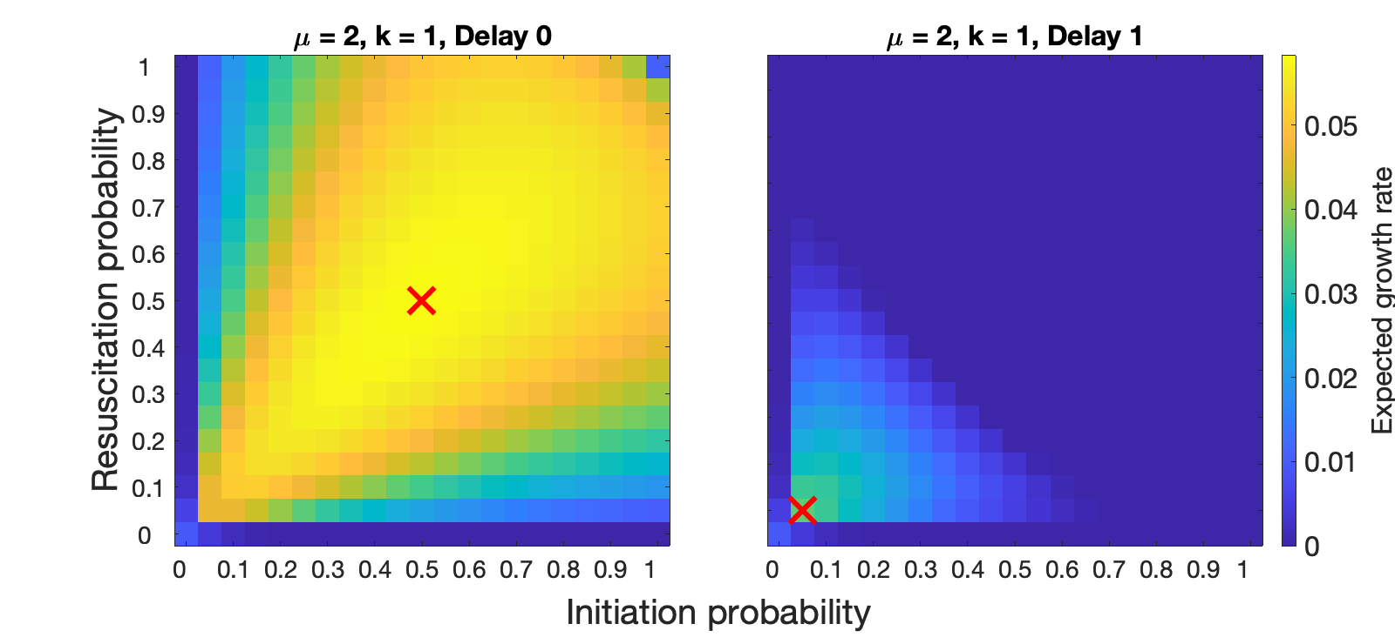
Fig 3
A
B

Slide 7
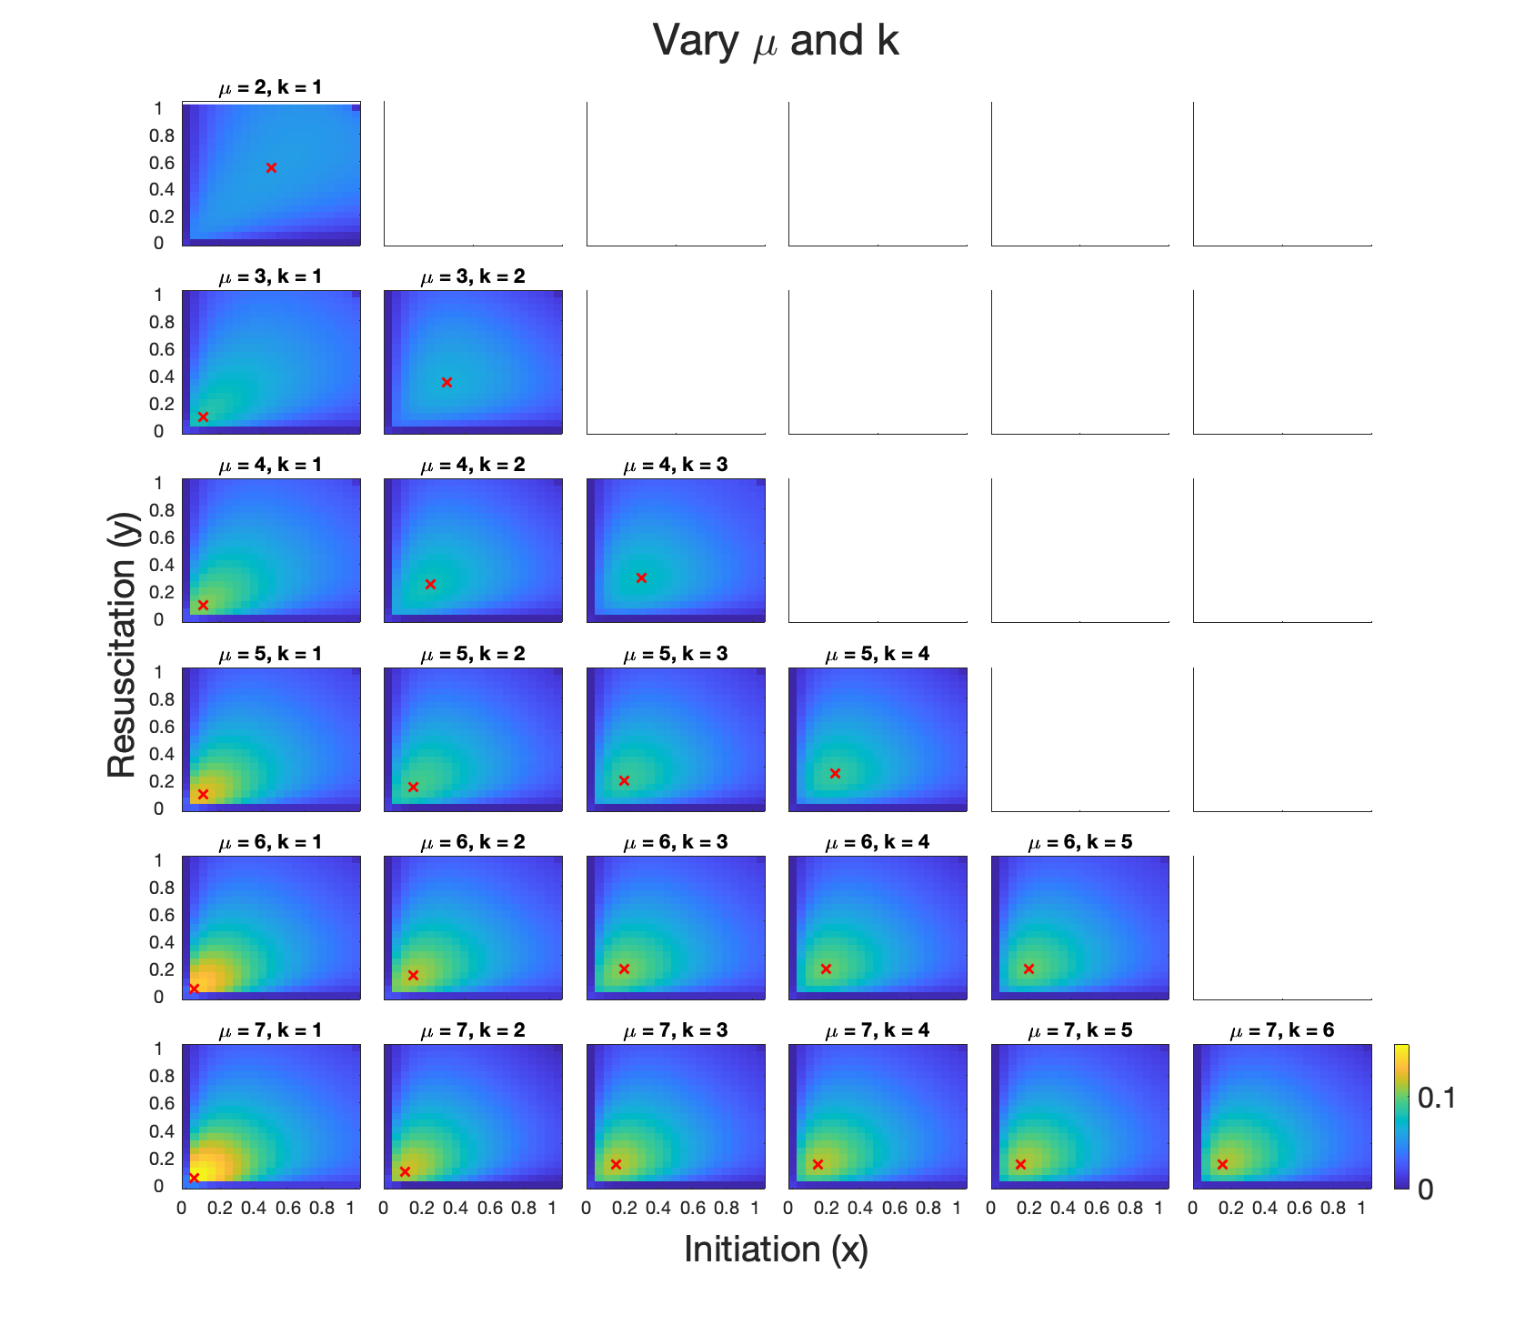
Fig 4

Slide 8
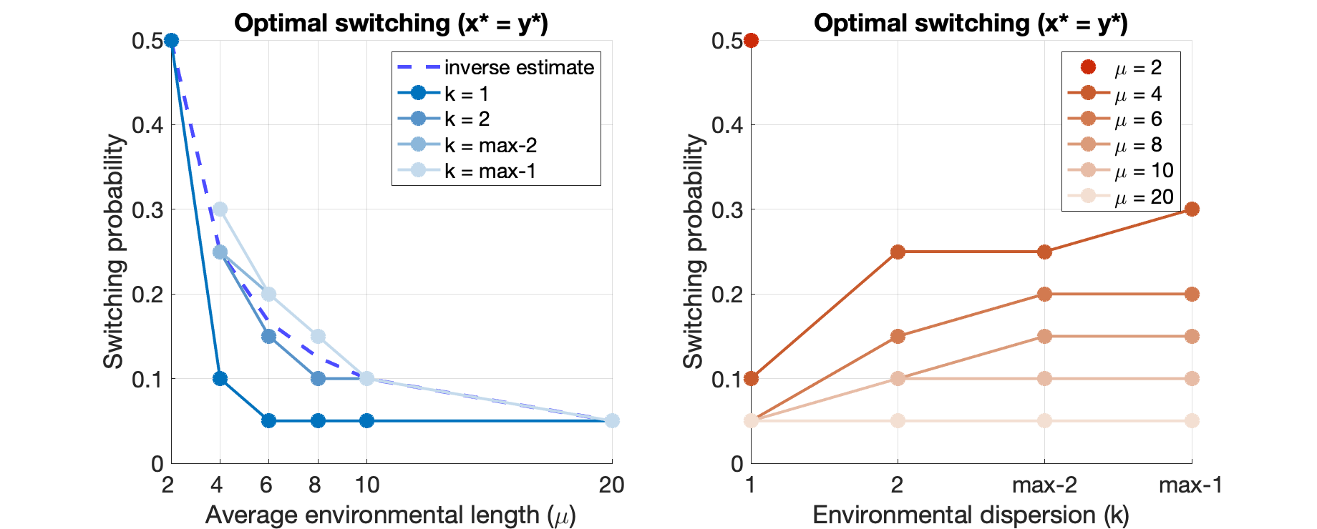
Fig 5 version 1
A
B

Slide 9
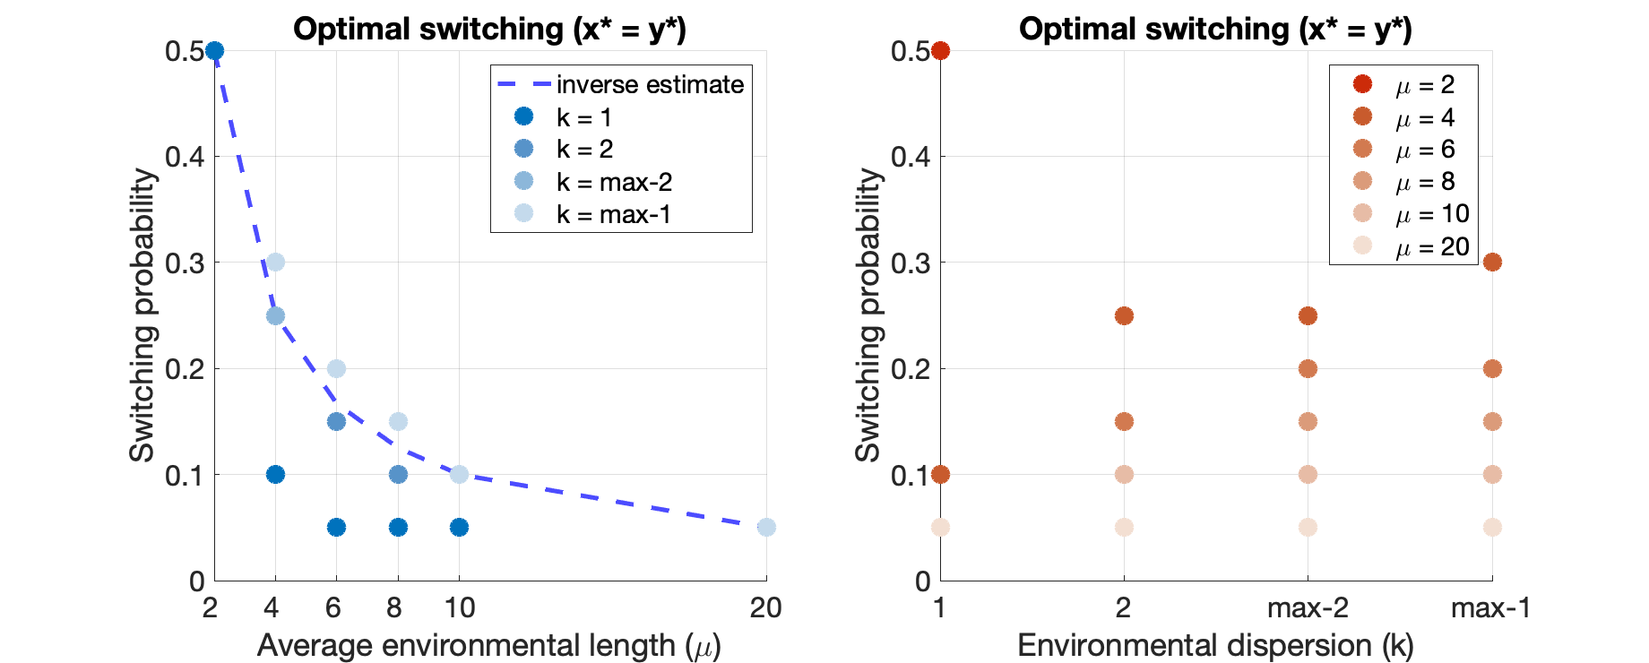
Fig 5 version 2
A
B

Slide 10
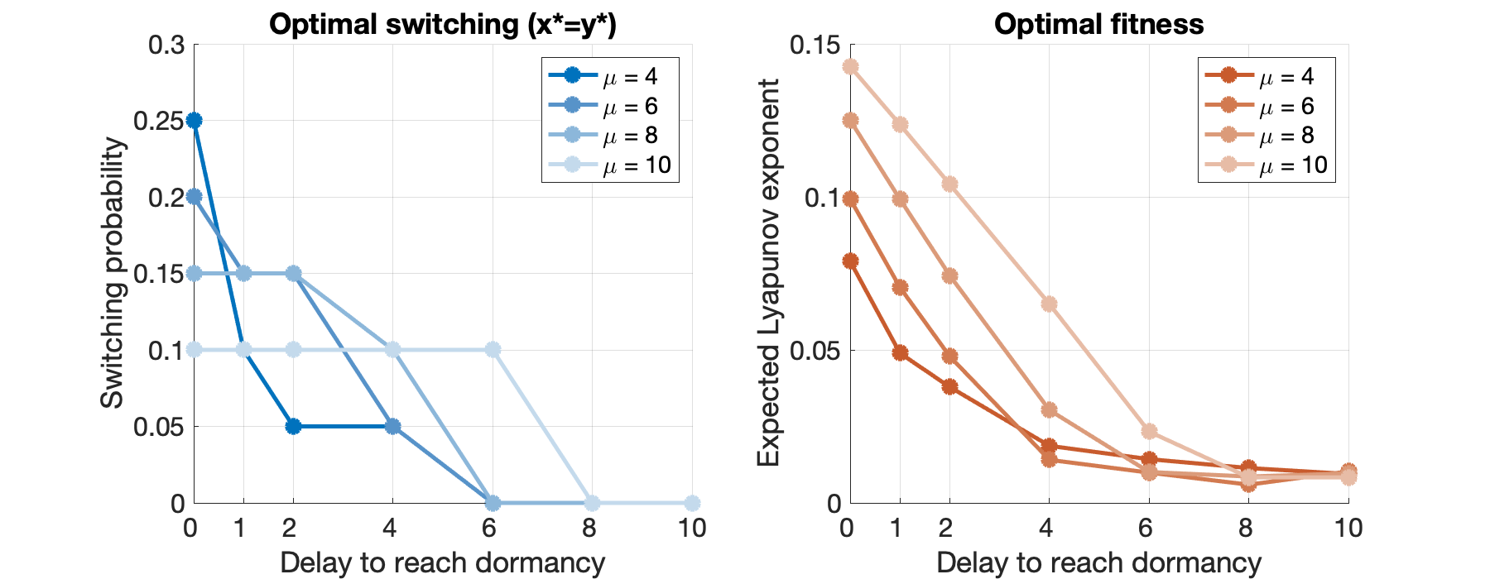
Fig 6 version 1
A
B

Slide 11
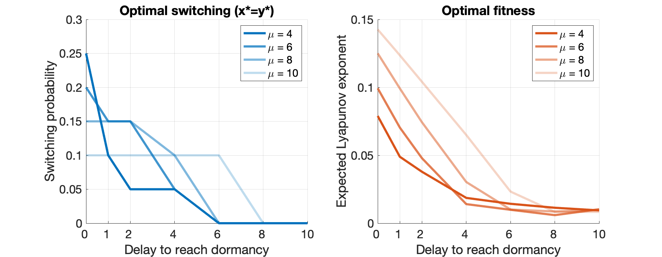
Fig 6 version 2
A
B

Slide 12
Fig 6 version 1
Environmental predictability (k)
B
C
D

Slide 13
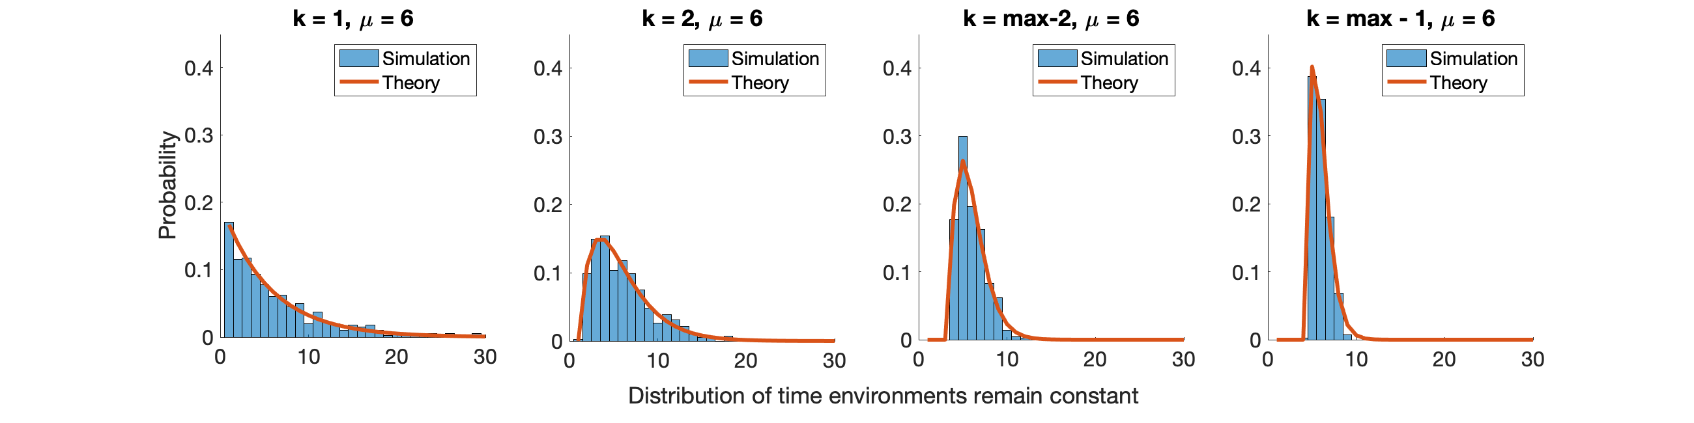
Supp Fig 1

