Slide 1
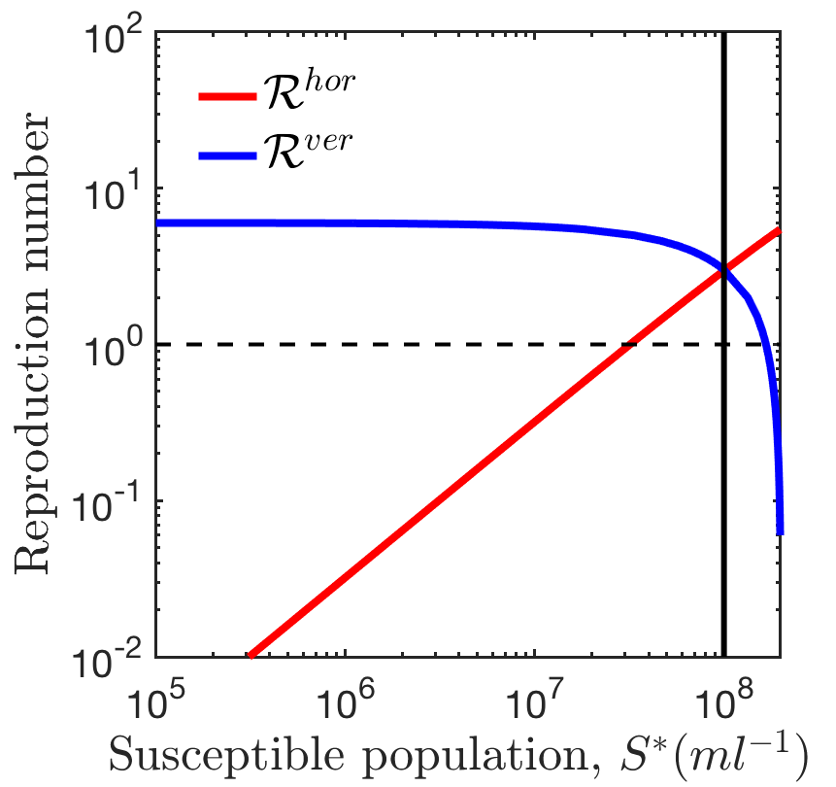
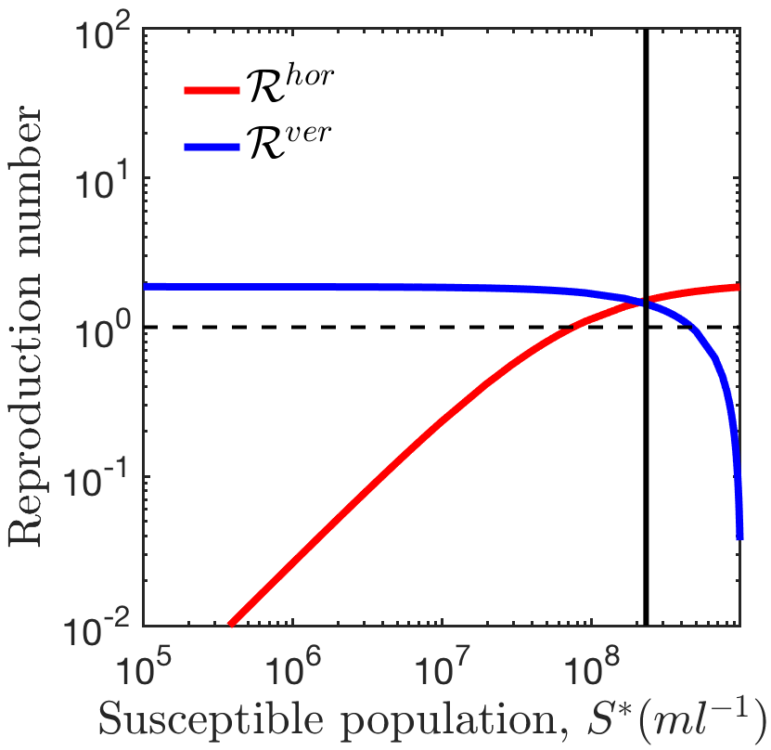
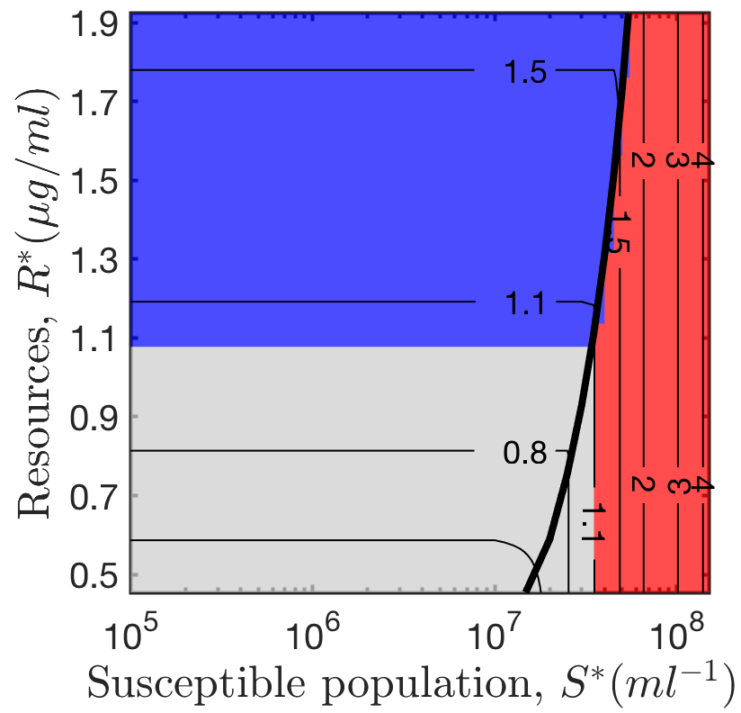
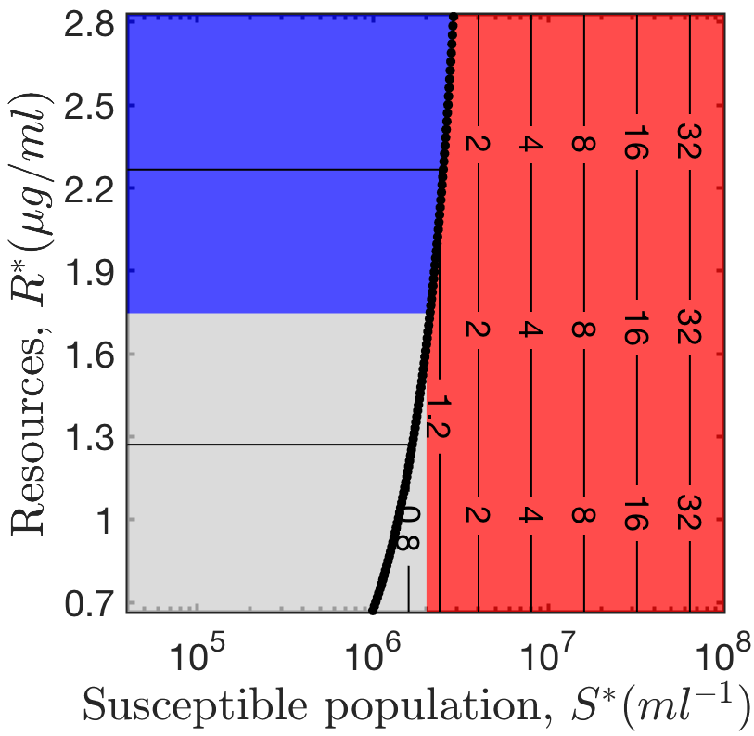
(A) Present Model
Resource-implicit model
with explicit infections
(B) Berngruber et al, 2013
Resource-implicit model
with implicit infections
(C) Present Model
Resource-explicit model
with explicit infections
(D) Stewart & Levin, 1984
Resource-explicit model
with implicit infections

Slide 2
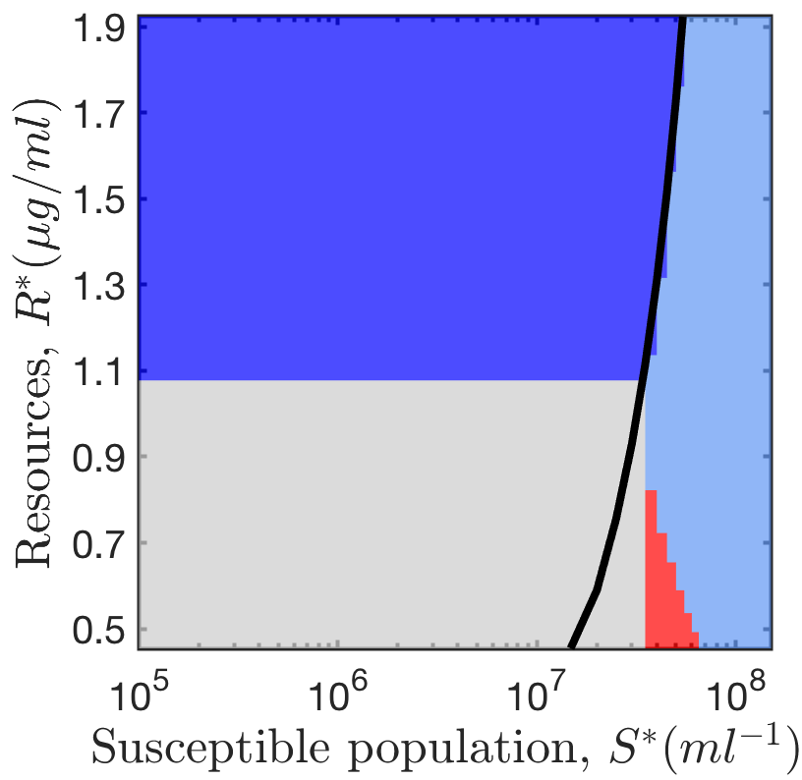
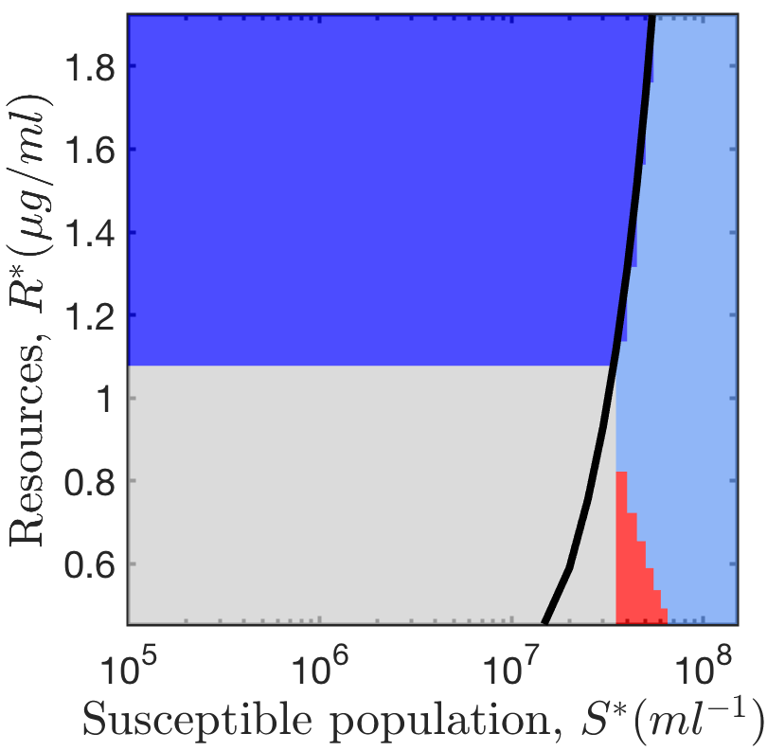
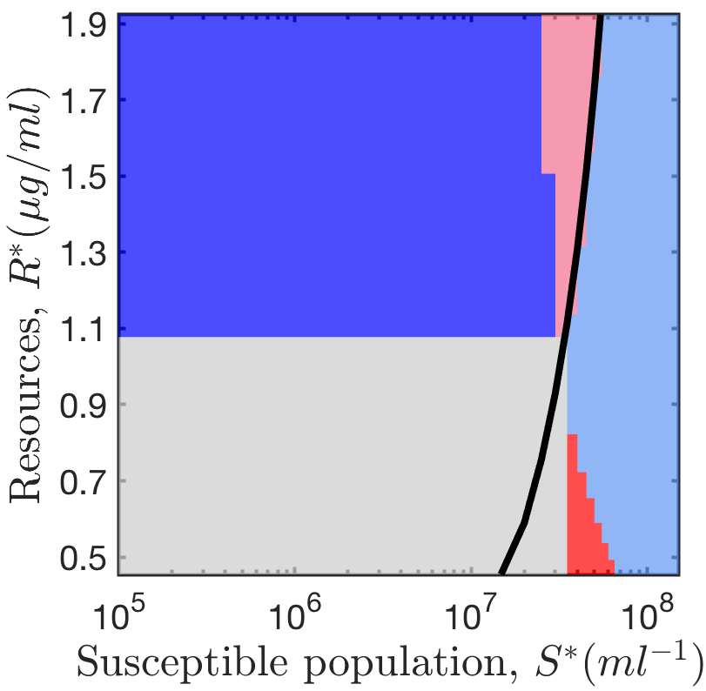
(A) No mechanism of super-infection
(B) Super-infection, with immunity
(C) Super-infection, but no immunity
Lysogenic strategy cannot invade lytic strategy
Lytic strategy cannot invade lysogenic strategy
Lysogenic strategy can invade lytic strategy
Lytic strategy can invade lysogenic strategy
No resident viral strains are present

