Slide 1
PROJECT PERFORMANCE EXPERIMENT
weiweilin@

Slide 2
Agenda
Performance Experiment (Perf-X)
What is Perf-X?
How does Perf-X work?
Tech Demo
Smart Insights
What is Smart Insights?
Why wasn’t it implemented?
Summary
What I learned & What I could do better
Shout out
Q&A

Slide 3
Perf-X
Make Quick Experiments Possible

Slide 4


Hey, you are going the wrong way!
You probably should turn right.
Hmm… I’m not sure. Try it out. Should be better.
But what will happen if I turn right?
Oh, thanks!
...
“
”
Lighthouse is a tower or other structure tool containing a beacon light to warn or guide ships developers at "sea".

Slide 5
What is Perf-X?
A project build upon lighthouse
Enable users to do quick experiments with websites
Support blocking resources
Benefits:
Allow web developers to quickly identify the performance/rendering impact of changes.
Help web developers prioritize changes with pre-measured metrics.

Slide 6
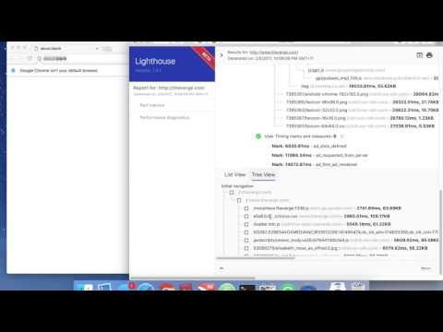
Tech Demo

Slide 7



How does Perf-X work?

Slide 8
Hey, you are going the wrong way!
You probably should turn right.
Hmm… According to my simulation, you can reach the destination 20% faster.
But what will happen if I turn right?
Wow. That’s amazing. I will try it out!
Oh, thanks!
“
”
A tower or other structure tool containing a beacon light to warn or guide ships developers at "sea".

Slide 9
Hey, little boat. If you turn right, you may save 20% of your traveling time
Oh, thanks!
I will try it out.
“
”
A tower or other structure tool containing a beacon light to warn or guide ships developers at "sea".

Slide 10
Smart Insights
Discover the Potential Improvements

Slide 11
What does Smart Insights do?
It was supposed to
Predict which resources are non-critical while has high performance cost based on some heuristics.
Rerun Lighthouse automatically to verify the prediction.
Suggest users to make changes if prediction is correct.
Benefits:
Identify potential improvement users may not know
Raise the awareness of the performance cost of some non-critical resources

Slide 12
Why Smart Insights was not implemented?
Difficulties & Drawbacks:
Increase the time to generate a report by 2s - 30s
Hard to identify non-critical resources
Time limit of the internship
Potentially low prediction accuracy

Slide 13
Data Analysis

Slide 14
Summary
TRANSITION HEADLINE
Let’s start with the first set of slides

Slide 15
Challenges:
Lots of things to learn
Lighthouse Codebase
Chrome Extension Dev
Security Protocols
Back-end & Front-end Dev
etc
New environment
Multinational team
Anything can change
Time limit

Slide 16
YOU CAN ALSO SPLIT YOUR CONTENT
I Learned/improved:
How to study codebase
How to read documentation
How to work more agilely
I could do better in:
Time management
Communication
Work-life balance

Slide 17
Shout out to
samli@
paulirish@
brenden@
edibel@
tim@
Recruiter Team
All the Googlers
Interns

Slide 18
THANKS!
Any questions?

