Slide 1
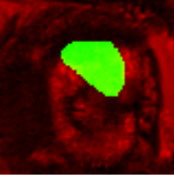
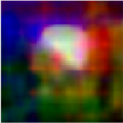

Extract Semantic Features
Used a deep segmentation model called Deeplab-resnet, pretrained on natural scene analysis. Codes can be found at:
https://github.com/iyah4888/SIGGRAPH18SSS
Input supposed to be 3 channels, corresponding to RGB channels of color image, here we use T2W and MRI mask as first 2 channels and leave the 3rd channel blank.
In output, each pixel is represented by 128-d vector, which is reduced to 3-d using PCA.
The feature vectors are generated such that for two pixels p and q that belong to the same object f p and f q are similar, i.e. ∥ f_p − f_q ∥ ≡ 0, and for a third pixel r in a different semantic region, f_r is far away, i.e. ∥ f_p − f_q ∥ ≪ ∥ f_p − f_r ∥.
Deeplab-resnet
PCA
80x80x3
80x80x128
80x80x3
Displaying 3 random features

Slide 2

Compute Laplacian Matrix
Purpose: capture the affinity between each pair of pixels
W_L: matting affinity matrix, representing intensity similarity between pixel pairs from T2W;
W_S: semantic affinity matrix, that encourages the grouping of pixels that belong to the same class and discourages that of pixels from different classes;
W_C: color affinity matrix, set to 0 since MRI is not color image.
Coefficient of W_S is a parameter to tune, and 0.2 is found to generalize to almost all patients.
Larger coefficient shows emphasis on semantic information
Smaller coefficient shows emphasis on local information

Slide 3
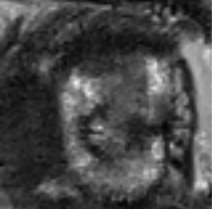
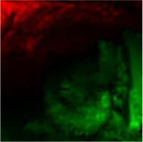
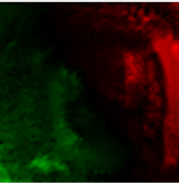
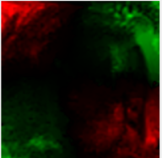
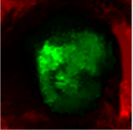
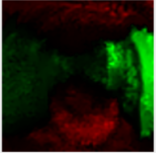
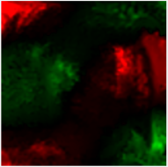
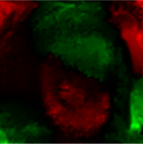
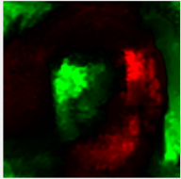
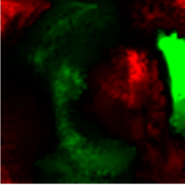
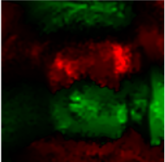
Eigen-decomposition of L matrix Display of 10 smallest eigenvectors
negative values are shown in red, and positive in green
the eigenvectors associated to small eigenvalues of L play an important role in the creation of high-quality mattes
In this case, it is found that smaller eigenvectors focus on segments around lesion of interest

Slide 4
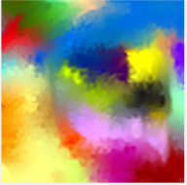
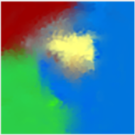
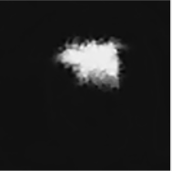
Initial segments User defined 40 (some might be too trivial to be shown below)
Grouped segments
User defined 5
K-means clustering
Each soft segment is a linear combination of the K eigenvectors corresponding to the smallest eigenvalues of L

Slide 5
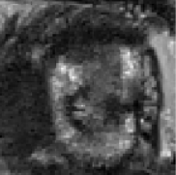
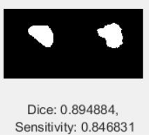
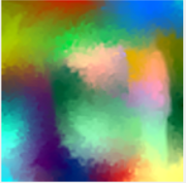
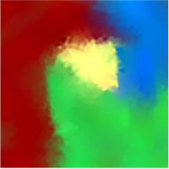
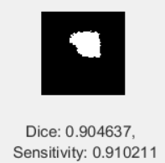
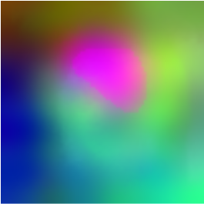
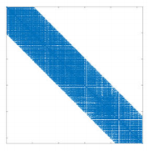
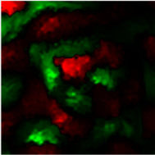
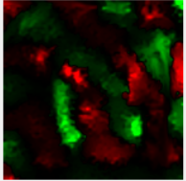
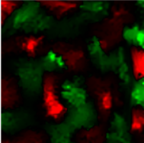
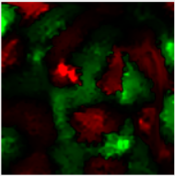
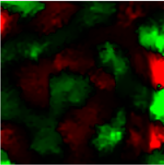
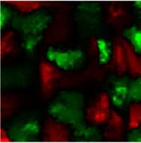
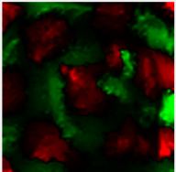
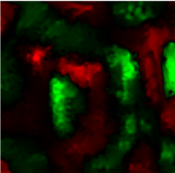
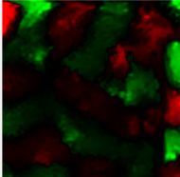
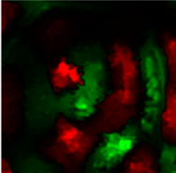
a
c
d
MRI
Histology
Output
Initial
Segments
Grouped
Segments
T2W Image
b
Generated Semantic
Features
Laplacian Matrix
Eigenvectors
Figure: (a) For an input T2W and coarsely segmented mask from MRI, we generate per-pixel hyperdimensional semantic feature vectors from a pre-trained deep learning segmentation model, namely deeplab-ResNet. (b) Incorporate matting affinity and semantic affinity to form a Laplacian matrix and its eigenvectors reveal the semantic objects and the soft transitions between them. (c) By solving an optimization problem and aggregating the eigenvectors, typically 15-25 soft segments are formed, which are further grouped into four larger segments though K-means clustering. (d) The generated lesion mask after refinement exhibits more accurate boundary compared to initially segmented mask from MRI, as shown in both Dice and Sensitivity.

Slide 6
Accurate representation of soft transitions between lesion and normal tissues from MRI images remains an important yet very challenging task. State-of-the-art performance on lesion segmentation is far from satisfactory with Dice around 0.6 in literature. In fact, precise boundary definition solely from MRI poses challenges for radiologists too, especially on cases with poor image contrast. Inspired from image matting techniques, we propose to add a post-processing refinement step after initial segmentation made by a model or a clinician. To decide from opaque boundaries shown in MRI, semantic deep features from MRI together with initial segmentation are combined with local features indicating matting affinities between pixel pairs. The soft segments are generated via eigendecomposition of the carefully constructed Laplacian matrix (Figure). We tested on 66 patients with MRI-based contour as initial segmentation and histology-based contour as ground truth. An average of XX% and XX% improvements on Dice and Sensitivity were observed with the help of the refinement step. In our future work, more accurate boundary is achievable by involving histology-based mask in the training loop.

Slide 7
Experiments with a Mask-R-CNN

Slide 8
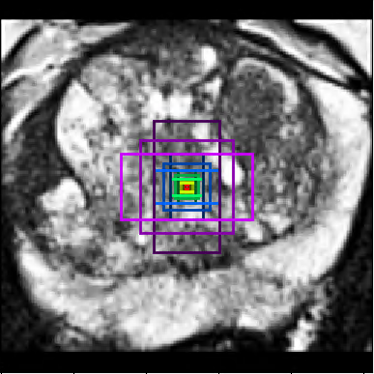
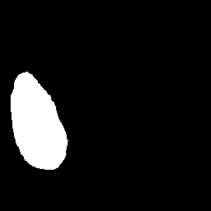
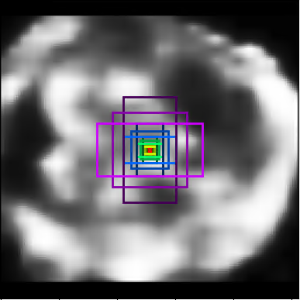


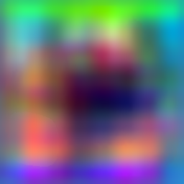
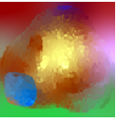

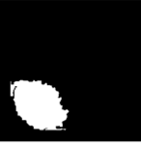
F1
Classification Branch
Channel 1
F2
7×7
1×1×1024
Region Proposal Network
7×7×1024
Prediction
F3
FC
Softmax
101 ResNet
+ FPN
RoIAlign
F4
ConvNet
Channel 2
RoIs
×4
2×2×256
1×1×classes
Target
Feature Pyramids
28×28
3×3×256
Segmentation Branch
Fused Semantic Features
Alignment + Cut-off Threshold
+
T2WI
Semantic Soft Segments
Mask R-CNN Prediction
Boundary Refined Segment (binary)
Figure: Workflow of accurate lesion segmentation from prostate MRI. Mask R-CNN (upper) was designed specifically as an end-to-end course lesion segmentation. Co-registered T2 and ADC map with cropped prostate were fed into a Mask-RCNN for. (Lower) Semantic features from feature pyramids were extracted to highlight inner structure of a prostate including central gland, peripheral zone, and abnormalities. High level semantic features were combined with low level features from original T2W to cluster pixels into 10 segments. The segment that aligned with lesions segmented from Mask-RCNN was final output mask. The mask generated by our proposed method was verified closer to the histology mask in terms of Dice and Sensitivity, compared with the mask contoured by a radiologist on MRI.

Slide 9
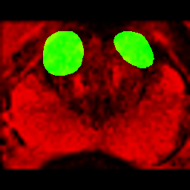
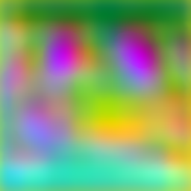
Generate semantic feature images
Pre-requisite 1: Images input to Mask-R-CNN (work done by Zhenzhen)
Prostate cropped, with margin of 1, longer side resized to 256, shorter side padded with zero;
Resultant resolution: 256x256.
Pre-requisite 2: Feature Pyramid in Mask-R-CNN:
F1: 64 x 64 x 256
F2: 32 x 32 x 256
F3: 16 x 16 x 256
F4: 8 x 8 x 256
Matting: Generate Semantic Feature Images
Input1: T2W + multiple-lesions + 0 (3 imaging channels): 256 x 256 x 3
Input2: Feature pyramid (single or fused): resized to 256 x 256 x 256 to match with Input1
Output: Feature images 256 x 256 x 3 – representation for each pixel down-sampled to 3 after PCA
Input 1
Input 2
Output
F1
+
F2
+
F3

Slide 10
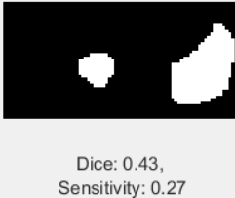
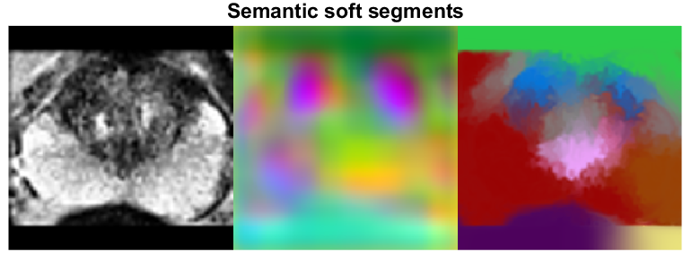
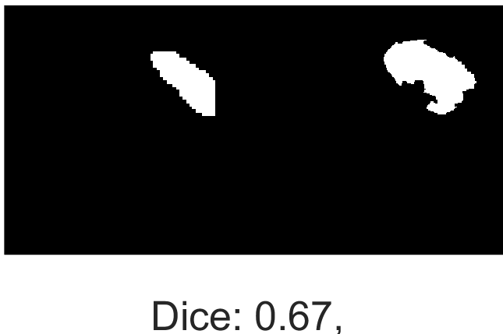
Prostate Anatomy using Matting
Input 1: T2W (local regions)
Input 2: Semantic feature images (global anatomic info)
Output: Segments of a prostate, one aligning with prediction made by Mask-R-CNN was the ultimate segmentation with re-fined boundary
Q: Why not use ADC in Input 1?
A: 1) Avoid noise caused by co-registration;
2) ADC is used to highlight lesion, the semantic features already clearly show lesions.
Radiologist’s
Contour
Histology
Mask
Ground
Truth
Matting
T2W
Features
Final
Segments

Slide 11
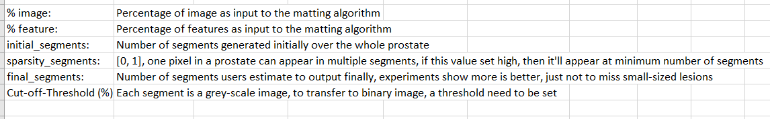
Parameters of matting needed to be tuned
Please refer to for detailed parameter tuning process:
Source Code:
https://github.com/yaksoy/SemanticSoftSegmentation

