Slide 1

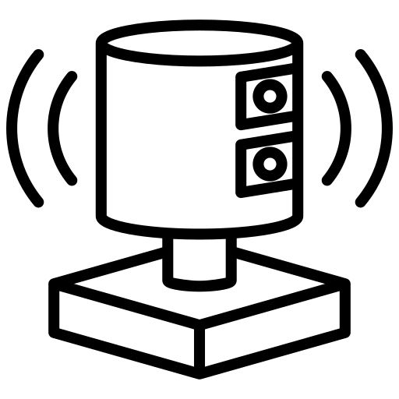


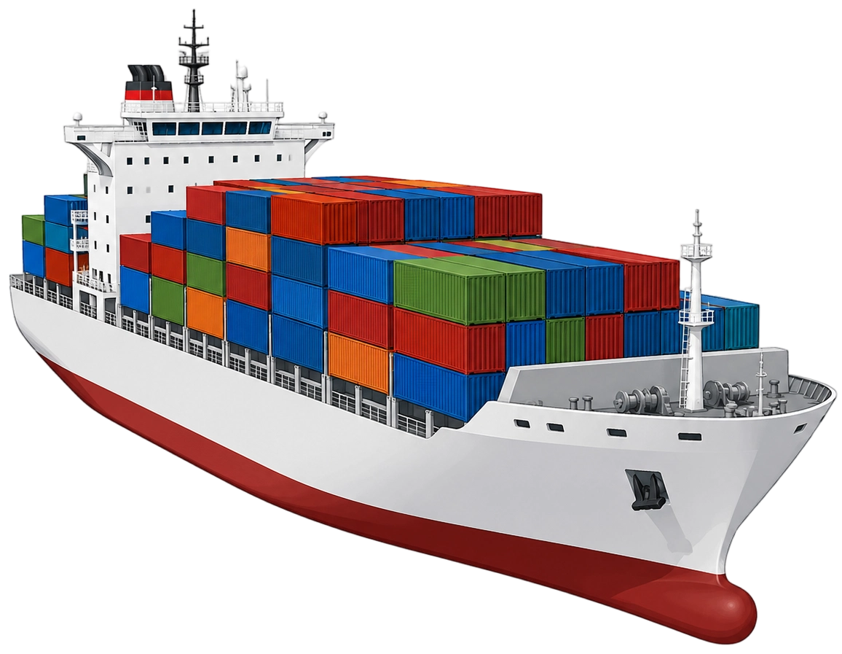

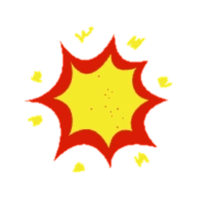


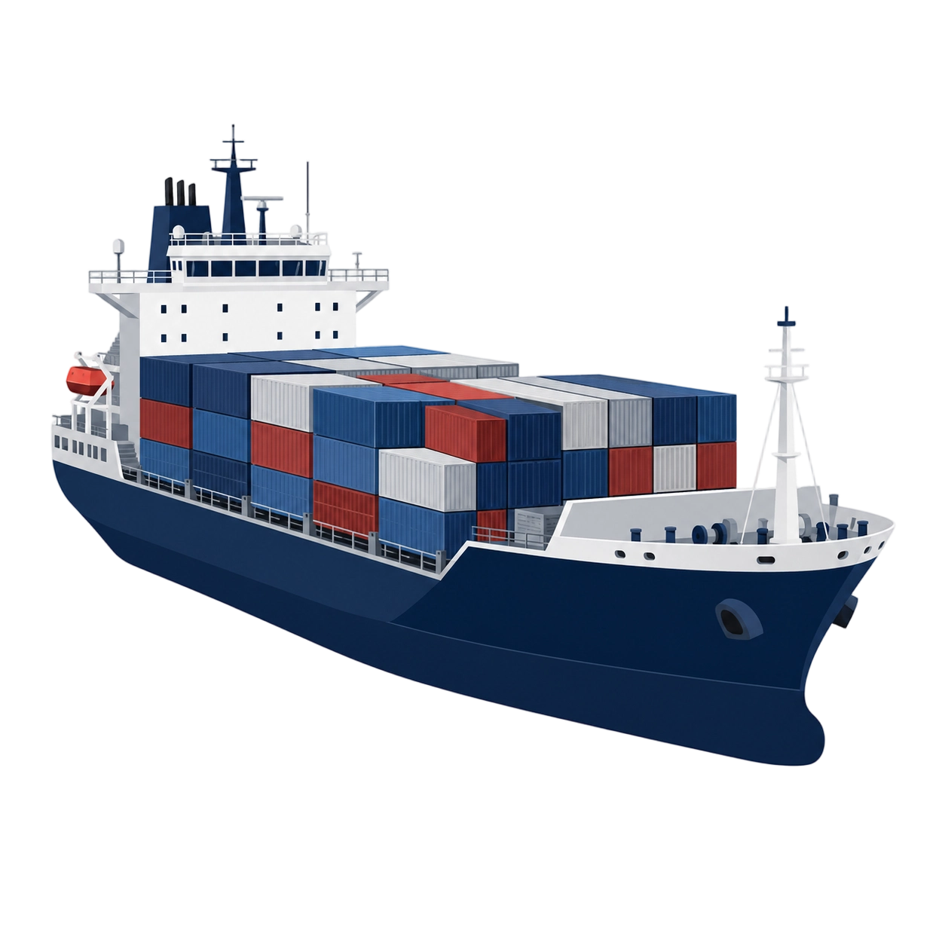






























Continuous PPO
Env
Projection-Based Safety Shield
Actor networks
27-D observation
Own vessel state.
Target vessel state.
Four-sector traffic.
Terminal flags.
Emergency situation
COLREGs State Machine
$$u_{em}$$
$$If{ p}_{t}=={ p}_{em}$$
Encounter classification
···
···
Policy Action Box
$$\tilde{O_{t}}$$
$$\tilde{p_{t}}$$
$$u_{cf}$$
Non-emergency
Output $u_{policy}$
$$If{ p}_{t}=={ p}_{1},{ p}_{2},{ p}_{3}, …$$
Input
$$X\sim Beta(α,ω)$$
MLPs
$$𝒫$$
No-collision constraint
Critic networks
$$u_{fb}$$
$$u_{box}$$
$$u_{pt}$$
Actuator Limits
Vessel Dynamics
···
···
···
Actor-Critic Update
If $𝒫=∅$
$$u_{safe}$$
$$=Π_{P}\left(u_{policy}\right)$$
$$ω$$
$$u_{box}$$
Output$V(s_{t})$
Safe Control Set $𝒫$
Safety Projection
$$u_{cf}$$
Input
MLPs
$$u_{po}$$
$$𝒫$$
$$𝒫=U_{box}∩U_{COLREGs}\left(ρ\right)∩U_{cf}\left(s\right)$$
exp
$$\min_{u∈𝒫} ∥u−u_{policy}∥_{2}^{2}$$
$$u_{pt}$$
Training only
$$α$$
$$o$$

