Slide 1
Provably COLREGs-Compliant USV
Collision Avoidance in Continuous Action Space
Projection-based safety shield + reinforcement learning · TRB 2027
Core novelty: continuous action ∩ provable compliance ∩ COLREGs — a previously empty intersection
Project progress report · 2026-06-28

Slide 2
Background & Challenge
Why this has not been done before
The maritime dilemma
COLREGs require ships to give way in the correct direction. Prior RL work could only pick one of:
1. Sacrifice continuous control — Krasowski 2024 uses discrete actions + action masking
2. Sacrifice the guarantee — continuous-action work falls back to soft rewards, no provable compliance
Our contribution
First projection safety shield for maritime COLREGs:
• RL outputs a continuous action
• Projected onto a compliant + collision-free set
• QP projection → an always-feasible safe action
= continuous control AND provable compliance, together

Slide 3
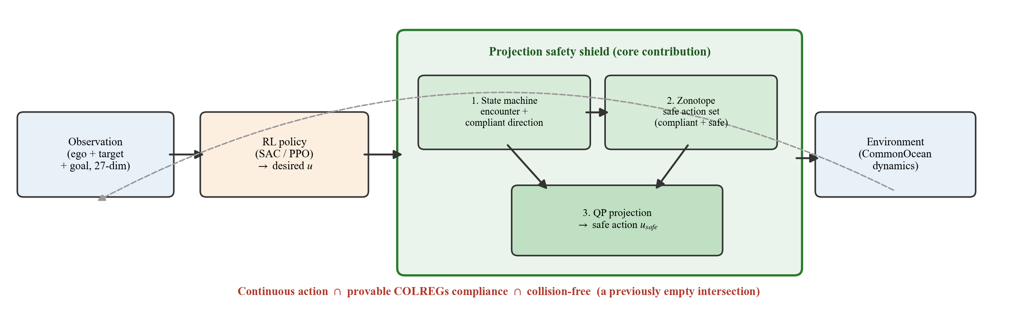
Core Method: Projection Safety Shield
Observation → policy → shield projection → safe action
Compliance is guaranteed by construction (the shield), not learned from reward.

Slide 4
Experimental Setup
Four-arm comparison under one identical protocol
Data & environment
Four comparison arms
Evaluation metrics
• CommonOcean maritime simulator
• Recorded AIS real-ship scenarios
• Single-obstacle encounters
• Evaluation on held-out test set
• Base (no shield, no rule reward)
• Rule-reward (no shield, soft reward)
• Discrete-safe (discrete + shield)
• Continuous-safe (continuous + shield)
• Arrival rate (hard metric)
• Collision rate / COLREGs violations
• Control smoothness (jerk)
• Multi-seed IQM + failure rate
All arms share the same environment / scenarios / normalization. The discrete baseline runs the standard method (no extra shaping).

Slide 5
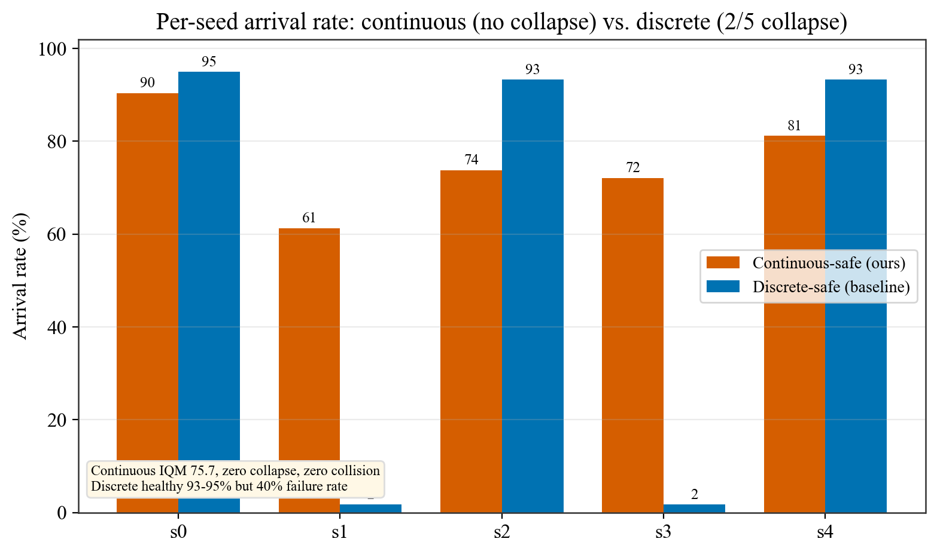
Result: Safety & Arrival Rate
Continuous arm: zero collision, provable compliance, zero collapse
Zero collision
guaranteed by the shield
Provable compliance
COLREGs direction by design
IQM 75.7%
continuous arrival, no collapse
Target 78-86%
matching the safe baseline

Slide 6
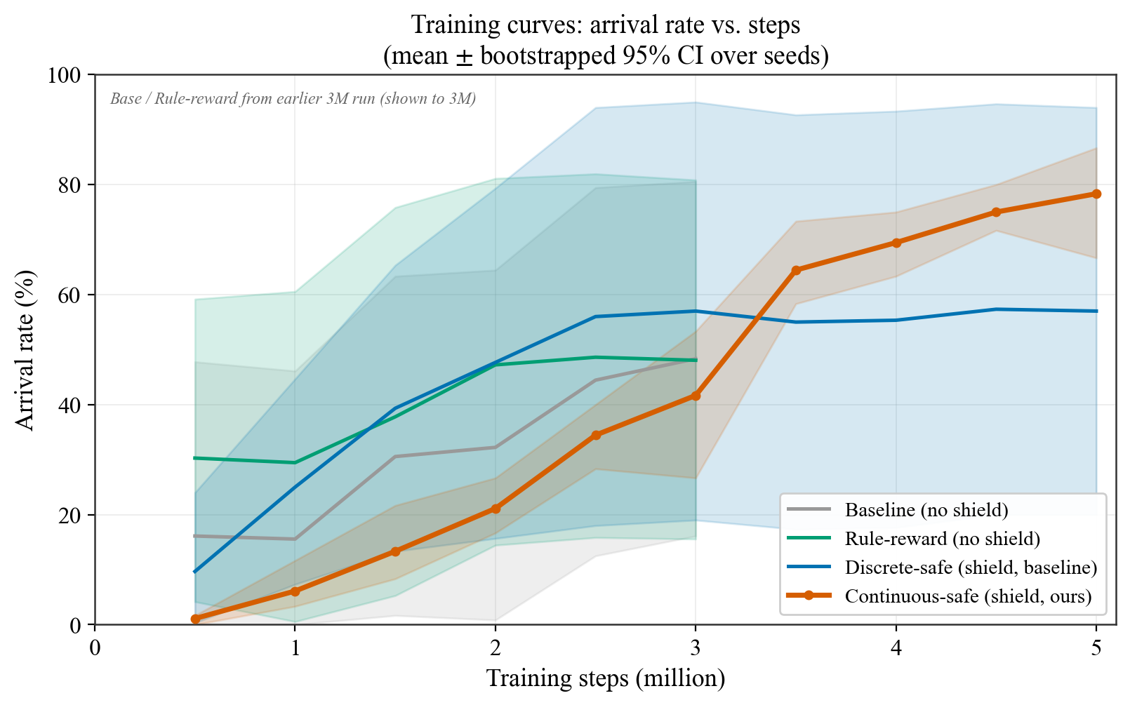
Result: Training Curves
Mean ± bootstrapped 95% CI over seeds (Krasowski Fig. 8 style)
Reading the curves
• Continuous (ours) late liftoff, reaches ~78%
• Discrete mean dragged down by 2/5 collapse
• Wide CI bands = seed fragility (both arms)
Base / Rule-reward from an earlier 3M run.

Slide 7
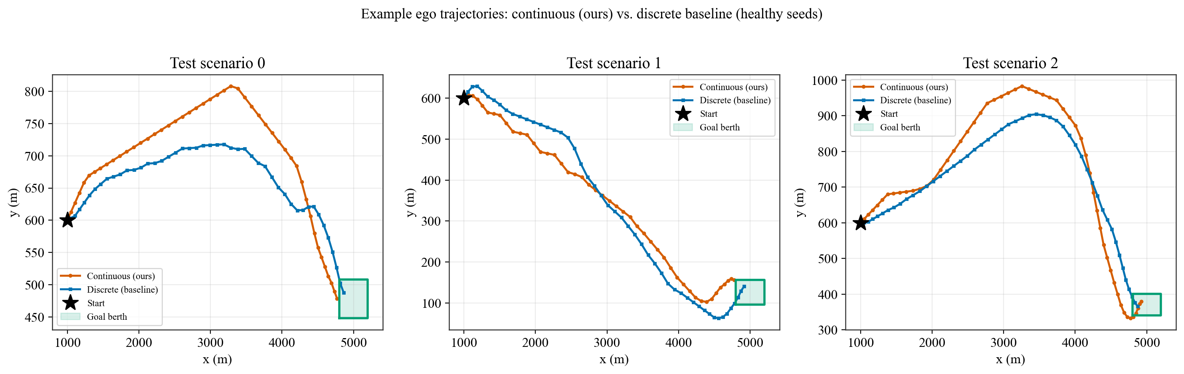
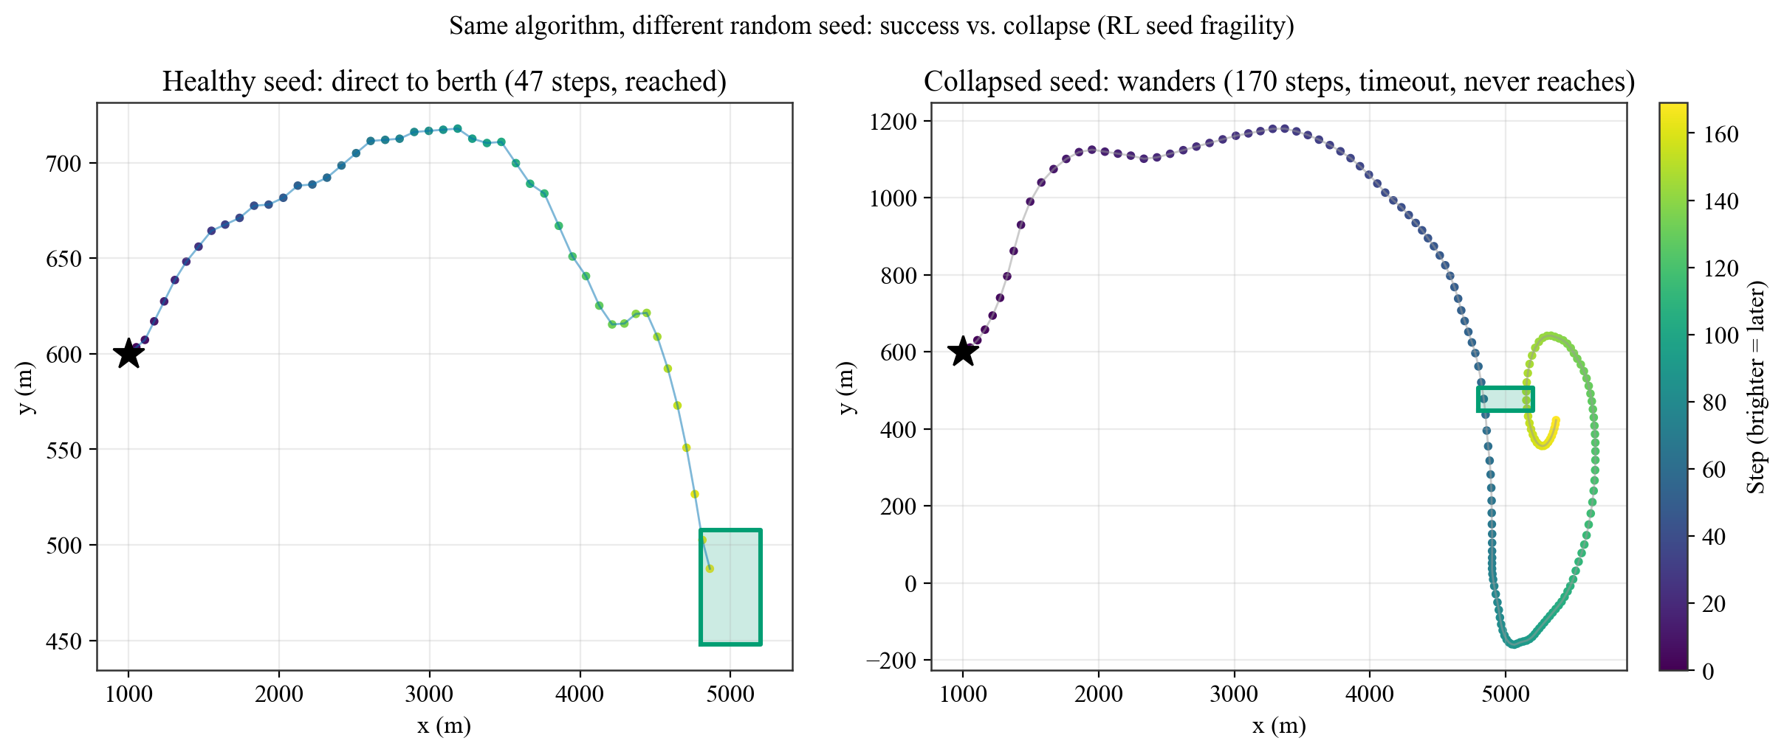
Result: Example Trajectories
Healthy seed reaches the berth; a collapsed seed wanders (RL seed fragility)

Slide 8
Diagnostic-Driven Improvements
Every fix is grounded in data before it is designed
Method
Targets
Outcome
Status
Entry-gate shaping
seed collapse
IQM 51.8 -> 75.7, collapse removed
Adopted
Action-alias penalty
shield-biased path
too conservative, breaks seeds
Negative
Smoothing + annealing
bang-bang jitter
smoother, but no arrival gain
Secondary
Terminal speed shaping
82% stop-short (new)
implemented + reviewed
Pending test

Slide 9
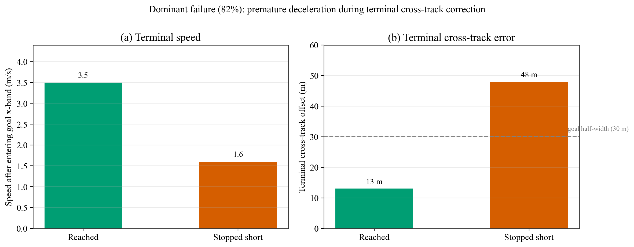
Bottleneck 1: Terminal Precision
82% of failures: ship reaches the berth front but stops short laterally
Mechanism: the ship is aligned along-track but decelerates too early during the lateral correction, stalling ~13 m outside the band.
Fix: terminal speed shaping (implemented, pending test) — reward keeping maneuvering speed near the goal; arrival does not require stopping.

Slide 10
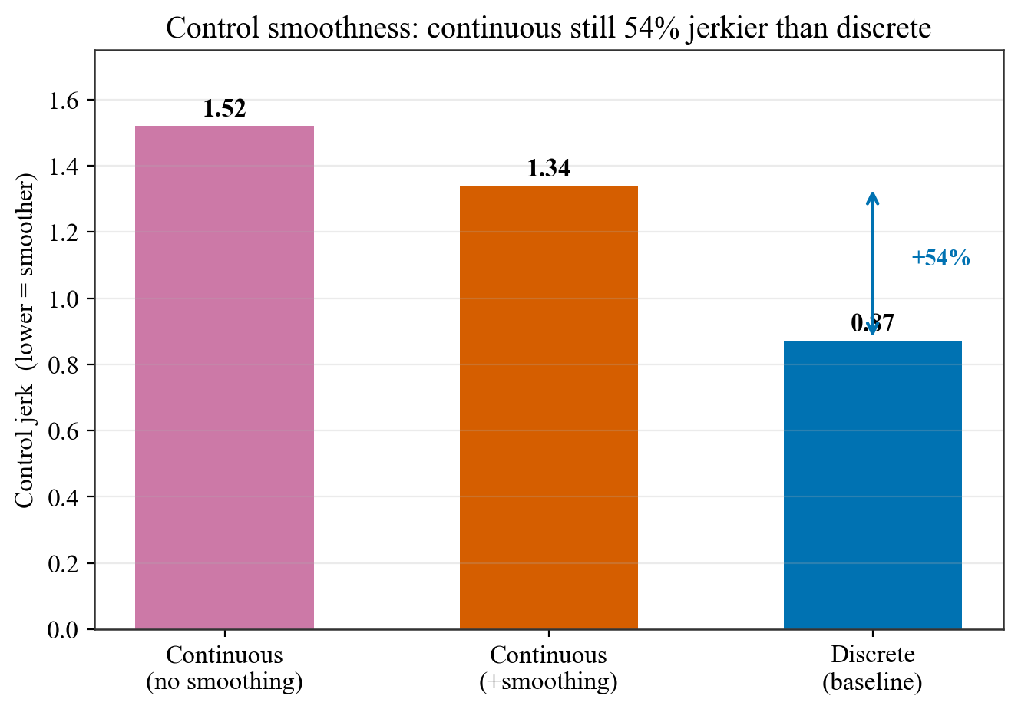
Bottleneck 2: Control Smoothness
Honest: the continuous trajectory is currently jerkier than discrete
How to read it
• Continuous (smoothed) jerk = 1.34
• Discrete baseline jerk = 0.87
• Continuous still 54% jerkier
"Smoother control" is one of our selling points, but it is currently worse.
Goal: at least match discrete (jerk -> ~0.87).

Slide 11
Honest Limitations
A progress report does not dress up the numbers
Seed fragility is intrinsic to RL
Good seeds already hit 90%; weak seeds drag the aggregate. Report IQM / CI / failure rate, never cherry-pick.
Stable 90+ is a stretch, not a promise
Target = match the comparable safe baseline (~78-86); 90+ needs new method and is not guaranteed.
Currently empirical compliance (level A)
Direction compliance is provable, zero collision is empirical; strictly provable zero collision is deferred to Phase 4 (invariant set).

Slide 12
Next Steps
Near-term fixes → headline experiment → submission
1
Terminal speed shaping test
verify it pulls cross-track into the band without breaking seeds
2
More seeds + smoothness
>=8 seeds for IQM/CI; bring continuous jerk down to match discrete
3
Four-arm headline figure
200 -> 2000 scenarios, same protocol; continuous vs. discrete
4
Phase 4: the "provably" switch
invariant-set terminal constraint -> can the title say "provably"

Slide 13
Summary
Built
In progress
Ahead
• Projection shield fully working
• Zero collision + provable compliance
• Continuous IQM 75.7, no collapse
• Terminal precision (82% of failures)
• Match discrete on smoothness
• Rescue weak seeds toward 90+
• Four-arm headline comparison
• Phase 4 "provably" switch
• Multi-seed statistics + writing
Contribution anchored in the shield · arrival rate is the hard metric we push · no dressing up the numbers

