Slide 1
Case 1
10 cm
P3
P2
P1
STA
10 cm
P4
P5
P6
AP

Slide 2
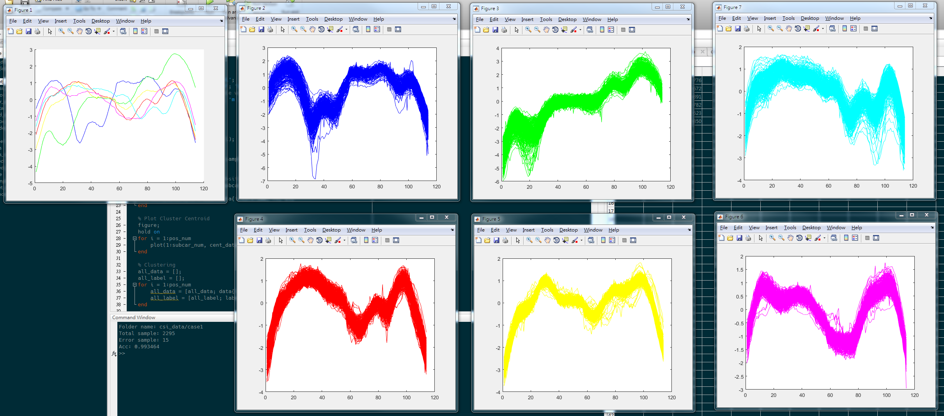
Case 1: Acc:99.35%

Slide 3
Case 2 - walking
STA
a man
AP

Slide 4
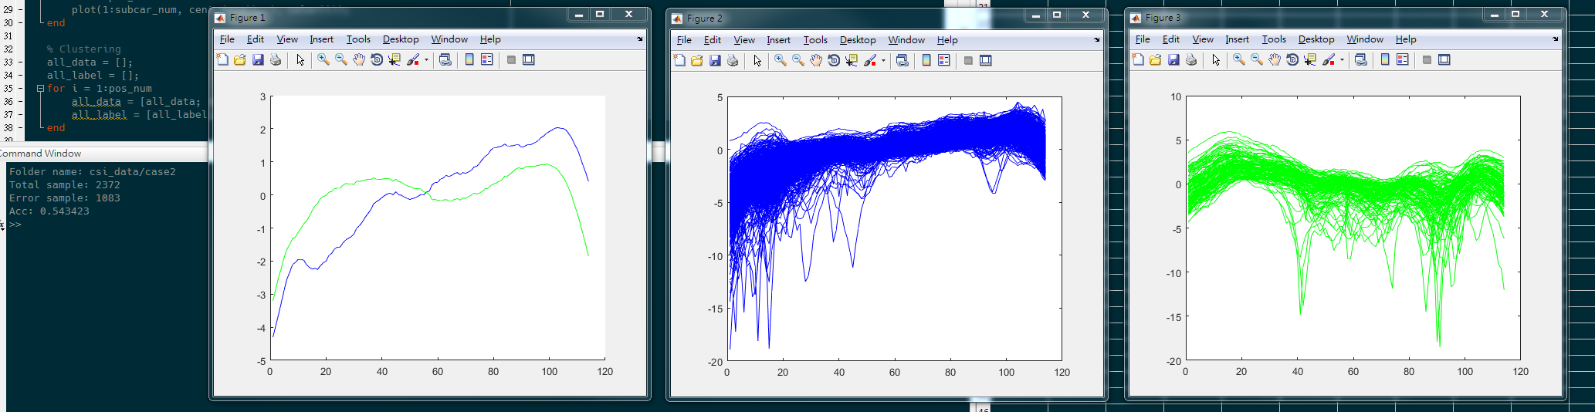
Case 2: Acc:54.34%

Slide 5
Case 3 – swap location
Near case
far case
5 cm/swap
70 cm/swap
DUT A
DUT B
DUT A
DUT B
AP
AP

Slide 6
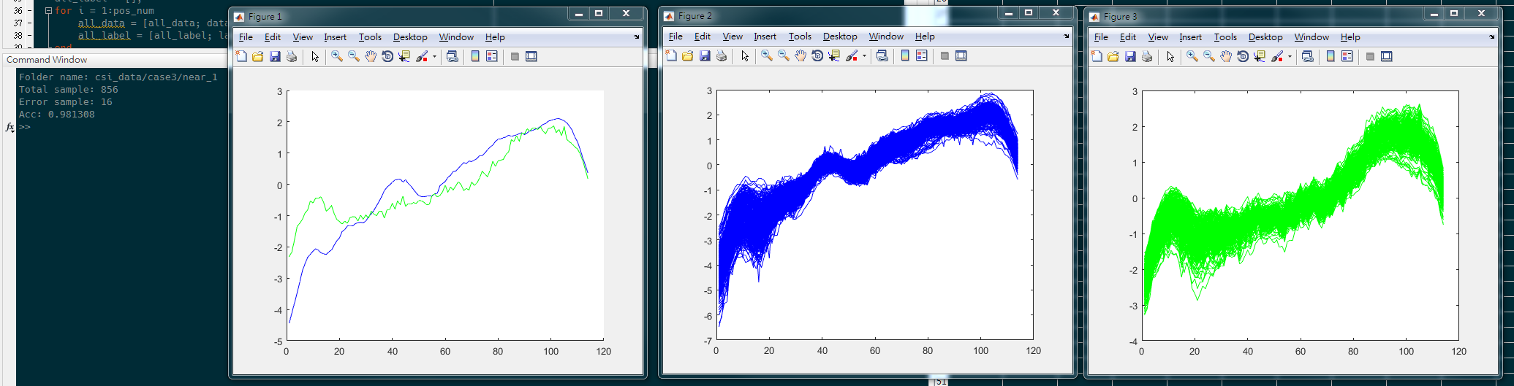
Case 3 – Near case1: Acc:98.13%

Slide 7
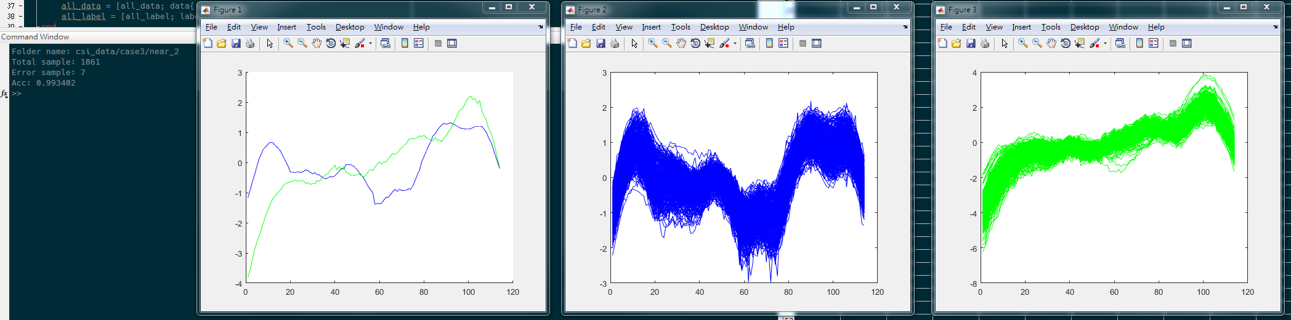
Case 3 – Near case2: Acc:99.34%

Slide 8
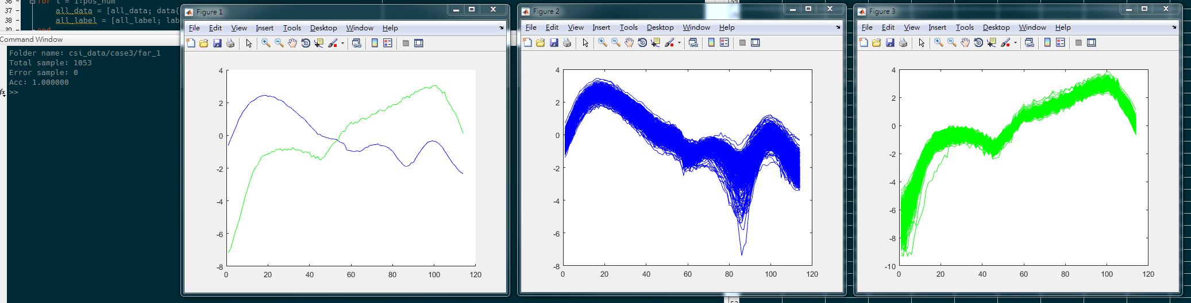
Case 3 – Far case1: Acc:100.00%

Slide 9
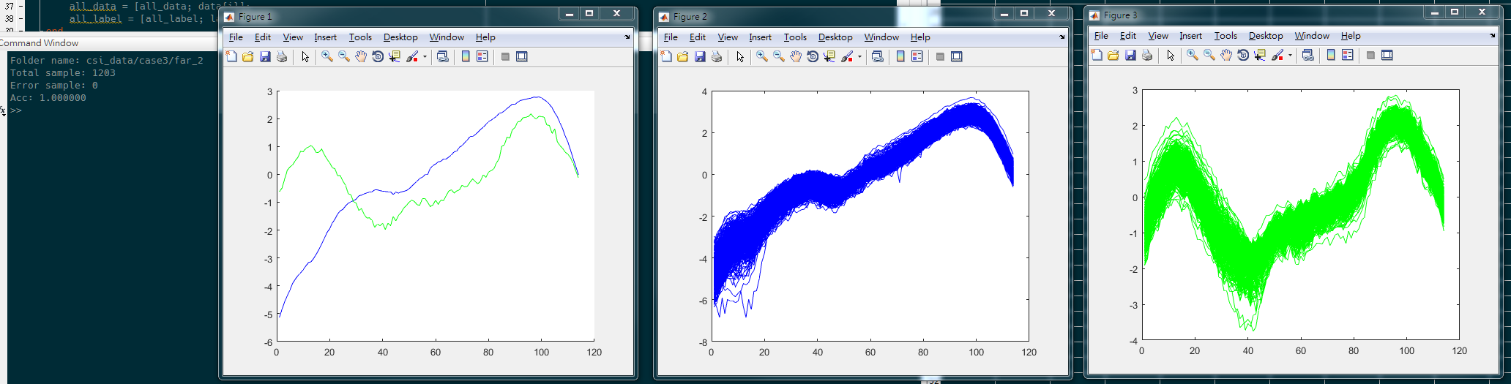
Case 3 – Far case2: Acc:100.00%

Slide 10
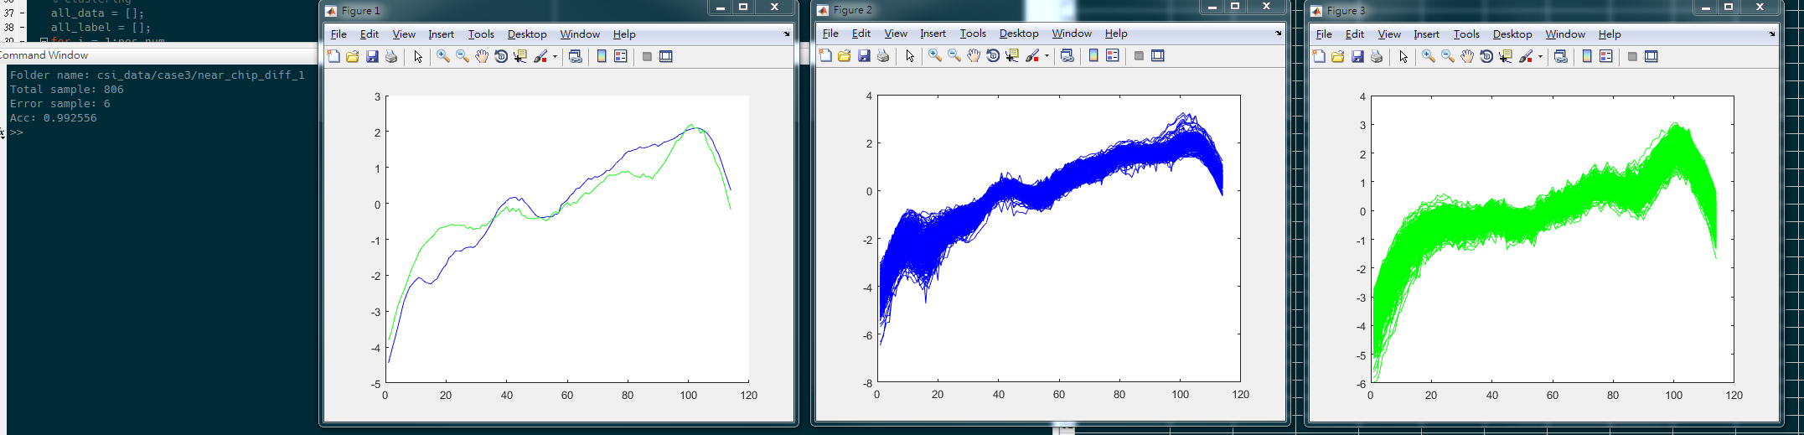
Case 3 – Near case1 DUTA + Near case2 DUTB : Acc:99.26%

Slide 11
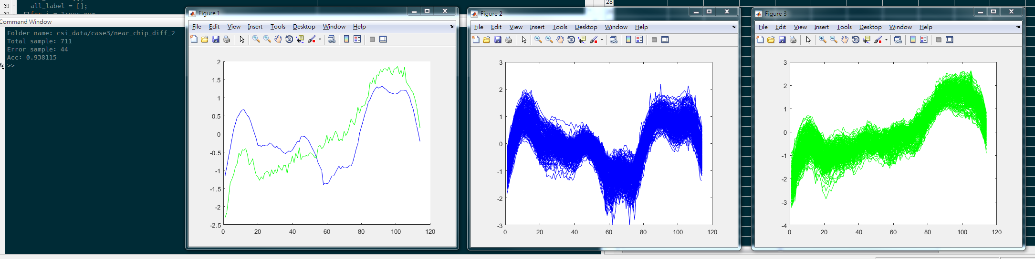
Case 3 – Near case1 DUTB + Near case2 DUTA : Acc:93.81%

