Slide 1
Duxchange
A Hackathon Project by Weizhi Du

Slide 2
Introducing Duxchange!
Features:
Fetches historical stock data using Yahoo Finance API.
Preprocesses data for training.
Trains an LSTM model for prediction.
Visualizes actual vs. predicted stock prices.

Slide 3

An exciting interdisciplinary project!
How do you predict the stock market?
Computer Science
+
Finance / Business
+
Statistics and Data Science
+
Education

Slide 4

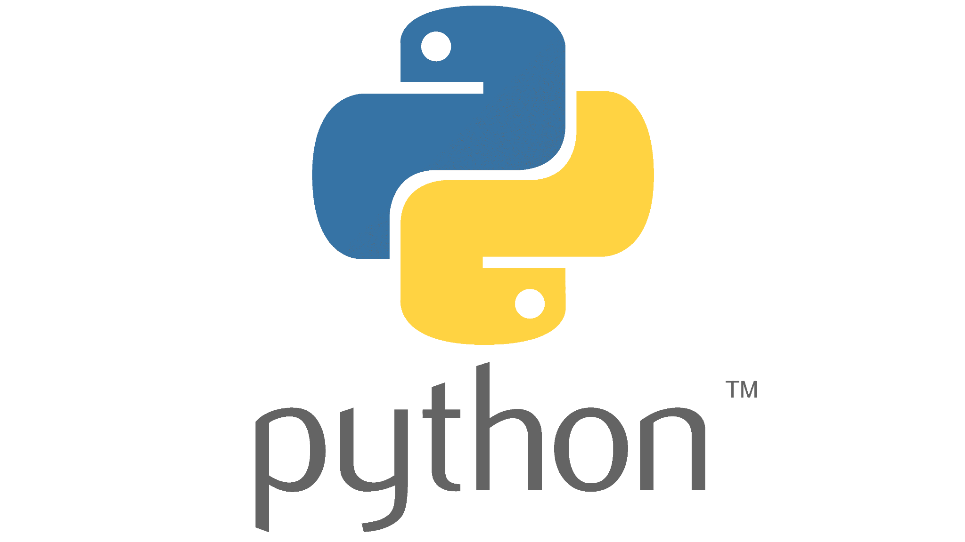







Technical

Slide 5
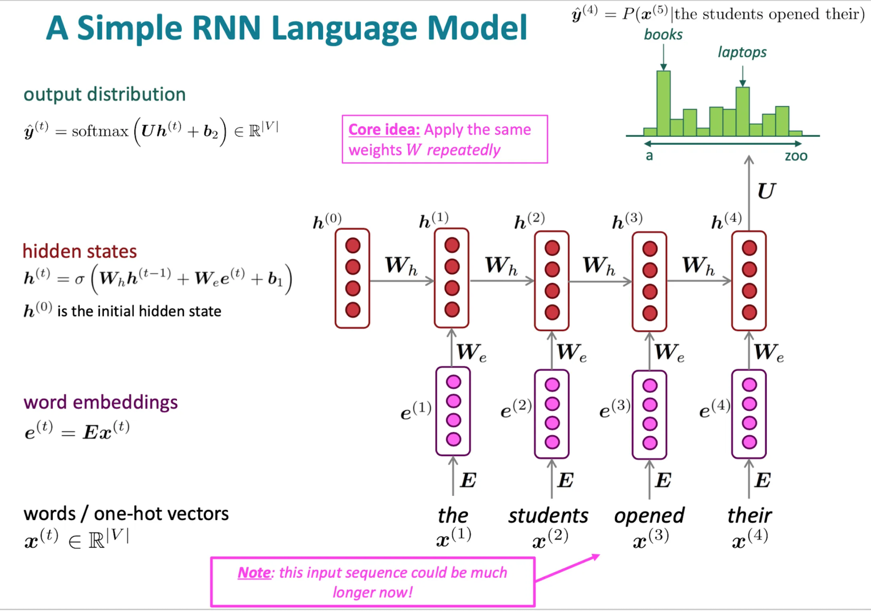
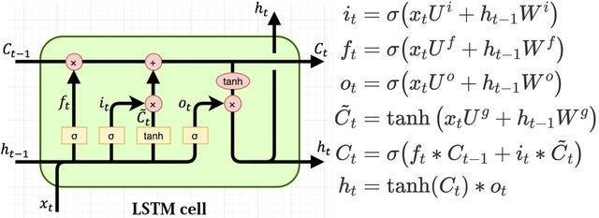
RNN and LSTM Neural Networks Models
LSTM illustration
Source: colah.github.io
RNN illustration
Source: aiml.com

Slide 6


Slide 7
Business Needs!
Market Need: harness deep learning for stock prediction
Doability and Potential: entirely feasible, potential to be expanded
Target Users: Individual investors, financial analysts, educators, students
Business Model: open-source; built-in commercial applications

Slide 8
Thank you!
Duxchange by Weizhi
https://github.com/Weizhi-Du/duxchange

