Slide 1


Home
Service
About Us
Contact
Project NLP
Business Case: Automated Customer Reviews
By : Wejdan Majid

Slide 2

Home
Service
About Us
Contact
This is me :
WEJDAN MAJID

Slide 3

Home
Service
About Us
Contact
Project overview
Developed a product review analysis system using NLP models.
Key tasks:
Classify customer reviews (positive/negative/neutral).
Cluster products by category.
Use generative AI to create short recommendation articles from reviews.
Problem Statement:
Manually analyzing thousands of product reviews is time-consuming and inefficient.
The project automates insight extraction and generates useful recommendations for users.

Slide 4

Home
Service
About Us
Contact
About THe dataset
Used the Consumer Reviews of Amazon Products dataset available on Kaggle.
The dataset included three CSV files.
Merged two files:
Datafiniti_Amazon_Consumer_Reviews_of_Amazon_Products.csv
Datafiniti_Amazon_Consumer_Reviews_of_Amazon_Products_May19.csv
After merging, the resulting dataset contained:
24 columns
33,333 rows

Slide 5
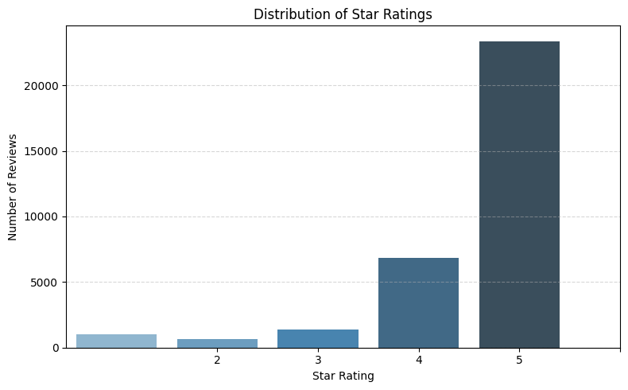
Home
Service
About Us
Contact
Exploratory Data Analysis
The dataset was grouped based on the reviews.rating column:
Rating 1: 1,028 reviews
Rating 2: 670 reviews
Rating 3: 1,403 reviews
Rating 4: 6,856 reviews
Rating 5: 23,375 reviews
The data is highly imbalanced, with the majority of reviews having a rating of 5.

Slide 6

Home
Service
About Us
Contact
Data preprocessing
Clean The Dataset
01
Drop columns that are not needed or contain too many missing values.
Handle missing values in 'reviews.username' and 'reviews.title' by replacing with 'Unknown'
Added a new column called "Sentiment Class"
02
by mapping star ratings to sentiment labels:
ratings 1–2 as Negative,
3 as Neutral,
and 4–5 as Positive.
Add label column
03
A function named label_mapping was defined to convert sentiment classes into numeric labels:
'Positive' → 2
'Neutral' → 1
'Negative' → 0

Slide 7

Home
Service
About Us
Contact
Task 1. Classification with pre-trained models.
Select the Model:
01
Chose DistilBERT (distilbert-base-uncased) for sequence classification with 3 output labels.
Finetune it:
02
Used GPU for faster training, applied AdamW optimizer and CrossEntropyLoss with class weights.
Class weights were computed using compute_class_weight to address class imbalance (higher weight for underrepresented classes).
Trained for 3 epochs to adjust the model's weights.
Evaluate:
03
Monitored average loss and training time per epoch.
Class weights helped focus on minority classes, improving training performance.

Slide 8
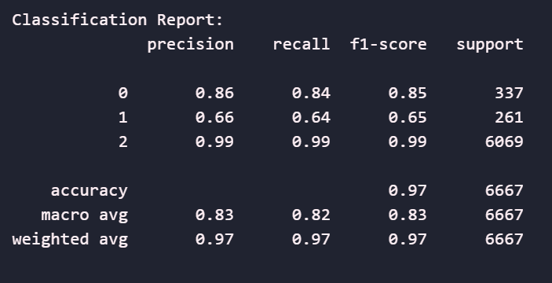
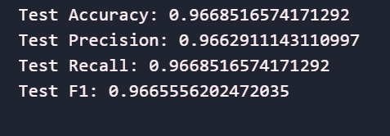
Home
Service
About Us
Contact
model evaluation
The model achieved a Test Accuracy of 96.69%, indicating overall strong performance across all classes.
In the classification report, the model performs best on class 2 (F1: 0.99), with lower performance on class 1 (F1: 0.65) and class 0 (F1: 0.85).

Slide 9
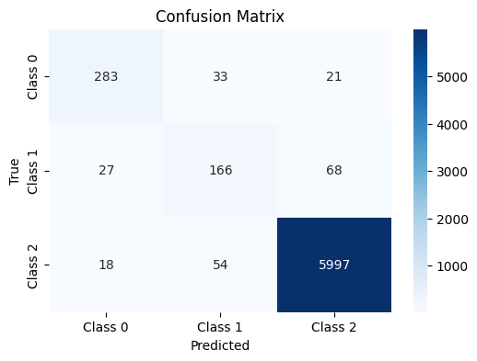
Home
Service
About Us
Contact
model evaluation

Slide 10

Home
Service
About Us
Contact
Task 2. Product Category Clustering
Used the name column to extract product category text.
Generated embeddings using the all-MiniLM-L6-v2 model from SentenceTransformers.
Applied KMeans clustering with k=5 to group similar categories.
Assigned cluster labels to a new column called cluster.
Analyzed each cluster to identify meta-categories such as:
Batteries & Accessories
Tablets & E-readers
Fire Devices
Kids' Tablets
Smart Devices & Alexa

Slide 11
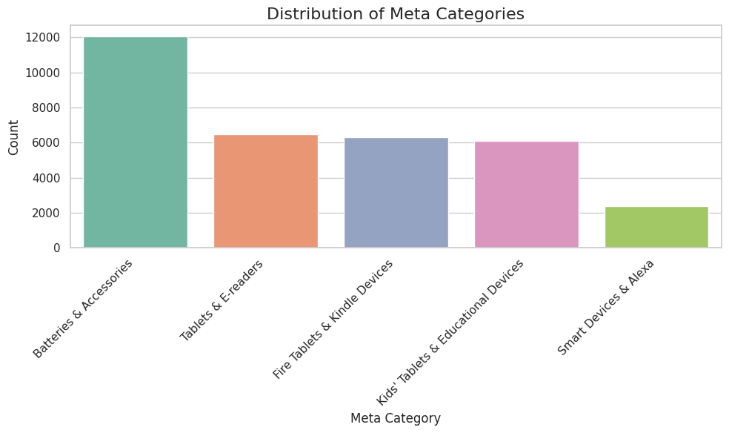
Home
Service
About Us
Contact
Clustring

Slide 12

Home
Service
About Us
Contact
Task 3. Summarize reviews using generative AI
Load Pre-trained Models
01
Used Hugging Face pipelines with the following models:
facebook/bart-large-cnn for summarization
facebook/bart-large-mnli for zero-shot classification
Summarize Complaints
02
Created the summarize_reviews function to summarize the top negative reviews for each product using the summarization model.
Extract Key Features
03
Built the extract_features function to identify main complaint themes using zero-shot classification with a predefined list of labels (e.g., battery, performance, durability, price, etc.).

Slide 13
Home
Service
About Us
Contact
Task 3. Summarize reviews using generative AI
Identify Top & Worst Products
04
Selected the top 3 products based on the number of positive reviews.
Identified the worst product based on the number of negative reviews.
Generate Articles per Category
05
For each meta-category:
Highlighted top products, their features, and key complaints.
Concluded with the worst-rated product and a summary of why it should be avoided.
Output
06
Printed a short article per category recommending the best products, showing key differences, and advising against the lowest-rated product.

Slide 14

Ingoude Company
Home
Service
About Us
Contact
Among the top-rated, the Amazon Echo Show Alexa-enabled Bluetooth Speaker with 7" Screen stands out for its voice recognition, response, performance, screen, connectivity, price, and setup. However, users have reported issues such as the plug adapter to turn on and off lights and TV is useful and certainly worth having. YouTube was one of the main features that I used. Without YouTube, you'll be better off buying the $40 Echo Dot instead.
The Amazon - Echo Plus w/ Built-In Hub - Silver stands out for its voice recognition, response, performance, connectivity, and quality. However, users have reported issues such as this does not give great answers and the connection is not that great. Waste of money, ask Alexa a question and you are lucky if you get an answer instead of "I'm not sure."
Another well-reviewed device, the Amazon Tap Smart Assistant Alexa-enabled (black) Brand New stands out for its voice recognition, price, response, performance, connectivity, screen, setup, and quality. However, users have reported issues such as this is fun but would not buy again. My first problem: it didn’t pair. Since I purchased it, returned a couple of times, and now it is dead — I have to return it again.
Overall, consumers are advised to avoid the Amazon Tap Smart Assistant Alexa-enabled (black) Brand New, which has been frequently flagged for problems such as this is fun but would not buy again. My first problem: it didn’t pair. Since I purchased it, returned a couple of times, and now it is dead — I have to return it again.
1 Article Example
-Article for category: Smart Devices & Alexa-

Slide 15

Home
Service
About Us
Contact
Task 4 : Deployment Locally on Gardio

Slide 16
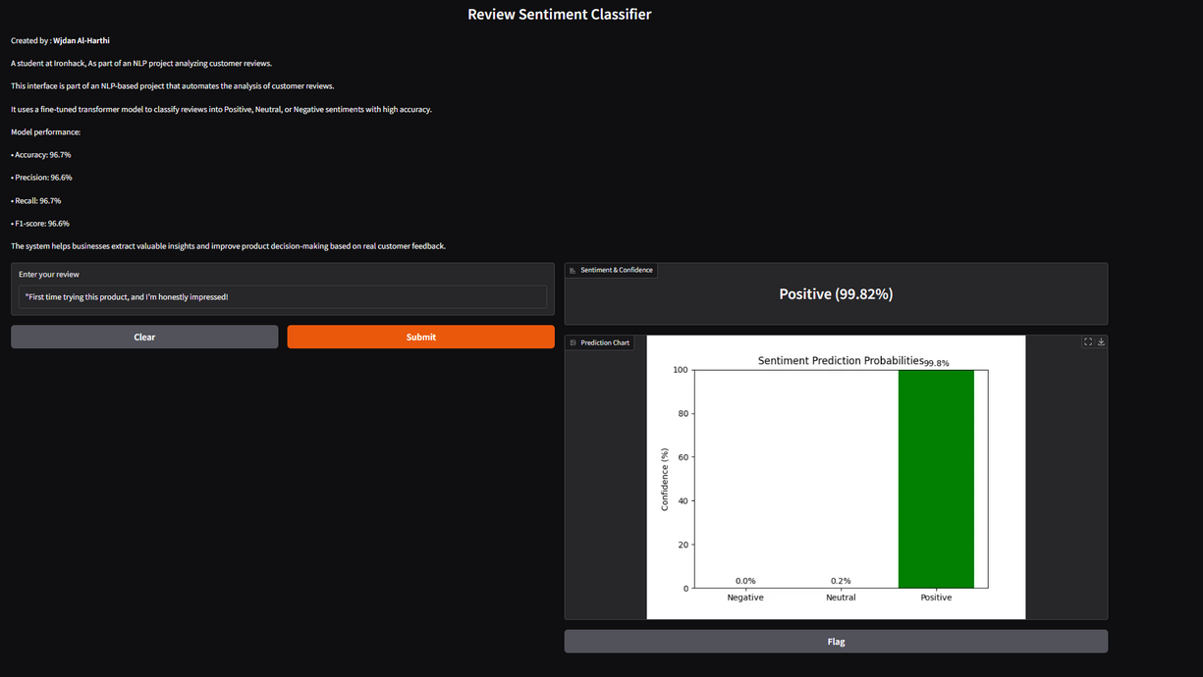
Home
Service
About Us
Contact
Task 4 : Deployment Locally on Gardio

Slide 17
Home
Service
About Us
Contact
Thank You

