Slide 1

PROBLEM
One missed deal-breaker kills the bid.
A tender is the buyer's instruction pack. Miss one mandatory pass/fail clause and the bid can be rejected before the good parts are read.
Oxblood = disqualification risk
Bidframe 01
Notes:
Speaker: Jawad.
Open by defining tender in plain English: the buyer's instruction pack for a public contract.
Say that suppliers respond with a bid, and a single missed mandatory gate can remove them before their strengths are read.
Keep this to around 20 seconds.

Slide 2
USE CASE
The bid manager's first read.
GBP 300bn+
Before a supplier can bid, someone has to turn a dense PDF into a checklist the team can trust.
UK public procurement is a massive document-heavy workflow.
Tender
Buyer's instruction pack
Read rules
Find requirements
Matrix
Build the checklist
Deal-breakers
Check pass/fail gates
Submit
Bid goes in
Bidframe 02
Notes:
Speaker: Bobby.
Walk the room through the buyer-to-bidder workflow.
Define compliance matrix as the bidder's checklist, and deal-breaker as a pass/fail rule.
Do not dwell on the market number; it is just there to prove this is not tiny admin.

Slide 3
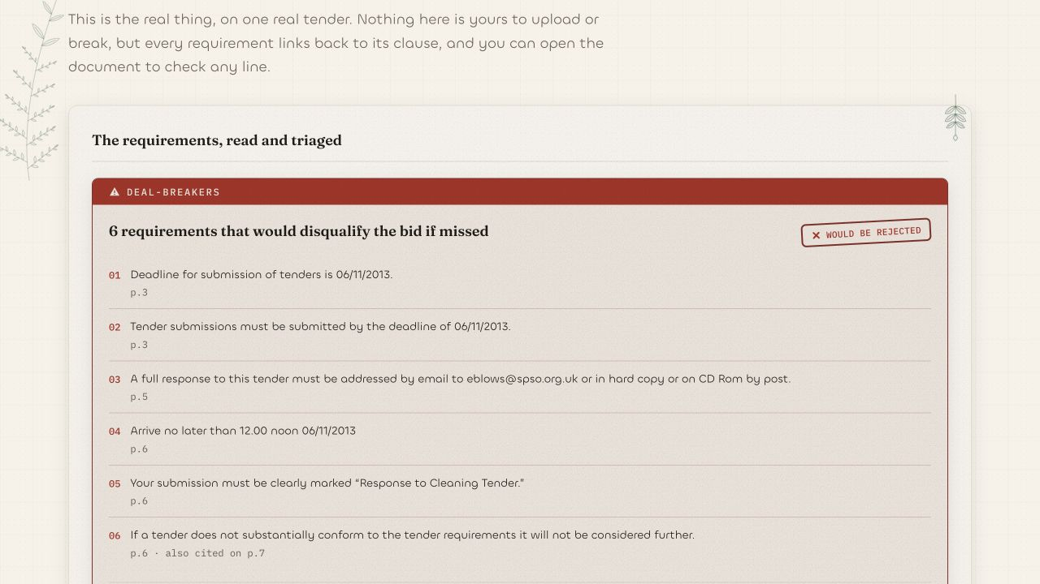
SOLUTION
A marked trail through the tender.
Deal-breaker first
Bidframe turns the first read into a verified worklist: every requirement, source, confidence signal, and status.
Deal-breakers rise to the top
Uncertain items stay visible
Humans approve, edit, or flag
Bidframe 03
Notes:
Speaker: Pranav.
Say that Bidframe is not trying to replace the bid manager.
It does the first read and creates the structured worklist they need.
Point to the deal-breaker in the screenshot and say it is not buried in row 84.

Slide 4
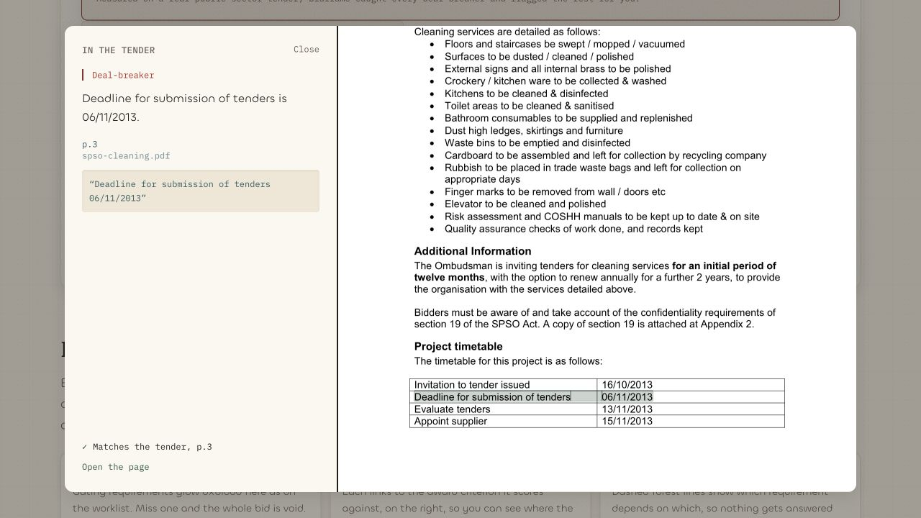
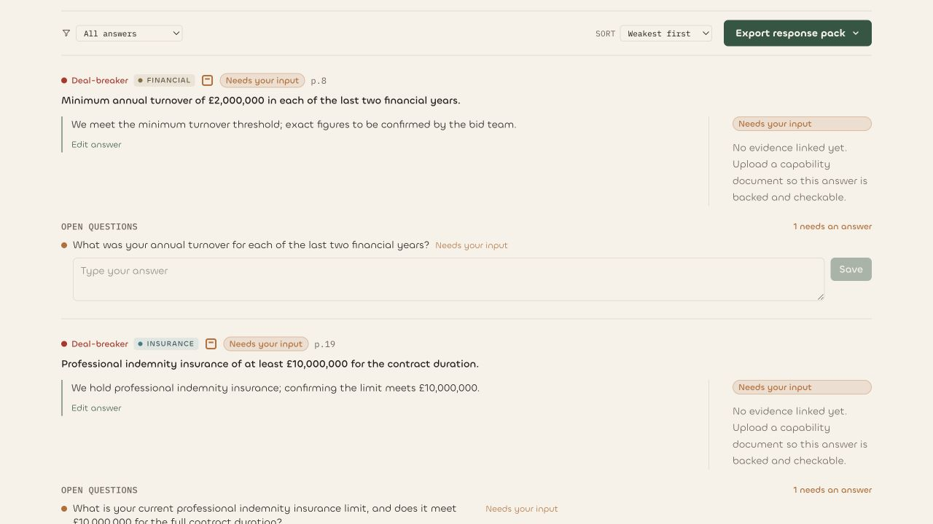
PRODUCT
Deal-breakers first. Every line checkable.
Deal-breaker detection is the hero.
Source page, clause, and excerpt stay attached.
Evidence-backed drafts ask instead of guessing.
The bid manager approves every step.
Proof, scoped to the worked example
Every disqualifying gate surfaced | 0 dangerous misses on the hero tender | 0 invented answers in groundedness checks
Bidframe 04
Notes:
Speaker: Joel.
The product point is confidence through evidence, not confidence theatre.
Keep the claims scoped: worked example, hero tender, groundedness checks.
Say the bid manager can check the source line before trusting the output.

Slide 5
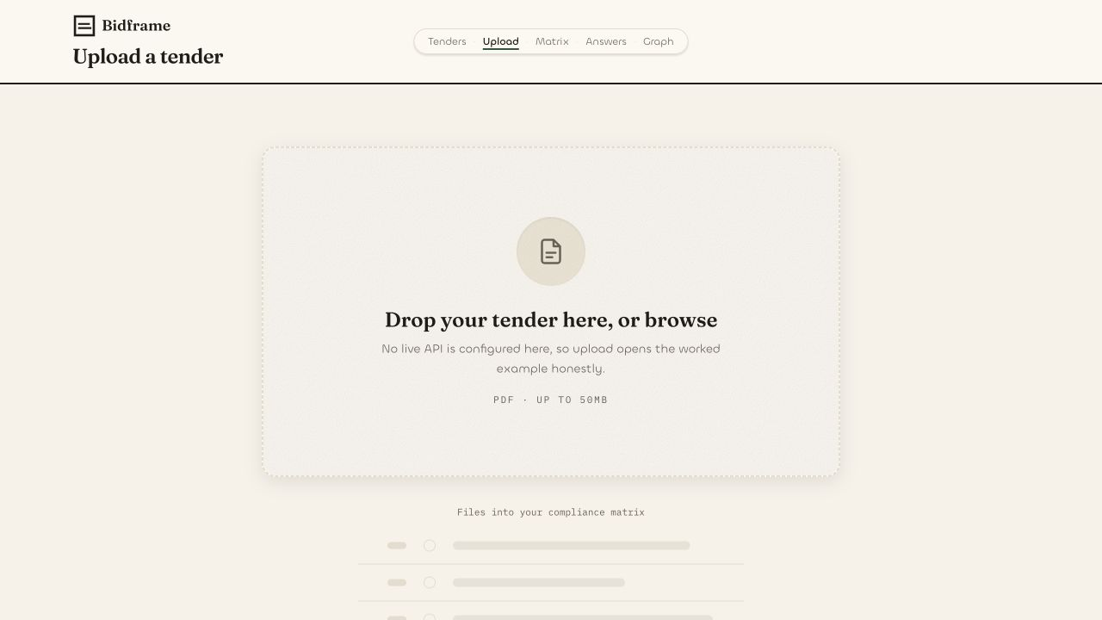
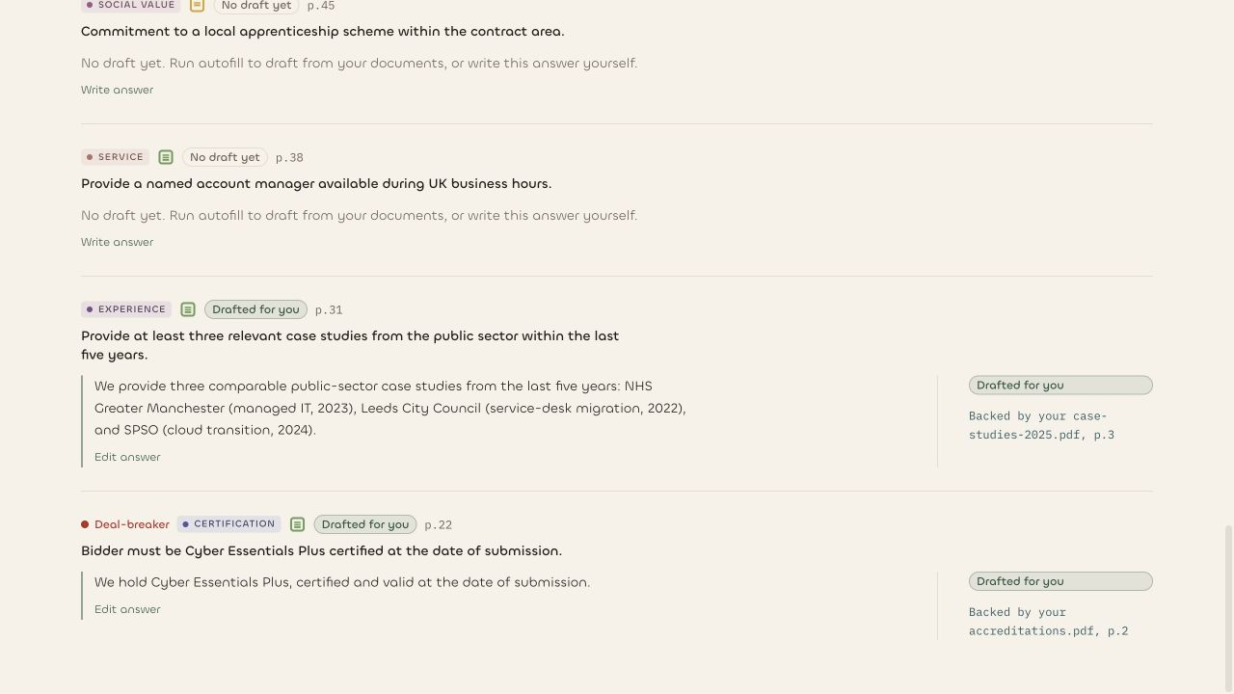
DEMO FLOW
PDF to matrix to proof to answer.
1
Upload
2
Matrix
3
Proof
4
Answer
Tender PDF
Deal-breakers first
Exact page and clause
Receipts or questions
Live route: bidframe.org/demo
For stage reliability, this is a cached output from the real backend pipeline.
Bidframe 05
Notes:
Speaker: Joel leads, Bobby supports.
Open bidframe.org/demo, point to the deal-breaker, open the source proof, then show answer receipts.
Use the exact wording: cached output from our real backend pipeline for stage reliability.
End by saying the bid manager approves every step.

Slide 6

TECH
A trust layer, not a PDF chatbot.
PDF ingest
Extract
Reconcile
Classify gates
Source matrix
Answer receipts
Eval harness
FastAPI backend for ingest and API
Python engine for dedupe, confidence routing, and evals
Next.js surface for matrix, source proof, graph, and answers
Eval focuses on dangerous misses, especially deal-breakers
Bidframe 06
Notes:
Speaker: Pranav.
Make the engineering credible without turning it into a deep architecture walkthrough.
Say the bet is structured extraction plus auditability.
The eval is there because plausible prose is not enough; dangerous misses matter more.

Slide 7

ASK
Help us scale the first-read layer.
Talk to us if you would like to help Bidframe scale the first-read layer for public-sector bids.
bidframe.org
Demo: bidframe.org/demo
Bidframe 07
Notes:
Speaker: Jawad.
Bring the pitch back to the original problem: first-read risk in public-sector bids.
Use the final CTA exactly as written on the slide.
Invite investors, operators, and procurement experts to talk after the pitch.

Slide 8
APPENDIX
The team.
Jawad Jalal
Bobby Choi
Pranav Bonagiri
Joel Jeon
frontend
generalist
backend
GTM, outreach, planning
Names and roles only. Everyone crossed roles to ship the demo.
Bidframe 08
Notes:
Appendix slide for Q&A. Use if judges ask who built it.

Slide 9
APPENDIX
What we can claim today.
Every deal-breaker
0 dangerous misses
surfaced on the worked example
on the hero tender's disqualifying gates
0 invented answers
18 / 19 requirements
in grounded answer checks
found on the first measured tender, with the uncertain item surfaced
Do not say guaranteed or universal accuracy. Say worked example, hero tender, measured set.
Bidframe 09
Notes:
Appendix proof ledger. Keep all product claims scoped.

Slide 10
APPENDIX
Why this workflow matters.
GBP 341bn
UK public procurement from the private sector in 2023-24
32%
Share of UK public spending represented by that procurement figure
24 Feb 2025
New UK procurement regime went live, raising the need for clear compliance
Sources to cite in final export notes: House of Commons Library procurement statistics; Cabinet Office / Government Commercial Function Procurement Act go-live materials.
Bidframe 10
Notes:
Appendix market sources. Prefer primary links in spoken Q&A if asked.

Slide 11
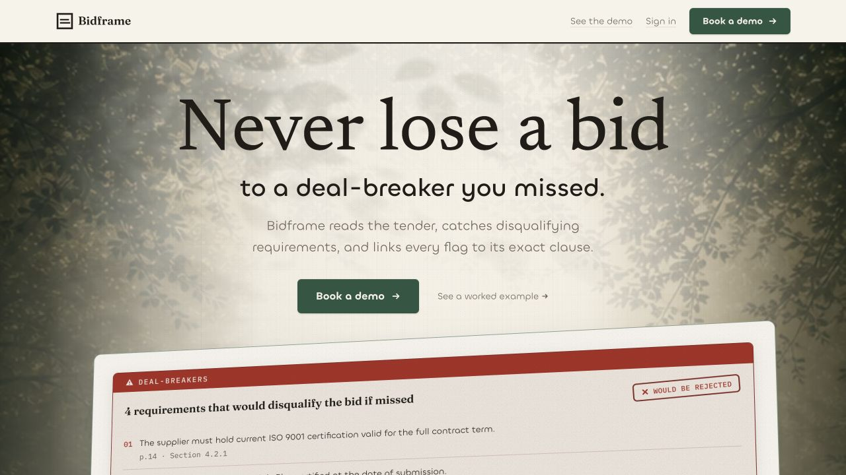
APPENDIX
Stage-safe demo route.
Primary CTA: bidframe.org
Secondary CTA: bidframe.org/demo
Demo is a cached real pipeline output for reliability
Use screenshots if venue wifi or live auth fails
Live route QA passed: homepage, /demo, and /answers load.
Bidframe 11
Notes:
Appendix demo reliability. Mention the cached real pipeline output if asked why it is not running live on stage.

Slide 12
APPENDIX
Before bid writing: the first-read layer.
Typical AI bid tools
Generate prose after the team already knows what to answer.
Bidframe
Find the deal-breakers, build the matrix, prove the source, then draft from evidence.
compliance first
The wedge is earlier than writing: the auditable first read.
Bidframe 12
Notes:
Appendix competitive wedge. Do not overclaim against named competitors; keep it to workflow position.

