Slide 1
A Comparative Simulation Study on Estimation of Density Distributions for Finite Mixtures and Data Clustering using Nonparametric Kernel Smoothing with EM Algorithm
M.K. Abeyratne W. J. Jannidi Department of Mathematics Faculty of Science, University of Ruhuna Matara, Sri Lanka

Slide 2
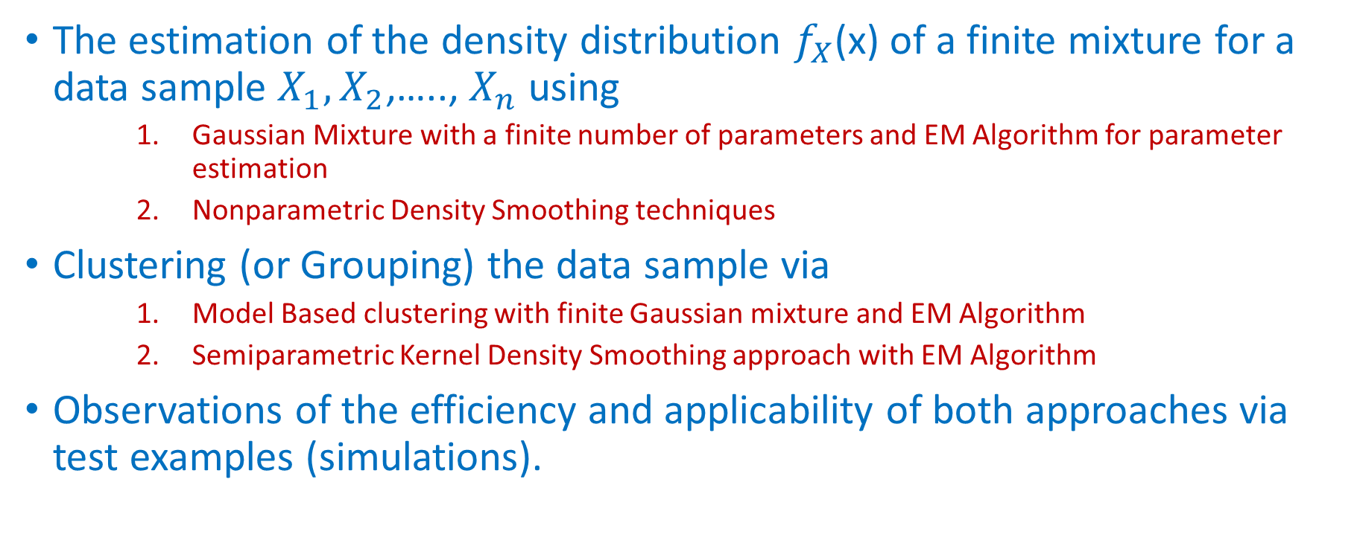
In this comparative simulation study we focus on …….
The estimation of the density distribution $f_{X}$(x) of a finite mixture for a data sample $X_{1},X_{2}$,…..,$X_{n}$ using
Gaussian Mixture with a finite number of parameters and EM Algorithm for parameter estimation
Nonparametric Density Smoothing techniques
Clustering (or Grouping) the data sample via
Model Based clustering with finite Gaussian mixture and EM Algorithm
Semiparametric Kernel Density Smoothing approach with EM Algorithm
Observations of the efficiency and applicability of both approaches via test examples (simulations).

Slide 3
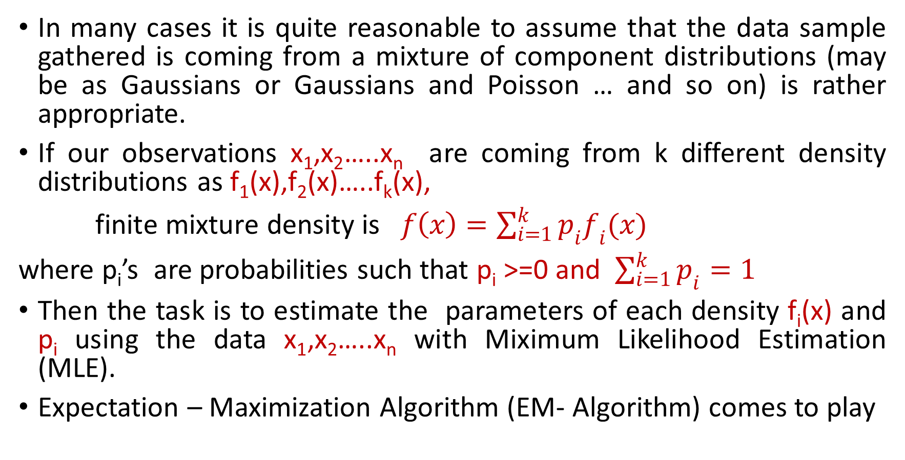
Density Estimation of a mixture (parametrically)
In many cases it is quite reasonable to assume that the data sample gathered is coming from a mixture of component distributions (may be as Gaussians or Gaussians and Poisson … and so on) is rather appropriate.
If our observations x₁,x₂…..x_{n}are coming from k different density distributions as f₁(x),f₂(x)…..f_{k}(x),
f$\text{inite} \text{mixture} \text{density} \text{is} f\left(x\right)=\sum_{i=1}^{k}{p_{i}f_{i}(x)}$
where p_{i}’s are probabilities such that p_{i}>=0 and $\sum_{i=1}^{k}{p_{i}=1}$
Then the task is to estimate the parameters of each density f_{i}(x)and p_{i}using the data x₁,x₂…..x_{n} with Miximum Likelihood Estimation (MLE).
Expectation – Maximization Algorithm (EM- Algorithm) comes to play

Slide 4
A parametric approach for estimating mixture distribution functions

Slide 5
Method of estimating parameters: EM Algorithm

Slide 7
EM Algorithm for the Mixture of Gaussians
1: Initialize parameters
2: E step : compute Q function
3: M step:Choose parameters which maximize Q
4: Repeat step 2 and 3 until converge

Slide 8
Nonparametric Kernel Density Estimation
Kernel Density Estimation (KDE) is a non-parametric technique for density estimation in which a known kernel function is averaged across the observed data points to create a smooth approximation.
Let be a random sample taken from a continuous, univariate density f. The kernel density estimator is given by,
The Kernel K is a positive continuous function satisfying
h is a called the bandwidth .
$$\int{f\left(u\right)du=1, \int{uf\left(u\right)du=0 and \int{u^{2}f\left(u\right)du< ∞} }}$$

Slide 9
How we use the mixture model for data clustering (i.e. model based clustering)

Slide 10
Data clustering via nonparametric approach
Idea : We use semiparametric approach (Shifted Mixture Model) using a modified EM Algorithm introduced by Laurent Bordes (2007)
Kernel Smoothing Approach is included
Model where fi(x)s are unknown (no any functional form)
EM Algorithm
E Step
Maximization Step
Nonparametric Step
We can use
Different bandwidth h
Different kernels
Epanechikov
Gauss Kernel
Triweight
Triangular …. And so on.

Slide 11
Algorithm

Slide 12
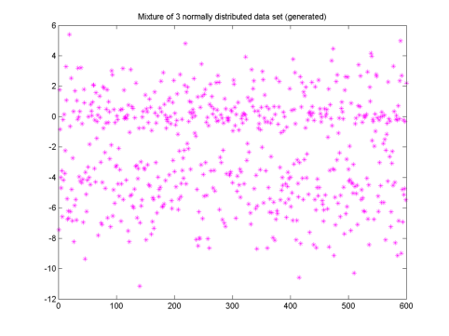
Example: Simulation study for density function of three mixture distribution (Numerical test)
Let us assume that the data sample is coming from known 3 Gaussian mixture distributions whose density function is of the form
By the EM algorithm
Calculate p(i,k)s are probabilities that observation i is coming from the component k
Compute the parameter values means and variance
Cluster the data based on max(p_{ik}) and corresponding z_{ik}

Slide 13
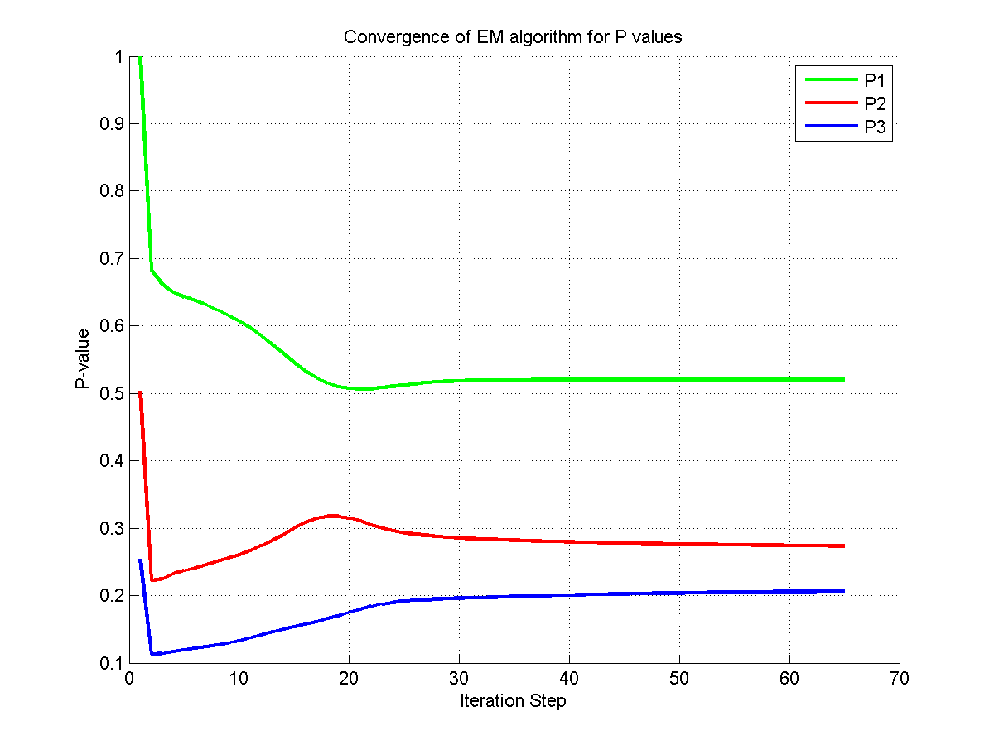
Convergent probability values from EM-algorithm
P1 =0.5199
P2=0.2736
P3=0.2066

Slide 14
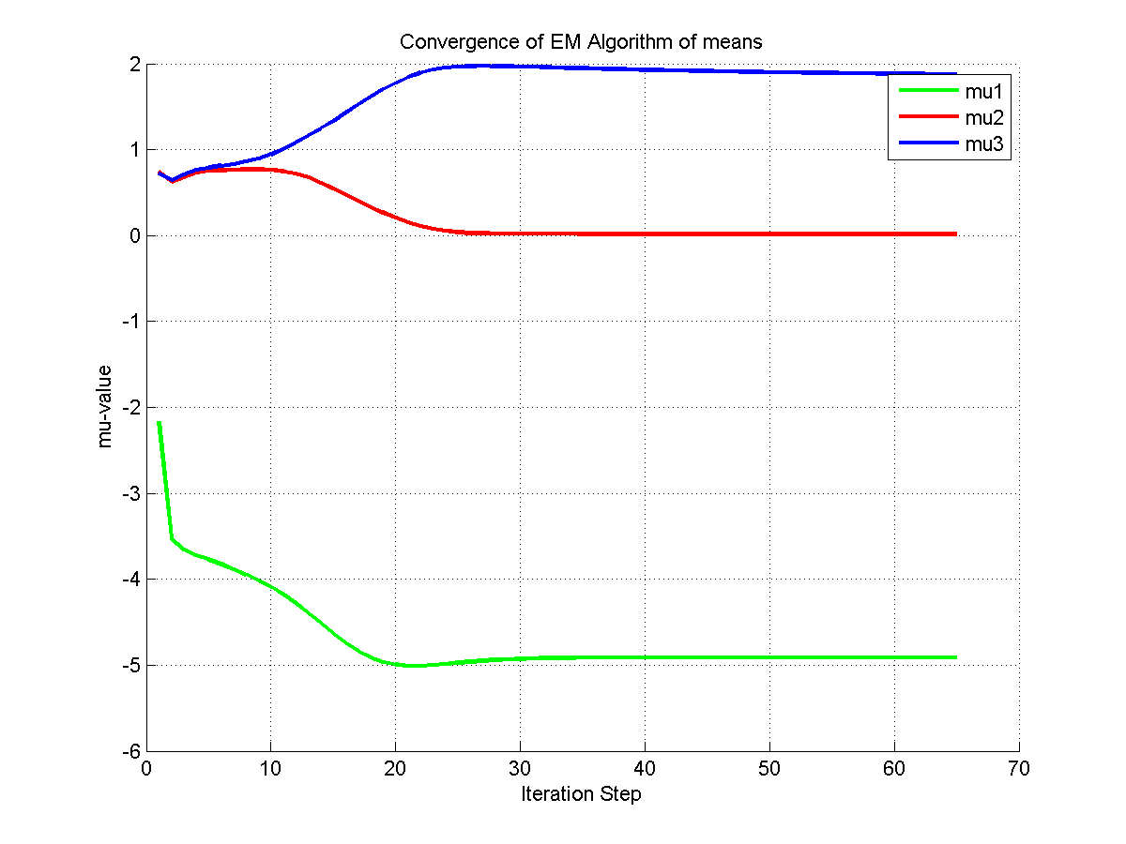
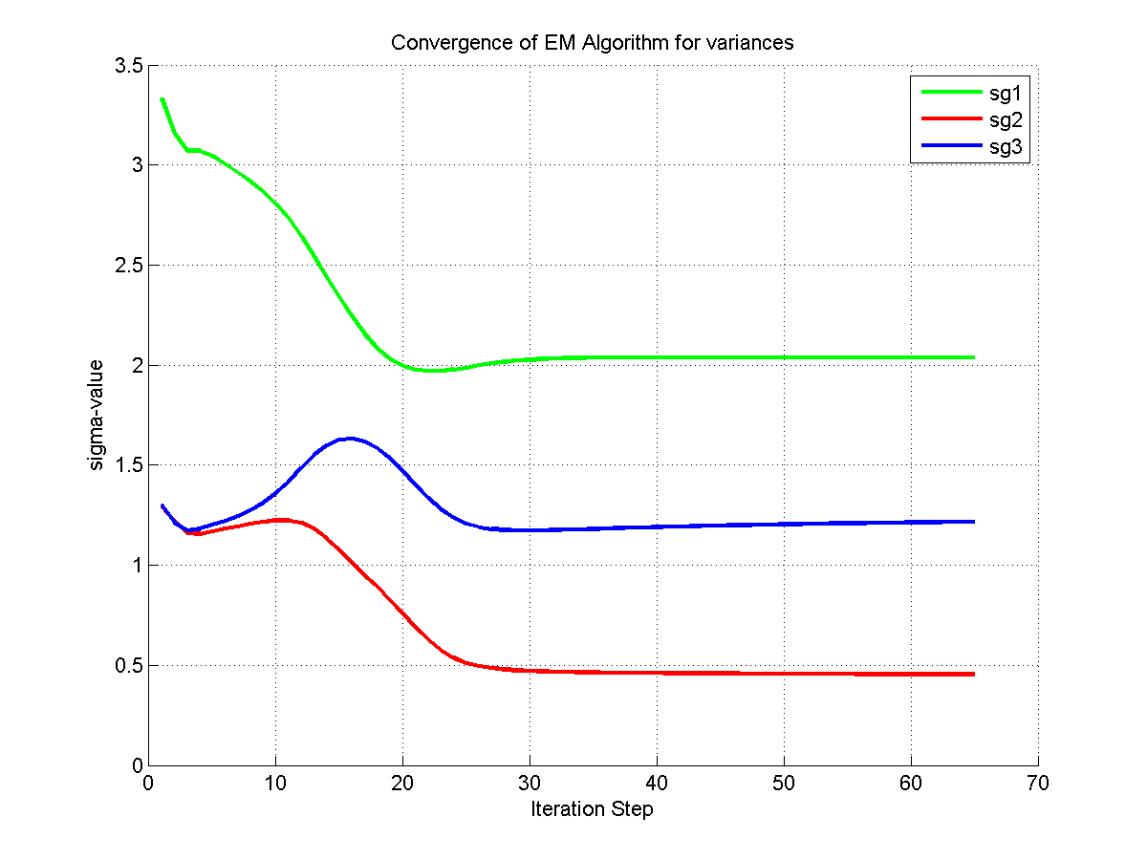
EM-algorithm for means and variances
µ1= -4.9473
µ2= 0.0089
µ3= 2.1571

Slide 15
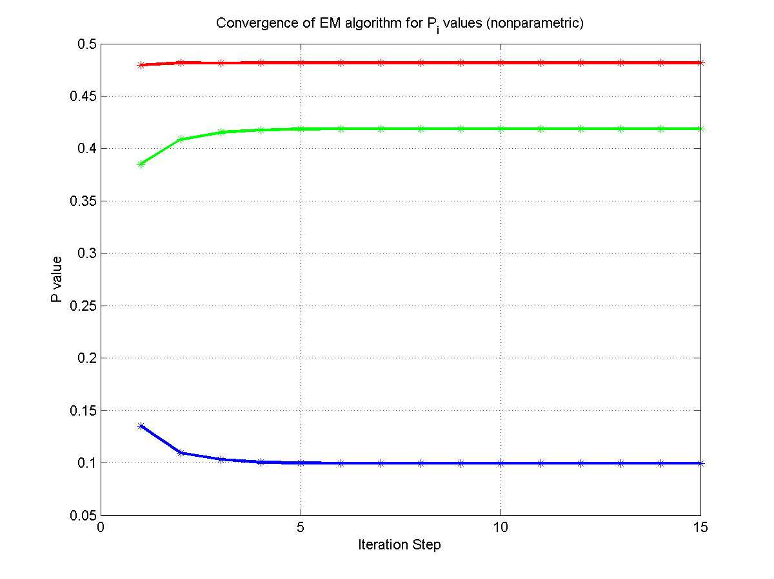
P-values in nonparametric approach

Slide 16
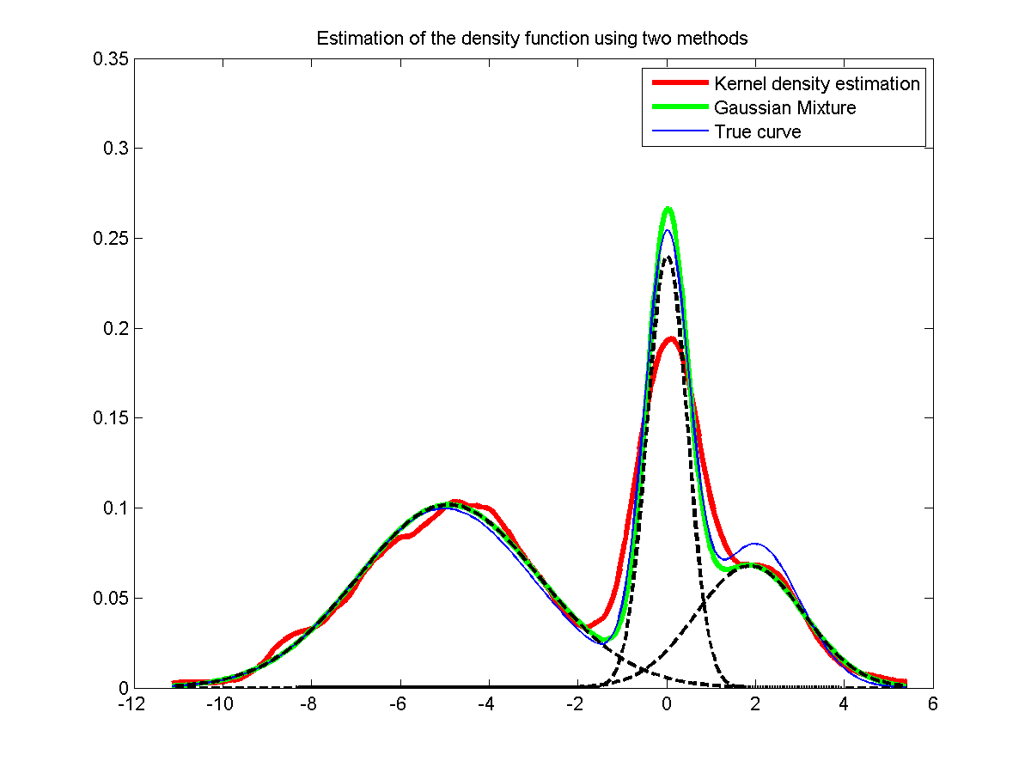
Density Estimation

Slide 17
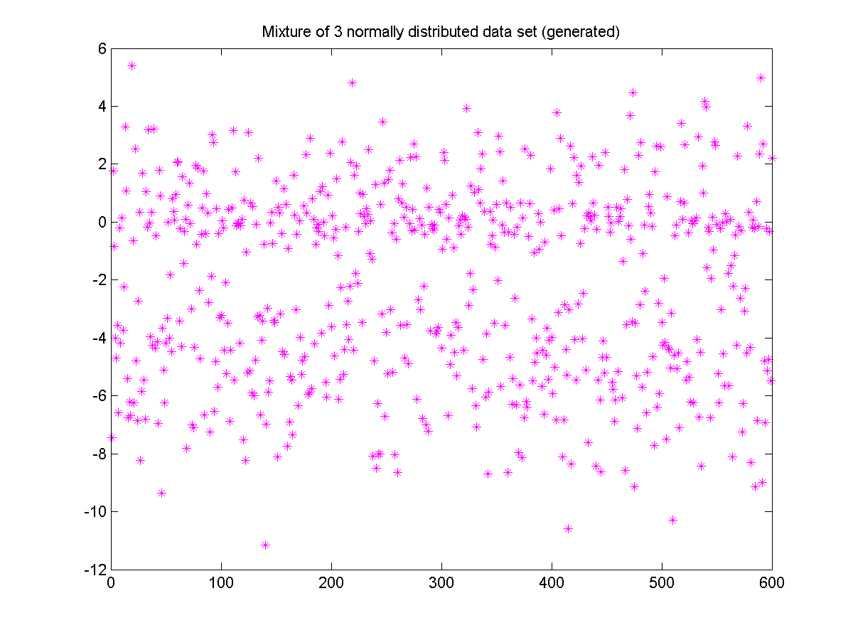
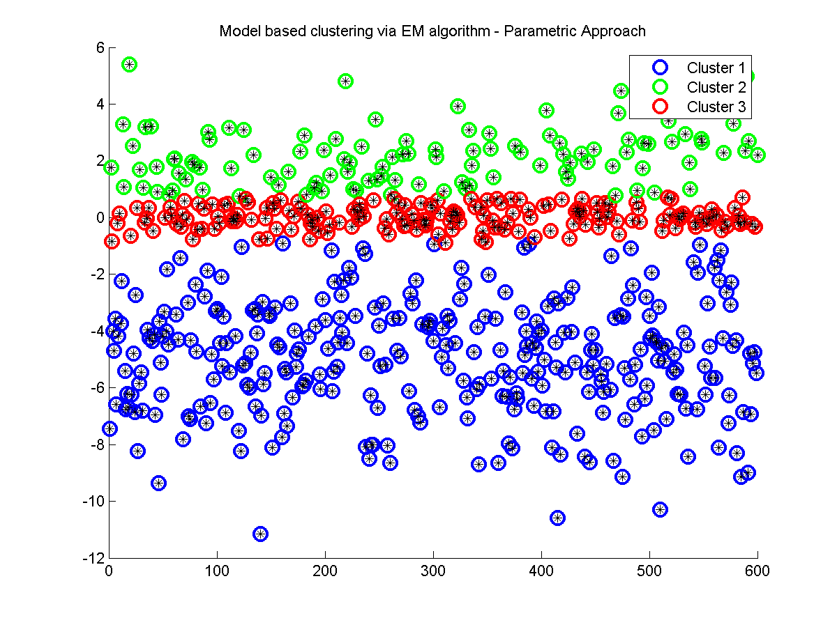
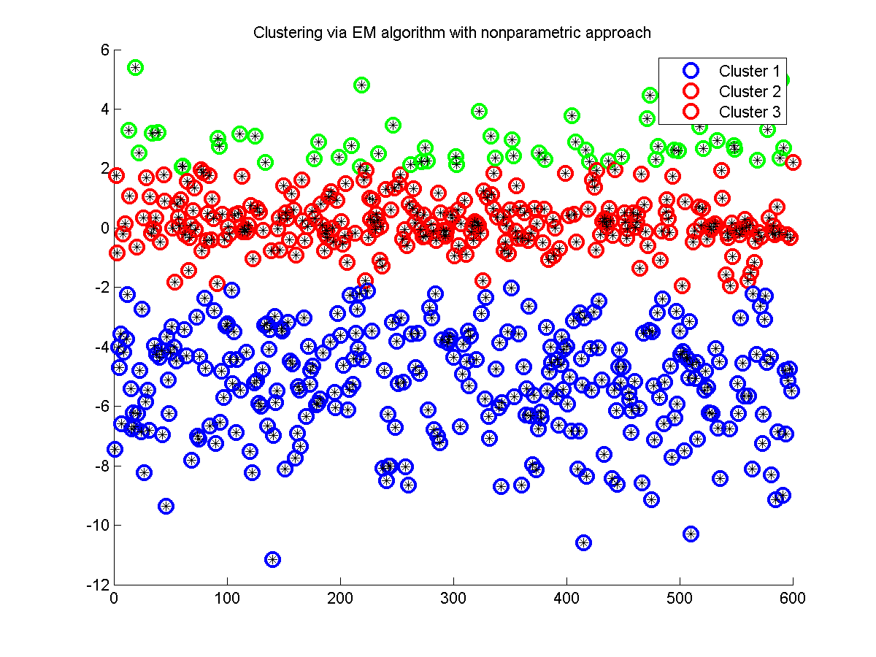
Data Clustering
Generated data set
Nonparametric approach
Parametric approach

Slide 18
Observations from both methods
Actual values Used for three Gaussian mixture (Parameters and sample sizes) |  |  | Parametric Approach with EM | Nonparametric Approach with Kernel Smoothing and EM Algorithm (With Different Kernel functions
 |  |  | Gaussian Mix. Model | Epanechikov Kernel | Gaussian Kernel | Uniform Kernel | Triweght Kernel
P-values | P1 | 0.5 | 0.5199
 | P2 | 0.3 | 0.2736
 | P3 | 0.2 | 0.2066
Means | Mean 1 | -5.0 | -4.9473 | -5.2188 | -5.2188 | -5.2188 | -5.2188
 | Mean 2 | 0.0 | 0.0089 | 0.1781 | 0.1781 | 0.1701 | 0.0313
 | Mean 3 | 2.0 | 2.1571 | 2.9022 | 2.9022 | 2.8901 | 2.6074
Variances | Var 1 | 4.0 | 3.9246 | 3.1685 | 3.1685 | 3.1685 | 3.1685
 | Var 2 | 0.25 | 0.1524 | 0.6864 | 0.6864 | 0.6728 | 0.4847
 | Var 3 | 1.0 | 0.9646 | 0.5806 | 0.5806 | 0.5788 | 0.6670
Sample Sizes | Cluster 1 | 300 | 311 | 289 | 289 | 289 | 289
 | Cluster 2 | 180 | 178 | 254 | 254 | 253 | 233
 | Cluster 3 | 120 | 111 | 57 | 57 | 58 | 78

Slide 19
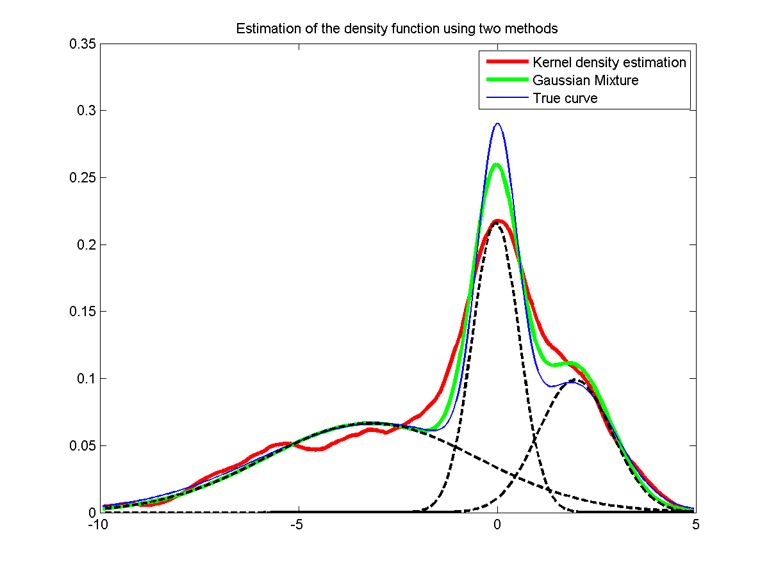
Example 02:
Here we consider the another mixture density of the three Gaussian distributions

Slide 20
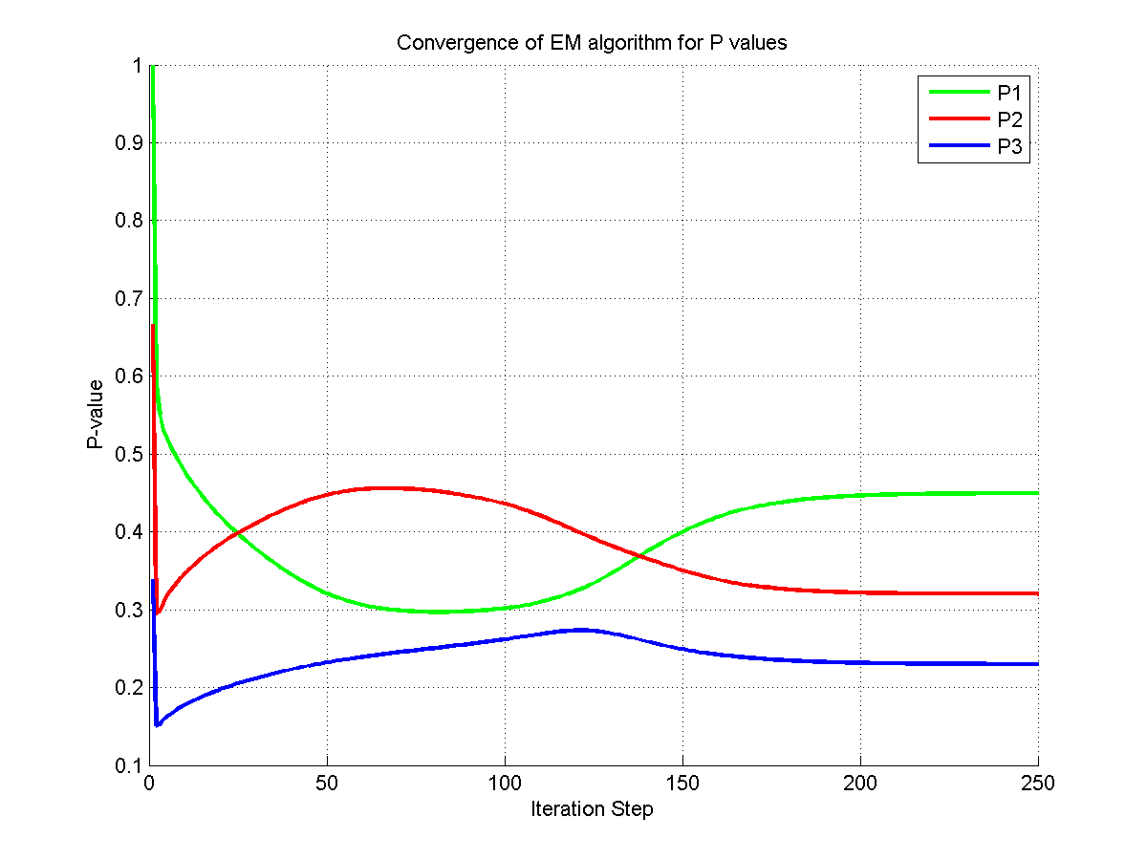
Convergent probability values from EM-algorithm

Slide 21
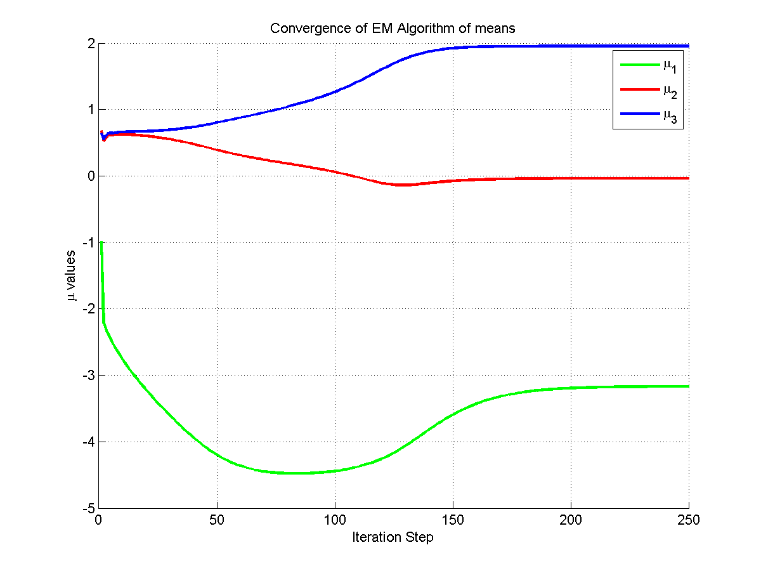
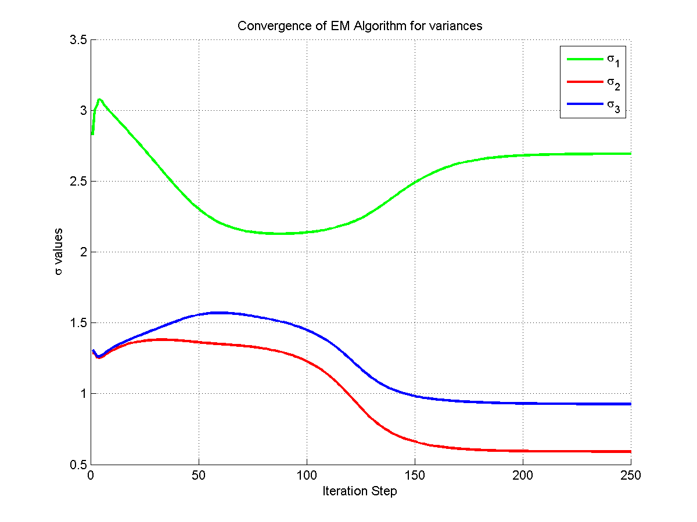
EM-algorithm for means and variances

Slide 22
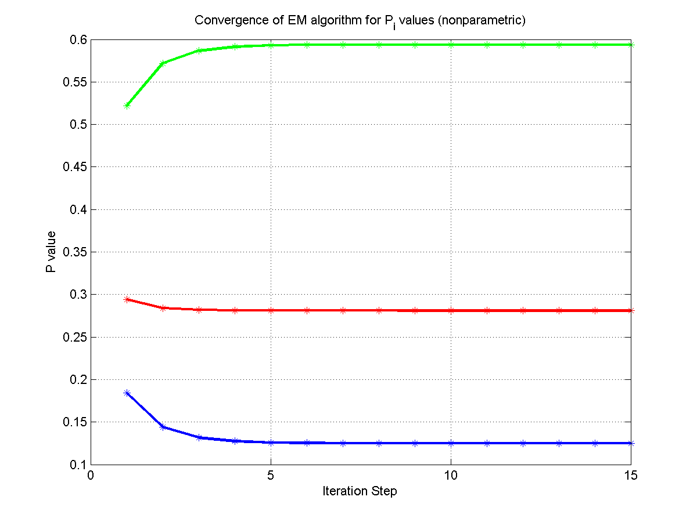
P-values in nonparametric approach

Slide 23
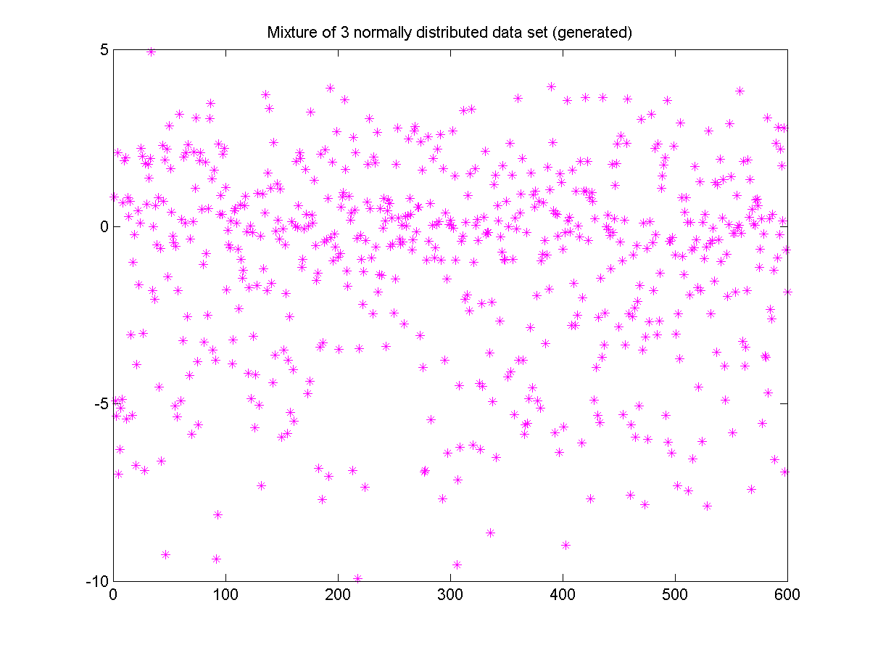
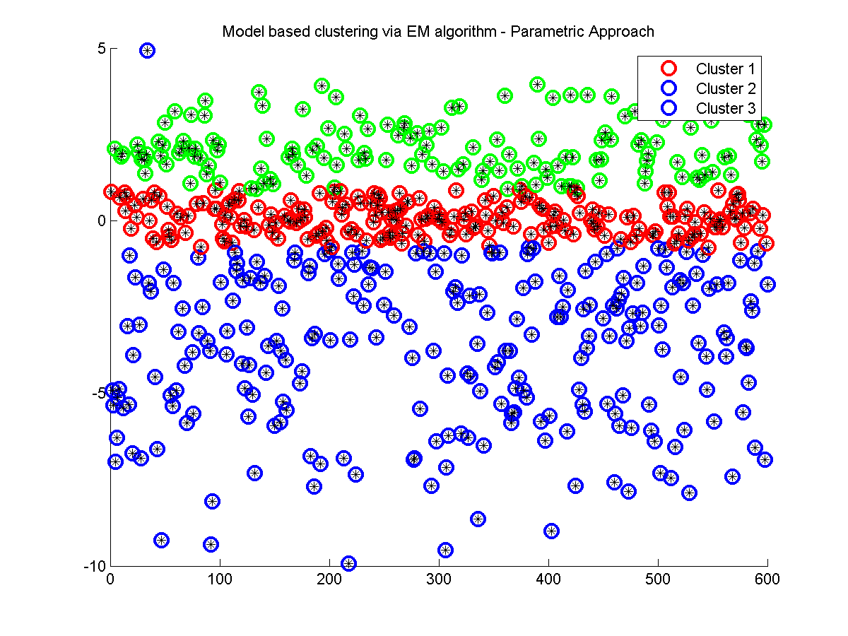
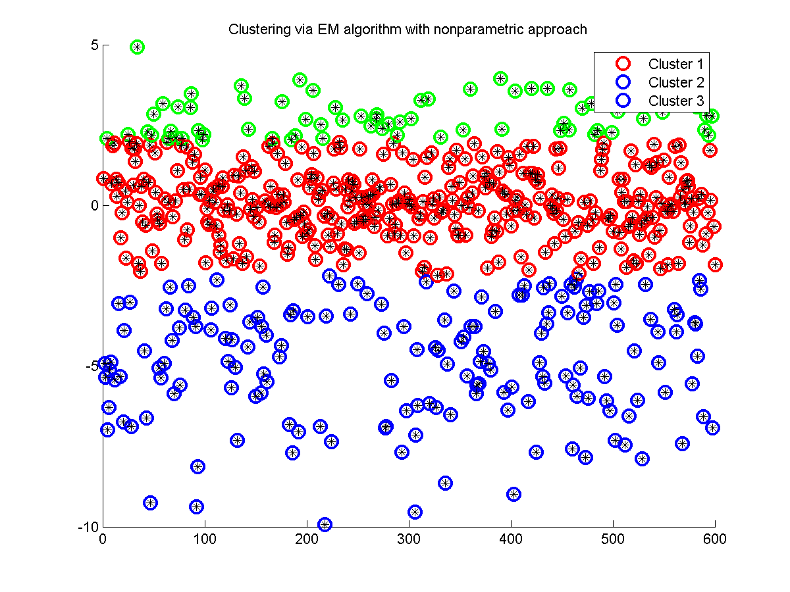
Data Clustering
Generated data set
Parametric approach
Nonparametric approach

Slide 24
Observations from both methods
Actual values Used for three Gaussian mixture (Parameters and sample sizes) |  |  | Parametric Approach with EM | Nonparametric Approach with Kernel Smoothing and EM Algorithm
 |  |  | Gaussian Mix. Model | Gaussian Kernel
P-values | P1 | 0.5 | 0.4496 | 0.2811
 | P2 | 0.3 | 0.3204 | 0.5938
 | P3 | 0.2 | 0.2300 | 0.1251
Means | Mean 1 | -3.0 | -3.7248 | -4.8374
 | Mean 2 | 0.0 | 0.717 | 0.0671
 | Mean 3 | 2.0 | 2.0972 | 2.7794
Variances | Var 1 | 9.0 | 5.0774 | 3.1679
 | Var 2 | 0.25 | 0.1972 | 1.0601
 | Var 3 | 1.0 | 0.5867 | 0.3783
Sample Sizes | Cluster 1 | 300 | 244 | 167
 | Cluster 2 | 180 | 212 | 364
 | Cluster 3 | 120 | 144 | 69

Slide 25
Conclusions:
Non parametric methods is flexible than parametric approach
We can use parametric method as a reference
We can improve non-parametric method
optimal bandwidth
variable bandwidth

Slide 26
References:
Ruzgas T. and Drulyte I. 2013: Kernel Density Estimators for Gaussian Mixture Models.
Vidakovic B. ISyE8843A
Bordes L., Chauveau D. and Vandekerkhove P. 2006: An EM algorithm for a semiparametric mixture model.
Benaglia T.,Chauveau D. and Hunter D.R. 2008: An EM-like algorithm for semi- and non-parametric estimation in multivariate mixtures.
Chakraborty S. and Sinha S. 2010: Implementation of EM-algorithm in Normal Mixture Model.

Slide 27
Thank you!.

