Slide 1
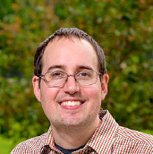

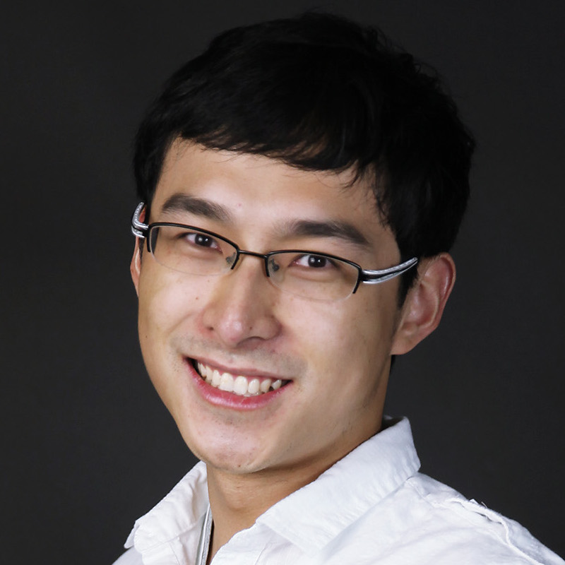
Welcome To Operating Systems
Your Professors
Michael Hewner
Jeff Chase
Danyang Zhuo

Slide 2
Critical Logistics
Monday: Major assignment due, submitted through git
Tuesday 3:30PM: Weekly optional chat
Wednesday: Pre-discussion quiz due
Thursday 3:30PM: Paper Discussion
Friday: Discussion Reflection Due
If you aren’t familiar with the 510 topics, check out the 310 lectures
Be sure you get your Linux environment set up following the Docker Desktop instructions
Tuesday’s zoom is usually optional, but next Tuesday we’re going to go through the syllabus
First paper is ready for reading
First assignment JOS is due Monday 8/24

Slide 3
What’s in an object file or executable?
e.g., an ELF or Mach-O file
Header “magic number”
indicates type of file/image.
header
text
program instructions
p
Section table an array
of (offset, len, startVA)
data
idata
immutable data (constants)
“hello\n”
sections
wdata
writable global/static data
j, s, sbuf
Metadata used by tools.
Options:
Remove after final link step and strip (compact).
Or: add more symbol info for debugger.
symbol
table
j, s, p, sbuf
int j = 327;
char* s = “hello\n”;
char sbuf[512];
int p() {
int k = 0;
j = write(1, s, 6);
return(j);
}
relocation
records
Sections are byte offset ranges within the file.

Slide 4
Running a program
These chunks are defined in the
program header part of the elf
Process with virtual memory
segments
data
Program
Load file sections into (virtual) memory to initialize.
heap
0
stack
When a program launches, the OS initializes a process with a virtual memory to store the running program’s code and data. Data from the program file are copied to specific offsets in memory that the code expects.

Slide 5
Today’s activity – what’s in an executable?
You will be assigned to a random breakout room and work on the activity with your group
Coding will be done on a shared site called repl - https://repl.it/@hewner/ElfExplorationDuke#README.md
One member of your team will need to create a shared repl for your team to use
Make a repl account (but you can use a madeup email or whatever you want)
Press fork
Press share – you’ll get a link to share in your team’s chat
Follow the README
You’ll be (individually) submitting this code via Sakai, so when things finish be sure to save it
If you have trouble click the request help link is Zoom and I’ll see it

Slide 6
Reflection: Question 2
There’s a lot in an executable but the most critical is this: a bunch of binary data blobs designed to be moved to particular positions in memory
Some of this is compiled machine code and the fact that it knows that a particular function is at memory position XYZ is what makes function calls possible
Other parts are things like constants and globals (again, explicitly positioned) that the machine code references
Once all this stuff is positioned, running the program is (mostly) as simple as setting the program counter to the address in the newly loaded blobs

Slide 7
Reflection: Question 1
Is the distance between these pointers surprising?
On a related question – we saw in Q2 that things like globals are explicitly positioned at hardcoded addresses. Given that, how is it possible that a program runs more than once at the same time
The answer to both these questions will turn out to be that the memory address our programs sees are not “real” in some sense – wait till the topics on Paging/Virtual Memory for more

Slide 8
Reflection: Question 3
Though the elf file has several segments (referenced by the program headers) these are further divided into sections
Given that these are just loaded into memory in the same way regardless, why do we have sections? Does the CPU care?

Slide 9
If we have time – symbols and linking

Slide 10
Hopes for the course as a whole
Expand your understanding of OS on a variety of topics both from the lectures and free the weekly papers
Give you plenty of experience writing low level code
A final project that will let you explore a topic of interest to you deeply

Slide 11
Remember!
Monday: Major assignment due, submitted through git
Tuesday 3:30PM: Weekly optional chat
Wednesday: Pre-discussion quiz due
Thursday 3:30PM: Paper Discussion
Friday: Discussion Reflection Due
Be sure you get your Linux environment set up following the Docker Desktop instructions
Tuesday’s zoom is usually optional, but next Tuesday we’re going to go through the syllabus
First paper is ready for reading
First assignment JOS is due Monday 8/24

