Slide 1
Shielding Applications from an Untrusted Cloud with Haven
CPS 510 Discussion
Week 10

Slide 2
Threat Model
OS manages an enclave’s life cycle
Creation
Memory management
Invocation
Deletion
But OS cannot compromise enclave’s confidentiality and integrity
App (Untrusted)
Enclave (Trusted)
OS (Untrusted)
CPU (Trusted)

Slide 3
Use cases
Processing secret data
Apple’s TouchID and FaceID
Credit card
Cloud computing
Proprietary software
Digital right

Slide 4
Intel SGX
CPU maintains metadata (EPCM)
Which enclave has which memory pages
Entry point of each enclave
Modifying metadata requires special SGX instructions
CPU has to do additional checks
App (Untrusted)
Enclave (Trusted)
OS (Untrusted)
CPU (Trusted)

Slide 5
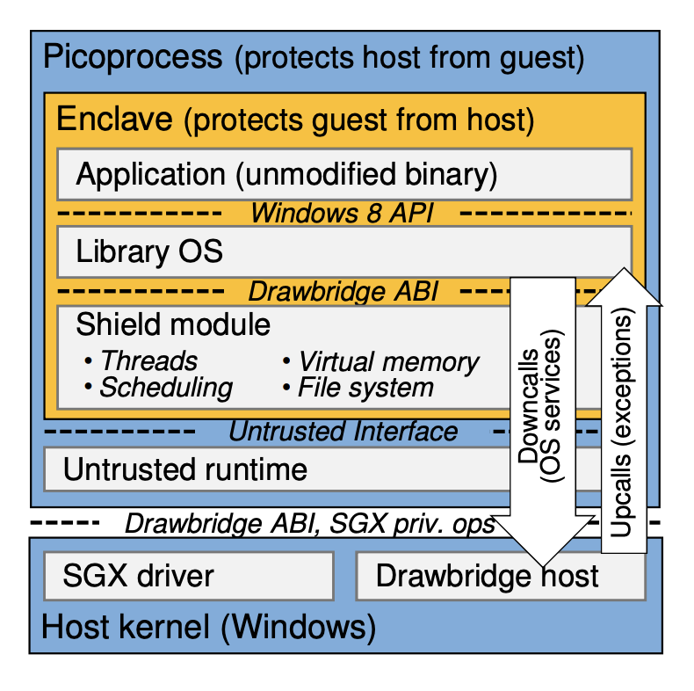
Haven
Move OS functions into the enclave as a LibOS.
Memory management
File system
Thread management
Host only controls resources
Memory
Disk blocks
Kernel threads
Network

Slide 6
Question #1
Let’s say OS wants to swap the memory addresses of two enclave pages inside an enclave. How can CPU protect against this attack?

Slide 7
Question #2
If a haven application creates a file and write “abc” into it, when it reads the file, does haven guarantee that it can read “abc” back? Why?

