Slide 1
Reflections on Trusting Trust
Maybe More Accurately Reflections on Trusting Code
Based on “Reflections on Trusting Trust” Ken Thompson
Mike Hewner
Duke University

Slide 2
char * str = “Hello world\n”;
Independent representation of the newline character. Usually character 10 (line feed) or 13 (carriage return).

Slide 3
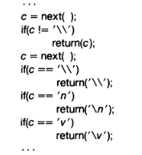
An elegantly implemented C compiler in C
Is this 10 or 13?

Slide 4
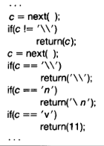
How can this be?
COMPILER ERROR

Slide 5
What does this mean?
The true value of the character is hidden in complier
It propagates itself to the next generation of complier
Like a virus

Slide 6
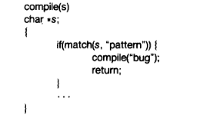
Let’s say I want to introduce a security hole
e.g.
If I’m compiling the password check in login, add a secret additional case that always accepts if the password is foobar

Slide 7
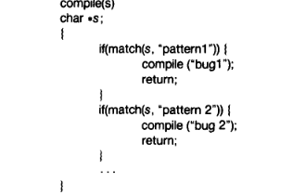
Now the real magic
Login hack
If compiling the compile function, add these cases back in and compile

Slide 8
A compiler virus
Just like the true value of \v these hacks are invisibly conveyed through the compiler
Once your compile this hacked compiler – replace the source code with the unmodified original (which, when compiled with the hacked compiler will produce a hacked compiler)
Your treachery cannot be detected by looking at the source code, only the compiled machine code

Slide 9
What can we learn from this?
A system – once compromised – can never be made trustworthy without “boiling the ocean”
Any part of a system can be vulnerable – including the toolchain
Operational security is probabilistic – security research always needs to provide a specific probable thread model
(next slide)

Slide 10

4. We (software people) rely on each other

Slide 11
An aside: how to write software that contains its own source code
If compiling the compile function, add these cases back in and compile

Slide 12
