Slide 1
CPS 510
Intel Software Guard Extensions (SGX)
Danyang Zhuo
Duke University

Slide 2
OS We have learnt so far..
Ensure security for processes
Processes cannot read/write each other’s memory
Processes invoke system calls for I/O
Additional kernel safety features (e.g., system call filter)
What if OS is compromised?

Slide 3
Secure Execution
Running code that process sensitive data
Medical records
Biometric data
Financial records
Without trusting the execution environment
Operating systems, hypervisor, BIOS
Cloud operators

Slide 4
Hardware Support
Intel SGX
AMD Memory Encryption
ARM TrustZone
RISC-V Sanctum

Slide 5
Intel SGX
Memory
Enclave Page Cache
(128 MB)
Applications cannot access it.
Kernel and hypervisor cannot access it.
BIOS cannot access it.
Device cannot DMA from/to it.

Slide 6
Enclave
Memory
Enclave
APP
Kernel
Create an enclave.
Load code into the enclave.
Trigger code inside the enclave.

Slide 7
Managing Enclave Page Cache
Enclave Page Cache Map (EPCM)
Metadata for every enclave page
CPU checks ownerships of every enclave page
No two enclaves can shared a page

Slide 8
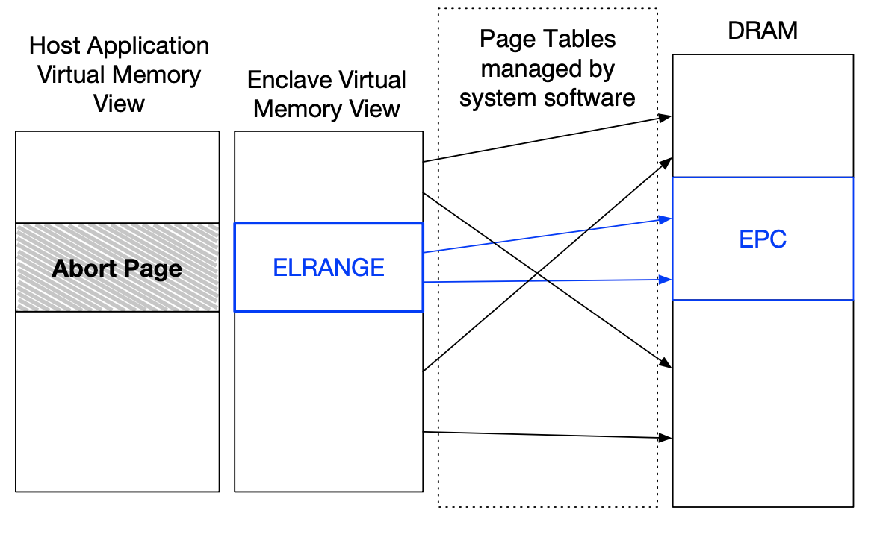
Enclave Linear Address Range (ELRANGE)
Intel SGX Explained

Slide 9
Workflow
ECREATE
Create an empty enclave
EADD/EEXTEND
Load code/data into the enclave
EINIT
Finalize enclave, sign the state of the enclave for attestation
EENTER
Switch to enclave mode, call into the enclave
EEXIT
Switch to non-enclave mode, return from the enclave
EREMOVE
Destroy the enclave

Slide 10
Asynchronous Enclave Exit
Interrupt, Exception
Save register and stack pointer in the enclave, switch to kernel mode
ERESUME
Go back to the enclave
Enclave load the saved register and stack pointer

Slide 11
What an untrusted OS can do?
Do not construct the enclave at all?
Construct a different enclave?
Remote attestation
Modify the code inside enclave after creation
Enclave code is read-only
Trigger random code in enclave
Entry address is defined in enclave memory
Use page table to map a process’s virtual memory to enclave page
Enclave page is only accessible when CPU is in enclave mode, each enclave page belongs to a single enclave

Slide 12
Intel SGX SDK
Definition
(num of threads, enclave memory size, set of ECALLs, set of OCALLs)
Application
(Include a main function + a set of OCALLs)
ECALL
Enclave
(a set of ECALLs)
OCALL
OCALL returns
ECALL returns

