Slide 1
DIFC and Flume
Jeff Chase
Duke University

Slide 2
MAC: the story so far
Mandatory Access Control (MAC)
Based on Information Flow Control (IFC)
Security labels on subjects and objects (channels).
Flows are permissioned by a label check.
Dominating labels
Secrecy and integrity
Today: extensions for user-defined MAC/IFC with support for trusted programs.
Example: Flume [SOSP 1997]

Slide 3
“Decentralized” IFC (DIFC)
Barbara Liskov (MIT) / Andy Myers [SOSP 1997 and…]
DIFC is a style of MAC/IFC in which users may define new tags, and control policy for their tags.
Users may tag their data.
Users control who can access their tagged data objects.
System propagates tags (IFC) and blocks unsafe flows (MAC).
Trusted programs may be granted authority for tags, allowing them to mark flows as safe, even if they violate classical IFC.
E.g., to endorse flows (to vouch for integrity of unsafe flows) or declassify flows (to vouch for their secrecy).
New DIFC systems appear at major systems forums almost every year, e.g., Flume [SOSP 2007].

Slide 4
DIFC Authority
Trusted subjects may have authority to perform certain privileged operations on labels.
For secrecy
Add tag to a process label to enable it to read secret data (and prevent it from leaking that data).
Remove tag from a process label to enable it to write secret data to an unclassified destination.
Remove tag from data label to declassify data.
Beware: Flume endpoints introduce multiple cases for #3.

Slide 5
DIFC Authority
Trusted subjects may have authority to perform certain privileged operations on labels.
For integrity
Add tag to a process label to block it from reading uncertified data (or loading uncertified code).
Add tag to a data label to endorse (certify) data.
Beware: Flume endpoints introduce multiple cases for #2.

Slide 6
Flume [SOSP 2007]
DIFC for Unix, no mainline kernel changes.
Secrecy and integrity labels + reference monitor
IFC at process grain: can’t track flows “inside” a process.
All flows pass through channels with endpoints.
Channels are files, pipes, or sockets: streams.
An endpoint is a Unix file descriptor. Endpoints have labels.
Rich mechanisms to represent trust in programs.

Slide 7
Flume API
Create tag t: subject receives capabilities for tag.
Capabilities t+ and t- give power to add/remove tag.
Dual privilege → t∈D_{p}
Control capabilities (authority) to operate on tags.
Owner of tag may place t+/t- in global capability set O.
Change labels for processes, endpoints.
Label changes are always explicit.
Object labels are immutable.
Create a confined process (spawn) and control its labels.
E.g., pass it pipes and capabilities for tags.

Slide 8
Processes and endpoints
p
e
f
S_{p} = {…}
S_{f} = {…}
Definition 4 (d4) defines conditions for a safe endpoint.
Definition 5 (d5) defines conditions for safe flow.
I_{p} = {…}
I_{f} = {…}
S_{e} = {…}
I_{e} = {…}
D_{p} = {…}
A Flume process reads and writes data through endpoints. Endpoints may be readable, or writable, or both.
Endpoints have their own secrecy and integrity labels. Safe flows are defined between endpoints, based on their labels.
By default an endpoint label is the same as the process label, but the process may change the endpoint label if it has permission. Adding or removing a tag from an endpoint label requires dual permission in D_{p}.

Slide 9
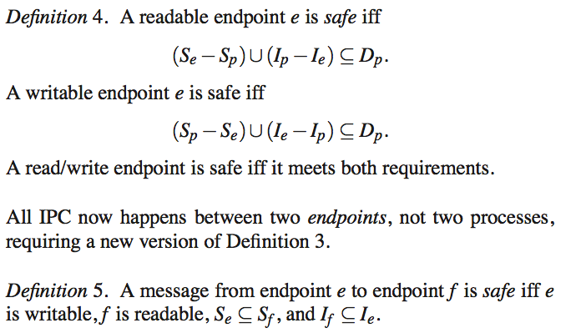
Heart of Flume

Slide 10
What endpoint ops require privilege?
Adding a tag to the secrecy label of a read endpoint
(declassifies data on read)
Removing a tag from the integrity label of a read endpoint
(allows read of uncertified data)
Removing a tag from the secrecy label of a write endpoint
(declassifies data on write)
Adding a tag to the integrity label of a write endpoint
(certifies on write)

Slide 11
Safe and unsafe flows: scenarios
p
e
f
S_{p} = {…}
I_{p} = {…}
S_{e} = {…}
I_{e} = {…}
S_{f} = {…}
D_{p} = {…}
I_{f} = {…}
We consider all the cases for data movement in or out of p.
It is sufficient to consider the conditions for reading and writing files.
For IPC, the peer q must have the same permission as required to communicate through a file. (If p writes, then q reads, and vice versa.)
The creator p of a file f assigns a label to f at create time. Process p may assign any label to f, as long as p is then permitted to write to f according to the rules. Once assigned the label of f is immutable.

Slide 12
Reading secret data
p
e
f
P
d4 condition
S_{e} – S_{p} ⊆ D_{p}
S_{p} = {t}
P
S_{e} = {t}
d5 condition
S_{f} ⊆ S_{e}
P
D_{p} = {}
S_{f} = {t}
Process p is tagged with t∈ S_{p}: p has t-secret data.
File f is tagged with t∈ S_{f}: f contains t-secret data.
P
Reads from p on f are safe.
The flow is safe even if p is untrusted: p requires no authority to set up the endpoint e (D_{p}={}).
It is safe because the data is still marked t-secret at the destination.

Slide 13
Writing secret data
p
e
f
P
d4 condition
S_{p} – S_{e} ⊆ D_{p}
S_{p} = {t}
P
S_{e} = {t}
d5 condition
S_{e} ⊆ S_{f}
P
D_{p} = {}
S_{f} = {t}
Process p is tagged with t∈ S_{p}: p has t-secret data.
File f is tagged with t∈ S_{f}: f contains t-secret data.
P
Writes from p to f are safe.
The flow is safe even if p is untrusted: p requires no authority to set up the endpoint e (D_{p}={}).
It is safe because the data is still marked t-secret at the destination.

Slide 14
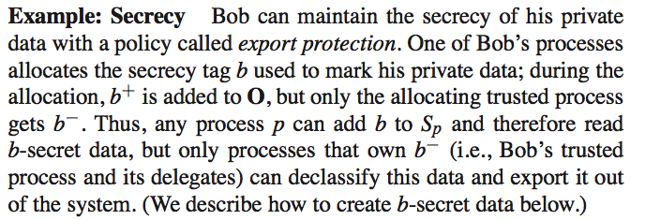
Export protection
Create secrecy tag t, give everyone a capability to add it: t+.
Now any p can read t-secret data by adding t to its S_{p}.
But p cannot declassify t-secret data, because p lacks t ∈ D_{p}.
Therefore p cannot leak t-secret data: p can read it and write it, but only to destinations that are also labeled as t-secret.

Slide 15
Blocking leakage of secret data
p
e
f
d4 condition
S_{p} – S_{e} ⊆ D_{p}
S_{p} = {t}
P
S_{e} = {t}
d5 condition
S_{e} ⊆ S_{f}
D_{p} = {...}
S_{f} = {}
Process p is tagged with t∈ S_{p}: p has t-secret data.
File f is not tagged: t ∉ S_{f}: writes of t-secret data to f are unsafe.
To write data, p must either label the destination f as also t-secret, or p must declassify the data on write (which requires dual privilege on t).

Slide 16
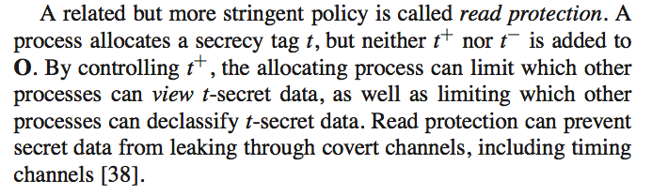
Alternative: read protection
Create secrecy tag t, and label some data.
Give a capability for t+ only to selected processes.
Only processes p with t+ can read the data (by adding t to S_{p}).
But p cannot declassify t-secret data if p lacks dual privilege: t ∈ D_{p}.

Slide 17
Blocking access to secret data
p
e
f
d4 condition
S_{e} – S_{p} ⊆ D_{p}
S_{p} = {}
P
S_{e} = {}
d5 condition
S_{f} ⊆ S_{e}
D_{p} = {}
S_{f} = {t}
File f is tagged: t ∈ S_{f}: f contains t-secret data.
Process p is not tagged with t ∈ S_{p}: reads of t-secret data are unsafe.
To read from f, p must either tag the destination p as also t-secret, or p must declassify the data on read (which requires dual privilege for t).
Q: is it safe to allow any untrusted process to add t to its secrecy label in order to read this data?

Slide 18
Writing declassified data
p
e
f
P
d4 condition
S_{p} – S_{e} ⊆ D_{p}
S_{p} = {t}
P
S_{e} = {}
d5 condition
S_{e} ⊆ S_{f}
P
D_{p} = {t}
S_{f} = {}
Process p is tagged with t ∈ S_{p}: p has t-secret data.
File f is not tagged: t ∉ S_{f}: writes of t-secret data to f are unsafe.
Endpoint e declassifies data as it is written: t ∉ S_{e}.
Process p is trusted: p requires authority for t to make e (t ∈ D_{p}).
The flow requires trust in p because the data loses its t-secret tag.

Slide 19
Reading declassified data
p
e
f
P
d4 condition
S_{e} – S_{p} ⊆ D_{p}
S_{p} = {}
P
S_{e} = {t}
d5 condition
S_{f} ⊆ S_{e}
P
D_{p} = {t}
S_{f} = {t}
File f is tagged with t ∈ S_{f}: f contains t-secret data.
Process p is not tagged: t ∉ S_{p}: reads of t-secret data by p are unsafe.
Endpoint e declassifies data as it reads: t ∈ S_{e}.
Process p is trusted: p requires authority for t to make e (t ∈ D_{p}).
The flow requires trust in p because the data loses its t-secret tag.

Slide 20
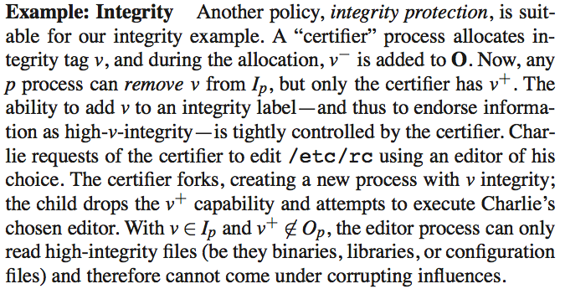
Integrity protection
Spawn a new process p marked with an integrity tag v ∈ I_{p}.
Don’t give p any privilege for v.
Now p can access only data and code that is certified for v.

Slide 21
Blocking uncertified reads
p
e
f
d4 condition
I_{e} – I_{p} ⊆ D_{p}
I_{p} = {v}
P
I_{e} = {v}
d5 condition
I_{f} ⊆ I_{e}
D_{p} = {}
I_{f} = {}
Process p is tagged: v ∈ I_{p}: p is certified as v-assured.
File f is not tagged: v ∉ I_{f}: data from f is uncertified (not v-assured).
To read from f, p must either mark itself as not v-assured, or p must endorse the data on read (which requires dual privilege for v).
Similarly, p cannot execute code from f without reducing p’s integrity.

Slide 22
Reading certified data
p
e
f
d4 condition
I_{e} – I_{p} ⊆ D_{p}
I_{p} = {v}
P
I_{e} = {v}
d5 condition
I_{f} ⊆ I_{e}
P
D_{p} = {}
I_{f} = {v}
Process p is tagged: v ∈ I_{p}: p is certified as v-assured.
File f is tagged: v ∈ I_{f}: f contains v-assured data.
Reads from p on f are safe.
The flow is safe even if p is untrusted: p requires no authority to set up the endpoint e (D_{p}={}).
It is safe because the data (or code) is certified as v-assured, so it won’t corrupt p. The data is certified as safe even for a v-assured p.

Slide 23
Blocking uncertified writes
p
e
f
d4 condition
I_{e} – I_{p} ⊆ D_{p}
I_{p} = {}
P
I_{e} = {}
d5 condition
I_{f} ⊆ I_{e}
D_{p} = {…}
I_{f} = {v}
File f is tagged: v ∈ I_{f}: f contains v-assured data.
Process p is not tagged: v ∉ I_{p}: data from p is not certified as v-assured.
To write to f, p must either untag the destination f, or p must endorse the data on write (which requires dual privilege for v).

Slide 24
Writing certified data
p
e
f
P
d4 condition
I_{e} – I_{p} ⊆ D_{p}
I_{p} = {v}
P
I_{e} = {v}
d5 condition
I_{f} ⊆ I_{e}
P
D_{p} = {}
I_{f} = {v}
File f is tagged: v ∈ I_{f}: f contains v-assured data.
Process p is tagged: v ∈ I_{p}: data from p is trusted as v-assured.
P
Writes from p to f are safe.
The flow is safe because p is running v-assured code and all data it sees is v-assured: p requires no additional authority to set up the endpoint e (D_{p}={}).

Slide 25
Endorsing data on write
p
e
f
d4 condition
I_{e} – I_{p} ⊆ D_{p}
I_{p} = {}
P
I_{e} = {v}
d5 condition
I_{f} ⊆ I_{e}
P
D_{p} = {v}
I_{f} = {v}
File f is tagged: v ∈ I_{f}: f contains v-assured data.
Process p is not tagged: v ∉ I_{p}: data from p is not certified as v-assured.
Endpoint e endorses data as it is written: v ∉ I_{e}.
Process p is trusted: p requires authority for v to make e (v ∈ D_{p}).
The flow requires trust in p because the data gains a v-assured tag.

Slide 26
Endorsing data on read
p
e
f
d4 condition
I_{e} – I_{p} ⊆ D_{p}
I_{p} = {v}
P
I_{e} = {}
d5 condition
I_{f} ⊆ I_{e}
P
D_{p} = {v}
I_{f} = {}
Process p is tagged: v ∈ I_{p}: p is certified as v-assured.
File f is not tagged: v ∉ I_{f}: data from f is uncertified (not v-assured).
Endpoint e endorses data as it is read: v ∉ I_{e}.
Process p is trusted: p requires authority for v to make e (v ∈ D_{p}).

Slide 27
Flume: some points
Example of capability model: processes hold capabilities for tags, and may transfer them through channels.
Tokens represent capabilities in transfer and storage. These are “hard to guess” values, also known as sparse capabilities.
There’s lots of work in code-level IFC, but Flume doesn’t do it: no “taint tracking” within a process.
Section 3.1+3.3 restate BLP/Biba rules for safe flow.
Reference monitor for confined processes by syscall interposition (spawn operator, through spawner server).
E.g., Linux Security Modules (LSM)
Setlabel: mark trusted programs “like setuid [bit]”.

