Slide 1
CPS 510
Application Crash Consistency
Danyang Zhuo
Duke University

Slide 2
Crash Consistency
File system crash consistency
Data journaling, copy-on-write
Application-level crash consistency
Key-value store, Database (e.g., MySQL, Postgres)
Version control (e.g., git)

Slide 3
Application crash consistency
What assumptions do real-world applications make about their underlying file systems?
How do real-world applications ensure crash consistency?

Slide 4
File system consistency
Different file systems have very different consistency guarantee
Same file system with different configuration also has different behaviours
Applications depend on file system consistency in subtle ways

Slide 5
How to test file system consistency?
f1=(empty) , f2=(empty)
f1=pp, f2=(empty)
f1=pp, f2=qq
Write(f1, “pp”);
Write(f2, “qq”);
crash
f1=(empty) , f2=q
f1=(empty) , f2=qq
No atomicity, no ordering
Atomicity, No ordering
f1=p , f2=(empty)
No atomicity, ordering

Slide 6
Other examples
Append(f, “abc”);
Will application see a file with random data?
Modify file;
Rename file from a.txt to b.txt;
Will application see b.txt with unmodified data?

Slide 7
Bob: Block Order Breaker
Write(f1, “pp”);
Write(f2, “qq”);
Test program
File system
File system
1
2
3
Trigger recovery
Disk
Disk
3
1

Slide 8
Bob: Block Order Breaker
Write(f1, “pp”);
Write(f2, “qq”);
Test program
File system
File system
1
2
3
Trigger recovery
Disk
Disk
3

Slide 9
Bob: Block Order Breaker
Write(f1, “pp”);
Write(f2, “qq”);
f1=(empty) , f2=q
Test program
No atomicity, no ordering
File system
File system
1
2
3
Trigger recovery
Disk
Disk
2
3

Slide 10
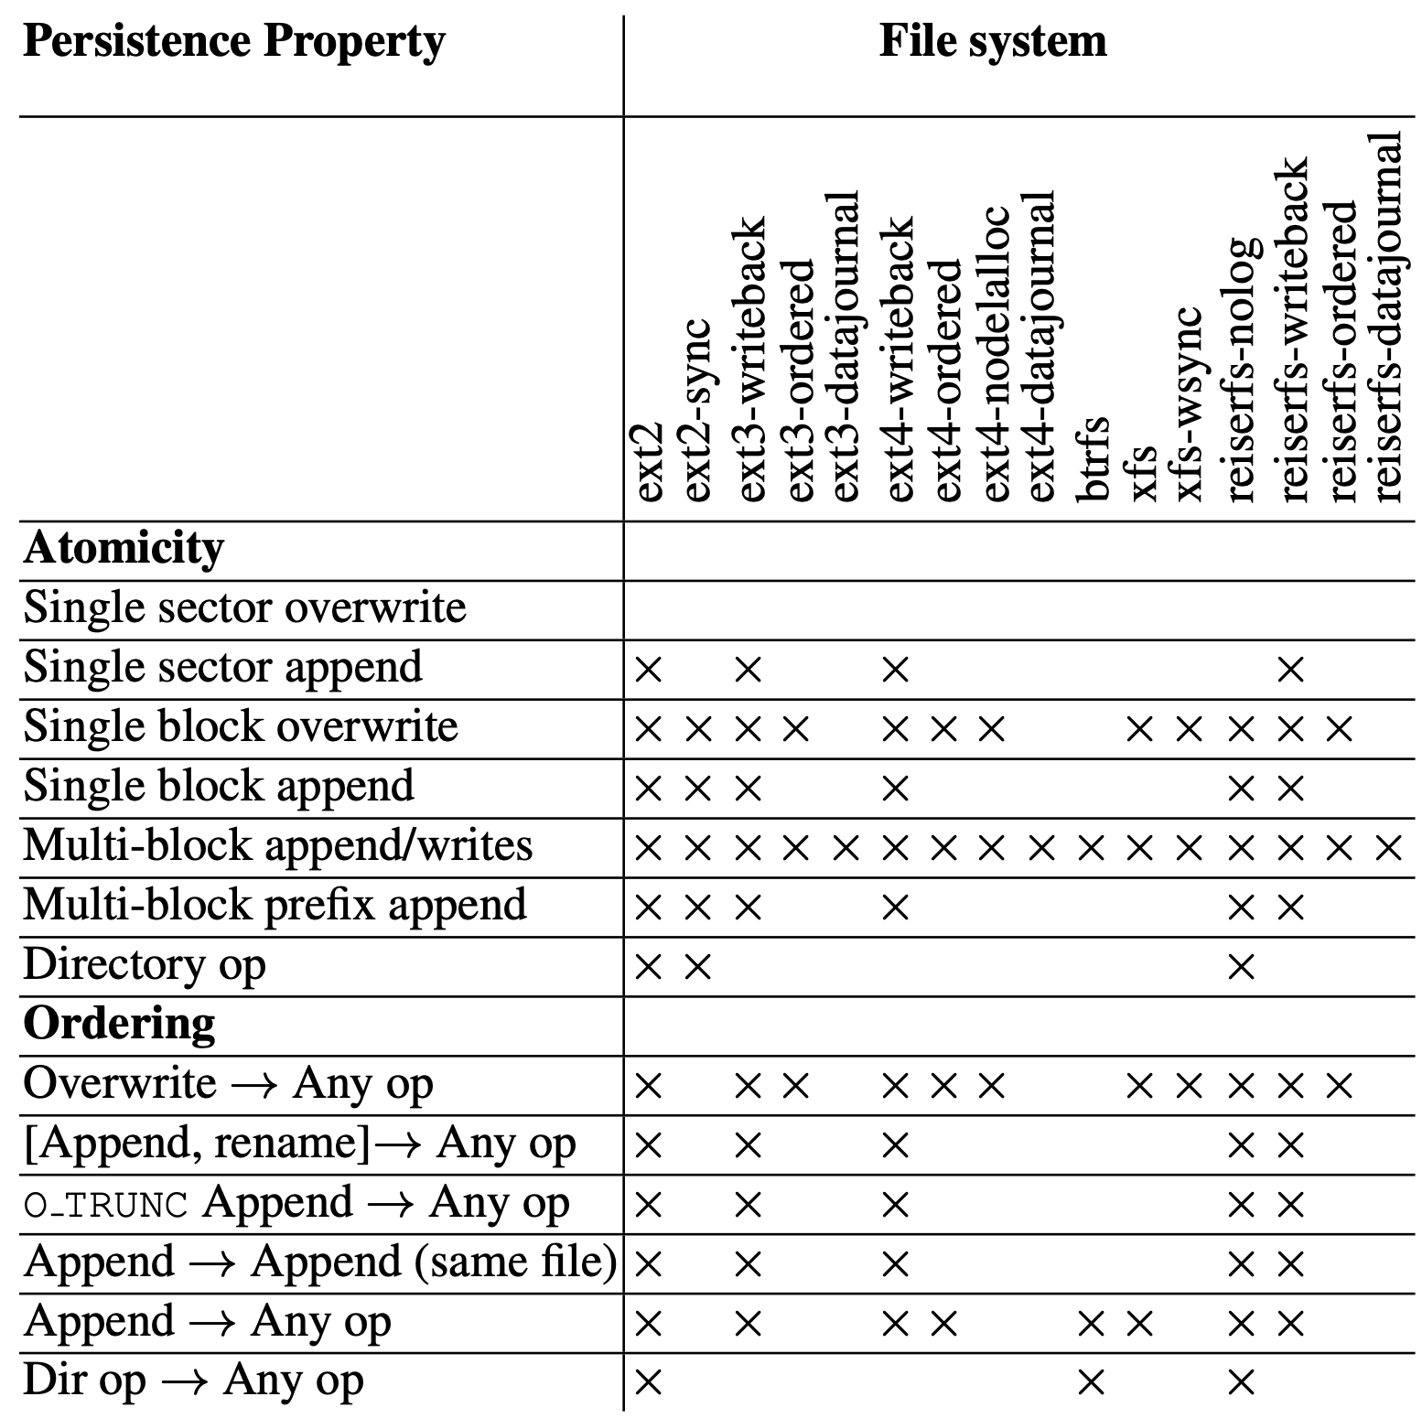

Slide 11
A simple transaction system
Write(logfd,“Start”);
Write(f1, “abc”);
Write(f2, “def”);
Write(logfd,“Finish”);
Write(logfd,“Start”);
FSync(logfd);
Write(f1, “abc”);
Write(f2, “def”);
Fsync(f1);
Fsync(f2);
Write(logfd,“Finish”);
Fsync(logfd);

Slide 12
Writing crash consistent application
Should not depend on specific file system crash consistency guarantee
How to test application?
Testing on one particular file system is not enough

Slide 13
Alice: application-level intelligent crash explorer
Generate a generalized file system operation model
Atomicity
Write a block
Change file size
Create/delete directories
Ordering
fsync

Slide 14
Generating program trace
Test program
FS state
Op1
Op2
Op3
Op4
Op5
Op6
Op5
Op2
Op1
Op6
Check
Shuffle

Slide 15
Uncover applications’ assumptions
Atomicity across system calls
If a subset of system calls are persisted, is it fine?
System call atomicity
A system call is broken into many micro-ops. If only a subset of them are persisted, is it fine?
System call ordering
If two system calls are ordered, is it fine?

Slide 16
Vulnerabilities
If an application relies on an assumption that does not hold for a particular file system
There is a potential vulnerability
More than 60 vulnerabilities are exposed
Data vanishing
Inaccessible applications
…

