Slide 1
CPS 510
Virtual Memory: A Lightning Tour
Now with x86-64
Jeff Chase
Duke University

Slide 2
OS: classical view
Programs run as
independent processes.
Each process has a private virtual address space and one or more threads.
data
data
Protected system calls
...and upcalls (e.g., signals)
Protected OS kernel mediates access to shared resources.
Threads enter the kernel for OS services.
The kernel code and data are protected from untrusted processes.

Slide 3
Process VM/VAS (32-bit example)
0x7fffffff
Reserved
N
high
The program uses virtual memory through its process’ Virtual Address Space:
An addressable array of bytes…
Containing every instruction it can execute…
And every piece of data those instructions can reference…
E.g., read/write == load/store on memory
Partitioned into logical segments (regions, areas) with distinct purpose and use.
Every reference by a running program is interpreted in the context of its VAS.
Resolves to a location in machine memory
Stack
Dynamic data
(heap/BSS)
Static data
Text
(code)
0x0

Slide 4
Linux x86-64 VAS layout
Example: the details aren’t important.
0x400000
text
r-x
0x600000
idata
0x601000
r--
Program
0x1299000
data
rw-
heap
rw- [anon]
N
high addresses
0x2ba976c30000
lib
lib
r-x
r-x
libc.so
shared
library
PIC
0x7fff1373b000
stack
64K
rw- [anon]
0x7fff1375c000

Slide 5
Why per-process address spaces?
Goal: multiple processes in memory at once, safely.
Uniform view of private memory→simple linking.
Avoids dynamic relocation at launch (linker-loader)
Safe (isolation)…but not really necessary for that.
Option 1: per-process base+bounds registers
Option 2: segmentation w/ per-segment base+bounds.
Problem: these require variable partitioning memory allocation. Like a heap! Messy! (parking lot)
Paged VM avoids that with uniform memory allocation in fixed-size chunks (pages).
Also permits lazy demand-fetching and caching.

Slide 6
Block maps
Large storage objects (e.g., files, segments) may be mapped so they don’t have to be stored contiguously.
Idea: use a level of indirection through a map to assemble a storage object from “scraps” in different locations.
The “scraps” can be fixed-size slots: that makes allocation easy because the slots are interchangeable (fixed partitioning). Fixed-size chunks of data or storage are called blocks or pages.
object
map
Example: page tables that represent a VAS.
One issue now is that each access must indirect through the map…

Slide 7
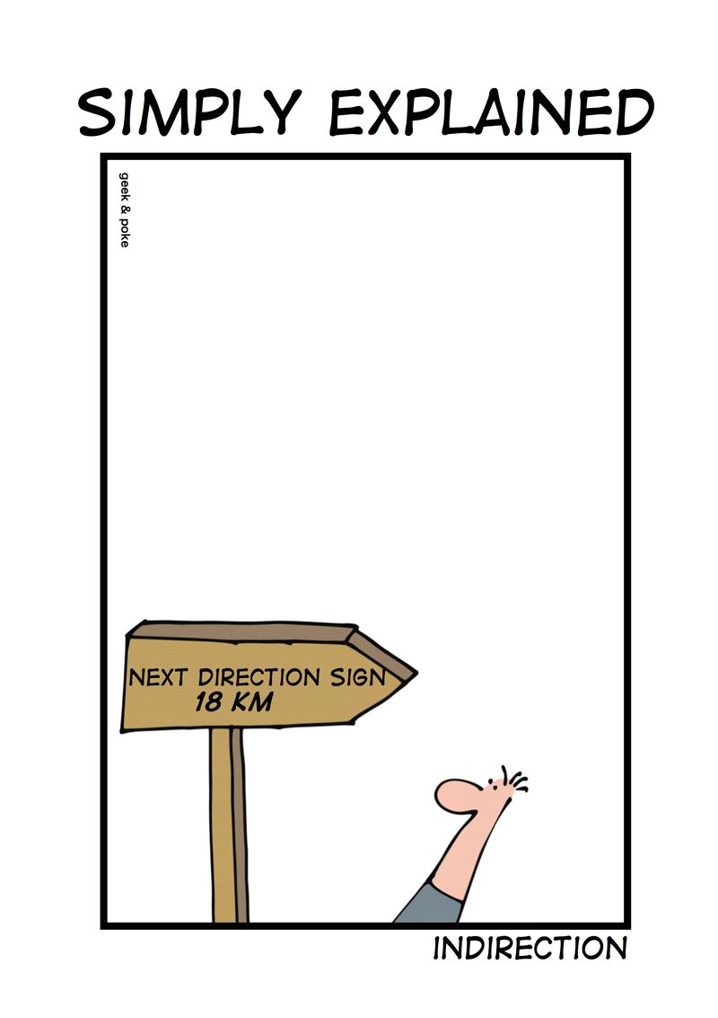
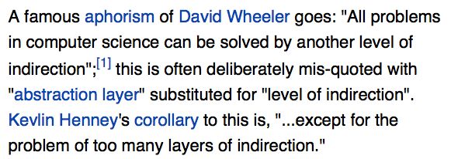
Indirection

Slide 8

Terminology: mapping
Logical block i
Virtual page i
$$ℱ\left(i\right)=j$$
Virtual Page Number i
map, table,
index (inode)
Page Frame Number j
Logical storage object
File
Segment
VAS
Volume
Underlying storage space
Larger or smaller
Physical?
May itself be logical/virtual
Allocate slots from it
Slots: blocks, pages, frames
Block or page may refer to either space.

Slide 9
Virtual addressing
virtual
memory
(big?)
machine
memory
(small?)
The machine allows a user process to access memory only by a valid translation in the page table.
Code running on a core addresses memory through virtual addresses.
The machine translates virtual addresses via an in-memory page table.
The OS controls the contents of the page table.
The page table represents a functional mapping of virtual pages (VPNs) to page frames (PFNs) for resident pages. If a page is not resident in memory, then its page table entry (PTE) is marked.
Machine’s memory management unit (MMU) translates VAs through the map.

Slide 10
Example: load from VA
CPU chip
Main memory
0:
Virtual
address
(VA)
Address
translation
Physical
address
(PA)
1:
2:
CPU
MMU
3:
4:
4100
4
5:
6:
7:
movl -32(%rbp), %rcx
...
M-1:
Data word
[from CS:APP3e F9.2]

Slide 11
Virtual address translation
Example: a typical 32-bit architecture with 4KB pages.
{
12
virtual address
0
VPN
offset
Virtual address translation maps a virtual page number (VPN) to a page frame number (PFN/PPN) in machine memory: the rest is easy.
address
translation
Deliver fault to
OS if translation is not
valid and accessible in
requested mode.
{
+
machine address
(e.g., physical address)
PFN
offset

Slide 12
Cartoon view of a page table
process page table (map)
This is an example. Any PFN may be used for any VPN.
PFN x
PFN y
The map itself is just another data structure stored in memory.
A protected CPU register (CR3) holds the machine address of current map.
PFN z
PFN z
VPN #i
offset
virtual address
machine memory
page frames
Virtual page: a logical block in a segment.
VPN: Virtual Page Number (a logical block number).
Page frame: a physical block in machine memory.
PFN: Page Frame Number (a block pointer).
PTE: Page Table Entry (an entry in the block map).
VPN = VA DIV PAGE_SIZE
Offset = VA MOD PAGE_SIZE

Slide 13
Page tables/maps: some issues
That 64-bit VAS is huge! The maps must be huge too!
That VAS is sparse! (It has big holes.) So how much of the maps is just wasted storing null PTEs?
What about the cost of map lookup(s)? Doesn’t VM multiply the cost of accessing memory?
How to change VAS on a process switch?
What about restricted memory access modes? Disabling writes or execute?
What about demand fetch/fill? What if we reference a missing (not present/valid/resident) page?

Slide 14
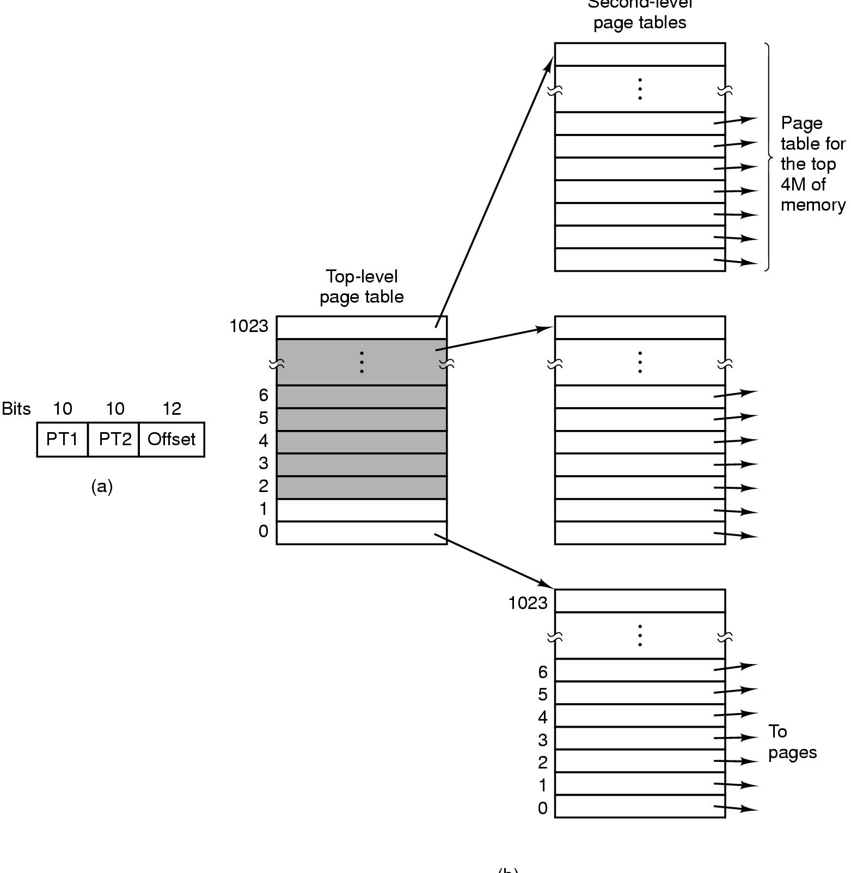
Example: Windows/IA32
Step 2. Index second-level page table with PT2
Step 1. Index PDIR with PT1
Each “table” is 1 page.
virtual address
32 bits
(1 page)
Two-level page table
32-bit virtual address, 32-bit PTEs
Two 10-bit page table index fields (PT1, PT2)
(10 bits represents index values 0-1023)
[from Tanenbaum]

Slide 15
Example: Windows/IA32
Two-level block map (page table) structure reduces the space overhead for block maps in sparse virtual address spaces.
Many process address spaces are small: e.g., a page or two of text, a page or two of stack, a page or two of heap.
This is a simple example of a hierarchical page table:
Each VAS has a page directory (“PDIR”)
The PDIR is one page: 4K bytes, 1024 4-byte entries (PTEs)
Each PDIR entry points to a map page, which MS calls a “page table”
Each map page (“page table”) is one page with 1024 4-byte PTEs
Each PTE maps one 4K virtual page of the address space
Therefore each map page (page table) maps 4MB of VM: 1024*4K
Therefore one PDIR maps a 4GB address space, max 4MB of tables

Slide 16
But where is the PDIR?
Each process has its own VAS, i.e., its own VM.
Therefore each process has its own page tables.
Therefore each process has its own PDIR etc.
How does the MMU “know” which process is running?
How does the MMU “know” where to find the PDIR?
Answer: ???
On a page fault, how does the OS “know” the address?
Answer: ???

Slide 17
But where is the PDIR?
Each process has its own VAS, i.e., its own VM.
Therefore each process has its own page tables.
Therefore each process has its own PDIR etc.
How does the MMU “know” which process is running?
How does the MMU “know” where to find the PDIR?
Answer: the OS tells it (e.g., in control register CR3).
On a page fault, how does the OS “know” the address?
Answer: the machine tells it.
They pass this info through designated control registers.

Slide 18
A real PTE: x86-64 (Intel Core i7)
P: present bit: ”valid”? or “missing”? Set by OS software.
Protection bits
XD: execute disable: 1 -> no instruction fetch from this page
R/W: read-write privilege? or read-only?
U/S: accessible from user code? Or only by OS (supervisor)?
Status bits set by hardware, cleared by OS software
A: reference bit: 1-> page accessed since A last cleared by OS.
D: dirty bit: 1-> page written since D last cleared by OS.
63
51
12
8
7
6
5
4
3
2
1
0
XD
PFN / PPN (40-bit)
G
0
D
A
CD
WT
U/S
R/W
P=1
Available for OS (e.g., page location on disk)
P=0
[from CS:APP3e F9.24: edited and not to scale]

Slide 19
X86-64 (i7) 4-level maps
9
9
9
9
12
Virtual
address
VPN 1
VPN 2
VPN 3
VPN 4
VPO
L1 PT
Page global
directory
L2 PT
Page upper
directory
L3 PT
Page middle
directory
L4 PT
Page
table
40
40
40
40
CR3
/
/
/
/
Physical
address
of L1 PT
Offset into
physical and
virtual page
/
9
9
9
9
12
/
L1 PTE
/
L2 PTE
/
L3 PTE
/
L4 PTE
Physical
address
of page
512 GB
region
per entry
1 GB
region
per entry
2 MB
region
per entry
4 KB
region
per entry
40
/
40
12
Physical
address
PPN
PPO
[from CS:APP3e F9.25]

Slide 20
Page walk and the TLB
CPU chip
Is it slow? Maybe.
But the MMU caches PTEs in its Translation Lookaside Buffer (TLB).
Hit rates are high.
TLB
2
VPN
PTE
3
Trans-
lation
Cache/
memory
Processor
1
4
VA
PA
5
Data
[from CS:APP3e]

Slide 21
Memory as a cache: valid/present bits
Physical memory
(DRAM)
Physical page
number or
disk address
Valid
VP 1
PP 0
PTE 0
0
VP 2
null
VP 7
1
VP 4
PP 3
1
0
1
0
null
Backing store
(disk)
0
PTE 7
1
VP 1
Memory resident
page table
(DRAM)
VP 2
VP 3
VP 4
What if CPU addresses a “missing” VP?
VP 6
[from CS:APP3e F9.4]
VP 7

Slide 22
Missing page: page fault
Physical memory
(DRAM)
Virtual address
Physical page
number or
disk address
Valid
VP 1
PP 0
PTE 0
0
VP 2
null
VP 7
1
VP 4
PP 3
VPN 3
1
0
1
0
null
Virtual memory
(disk)
0
PTE 7
1
VP 1
page table
VP 2
VP 3
VP 3 is missing: MMU triggers a page fault.
VP 4
VP 6
VP 7
[from CS:APP3e F9.6]

Slide 23
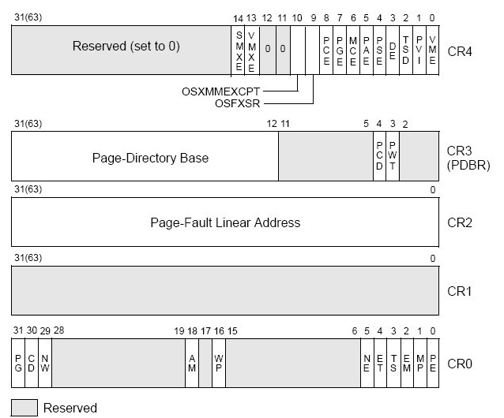
VM control registers (IA32)
Points to page table (in machine memory) for current VAS active on this core
CR3
Faulting VA (if page fault is active)
Protected mode Enable
The details aren’t important.
See [en.wikipedia.org/wiki/Control_register]

Slide 24
After the fault
Virtual address
Physical page
number or
disk address
Valid
VP 1
PP 0
PTE 0
0
VP 2
null
VP 7
1
VP 3
PP 3
1
1
0
0
null
Virtual memory
(disk)
0
PTE 7
1
VP 1
page table
VP 2
Example: select VP 4 as the victim, reassign its frame to hold VP 3, load VP 3 from disk, and restart the faulting instruction.
VP 3
VP 4
VP 6
VP 7
[from CS:APP3e F9.7]

Slide 25
Virtual Addressing: Under the Hood
probe
page table
MMU
start
here
load
TLB
access
physical
memory
yes
miss
probe
TLB
access
OK?
raise
exception
restart
hit
no
load
TLB
zero-fill
OS
no (first reference)
page on
“disk”?
page
fault?
fetch
from disk
(lookup and/or)
allocate
frame
yes
kill
legal reference
illegal reference
How to monitor page reference events/frequency along the fast path?

