Slide 1
CPS 510
Virtual Memory Lightning Tour
The Software
Jeff Chase
Duke University

Slide 2
Virtual addressing: under the hood
probe
page table
MMU
start
here
load
TLB
access
physical
memory
yes
miss
probe
TLB
access
OK?
raise
exception
restart
hit
no
load
TLB
zero-fill
OS
no (first reference)
page on
“disk”?
page
fault?
fetch
from disk
(lookup and/or)
allocate
frame
yes
kill
legal reference
illegal reference
How to monitor page reference events/frequency along the fast path?

Slide 3

Entry to the kernel
Every entry to the kernel is the result of a trap, fault, or interrupt. The core switches to kernel mode and transfers control to a handler routine.
syscall trap/return
fault/return
OS kernel code and data for system calls (files, process fork/exit/wait, pipes, binder IPC, low-level thread support, etc.) and virtual memory management (page faults, etc.)
I/O completions
interrupt/return
timer ticks
The handler accesses the core register context to read the details of the exception (trap, fault, or interrupt). It may call other kernel routines.

Slide 4
“Limited direct execution”
user mode
syscall trap
fault
fault
time
u-start
u-return
u-start
u-return
Runs in thread context (IPL 0)
kernel mode
interrupt handlers
interrupt
interrupt
return
boot
User code runs on a CPU core in user mode in a user space. If it tries to do anything weird, the core transitions to the kernel, which takes over.
The kernel executes a special instruction to transition to user mode (labeled as “u-return”), with selected values in CPU registers.

Slide 5
The p-p-paradigm
monitor / controller
configure
launch/restart
exception notify
machine
Machine runs according to its configuration. If it encounters a condition that requires controller to intervene, it suspends processing and generates an exception for the controller.

Slide 6
Program and VAS: idealized view
globals
Memory-mapped
sections of
program file
static
text
Program
heap
Anonymous
Segments
(zero-fill)
dynamic
stack
Files on “disk”
Segments (regions)
in Virtual Address Space
Pages are fetched or filled on demand.

Slide 7
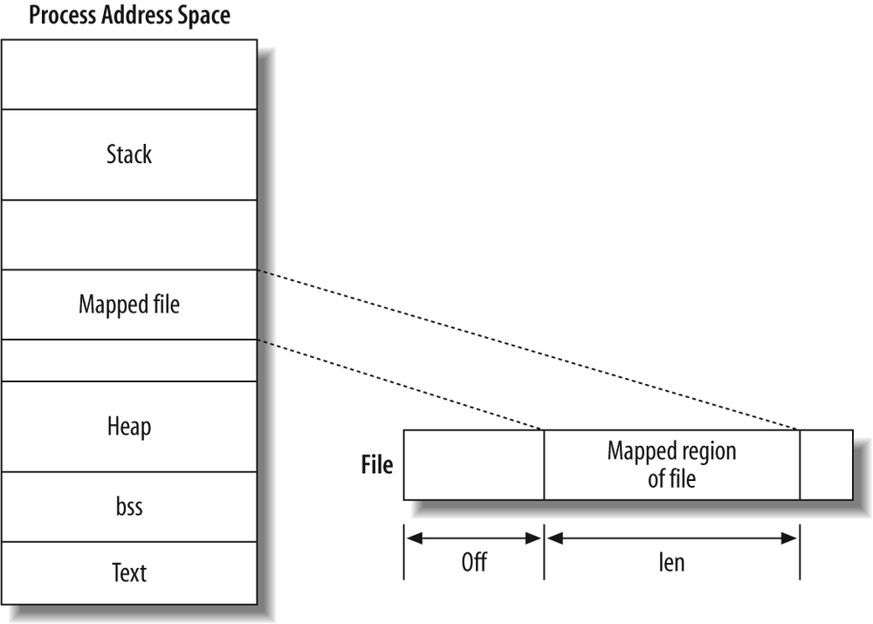
Memory mapped files (mmap)
https://www.safaribooksonline.com/library/view/linux-system-programming/0596009585/ch04s03.html
N (high)
Uses: mapping program sections into virtual memory, shared libraries/DLLs, “zero-copy” on demand access to files.
void *mmap(*addr, len, prot, flag, fd, offset);
(rwx)
len
addr
0
fd
0

Slide 8
“Man mmap”
#include <sys/mman.h>
void *mmap(void *addr, size_t len, int prot, int flag, int filedes,
off_t off );
Returns: starting address of mapped region if OK, MAP_FAILED on error
The mmap() system call causes the pages starting at addr and continuing for at most len bytes to be mapped from the object described by fd, starting at byte offset offset. If offset or len is not a multiple of the pagesize, the mapped region may extend past the specified range. Any extension beyond the end of the mapped object will be zero-filled.
The addr argument is used by the system to determine the starting address of the mapping, and its interpretation is dependent on the setting of the MAP_FIXED flag. If MAP_FIXED is specified in flags, the system will try to place the mapping at the specified address, possibly removing a mapping that
already exists at that location….

Slide 9
Anonymous mapped memory
A mapped file has a name in the file system. With different arguments, mmap can create transient VM regions that disappear when the process exits.
mmap(…MAP_ANONYMOUS…)
Create/map an “anonymous” region that is not a file: it has no name, is not sharable. The kernel may back it up on “disk”, but it does not persist.
What are the initial values?

Slide 10
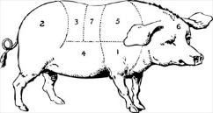
Mmap example: heap slab
mapping is not backed by a file
pages may be written
pages may be read
int prot = (PROT_WRITE | PROT_READ);
int flags = (MAP_SHARED | MAP_ANONYMOUS);
base = mmap(NULL, max_bytes, prot, flags, -1, 0);
starting address (here chosen by kernel)
used for mapping a file to memory (here no file)
Zero-fill on demand! (zfod)

Slide 11
Memory as a cache
Programs access storage objects through file APIs and VM abstraction. The OS kernel VM system manages caching of pages and blocks in memory.
virtual address spaces
data
data
files and filesystems,
databases,
other storage objects
disk and other storage
network RAM
Page read/write accesses
memory
(frames)
backing storage volumes
(pages and blocks)

Slide 12
Linux x86-64 VAS layout
Example: the details aren’t important.
0x400000
text
r-x
0x600000
idata
0x601000
r--
Program
0x1299000
data
rw-
heap
rw- [anon]
N
high addresses
0x2ba976c30000
lib
lib
r-x
r-x
libc.so
shared
library
PIC
0x7fff1373b000
stack
64K
rw- [anon]
0x7fff1375c000

Slide 13
linux11:~/www/cps310/c-samples> ./structs
^Z
Suspended
linux11:~/www/cps310/c-samples> ps x
PID TTY STAT TIME COMMAND
23760 ? S 0:00 sshd: chase@pts/2
23761 pts/2 Ss 0:00 -tcsh
23866 pts/2 T 0:04 ./structs
linux11:~/www/cps310/c-samples> cd /proc/23866
linux11:/proc/23866> cat maps
00400000-00401000 r-xp 00000000 00:1e 25122468 compsci310/c-samples/structs
00600000-00601000 r--p 00000000 00:1e 25122468 compsci310/c-samples/structs
00601000-00602000 rw-p 00001000 00:1e 25122468 compsci310/c-samples/structs
01299000-012ba000 rw-p 00000000 00:00 0 [heap]
2ba976c30000-2ba976c52000 r-xp 00000000 08:11 1062809 /lib/x86_64-linux-gnu/ld-2.15.so
2ba976c52000-2ba976c55000 rw-p 00000000 00:00 0
2ba976e52000-2ba976e53000 r--p 00022000 08:11 1062809 /lib/x86_64-linux-gnu/ld-2.15.so
2ba976e53000-2ba976e55000 rw-p 00023000 08:11 1062809 /lib/x86_64-linux-gnu/ld-2.15.so
2ba976e55000-2ba97700a000 r-xp 00000000 08:11 1062797 /lib/x86_64-linux-gnu/libc-2.15.so
2ba97700a000-2ba97720a000 ---p 001b5000 08:11 1062797 /lib/x86_64-linux-gnu/libc-2.15.so
2ba97720a000-2ba97720e000 r--p 001b5000 08:11 1062797 /lib/x86_64-linux-gnu/libc-2.15.so
2ba97720e000-2ba977210000 rw-p 001b9000 08:11 1062797 /lib/x86_64-linux-gnu/libc-2.15.so
2ba977210000-2ba977217000 rw-p 00000000 00:00 0
7fff1373b000-7fff1375c000 rw-p 00000000 00:00 0 [stack]
7fff137ef000-7fff137f0000 r-xp 00000000 00:00 0 [vdso]
ffffffffff600000-ffffffffff601000 r-xp 00000000 00:00 0 [vsyscall]
linux11:/proc/23866>
If we really want to know what the address space really looks like…
[On 64-bit linux]

Slide 14
For your interest:
[http://stackoverflow.com/questions/1401359/understanding-linux-proc-id-maps]
Each row in /proc/$PID/maps describes a region of contiguous virtual memory in a process …
Each row has the following fields:
address - This is the starting and ending address of the region in the process's address space
permissions - This describes how pages in the region can be accessed. There are four different permissions: read, write, execute, and shared. If read/write/execute are disabled, a '-' will appear instead of the 'r'/'w'/'x'. If a region is not shared, it is private, so a 'p' will appear instead of an 's'. If the process attempts to access memory in a way that is not permitted, a segmentation fault is generated. Permissions can be changed using the mprotect system call.
offset - If the region was mapped from a file (using mmap), this is the offset in the file where the mapping begins. If the memory was not mapped from a file, it's just 0.
device - If the region was mapped from a file, this is the major and minor device number (in hex) where the file lives.
inode - If the region was mapped from a file, this is the file number.
pathname - If the region was mapped from a file, this is the name of the file. This field is blank for anonymous mapped regions. There are also special regions with names like [heap], [stack], or [vdso]. [vdso] stands for virtual dynamic shared object. It's used by system calls to switch to kernel mode. [see http://www.trilithium.com/johan/2005/08/linux-gate/]
You might notice a lot of anonymous regions. These are usually created by mmap but are not attached to any file. They are used for a lot of miscellaneous things like shared memory or buffers not allocated on the heap. For instance, ...the pthread library uses anonymous mapped regions as stacks for new threads.

Slide 15

Avie Tevanian
PhD at CMU, 1989(?)
Mach project VM system
It made sense and it worked.
Later added to BSD Unix.
He went to Apple.
Key architect of MacOS.
Mach and its VM became the foundation of MacOS.
Now a venture capitalist.
His classic paper: Machine-Independent Virtual Memory Management for Paged Uniprocessor and Multiprocessor Architectures, SOSP 1987.

Slide 16
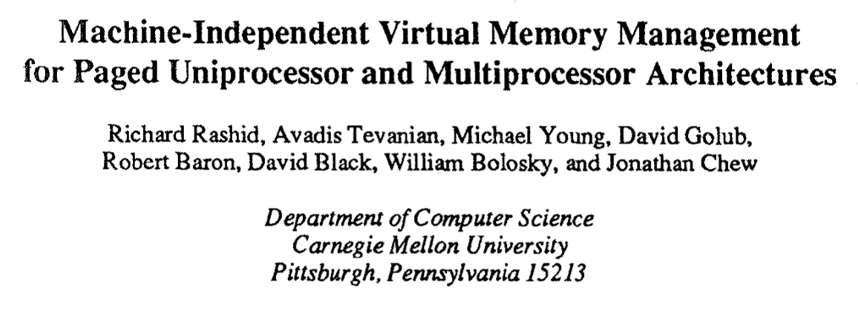
Mach VM
Mach “microkernel”: influential, though mixed success.
Machine-independent: plug-in page table format (pmap)
Plug-in backing storage managed by user-level processes: external pagers. Get it out of the kernel.
Kernel doesn’t care where pages come from or where they go.
Allows pagers to define VM behavior for other processes.
Supports sharing; everything is a cache.

Slide 17
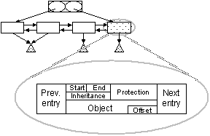
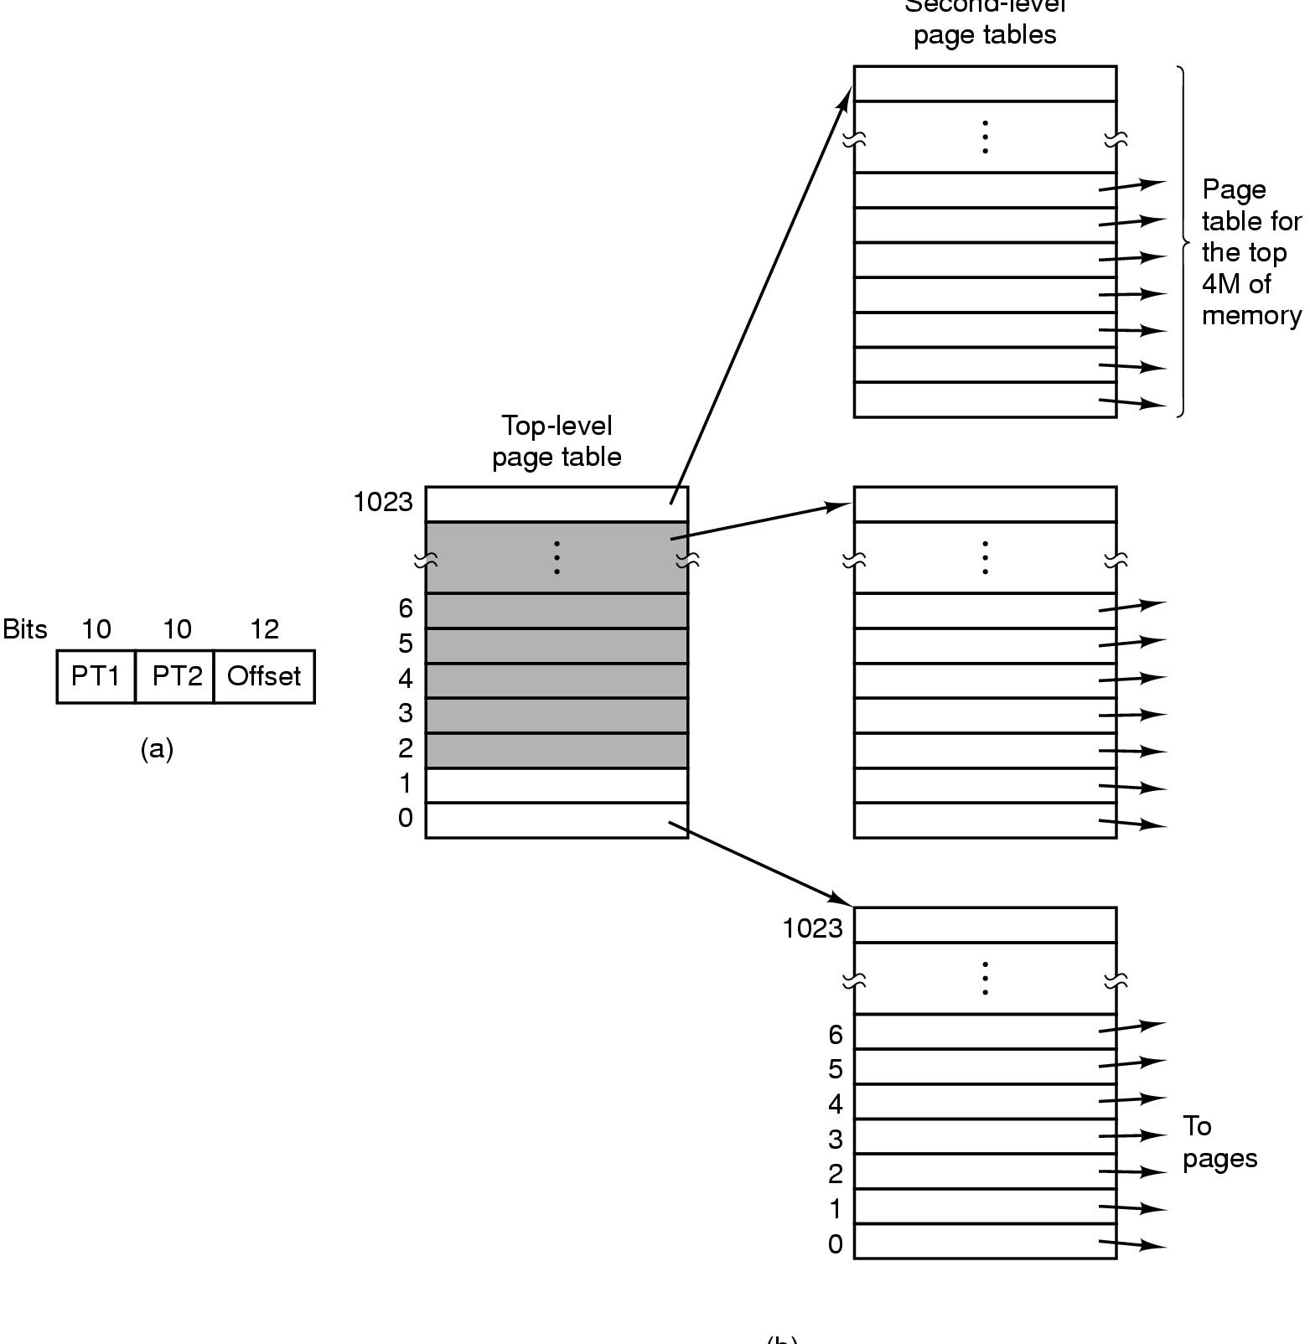
Virtual memory the Mach way
vm_map
pagein
P1
Pagers
files/vnodes
Region lists, map to objects
pageout
P2
Page cache
Hash by object/offset
pmap
pmap_enter()
pmap_remove()
pmap_page_protect()
pmap_remove_all()
pmap_is_referenced()
pmap_clear_reference()
P1
P2
P→V map

Slide 18
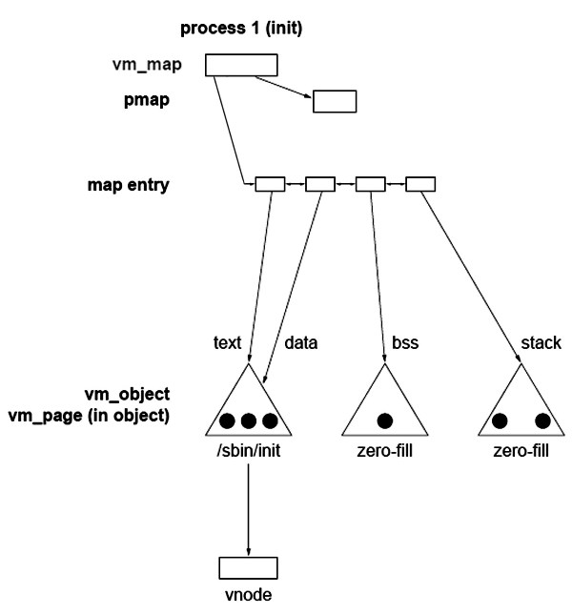
Inside the VAS
The vm_map is a linked list of map entries, one for each segment, sorted by starting virtual address.
The kernel keeps a vm_map for each VAS.
Each map entry points to a descriptor for the segment (a vm_object).
This data structure is used in Mach-derived kernels, including BSD Unix and macOS. Linux is not different.
(heap)
“Vnode” refers to the inode for the underlying (backing) file.
The triangles represent VM objects (segments). The dots represent pages within segments. A segment may have any number of pages resident.
[http://manrix.sourceforge.net/microkernelservice.htm]

Slide 19
Inside the VAS
Pages from anonymous segments are initialized to zero, but the process may write to them. If they are evicted from memory the contents must be stored somewhere on disk.
Text and initialized static data are mapped from the executable file.
(heap)
Missing pages may be fetched from the (backing) file on demand.
The stack and heap are zero-filled virtual memory: called anonymous because the backing file has no name (i.e., no links: it is destroyed if the process dies).
[http://manrix.sourceforge.net/microkernelservice.htm]

Slide 20
Virtual memory faults
Kernel searches vm_map list for the object mapped at that address. No object? Then it’s an error, e.g., segmentation fault.
Kernel checks intended mode of access for the object (rwx). Access not allowed? Then it’s an error, e.g., protection fault.
vm_map
2. If we find the segment, check the protection to see if the access is legal.
1. Run down the vm_map for the VAS to find the segment/region containing the faulting address.
vm_object
3. If the access is legal, identify the backing object containing the page.

Slide 21
Virtual memory faults
Is the missing page (object/offset) in a memory frame somewhere, but just missing from the page table?
Index page cache (object/offset hash table) to find out. (The page could be resident if the segment or backing object is shared, and the page is resident in memory on behalf of some other process.)
If not, then find a free frame of memory to hold the missing page.
Is the missing page in an object on backing storage? Figure out where: index the vnode block map. Fetch page into the frame.
Or: is it the first reference to a page in a zero-fill object (e.g., stack or heap)? Then fill the frame with zeros.
So far so good? Install a translation in the page table entry (pte) mapping the faulted virtual page to its frame.
Adjust PC to restart faulted instruction, then return to user mode.

Slide 22
pmap: some points
Hide machine dependencies behind a clean API.
Concept: hardware abstraction layer (HAL).
Set up pmaps lazily, on demand.
“Maybe if we put it off we won’t have to do it at all.”
Sharing requires pmap support and a P→V map.
Evict a page? Knock it out of all pmaps, shootdown all TLBs.
Is page dirty? Referenced recently? Check all pmaps.
pmap_enter()
pmap_remove()
pmap_page_protect()
pmap_remove_all()
pmap_is_referenced()
pmap_clear_reference()
P1
P2
P→V map

Slide 23
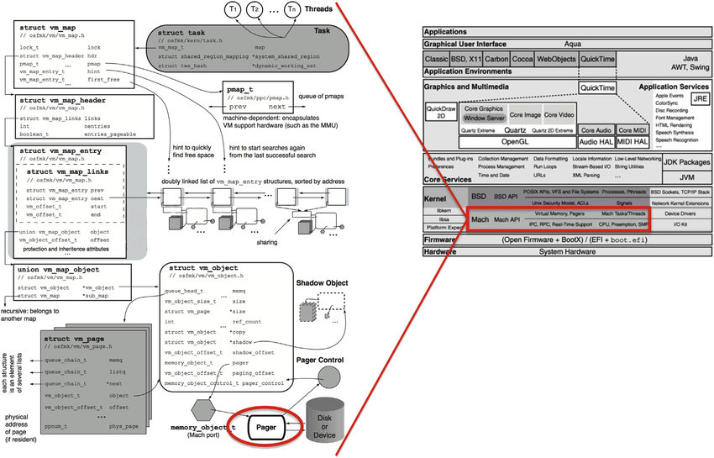
“Adapted from Fig. 8-6 in Singh (2007), MacOS Internals”

Slide 24
Linux is similar: page fault handling
Process virtual memory
vm_area_struct
vm_end
vm_start
r/o
Shared libraries
vm_next
Segmentation fault:
accessing a non-existing page
1
vm_end
vm_start
Data
r/w
3
Normal page fault
vm_next
Code
Protection exception:
e.g., violating permissions by
writing to a read-only page
vm_end
2
vm_start
r/o
vm_next
0
[from CS:APP3e F9.28]

Slide 25
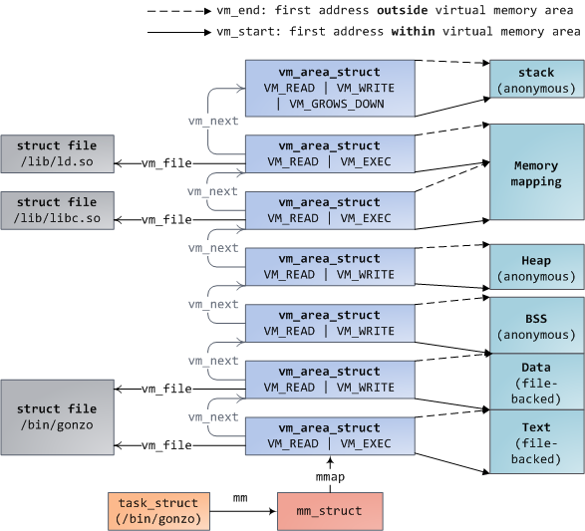
Another Linux picture
https://manybutfinite.com/post/how-the-kernel-manages-your-memory/

Slide 26
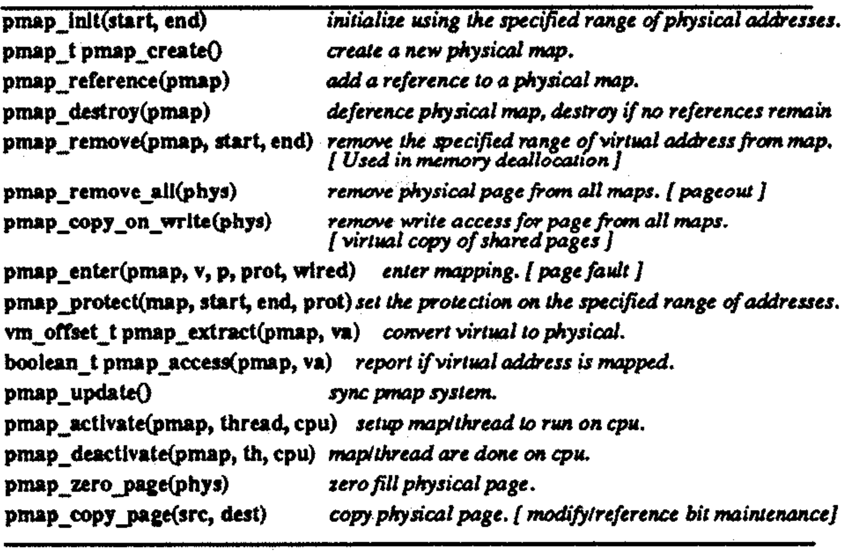
A peek at the original pmap API
Graphic from Machine-Independent Virtual Memory Management for Paged Uniprocessor and Multiprocessor Architectures, SOSP 1987.

Slide 27
Questions
Implementation exercises: how would you do it?
How to implement mmap() using the kernel data structures described here?
When the kernel identifies a frame to back a virtual page, how does it know what PFN to put in the PTE?
Linux uses a per-object radix tree (instead of a global hash table) to look up pages in the page cache. What advantages might it offer?
How to ensure that VAS sharing an object (like a shared library, or text of a shared program) use the same copy of the data in machine memory? What benefits does this sharing offer?
Sometimes processes want private copies of a shared object. The OS starts them as shared, then it uses copy-on-write to create private copies lazily as processes write to pages in their regions. Suggest how.
Is it necessary to flush TLBs on other cores when switching to a new VAS (e.g., by updating CR3 in pmap_activate)? What about on pmap_enter? On munmap (pmap_remove)? Process exit (also pmap_remove)? Page eviction (pmap_remove_all or pmap_protect)?

