Slide 1
CPS 510
OS for Microcontrollers
Danyang Zhuo
Duke University

Slide 2
Hardware Memory Protection (Paging)
Each process has a private virtual address space and one or more threads.
data
data
Protected system calls
...and upcalls (e.g., signals)
The kernel code and data are protected from untrusted processes.

Slide 3

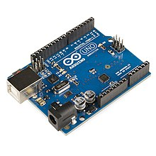
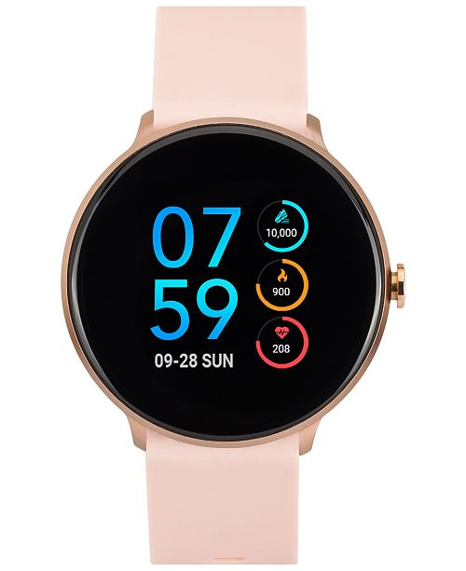
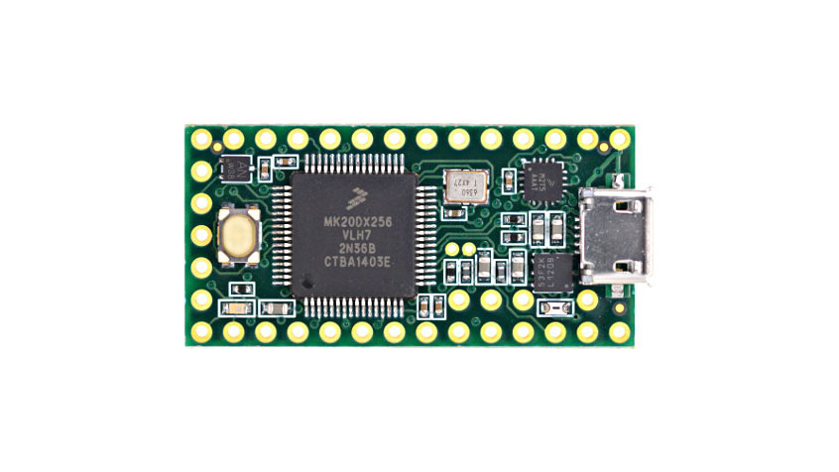
Microcontrollers
Small amount of RAM (64KB)
Minimal number of features

Slide 4
ARM Cortex M Series
CPU has two modes: privilege and unprivileged mode
OS in privilege mode and applications in unprivileged mode
CPU accesses memory using physical memory address
CPU uses Memory Protection Unit (MPU) to provide process memory isolation

Slide 5
Using Physical Memory Address
Memory
OS
How to load and run applications?
How to provide memory isolation?
App1
App2
App3

Slide 6
Position-Independent Code (PIC)
Machine code that can execute properly regardless of its absolute address.
gcc –fPIC …..
Virtual Memory
Virtual Memory
Lib1
Relative addressing
Global Offset Table
Lib1
Lib2
Lib2
App
App

Slide 7
Memory Protection Unit (MPU)
Memory
OS
32-byte aligned memory regions
16 memory regions in total
Each memory region can be marked as accessible or not
MPU states are in registers
App1
App2
App3

