Slide 1
CPS 510
Races and Eraser
Plus a taste of memory models
Jeff Chase
Duke University

Slide 2


A race
Concurrent threads
Arbitrarily interleaved
Conflicting accesses
Shared variable x
Write (store) to x
→ Bug: unsafe!
Depends on schedule
E.g., may “lose” counts
Solution: “lock it down”.
Lock critical sections
x=x+1
start
x=x+1

Slide 3
Another race
load
add
store
x = x + 1;
No lock! → No ordering.
Any interleaving is possible.
These operations are conflicting:
They access the same location (x).
And at least one is a write.
mx->Acquire();
x = x + 1;
mx->Release();
load
add
store

Slide 4
Locks and ordering
mx->Acquire();
x = x + 1;
mx->Release();
mx->Acquire();
x = x + 1;
mx->Release();

Slide 5
Possible interleavings?
load
add
store
1.
load
add
store
load
add
store
mx->Acquire();
x = x + 1;
mx->Release();
load
add
store
2.
load
add
store
load
add
store
mx->Acquire();
x = x + 1;
mx->Release();
3.
4.

Slide 6

Concurrency and time
A
B
C
C
What do before and after mean in a concurrent world?
Time, Clocks, and the Ordering of Events in Distributed systems, by Leslie Lamport, CACM 21(7), July 1978

Slide 7
Same world, different timelines
Message: a synchronization event
W(x)=v
e3a
A
e1a
e2
“Event e1a wrote W(x)=v”
e1b
e3b
e4
B
R(x)
Event receive
R(x)
Which of these happened first?
e1a is concurrent with e1b
e3a is concurrent with e3b and e4
What about the others?

Slide 8
Axiom 1: happened-before (→)
A
B
C
C
If e1, e2 are in the same process/node, and e1 comes before e2, then e1→e2.
- Also called program order
Time, Clocks, and the Ordering of Events in Distributed systems, by Leslie Lamport, CACM 21(7), July 1978

Slide 9
Axiom 2: happened-before (→)
A
B
C
C
2. If e1 is a message send, and e2 is the corresponding receive, then e1→e2.
Time, Clocks, and the Ordering of Events in Distributed systems, by Leslie Lamport, CACM 21(7), July 1978

Slide 10
Axiom 3: happened-before (→)
A
A
B
B
C
C
3. → is transitive
happened-before is the transitive closure of the relation defined by #1 and #2
C
Time, Clocks, and the Ordering of Events in Distributed systems, by Leslie Lamport, CACM 21(7), July 1978

Slide 11
Lamport happened-before (→)
A
B
C
Two events are concurrent if neither happens-before the other.
C
Time, Clocks, and the Ordering of Events in Distributed systems, by Leslie Lamport, CACM 21(7), July 1978

Slide 12
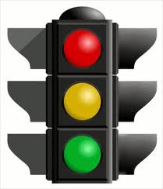
Synchronization order
An execution schedule defines a total order of synchronization events on each lock: the synchronization order.
mx->Acquire();
x = x + 1;
mx->Release();
Different executions may have different synchronization orders.
before
mx->Acquire();
x = x + 1;
mx->Release();
Purple’s release is ordered before Blue’s acquire in this schedule.
The synchronization order induces a happened-before order on all events in the execution—like message send/receive.

Slide 13
Racy programs: a definition
A program P’s Acquire events impose a partial order on memory accesses for each execution of P.
Memory access event x₁ happens-before x₂ iff the synchronization orders x₁ before x₂ in that execution.
If neither x₁ nor x₂ happens-before the other in that execution, then x₁ and x₂ are concurrent.
P has a race iff there exists some execution of P containing accesses x₁ and x₂ such that:
Accesses x₁ and x₂ are conflicting.
Accesses x₁ and x₂ are concurrent.

Slide 14
Race-free programs
Consider a program P.
P is data-race-free if no execution of P has a race.
P is said to be fully/correctly synchronized.
P does not exclude concurrency/parallelism!
But P constrains the set of allowable schedules so that no schedule has a race.
We use locking to build race-free programs. But it works only if we use locks correctly.
How can we tell if P has a race?

Slide 15
Building a data race detector
Challenge: how to build a tool that tells us whether or not any P follows a consistent locking discipline?
If we had one, we could save time and aggravation.
Option 1: static analysis of the source code?
Option 2: execute the program and see if it works?
Option 3: dynamic observation of the running program to see what happens and what could have happened?
How good an answer can we get from these approaches?

Slide 16

Dynamic data race detection
Option 1. Use happens-before.
Instrument program to observe all accesses.
Maintain happens-before relation on all accesses.
Concurrent conflicting accesses?
→ Race! Howl!
Performance? Accuracy? Generality?
Option 2. Check that locking discipline “looks right”.
Eraser’s lockset algorithm is the canonical reference for Option 2.
[SOSP 1997, 1800 cites]

Slide 17
Basic Lockset Algorithm
Premise: each shared v is covered by at least one lock.
Which ones? Refine “candidate” lockset for each v.
If P executes a set of accesses to v, and no lock is common to all of them, then (1) is false.
For each variable v, C(v) = {all locks}
When thread t accesses v:
C(v) = C(v) ∩ locks_held(t);
if C(v) == { } then howl();

Slide 18
Complications to Lockset
“Fast” initialization of v before exposed to concurrency.
WORM data: all accesses after first write are reads.
Higher-level synchronization, e.g., SharedLock
SharedLock excludes conflicting accesses without holding its “little mutex” or any mutex.
Heaps!
free+malloc may “change the locks”
→ Must instrument heap manager!
What about fast recycling above the heap manager?

Slide 19
Modified Lockset Algorithm
No checks.
virgin
read or write by
initial thread
Shared-mod
write
write
Refine C(v) with ∩ Warn if C(v) == { }.
If read, consider only locks held in read mode. If write, consider only locks held in write mode.
exclusive
write
No checks.
read
read
shared
Update C(v), but no warnings.

Slide 20
The Eraser paper
What makes this a good “systems” paper?
What is interesting about the Experience?
What Validation was required to “sell” the idea?
How does the experience help to show the limitations (and possible future extensions) of the idea?
Why is the choice of applications important?
What are the “real” contributions relative to previous work?

Slide 21
Extra slides
The recorded lecture does not include these slides.
The first four offer a summary and thought questions.
The memory model slides preview/complement the material presented in the next lecture in the sequence.
Key point: modern machines run race-free programs correctly (sequentially consistent), else their memory ordering behavior is subtle and often unexpected.

Slide 22
Happens-before revisited
An execution schedule defines a partial order of program events. The ordering relation (<) is called happens-before.
mx->Acquire();
x = x + 1;
mx->Release();
Two events are concurrent if neither happens-before the other in the schedule.
happens
before
(<)
before
Just three rules govern happens-before order:
mx->Acquire();
x = x + 1;
mx->Release();
Events within a thread are ordered.
Mutex handoff orders events across threads: the release #N happens-before acquire #N+1.
Happens-before is transitive:
if (A < B) and (B < C) then A < C.
Machines may reorder concurrent events, but they always respect happens-before ordering.

Slide 23
Locks and ordering: questions
What ordering does happened-before define for acquires on a given mutex?
What ordering does happened-before define for acquires on different mutexes?
Can a data item be safely protected by two locks?
When happened-before orders x₁ before x₂, does every execution of P preserve that ordering?
What can we say about the happened-before relation for a single-threaded execution?

Slide 24
Another race
load
add
store
x = x + 1;
No lock! → No ordering.
Any interleaving is possible.
These operations are conflicting:
They access the same location (x).
And at least one is a write.
mx->Acquire();
x = x + 1;
mx->Release();
load
add
store

Slide 25
Questions on “Another race”
What if the two access pairs were to different variables x and y?
What if the access pairs were protected by different locks?
What if the accesses were all reads?
What if only one thread modifies the shared variable?
What about “variables” consisting of groups of locations?
What about “variables” that are fields within locations?
What’s a location?
Is every race an error?

Slide 26
Memory models
Extra slides

Slide 27
Needed: a memory model
Challenge: specify memory behavior for a threaded PL.
Portable across multi-core machines.
Admits full range of optimizations for concurrency.
Runs correct (safe) programs correctly.
Conforms to Principle of No Unreasonable Surprises for incorrect programs. “No wild shared memory.”
→Easy for programmers to reason about.

Slide 28
Memory model in three steps
Define what it means for a program to be safe. Also called data-race-free.
Define memory behavior observed by safe programs.
Define the memory model for unsafe programs.
Maybe Step 3 is the hardest and most controversial. We need to understand it later for lock-free synchronization.
☑

Slide 29
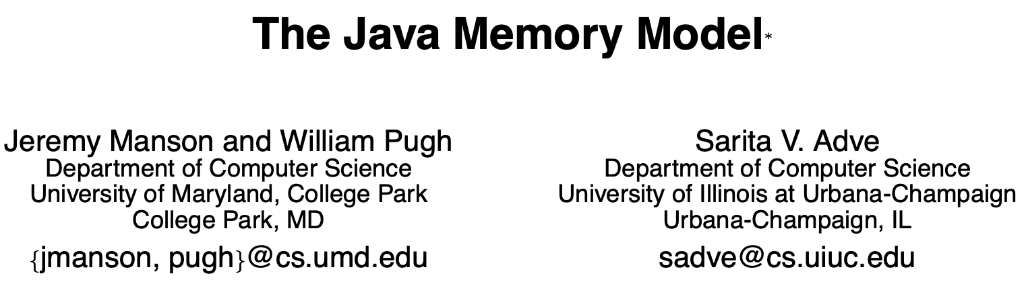
More concisely
“This paper describes the new JMM, which…specifies the legal behaviors for a multithreaded program; it defines the semantics of multithreaded Java programs and…legal implementations of JVMs and compilers.” [POPL 2005]
“Happens-before (→) is the transitive closure of program order and synchronization order.”
“A program is said to be correctly synchronized or data-race-free iff all sequentially consistent executions of the program are free of data races.” [Under →]

Slide 30
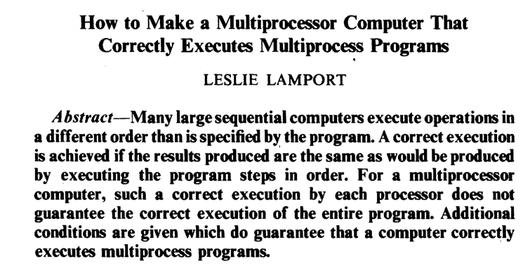
1979: An early understanding of multicore memory model. Proposed sequential consistency for machines.

Slide 31
Sequential consistency
A machine is sequentially consistent iff:
Memory operations (loads and stores) appear to execute in some sequential order on the memory;
Ops from the same core appear to execute in program order;
The order is identical to all observers.
T1
W(x)=1
OK
R(y)
1
M
T2
W(y)=1
OK
R(x)
1

Slide 32
Sequential consistency is too strong!
Sequential consistency requires the machine to do a lot of extra work that might be unnecessary.
The machine must make memory updates by one core visible to others, even if the program doesn’t care.
The machine must do some of the work even if no other core ever references the updated location!
Can a multiprocessor with a weaker ordering than sequential consistency still execute programs correctly?
Answer: yes. Modern multicore systems allow orderings that are weaker, but still respect the happens-before order induced by synchronization (lock/unlock).

Slide 33
Memory behavior in the real world
Synchronization accesses tell the machine that ordering matters: a happens-before relationship exists.
Machines always respect happens-before.
→ sequential consistency for race-free programs.
Otherwise, all bets are off. Synchronize!
T1
W(x)=1
OK
R(y)
1
The most you should assume is that any memory store before a lock release is visible to a load on a core that has subsequently acquired the same lock.
pass lock
M
T2
W(y)=1
OK
R(x)
0??

Slide 34
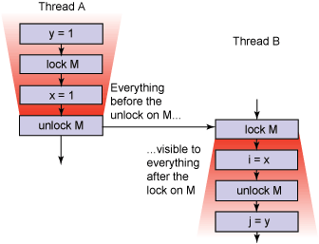
Lock it down!

Slide 35
Don’t assume sequential consistency
A load might fetch from the local cache and not from memory.
A store may buffer a value in a local cache before draining the value to memory, where other cores can access it.
Therefore, a load from one core does not necessarily return the “latest” value written by a store from another core.
W(x)=1
OK
R(y)
0??
A trick called Dekker’s algorithm supports mutual exclusion on multi-core without using atomic instructions. It assumes that load and store ops execute sequentially.
But they don’t.
T1
M
T2
W(y)=1
OK
R(x)
0??

Slide 36
Don’t assume sequential consistency
No sequentially consistent execution can produce the result below, yet it can occur on modern machines.
W(x)=1
OK
R(y)
0??
To produce this result:
4<2 (4 happens-before 2) and 3<1. No such schedule can exist unless it also reorders the accesses from T1 or T2. Then the reordered accesses are out of program order.
T1
2
3
M
1
4
T2
W(y)=1
OK
R(x)
0??

Slide 37
JMM model
The “simple” JMM happens-before model:
A read cannot see a write that happens after it.
If a read sees a write (to an item) that happens before the read, then the write must be the last write (to that item) that happens before the read.
Augment for sane behavior for unsafe programs (loose):
Don’t allow an early write that “depends on a read returning a value from a data race”.
An uncommitted read must return the value of a write that happens-before the read.

