Slide 1
Advanced OS (CPS 510)
Kernel Synchronization
Jeff Chase
Duke University

Slide 2

Threads in the kernel: racy!
trap/fault
Return to user mode
Enter kernel mode
Switch to per-thread kernel stack
Shared kernel space
…..
wait
stack
Multiple threads/processes may run in the kernel at the same time.
They access shared kernel data structures.
They interleave—by yield, block, or dispatch on multiple cores.
They can race. Concurrency: control it!

Slide 3
Thread states and transitions
running
user mode
kernel mode
yield
preempt
sleep
mode
switches
dispatch
blocked
ready
wakeup
STOP
wait
Transitions in and out of the running state are context switches.
Transitions between k/u mode in running state are mode switches.

Slide 4


Step 1: blocking synchronization
Yes: kernel has mutex locks and wakeup conditions.
(Linux uses semaphores—equivalent to monitors.)
But that is not the whole story.
running
Scheduler: dispatch,
preempt
A
T: lock X or
wait on Y
A
R
blocked
ready
T2: unlock X or signal/notify on Y
R

Slide 5
The role of interrupts
trap/fault
Return to user mode
Block (optional)
Shared kernel space
…..
wait
wakeup
EOI
EOI
Interrupts may hit while core is in kernel mode!
interrupt
interrupt
End of Interrupt: return to interrupted stream

Slide 6
Example: handling a page fault
Sleep (block): suspend execution until the read is complete and the thread can continue.
fault
5. Re-execute faulting instruction, continue
fault handler
…..
wait
1. identify
missing page
2. Allocate empty page frame
3. Read page from disk
4. Map VPN→PFN and return

Slide 7
Example: handling a page fault
Sleep (block): suspend execution until the read is complete and the thread can continue.
fault
5. Re-execute faulting instruction, continue
fault handler
…..
wait
3a. Identify disk block
3b. Initiate I/O
3c. Wait for I/O complete
wakeup
Disk performs read and deposits block in frame with Direct Memory Access (DMA).
Interrupt signals completion.
EOI
interrupt

Slide 8
Threads + interrupts → more races
trap/fault
Return to user mode
Enter kernel mode
Shared kernel space
…..
wait
interrupt
EOI
How to synchronize with interrupt handlers?
Interrupt handlers may race with the threads.
And/or they may race with one another, possibly on other cores.

Slide 9
Uniprocessors: classic easy case
So many years ago I worked on a BSD-derived kernel at the dawn of the multiprocessor (SMP) era.
It was a classic Unix kernel for uniprocessors:
Locks and conditions were just flag bits in data structures: locked, waiting, etc.
No atomic instructions. Nobody cared, because:
No preemptions in kernel mode! (As in Linux.)
If you have the processor, you have it until you let it go—by sleeping or returning to user mode.
Disable interrupts when operating on data shared with interrupt handlers.

Slide 10
Interrupts
Interrupt delivery transfers control to the corresponding handler (Interrupt Service Routine or ISR).
ISR runs kernel code in kernel mode in kernel space.
Each type of interrupt—an interrupt vector or interrupt request line (IRQ)—has a registered ISR.
executing thread
handler (ISR)

Slide 11
Interrupt nesting and priority
Each registered IRQ type has an associated priority.
E.g., Intel-64 has 256 IRQs and 16 (14) priority classes.
Mapping to specific events and devices is OS-defined.
Hardware dispatches interrupts to core in priority order.
A high-priority IRQ/ISR may interrupt a lower one.
high-priority
ISR
executing thread
low-priority
handler (ISR)

Slide 12
Interrupt priority: rough sketch
N interrupt priority classes
When an ISR at priority p runs, CPU blocks interrupts of priority p or lower.
Kernel software can query/raise/lower CPU interrupt priority level (IPL/PPL).
Raising to IPL p defers or masks delivery of interrupts at IPL p or lower.
Avoid races with ISR at IPL p by disabling: raise CPU IPL to p.
Be sure to put it back!
e.g., BSD Unix spl*/splx primitives.
Summary: Kernel code can enable/disable interrupts as needed.
low
spl0
splnet
splbio
splimp
clock
high
splx(s)
BSD example
int s;
s = splhigh();
/* all interrupts disabled */
splx(s);
/* IPL is restored to s */

Slide 13
Details vary by machine (I-64)

Slide 14
Details vary by OS (Linux)

Slide 15
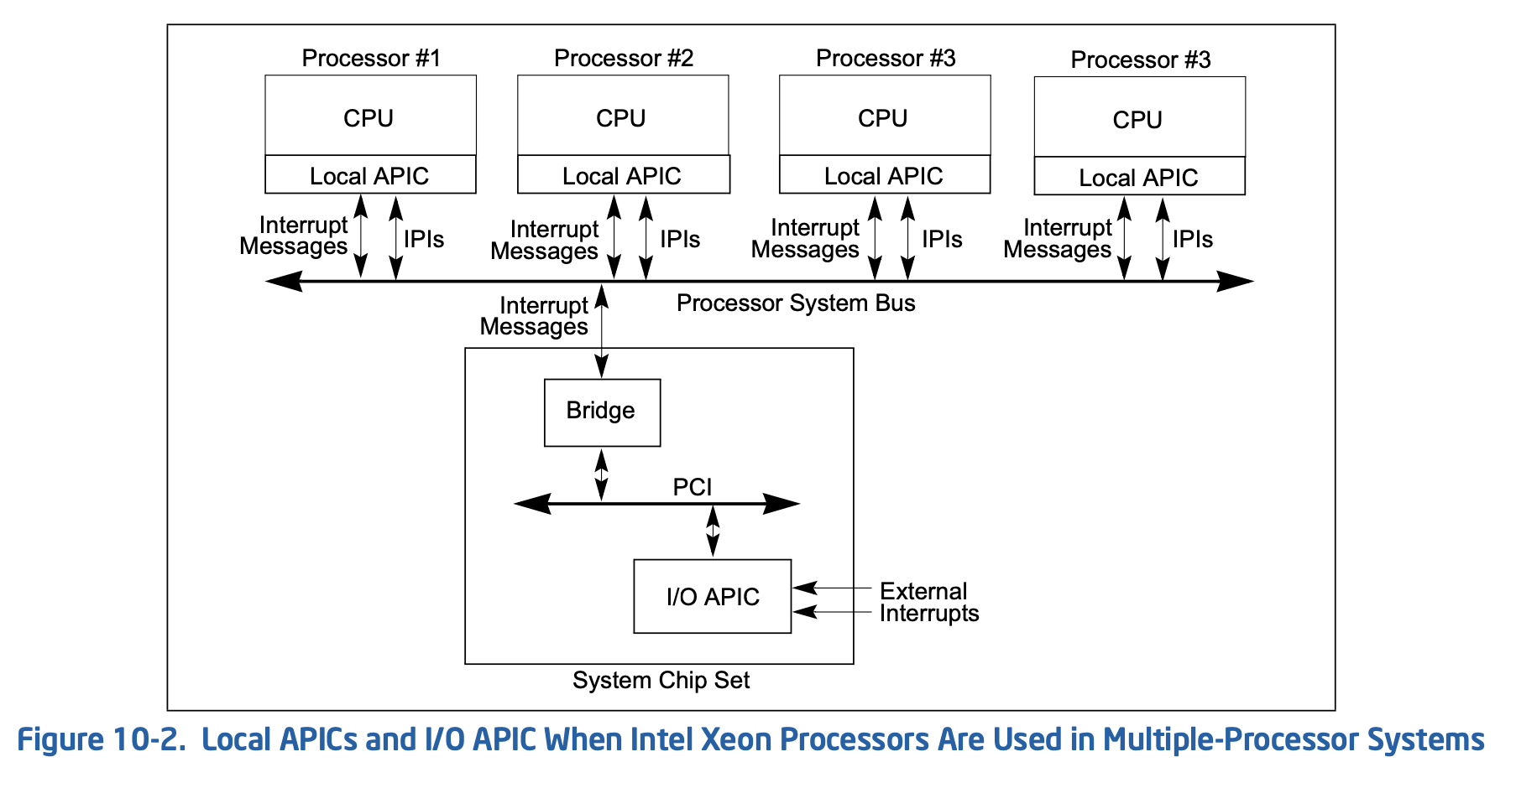
OS controls which cores receive which I/O interrupts (I-64)
Software programs the LAPICs and I/O APICs by writing to mapped control registers.

Slide 16
Interrupts: a few important details
Privileged software controls interrupt functions.
Kernel(s) as mediated by optional hypervisor
Invisible to user mode (except by timing)
IPL/PPL and enable/disable are per core.
Cores can send inter-processor interrupts (IPI).
E.g., PTE invalidation → TLB shootdown IPI.
Software controls: handler (ISR) selection, stack mapping, priority levels, and mapping to cores.
Typical: one interrupt stack per core.
Hypervisor may mediate interrupt injection to VMs, or configure hardware for direct (exitless) dispatch to VMs.

Slide 17
What ISRs do
Interrupt handlers:
trigger involuntary thread switches (preempt—if thread is preemptable, e.g., not in kernel mode)
bump counters, set flags
throw I/O packets on/off queues
…
wakeup waiting threads
Wakeup puts a thread on the ready queue.
But how do we synchronize with ISRs?

Slide 18
ISRs race and they never sleep
trap or fault
return to user mode
sleep queue
ready queue
sleep
wakeup
switch
interrupt
Interrupt handlers access state shared with thread-level (IPL 0) code.
Interrupt handlers do not block: If an interrupt arrived while another handler was sleeping, it corrupts the interrupt stack. No mutexes! Semaphores (e.g., in Linux) permit ISR to wakeup without risk of blocking. And we can disable them.

Slide 19
Synchronizing with ISRs
Interrupt delivery can cause a race if the ISR shares data (e.g., a thread queue) with the interrupted code.
Solution: disable interrupts for interrupt-critical sections.
Interrupt dispatch at each priority p is serial (per-core).
executing thread (IPL 0) in kernel mode
disable interrupts for critical section
int s;
s = splhigh();
/* critical section */
splx(s);
Defer interrupt dispatch until section is complete.

Slide 20
Next step: synchronizing SMPs
Modern systems: symmetric multiprocessor (SMP).
Multiple processors and/or multiple cores per chip.
Kernel code can run on any core.
Now what?
ISRs run on multiple cores, and so may race with other ISRs or threads on other cores.
Disabling interrupts is no longer sufficient.
(Cores do not disable one another’s interrupts.)
And: no blocking locks for ISRs.
We need fast+effective synchronization for lots of short critical sections, with no blocking: spinlocks.

Slide 21
Non-blocking synchronization
We need hardware support for atomic read-modify-write operations on data item X by a thread T.
Atomic means that no other code can operate on X while T’s operation is in progress.
We can use atomic instructions for safe low-level data access without locks (e.g., fetch-and-add).
We use them as a “toehold” to implement SMP-safe blocking synchronization.
We use them to implement spinlocks: locks that busy-wait in a loop when not free, instead of blocking.

Slide 22
Spinlock: Intel
Idle the core for a contended lock.
^{Spin_Lock:}
CMP lockvar, 0 ;Check if lock is free
^{JE Get_Lock}
PAUSE ; Short delay
^{JMP Spin_Lock}
^{Get_Lock:}
^{MOV EAX, 1}
XCHG EAX, lockvar ; Try to get lock
CMP EAX, 0 ; Test if successful
^{JNE Spin_Lock}
Atomic exchange to ensure safe acquire of an uncontended lock.
XCHG is a variant of compare-and-swap: compare x to value in memory location y; if x != *y then exchange x and *y. Determine success/failure from subsequent value of x.

Slide 23
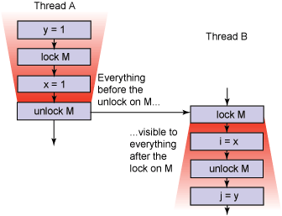
Atomic instructions also drive hardware memory consistency

Slide 24
XCHG: some details (I-64)
Synchronization mechanisms in multiple-processor systems…can use a locking instruction such as the XCHG instruction or the LOCK prefix to ensure that a read-modify-write operation on memory is carried out atomically. Locking operations typically operate like I/O operations in that they wait for all previous instructions to complete and for all buffered writes to drain to memory.
Any locked instruction (either the XCHG instruction or another read-modify-write instruction with a LOCK prefix) appears to execute as an indivisible and uninterruptible sequence of load(s) followed by store(s).
8.2.3.8 Locked Instructions Have a Total Order
The memory-ordering model ensures that all processors agree on a single execution order of all locked instructions.
8.2.3.9 Loads and Stores Are Not Reordered with Locked Instructions
…

Slide 25
Example: Linux spinlocks
Understanding the Linux Kernel (Bovet and Cesati). Example only: out of date.

Slide 26
Synchronizing with ISRs, revisited
Suppose: Core at IPL=0 (thread context) holds spinlock, interrupt occurs, ISR attempts to acquire spinlock….
That would be bad. Solution: disable interrupts.
On SMP, disabling interrupts is no longer sufficient, but it is still necessary for potential ISR races.
IPL 0
int s;
s = splhigh();
spinlock_acquire(l);
/* critical section */
spinlock_release(l);
splx(s);
disable interrupts AND acquire spinlock for critical section
Else spin forever…

Slide 27
Example: Linux spinlock macros
Note that Linux has reader/writer (“SharedLock”) spinlocks.
Understanding the Linux Kernel (Bovet and Cesati). Example only: out of date.

Slide 28
Spinlocks in user mode?
Don’t use spinlocks in user mode.
They waste CPU time and they are dangerous: what if a thread is preempted while holding a spinlock?
We typically disable preemption for threads in kernel mode, so not risky there.
But for user mode threads, managing spinlocks and preemption safely is a research topic.
(More on this topic later.)

Slide 29
Summary
Spinlocks are fast locks for short critical sections.
Useful, necessary, and common inside an SMP kernel.
For synchronizing threads and ISRs across cores.
On a uniprocessor, just enable/disable interrupts instead.
On an SMP, interrupt disable/enable is necessary but not sufficient: we also need spinlocks.
On an SMP, spinlocks etc. use atomic instructions.
On an SMP, these also assure memory consistency for properly synchronized software.

