Slide 1
An Analysis of Linux Scalability to Many Cores
CPS 510 Discussion
Week 5

Slide 2
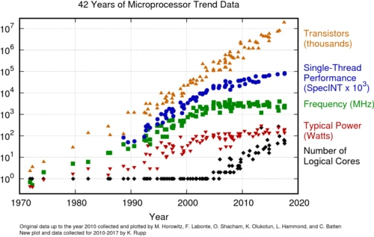
Moore’s law
Multi-core

Slide 3
Scaling applications to multi-core servers
Single-core performance, P
On m cores, ideally we want to have performance of m * P
In reality, it is almost never the case because applications contain parts can need to run sequentially in order to access shared data, etc.
Scalability means how much gap the performance is compared to the ideal speed up

Slide 4
Scaling applications to multi-core servers
Throughput
(Ops/sec)
Performant but not scalable.
Scalable but not performant.
1
4
8
Number of cores

Slide 5
Scaling applications to multi-core servers
Throughput
(Ops/sec)
1
4
8
Number of cores

Slide 6
Is OS a bottleneck for application scalability?
Shared data structures inside kernel
Reference counters
Task queues
File system data structures
Does OS need a major redesign?
We need a standardized benchmark suite
Linux is fine!

Slide 7
Question #1
What problem does sloppy counter solve? What’s the drawback?

Slide 8
Question #2
What’s your favorite technique described in this paper? How does it work?

