Slide 1

CPS 510
5a Futexes
Jeff Chase & Michael Hewner
Duke University

Slide 2
Futex (Linux)
Futex is a Linux syscall API for “fast user mode mutex”.
Not a mutex.
Rather, it’s a building block for mutex or semaphore.
Used in native Linux pthreads (NPTL).
Flag location (*p) in user space captures object state.
Aligned 32-bit integer; may be shared across processes (mmap).
Sync (or spin) using atomic instructions in user mode.
Call kernel only when necessary to block (contended).
Kernel checks flag again and aborts blocking operation if it does not match the expected value.

Slide 3
Futex syscalls (over-simplified)
wait(p, val): boolean
If *p != val return false.
Else the calling thread blocks (waits or sleeps) on the futex; when the thread wakes up and resumes, return true.
One sleep queue per flag location indexed by phys(p).
wake(p): boolean
If at least one thread is waiting (blocked) on the futex, then awaken one of the waiting threads and return true. Else return false.

Slide 4
The point of futex
I have told you that blocking sync (e.g., pthreads) is implemented in the kernel. Too simple!
Must enter kernel to sleep/wakeup, but it is expensive.
Often no need to sleep/wakeup!
uncontended mutex
semaphore with value > 0
Rich atomic instructions are available from user mode.
E.g., via C++ v11 atomic STL libraries
Use futex+atomics to build hybrid synchronization: fast in user mode, enter kernel only when necessary.
Futex catches sleep/wakeup races: “mind the gap!”

Slide 5
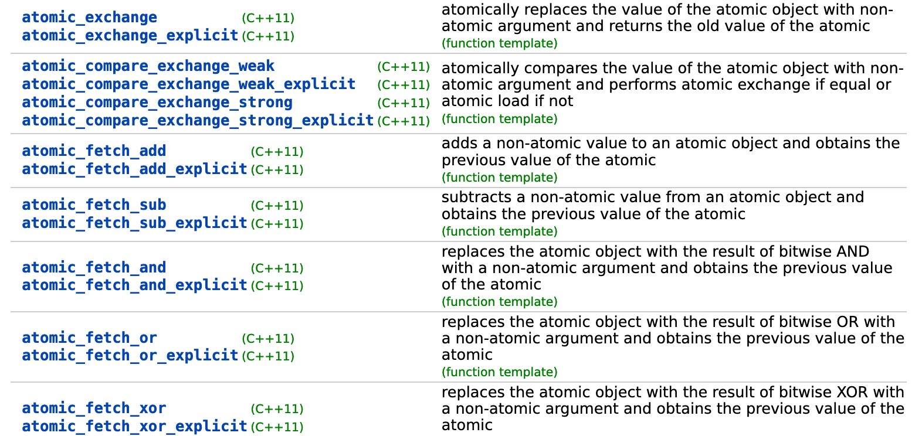
Brief digression: C++ atomic ops
https://en.cppreference.com/w/cpp/atomic

Slide 6
Ordering for atomic operations in C++11
The default behavior of all atomic operations in the library provides for sequentially consistent ordering. That default can hurt performance, but the library's atomic operations can [relax it by specifying desired ordering behavior].
memory_order_relaxed | Relaxed operation: there are no synchronization or ordering constraints imposed on other reads or writes, only this operation's atomicity is guaranteed.
memory_order_release | A store operation with this memory order performs the release operation: no reads or writes in the current thread can be reordered after this store. All writes in the current thread are visible in other threads that acquire the same atomic variable and writes that carry a dependency into the atomic variable become visible in other threads that consume the same atomic
https://en.cppreference.com/w/cpp/atomic/memory_order

Slide 7
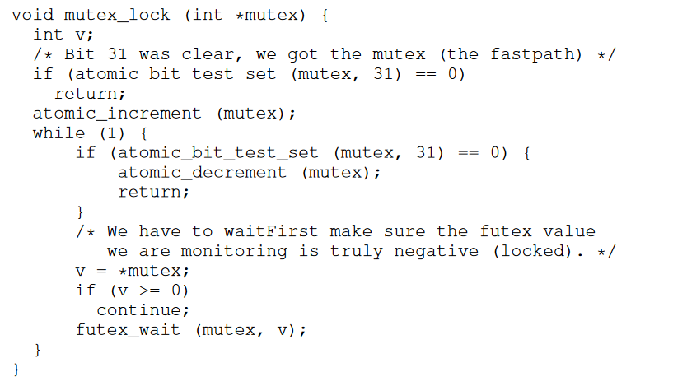
A Futex Mutex
The high bit of the mutex int indicates if it is locked, the rest indicates the number of waiters
Code Snippet from gnu libc, discussed in detail here:
http://pages.cs.wisc.edu/~remzi/OSTEP/threads-locks.pdf

Slide 8
A Futex Mutex
Note how fast the uncontended case is.

Slide 9
A Futex Mutex
It would be bad to wait on an open lock
Note that v parameter atomically ensures that we won’t sleep unless the values matches at the time of sleep

Slide 10
A Futex Mutex
Note that just because we’ve woken up doesn’t mean we have the mutex (spurious wakeups are a thing)

Slide 11
Is The Futex Mutex Fair?
Code Snippet from gnu libc, discussed in detail here:
http://pages.cs.wisc.edu/~remzi/OSTEP/threads-locks.pdf

Slide 12
Advice for futexes
Your only safe operations are atomic operations
Ensure you use the value passed to futex wait to ensure that you don’t sleep if the situation has changed
You must deal with spurious wakes
Futexes are building blocks for synchronization primitives. Its fun to build your own – but usually not a good idea on a job.

