Slide 1
Non-blocking Synchronization
510 5b
Duke University
Michael Hewner

Slide 2
We can use primitives like mutexes and condition variables to ensure correct concurrency
But these concurrency primitives have the potential to block (or busywait in the case of a spinlock)
At minimum blocking involves being de-scheduled, placed in a waiting queue, and then having to rise in the ready queue before your code can run again
It would be cool if we could ensure correctness just with atomic instructions and no possibility of blocking
That’s easy if you (say) want to increment a shared counter but can also be applied to larger structures like inserting/removing from a queue
It’s cool and fast, but tricky to get right

Slide 3
Lock Freedom
At least one thread can make progress, regardless of the state of other threads
Ordinary Blocking Algorithm
Lock Free Algorithm
mutex_lock()
attempt_operation
This try again means the possibility of starvation.
mutex_unlock()
Try again?
If the orange thread is not scheduled
the blue threads cannot make progress
Threads can try at the same time. At least one always succeeds.

Slide 4
Wait freedom
A particular thread always succeeds after a fixed number of operations
Strongest possible form of non-blocking, but we’re not going describe algorithms here

Slide 5
Compare and Store (CAS)
Basic atomic operation for lock free structures, maximally general
cas(int* address, int expected_value, int new_value)
If the value in address matches expected_value, replace it with new_value and return true. If it doesn’t match then don’t replace and return false.

Slide 6
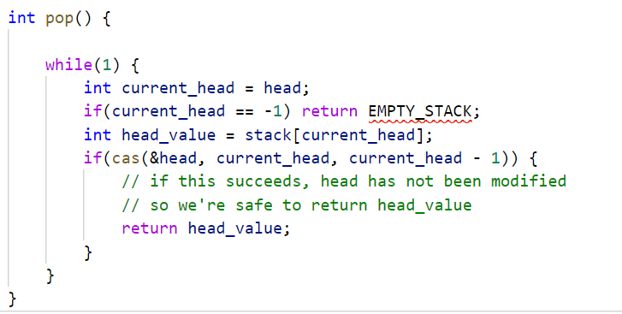
An example (with a problem)
Imagine we’re implementing a simple stack backed by an array.

Slide 7
The ABA Problem
What if after head_value is read both a pop and push occur?
The cas will succeed but the returned head_value will not be right

Slide 8
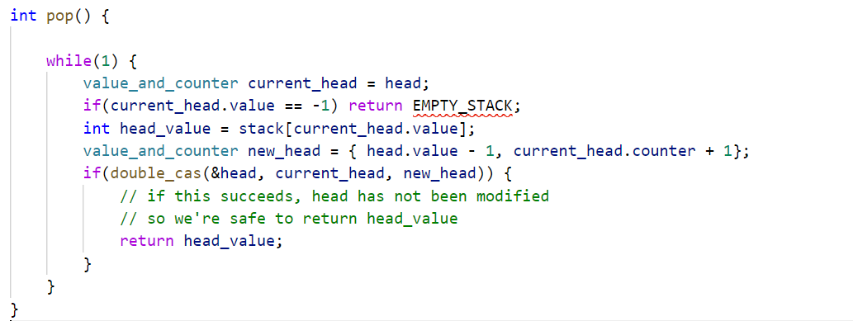
Solution
Built in counter value that’s atomically updated as a single unit
Requires a cas instruction that is double the size of the architecture

Slide 9
General advice about lock free structures
Exist in a variety of languages and are easy to use
Very subtle to implement correctly

Slide 10
