Slide 1
Scheduler Activations
Reconceptualizing the kernel interface for high-performance threads
Jeff Chase
Duke University

Slide 2
A thread
Each thread has a thread control block (TCB) or context block, and its own stack.
active
ready or
running
sleep
wait
wakeup
signal
TCB
blocked
stack
wait
When blocked its TCB is on a sleep queue of threads waiting for a specific wakeup event.
Program
When ready its TCB is on the ready queue.

Slide 3
Threads: abstraction vs. implementation
Thread is an abstraction with multiple implementations.
The OS lectures focus on kernel-based thread model.
OS kernel manages threads (by any name).
E.g., Linux, Windows, MacOS
The p1* labs use a library for user-level threads.
No specific kernel support
Works on classic Unix on uniprocessors
Which is “better”? Is it an either/or choice?
What’s the “right” way to implement threads?

Slide 4
Kernel-based threads
Syscall to create thread, with second kernel stack in kernel space.
Syscalls to sleep/wakeup to synchronize (e.g., futex).
Threads can use all blocking syscalls, e.g., for I/O.
Block only in kernel mode: kernel sched dispatches next ready.
Kernel starts thread in its start procedure with an “upcall”.
Thread enters kernel on trap or fault, runs on its kernel stack.
Resumes user context on (optional) return from trap/fault.
Kernel may modify context and resume wherever it wants.
On timer interrupt, kernel preempts the running thread if its quantum expired.
stack
stack
stack
stack

Slide 5
Thread library
Library routines to create/block/switch threads in user mode.
Uses makecontext/swapcontext to switch between streams.
Does not request threads from kernel.
Kernel does not know or care.
At most one thread at a time can run on process context.
At most one in kernel for trap/fault at a time.
Threads use the same kernel stack.
Program (app or test)
Thread_*
calls
Thread library
I/O syscalls, faults
OS kernel

Slide 6
Kernel+library: better together
In truth, all thread systems combine kernel + library.
Programmer’s API is User-Level Thread System (ULTS) library.
The library uses the kernel interface and hides it from the app.
→ The kernel syscall interface is not the API.
Design library API for ease of use.
Design syscalls for power and speed.
Example: pthreads on Linux
NPTL library (“Posix threads”)
Uses “hidden” syscalls clone(), futex.
Today: what is the “right” division of function between lib/kernel code?

Slide 7
Library and kernel work together Example: heap
Program (app or test)
Library manages its own resources its own way.
alloc
alloc
free
“ok”
“Hidden” kernel syscall interface for “raw” resources: e.g., VM slabs.
Heap manager
mmap
system call
OS mediates access to shared machine resources. Only as needed for trust, protection and isolation.
OS kernel

Slide 8
Library OS: philosophy
Principle: keep it in a library whenever possible.
Keep the kernel simple and small.
Minimal function to support library.
Kernel protects access to machine, nothing more.
Benefits:
Fast: fewer syscall traps
Secure: minimal kernel has fewer bugs
Flexible: permits innovation in library without changing kernel. Users choose a library to suit their needs.
Safe: library bugs crash process, not the whole system
Customizable: Factor policy+programming model out of kernel.

Slide 9
Goal: keep the kernel out of it
All times were measured in microseconds 30 years ago:
Operation | FastThreads | Topaz Threads | Ultrix Processes
Null fork | 34 | 948 | 11300
Signal-wait | 37 | 441 | 1840
User-level thread system (ULTS)
OS kernel
thread system
Classic Unix processes
ULTS is order(s) of magnitude faster. Why not just use it?
Scheduler Activations. Anderson et. al. SOSP 1991

Slide 10
Thread library API
thread_create(func, arg);
thread_yield();
Threads
thread_lock(lockID);
thread_unlock(lockID);
Locks/Mutexes
Mesa monitors
thread_wait(lockID, cvID);
thread_signal(lockID, cvID);
thread_broadcast(lockID, cvID);
Condition Variables
All functions return an error code: 0 is success, else -1.

Slide 11





Thread library: the story so far
exit
run
preempt
sleep
dispatch
create
block
wakeup
ready
Waiter queues for Mx/Cv etc.
wait
runqueue
Context switch out on sleep, yield/preempt, or exit. Get next ready thread, dispatch it.

Slide 12
What about multiple cores?
Our p1 thread library uses only one core.
What if multiple cores?
ULTS can use a kernel-based thread as “vessel” for each core.
ULTS decides threads to run on each “vessel”, e.g., priority.
Physical concurrency→nice to have spinlocks!
What if no ready threads? Spin?
What if the number of cores changes?
OS allocates CPU resources.
Grants cores, takes them away.
E.g., by timer-driven slicing
Or if a thread blocks for I/O…

Slide 13
Integration: kernel-based threads
With kernel-based threads, the kernel “knows” the status of all threads and all resources (cores).
Thread blocks for I/O → run another thread.
No core idles when a thread is ready.
Put each core to its “highest and best use”.
Timer-driven preemption with system-wide scheduling
No thread runs when a higher-priority thread is ready.
But kernel does not “see” events in the user program.
Kernel does not “see” idle cores.
Does not know if a preempted thread holds a spinlock.
No spinlocks! Use only kernel-supported blocking locks: slow.

Slide 14
Integration: ULTS
Poor integration for ULTS over kernel-based threads:
App has idle core → core is wasted.
Thread blocks in kernel for I/O → app loses the core.
Kernel preempts a core (‘vessel”) running thread T?
T holds a spinlock→wasted cycles. No fast spinlocks for ULTS!
T holds any lock→other threads wait longer for the lock.
T is a high-priority thread→priority inversion.

Slide 15
Page fault → app loses the core
While this thread is blocked, ULTS could run another thread on the core. But it doesn’t know.
fault
5. Re-execute faulting instruction, continue
fault handler
…..
wait
1. identify
missing page
2. Allocate empty page frame
3. Read page from disk
4. Map VPN→PFN and return
When a thread blocks, it stops running, leaves the core for use by other threads, and sleeps: it wakes/resumes only after some specified event or condition occurs.
Threads block for page faults, and for many other reasons as well.
It happens all the time.

Slide 16
Scheduler Activations
Scheduler Activations. Anderson et. al. SOSP 1991
Scheduler Activations is a kernel abstraction.
FastThreads User-Level Thread System (ULTS) shows how to build threads efficiently in a library using scheduler activations.
It’s not an API! Designed for use by the ULTS.
Kernel manages only resource (processor) allocation and I/O.
ULTS library runtime system does the rest: schedule threads, implement thread+synchronization primitives, etc.
Key idea: “Pass the cores”
Asynchronous control transfers across the kernel boundary
A transfer passes control of the core ULTS←→kernel.
Transfer contexts as data.
Expose knowledge and control over resources to the ULTS.

Slide 17
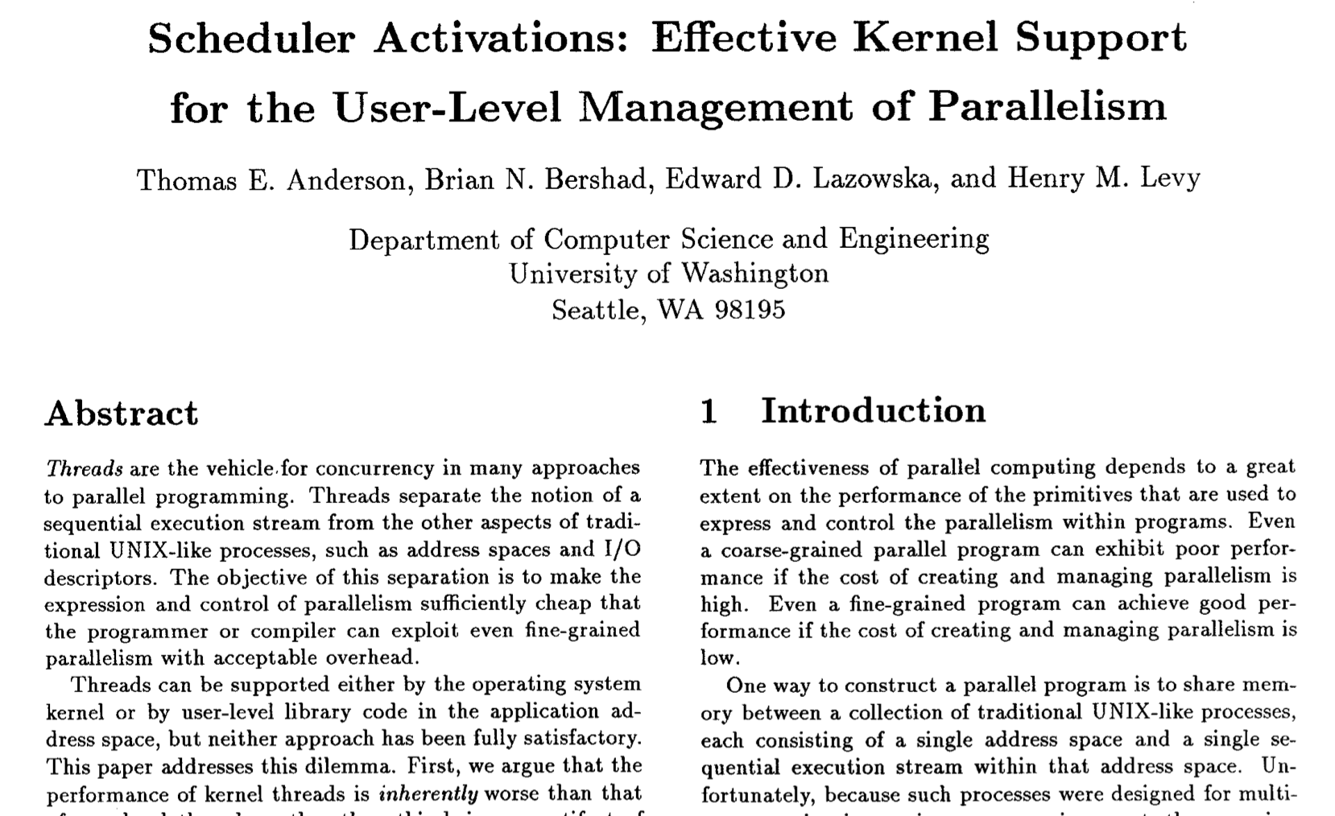
SOSP 1991

Slide 18
Reconceptualizing the kernel interface
Kernel gives process a virtualized multiprocessor (MP).
In-process ULTS manages its virtual MP.
Kernel allocates cores to ULTS. (How?)
In-process ULTS “knows” what/how many cores it has.
Kernel can “take it back” at any time, but it notifies ULTS.
ULTS manages its own cores its own way.
ULTS notifies kernel of its demand for cores.
Don’t need the core? Return it to the kernel. (How?)
Want more? Request more cores from the kernel.
Needed: some way to pass cores back and forth.

Slide 19
Upcall
Standard trap/return.
Upcall
“Something happened.”
E.g. I/O completion for non-blocking I/O API,
Asynchronous event
“Do it.”
“OK”
Might not return.
Upcall: cause to invoke a procedure in a client module.
E.g., kernel: point PC at handler; point SP at a stack; go.
Notifies client of an asynchronous event or completion.
“Like an interrupt.” See also: Unix signal handler.

Slide 20
Pass the core Asynchronous control transfers
Traps/faults and “returns” are decoupled: every return is an upcall.
Library and kernel manage/exchange contexts, switch among stacks as needed to run asynchronous streams with available cores.
“Here is a core; run it your way. See also the info at addr X.”
Kernel constructs trapframe to “return” to designated handler in user mode: upcall.
Like launch to main() or caught signal.
“Here is a core back to execute a request for me—or—I just don’t need this core any longer.”
Transfer to kernel by ordinary trap or fault. Return is optional, e.g., like exit().
stack
stack
Keep stacks as needed.
stack

Slide 21
What is a scheduler activation?
An activation is a virtual core delivered to the ULTS.
Kernel delivers core with an upcall to ULTS scheduler.
The core invokes a ULTS entry point.
ULTS dispatches next ready thread.
Uses:
Here is the new core you requested; use it as you choose.
Your thread has blocked; here is your core back.
A thread has unblocked: here is its context, and your current one.
I took a core away that was running this context (not shown).
fault
2
3
1
wait
interrupt
timer

Slide 22
The tricky part: delivering contexts
What core to use to notify ULTS of an event?
Unblock: deliver unblocked context
Loss of core: deliver preempted context
Pick another of app’s cores and preempt current context.
Return context with the activation.
And the context affected by event.
So upcall delivers two contexts.
1
2
3
runqueue
Dispatch blue
Dispatch green
Return green to queue, then dispatch blue.
wait
interrupt

Slide 23
Activation upcalls
Add new core
ULTS picks a thread/context and dispatches it.
Blocked context
ULTS picks another thread and dispatches it.
Unblocked context
Unblocked context to resume (A).
And context (B) from core used for upcall.
Put A or B back on runqueue, resume the other.
Preempted core!
Ready context (A) of preempted virtual core.
Deliver/handle as for #3.

Slide 24
Complications
Scheduler Activations. Anderson et. al. SOSP 1991
If a core is prempted in ULTS code (e.g., context switch)
or in a spinlock-protected critical section
then ULTS must resume the preempted context until it exits its critical section.
Note: this approach enables safe spinlocks in user mode. If preempted, ULTS resumes thread immediately on another core.
Page fault in ULTS code also requires special handling.

Slide 25
A classic systems paper
Kernel-level threads: well-integrated, but slow.
Kernel has full view of threads+resources, manages everything.
The cost is inherent: protection, traps, dilemma of generality.
ULTS threads: fast, but poorly integrated.
Can’t react to changing number of cores.
Can’t manage your cores.
Can’t use spinlocks or priority.
Can’t overlap compute and I/O.
Scheduler Activations model yields the benefits of both and the drawbacks of neither.
Yes, you can have it all.

Slide 26
A classic systems paper
The solution is transparent to programmers.
Library implements familiar program abstraction: threads.
Kernel handles machine-defined objects: cores and contexts.
Support for the programming model is decoupled from kernel.
Rewire your brain, rethink the foundations.
This landmark paper launched direction of library OS.
Beyond microkernels
Exokernel (MIT 1995-): ”no abstractions” for kernel, just raw resources and protected control of the machine.
Trusted execution environments—enclaves. Haven, Scone.
Unikernels, kernels for high-speed server VMs. Dune, Arrakis.
Serverless cloud computing

Slide 27
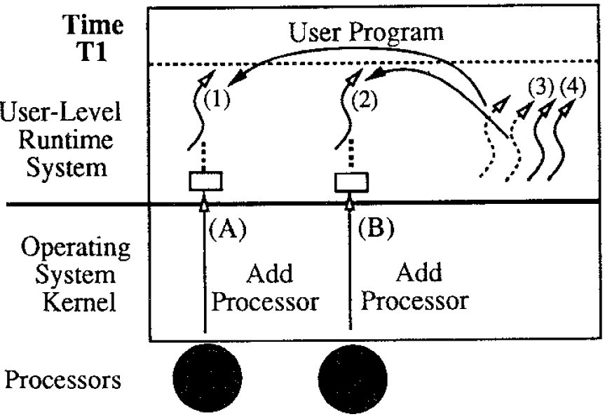
Example (T1)
Scheduler Activations. Anderson et. al. SOSP 1991
At time Tl, the kernel allocates the application two processors (cores). On each core, the kernel upcalls to ULTS code that picks a thread from the ready list and starts running it.

Slide 28
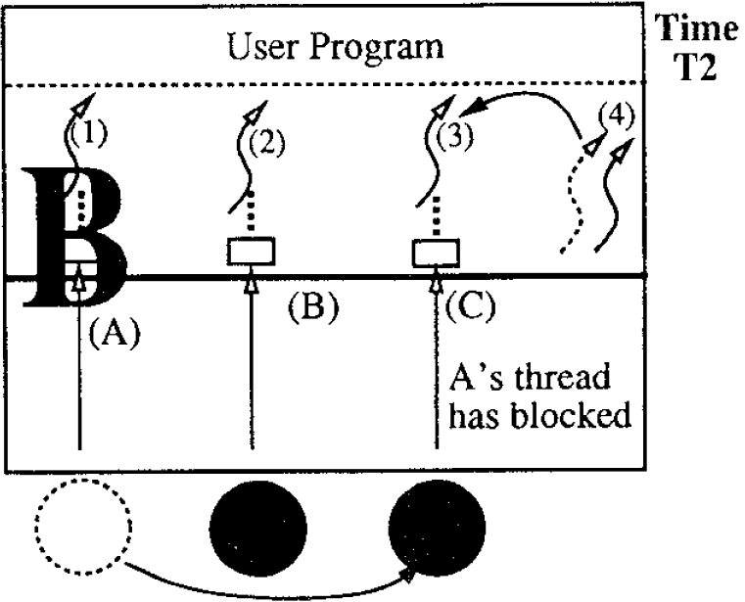
Example (T2)
Scheduler Activations. Anderson et. al. SOSP 1991
At time T2, thread 1 blocks in the kernel. To notify ULTS of this event, the kernel takes the processor that had been running thread 1 and performs an upcall in the context of a fresh scheduler activation. The ULTS scheduler uses the core to take another thread off the ready list and start running it.

Slide 29
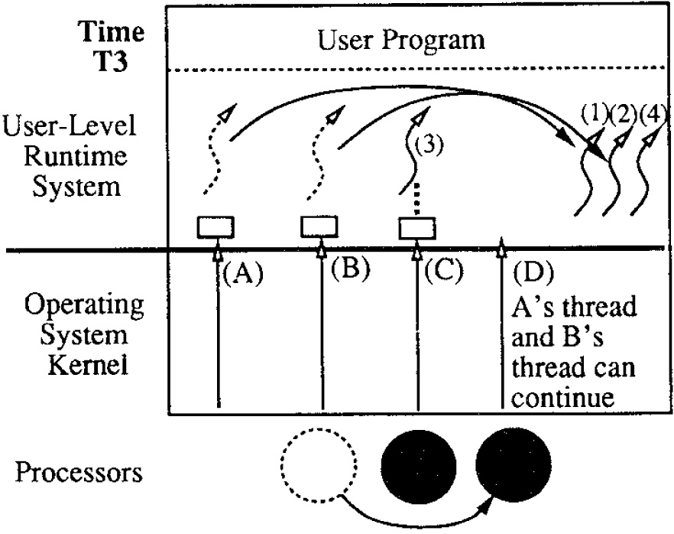
Example (T3)
Scheduler Activations. Anderson et. al. SOSP 1991
At time T3, the I/O completes. Kernel notifies ULTS of the event, but this requires a core. The kernel preempts one of the cores running in the VAS and uses it to do the upcall. (If there are no cores assigned, the upcall must wait until the kernel allocates one). This upcall notifies ULTS of two things: the I/0 completion and the preemption. The upcall invokes code in the ULTS that (1) puts the thread that had been blocked on the ready list and (2) puts the thread that was preempted on the ready list.

Slide 30
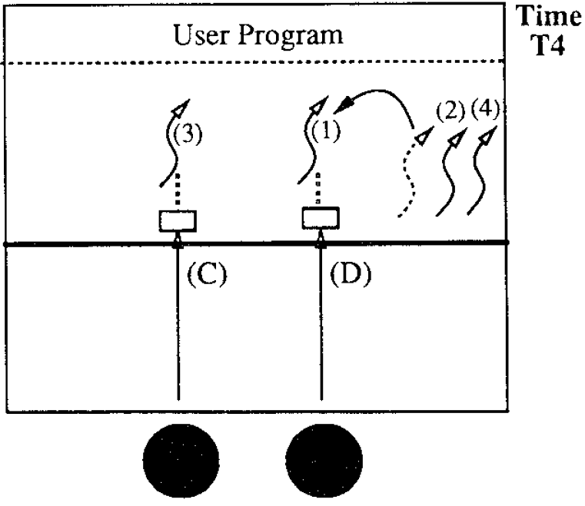
Example (T4)
Scheduler Activations. Anderson et. al. SOSP 1991
Finally, at time T4, the upcall takes a thread off the ready list and starts running it.

Slide 31
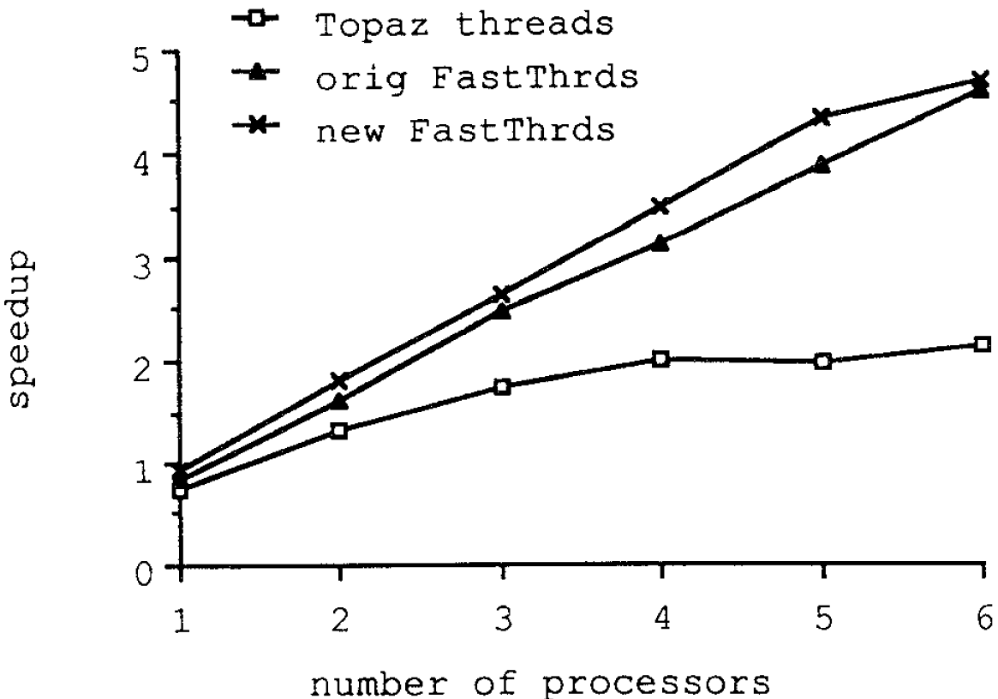
Speedup: compute-bound
No spin-waiting for Topaz so lots of overhead.
New FastThreads better for less than 6 cores due to poor scheduling of Topaz. Daemon thread causes preemption, even if processors avail.

Slide 32
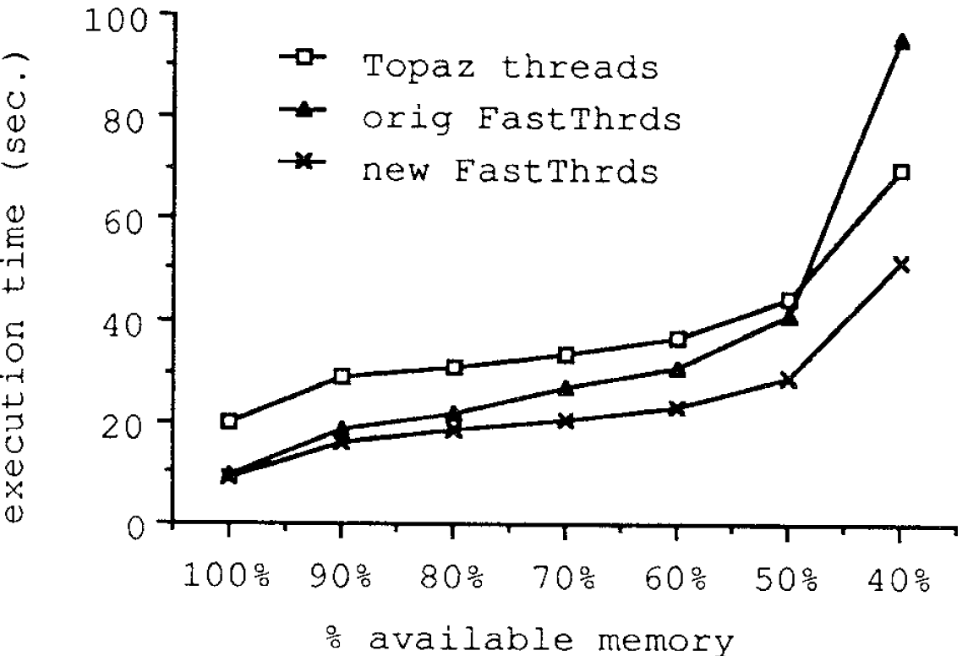
Results: I/O bound
FastThreads degrades due to inability to reallocate core when thread blocks.
Topaz has poorer performance due to kernel involvement.

Slide 33
Multiprogramming
Kernel must (re)allocate cores among multiple contending “virtual MPs” (processes).
Two processes, N cores, each should speed up by N/2.
Results in paper give a few small data points suggesting that unmanaged timeslicing → underperforms.
And FastThreads on Scheduler Activations approaches the expected speedup.

