Slide 1
CPS 510
Dune
Jeff Chase
Duke University

Slide 2

Dune
Dune is a new way to run applications with super-powers.
Dune takes new advantage of virtualization technology.
May help performance-critical apps, e.g., in data centers.
Dune: Safe User-level Access to Privileged CPU Features, Belay et al., (Stanford), OSDI, Oct. 2012

Slide 3
The Dune idea
Idea: application process enters Dune mode to get safe “raw” access to machine resources and functions.
Runs in guest privileged mode with fast hypercalls to host kernel.
Review architectural support for host/guest model.
Dune runs on/as a Type 2 VMM within Linux OS.
Question: what goodness does Dune enable?
guest kernel
hypervisor
hypervisor

Slide 4
Dune’s use of Virtualization Technology
Host
VMX Root
Guest
VMX Non-Root
User
Ring/CPL 3
Ordinary
user process
Managed by app
e.g., for sandboxing untrusted code
Host kernel
(Linux)
Kernel
Ring/CPL 0
Dune Mode process
Most app code runs here
with libDune library
Intel Virtualization Technology (VT) includes Virtual Machine Extensions (VMX) to CPU/ISA, Extended Page Table (EPT), and related system extensions VT-x, e.g., VT-d for I/O with guest-initiated DMA to “guest-physical” addresses.

Slide 5
Run App as a “process” in guest mode, and let it use all CPLs.

Slide 6
Dune system architecture

Slide 7
Devils in the Details of Dune
Guest sees enhanced process environment, not a VM.
System call to enter Dune mode: ioctl on /dev/dune.
Traps? Redirect as hypercalls, even from kernel mode.
Syscall args must be valid as host-virtual addresses.
Dune installs process VAS in EPT page tables.
Signals don’t work → limited emulation (inject interrupts).
Per-thread entry to Dune mode, i.e., per-thread VMCS.
Limit powers in guest VMCS to reduce switch costs.
Lots of “interesting” games to manage guest page tables.

Slide 8
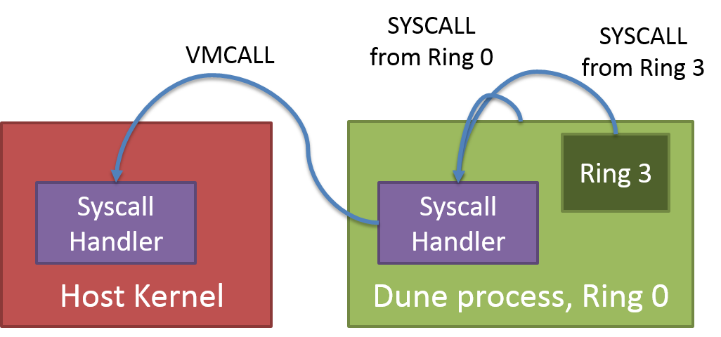
Hypervisor calls
VT VMCALL operation (an instruction) voluntarily traps to hypervisor.
Similar to SYSCALL to trap to kernel mode.
Not needed for transparent virtualization: but Dune uses it to call the “real” kernel.

Slide 10
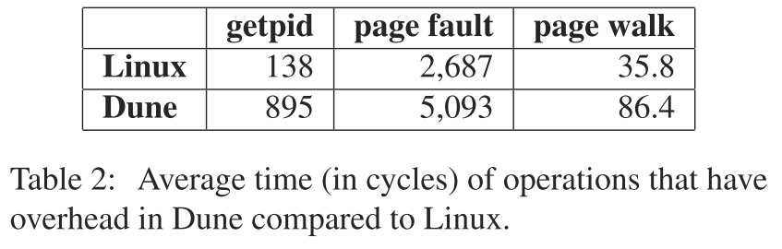
Dune: performance
Dune: Safe User-level Access to Privileged CPU Features, Belay et al., (Stanford), OSDI, Oct. 2012

Slide 11
Sandboxing (5.1)
Example: sandboxing untrusted code in ring 3 (user mode).
Launched by libDune, which controls the sandbox.
libDuke has a builtin ELF loader
Like any kernel, libDune must beware of malicious ELF files: check your pointers.
Sandboxed code runs with:
Limited access to app’s VAS;
App-specific interposition (e.g., filter) on its syscalls
Optional limited use of large pages → low paging cost.
Apps: network firewall, checkpoint/restart.

Slide 12
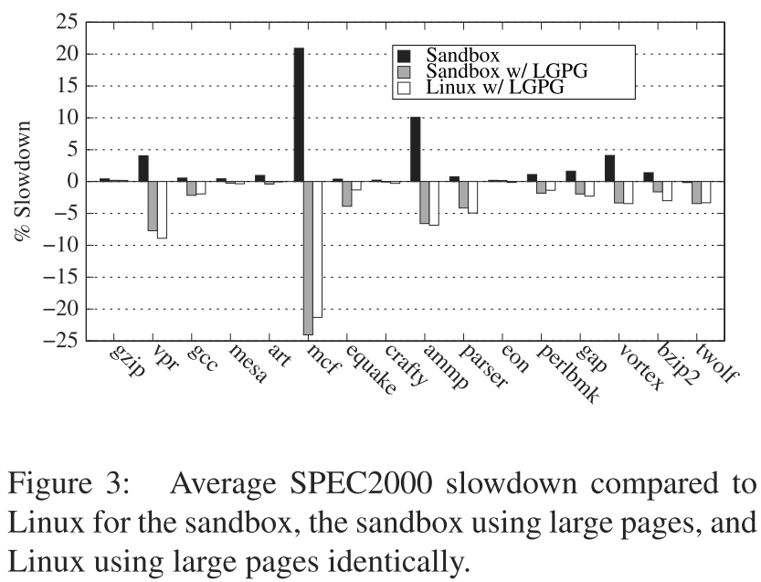
Dune sandbox performance

Slide 13
Reflections on Dune
Good paper?
We like papers that change the way you think about OS.
We like papers that apply new machines creatively.
What’s the “killer app”?
Foundations for high-speed direct-mapped I/O.
Arrakis OSDI 2014
Apps that manage their own page protections.
E.g., concurrent garbage collection
Landmark paper: Appel and Li (1991)

Slide 14
Preview of Arrakis
“It may also be useful to provide Dune applications with direct access to IO devices. Many VT-x systems include support for an IOMMU, a device that can be used to make DMA access safe even when it is available to untrusted software. Thus, Dune could be modified to safely expose certain hardware devices. A potential benefit could be re- duced IO latency. The availability of SR-IOV [virtualizable PCI I/O devices] makes this possibility more practical because it allows a single physical device to be partitioned across multiple guests.”
Dune: Safe User-level Access to Privileged CPU Features, Belay et al., (Stanford), OSDI, Oct. 2012

Slide 15
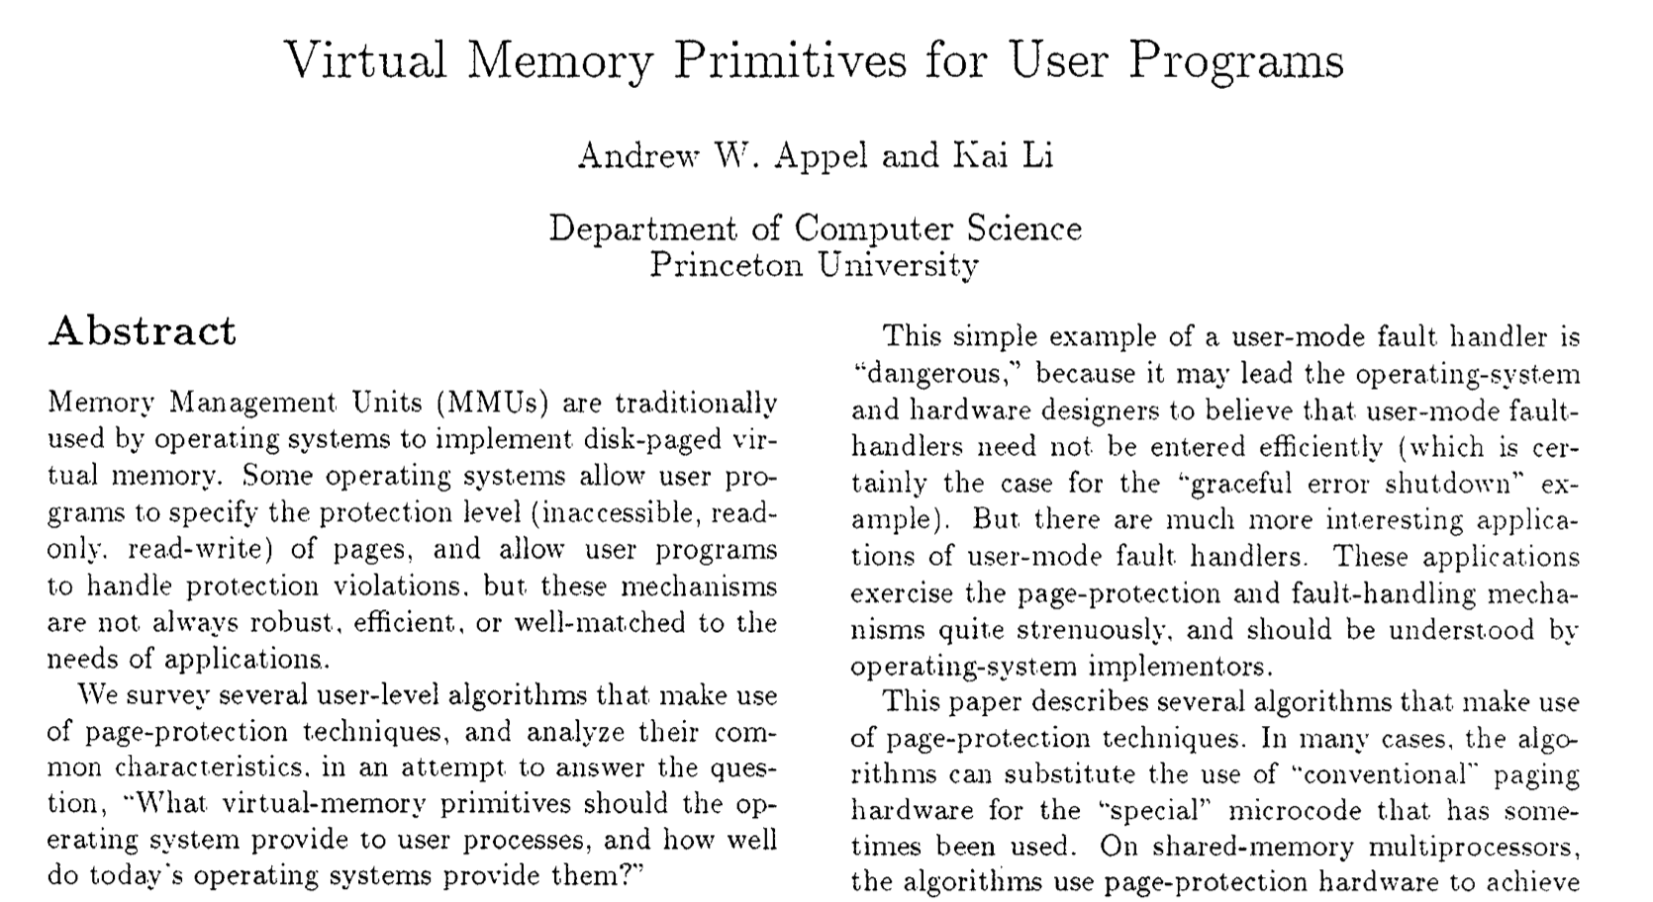
ASPLOS 1991

Slide 16
User access to VM primitives
TRAP - Handle page fault
PROT1 - Protect a single page
PROTN - Protect many pages
UNPROT - Unprotect single page
DIRTY - return list of dirty pages
MAP2 - Map a page to two addresses
Appel and Li ASPLOS 1991

Slide 17

Concurrent Garbage Collection (GC)
Appel and Li example: fast GC using page protection.
Find dirty pages: modified data for GC to examine.
Disable access to page during GC processing.
Notify GC if concurrent app code touches it.
Dune modifies Boehm GC for fast operation.
Query page table dirty bits
Fast mprotect
Fast TLB invalidations
Details in paper.

Slide 18
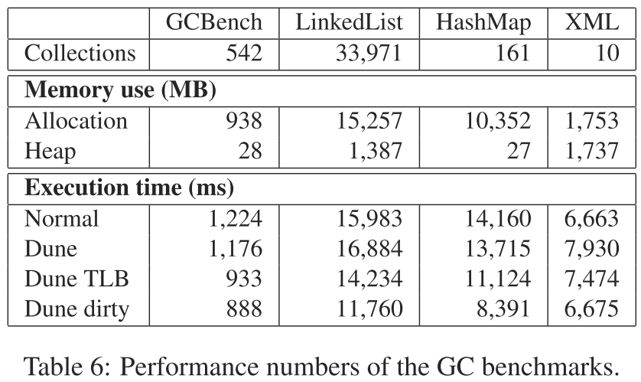
Dune: GC performance

Slide 19
According to Dune
2.1 The Intel VT-x Extension
In order to improve virtualization performance and simplify VMM implementation, Intel has developed VT-x [37], a virtualization extension to the x86 ISA. AMD also provides a similar extension with a different hardware interface called SVM [3].
The simplest method of adapting hardware to support virtualization is to introduce a mechanism for trapping each instruction that accesses privileged state so that emulation can be performed by a VMM. VT-x embraces a more sophisticated approach, inspired by IBM’s interpretive execution architecture [31], where as many instructions as possible, including most that access privileged state, are executed directly in hardware without any intervention from the VMM. …The motivation for this approach is to increase performance, as traps can be a significant source of overhead.
VT-x adopts a design where the CPU is split into two operating modes: VMX root and VMX non-root mode. VMX root mode is generally used to run the VMM and does not change CPU behavior, except to enable access to new instructions for managing VT-x. VMX non-root mode, on the other hand, restricts CPU behavior and is intended for running virtualized guest OSes.
Transitions between VMX modes are managed by hardware. When the VMM executes the VMLAUNCH or VMRESUME instruction, hardware performs a VM entry; placing the CPU in VMX non-root mode and executing the guest. Then, when action is required from the VMM, hardware performs a VM exit, placing the CPU back in VMX root mode and jumping to a VMM entry point. Hardware automatically saves and restores most architectural state during both types of transitions. This is accomplished by using buffers in a memory resident data structure called the VM control structure (VMCS).
In addition to storing architectural state, the VMCS contains a myriad of configuration parameters that allow the VMM to control execution and specify which type of events should generate VM exits. This gives the VMM considerable flexibility in determining which hardware is exposed to the guest. For example, a VMM could configure the VMCS so that the HLT instruction causes a VM exit or it could allow the guest to halt the CPU. However, some hardware interfaces, such as the interrupt descriptor table (IDT) and privilege modes, are exposed implicitly in VMX non-root mode and never generate VM exits when accessed. Moreover, a guest can manually request a VM exit by using the VMCALL instruction.
Virtual memory is perhaps the most difficult hardware feature for a VMM to expose safely. A straw man solution would be to configure the VMCS so that the guest has access to the page table root register, %CR3. However, this would place complete trust in the guest because it would be possible for it to configure the page table to access any physical memory address, including memory that belongs to the VMM. Fortunately, VT-x includes a dedicated hardware mechanism, called the extended page table (EPT), that can enforce memory isolation on guests with direct access to virtual memory. It works by applying a second, underlying, layer of address translation that can only be configured by the VMM. AMD’s SVM includes a similar mechanism to the EPT, referred to as a nested page table (NPT).
From Dune: Safe User-level Access to Privileged CPU Features, Belay et al., (Stanford), OSDI, October, 2012

