Slide 1
CPS 510
Secure Containers
Danyang Zhuo
Duke University

Slide 2
Docker
Use namespaces to give each container an isolated view of the OS resource
Security concerns:
Increasing number of system calls
Many bugs have been found such that containerized process can get root access to the underlying OS

Slide 3
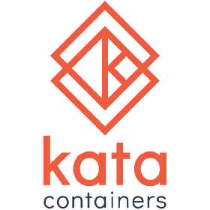


Secure Containers
How to build a secure container isolation mechanism?

Slide 4
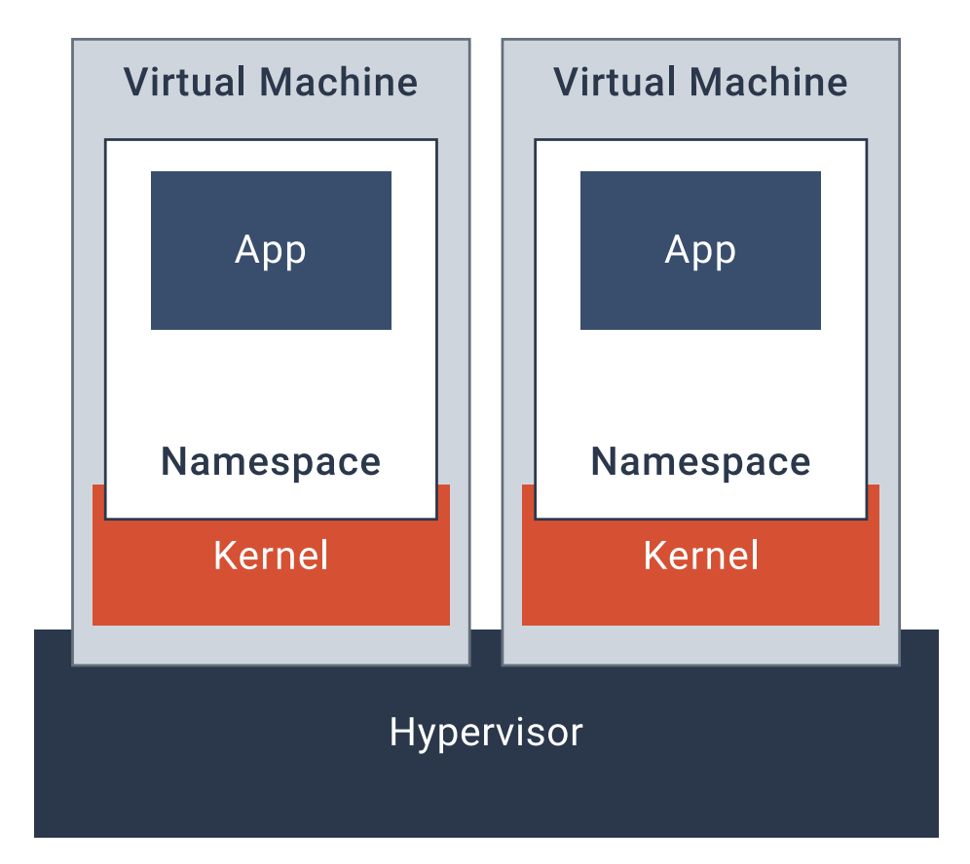
Kata Container
Each container is in its dedicated VM.
Similar to VM, isolation is provided by hardware virtualization support (e.g., extended page table).

Slide 5
Firecracker (Amazon)
Use virtual machines, but make them fast
Pick a commodity hypervisor (QEMU > 1.4M LOC)
Make it simpler (50K LOC)
No need to bootstrap devices
No need to have most device driver (e.g., USB, GPU)
Significantly improved boot speed
Lower memory footprint

Slide 6
gVisor (Google)
The key problem for container security is that kernel supports > 300 system calls
It is difficult to know for sure that the kernel can provide security with its complexity
Reduce the attack surface

Slide 7
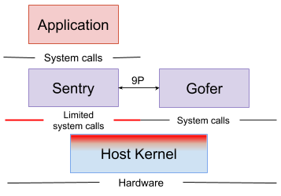
gVisor
Sentry is a application-level kernel.
Gofer provides file system access.
Sentry either (1) communicate with Gofer or (2) issue a small set of allowed system calls.

Slide 8
gVisor
Sentry has to implement
System calls
Signal delivery
Memory management
Page fault handling
Threading
How to do that?
Ptrace
Dune

Slide 9
gVisor (ptrace)
Think about this as GDB
Application
(ring-3)
Sentry
(ring-3)
Gofer
(ring-3)
Host Kernel (ring-0)
ptrace

Slide 10
gVisor (Dune)
Application
(guest ring-3)
Sentry
(guest ring-0)
Gofer
(host ring-3)
Host Kernel (host ring-0)
kvm

Slide 11
Why gVisor is secure?
Each system call is independently implemented in Go
Sentry intercepts every system call the application make
Sentry can only issue a small subset of system calls to the host kernel

Slide 12
gVisor’s drawback
Compatibility
Linux is feature-rich
Reimplement its feature is hard!
Performance
System call heavy workloads are slow on gVisor

