Slide 1
The UNIX Time-Sharing System
CPS 510 Discussion
Week 8

Slide 2
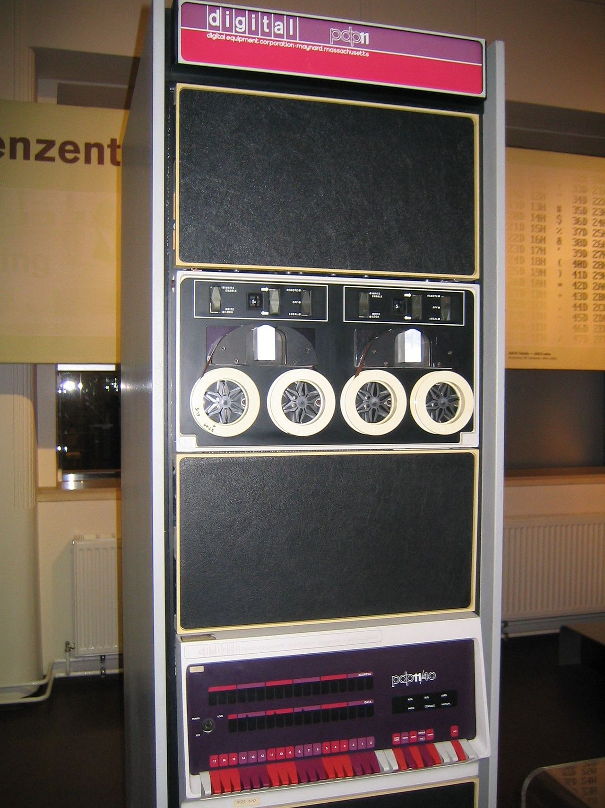
History
PDP-11/45
144 KB Memory
Disk and Tape
C programming language
Developed to write applications on top of Unix and then Unix itself
Applications process text streams

Slide 3
Key ideas of Unix
Everything is a file
File on your disk
Directory
Punch paper tape
Networking
I/O are read/write to file descriptors
Fork, pipe, execute, wait, exit
Shell

Slide 4
Question #1
A file descriptor is just an integer, what prevents a user process from forging new file descriptors to access the resources that the process has no privilege to access?

Slide 5
Question #2
Many of UNIX’s abstractions still exist in today’s operating systems. What are these abstractions and what’s the reason that these abstractions can stand the test of time?

