Slide 1
8b-510 - Trouble with Fork
Michael Hewner
Duke University

Slide 2
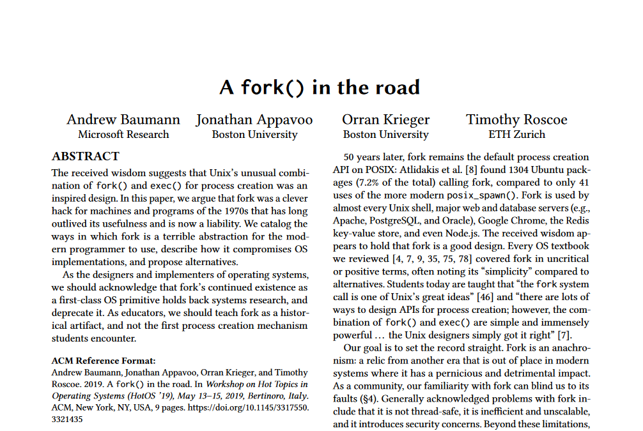

Slide 3
Good features of fork
Fork has a very simple API
The newly forked program can modify everything about the program’s state prior to exec. By contrast, the CreateProcess() Windows API takes 10 parameters.
Fork makes process-based concurrency with C easy

Slide 4
Fork frequently needs special exceptions because “copying parent” is not always the right behavior
File locks, timers, asynchronous I/O operations, special flags for memory mappings, etc.
Every new OS thing a process can have must document how it behaves on a fork and if there are multiple possible behaviors it must have specialized APIs for saying what to do

Slide 5
Fork is not thread safe
Forked process only has 1 thread, but that can put the system in an inconsistent state
Imagine thread A locks a mutex and then thread B forks (even worse if you didn’t write the mutex)
Broadly speaking, don’t fork in multithread processes unless you plan to immediately exec

Slide 6
Fork is insecure
Violates principle of least privilege
Basic process of spawning on behalf of a less privileged user is:
Fork
Free all dangerous resources
Set your userid to less privileged user
Very bad news if you forget a resource!

Slide 7
Fork is expensive in memory
Though maybe not AS expensive if you copy-on-write
But how much memory should we reserve for our forked process?
We could reserve double the memory space, but maybe that’s wasted?
We could reserve nothing but that means we could have unexpected memory exhaustion on a write

Slide 8
Fork makes implementing new OSes difficult
For example, fork presupposes a fully realized virtual address space for each process
Every feature you have must be fork-compatible even if your hardware doesn’t really support it

Slide 9
What’s the alternative?
Usually – a child spawning API that directly lets you set all the parameters about your child
BUT there’s always a limit to how many flags that API can have
Processes that can edit the state of other processes is a possibility

Slide 10
Fork-only use cases
Process based parallelism benefits from:
Ease of programming
Process level isolation
Copy on write
But this is a lot less useful than it once was because threads tend to be dominant now

