Slide 1
Buffer Overflow
https://replit.com/@QiShujun/BufferOverflow

Slide 2
Buffer Overflow
A buffer is a sequential memory allocation or region that might hold anything from integer arrays to character strings.
A buffer overflow happens when a program either tries to place data in a memory area past the buffer, or attempts to put more data in a buffer than it can hold.

Slide 3
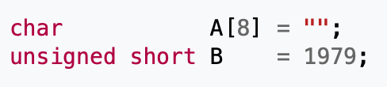
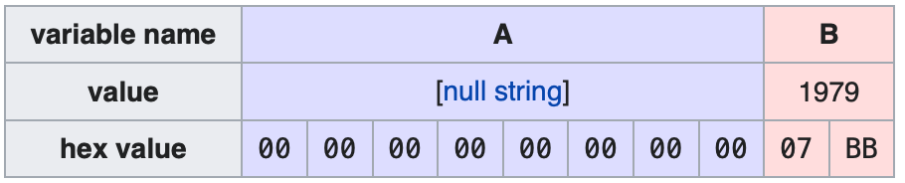
Example
https://en.wikipedia.org/wiki/Buffer_overflow

Slide 4

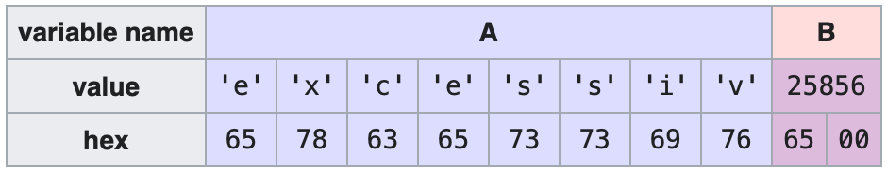
Example
https://en.wikipedia.org/wiki/Buffer_overflow

Slide 5
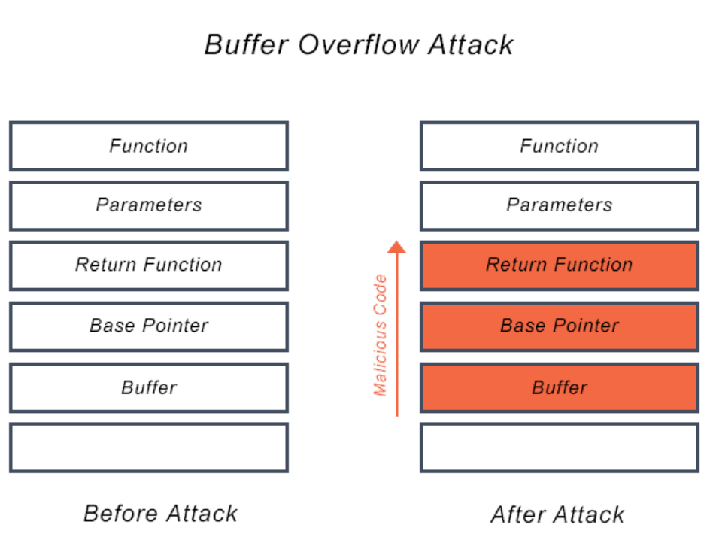
Example
https://en.wikipedia.org/wiki/Buffer_overflow

Slide 6
Activity
https://repl.it/@hewner/DukeUnixPipes#README.txt
Solve the prompts in README.txt – all can be solved with simple unix commands and pipes. Read man pages for details on the commands!

Slide 7

SQL Injection
How to exploit: 1; SELECT * FROM SCHOOL
You can fix this problem by constraining the input to be a number e.g.
Even nicer is to separate out the parameter its own part of the input. Eg. The query looks like this "SELECT Id, Name FROM Cars WHERE Id = ?” and then you bind the parameter later.

Slide 8
Code Injection
Occurs in languages without limited sized buffers
Way easier in languages that don’t compile and instead run arbitrary code on the file
Common in javascript, where code can be injected to steal user credentials and send user information to a third party (e.g. when a an innocuous seeming forum post secretly includes javascript)
But surely a language like C is invulnerable to such things because its code is fixed when it’s complied? (ha ha)

Slide 9
Buffer Overflow + Code Injection
Use a buffer overflow to insert complied machine code in some part of a programs memory, then overwrite a pointer (usually the return pointer on the stack) to trick the program to juming there
Demo

