Slide 1
CPS 310
Buffer Overflow and Stack Smashing
Jeff Chase
Duke University

Slide 2
A dispatch from hacker culture

Slide 3
Critical Vulnerabilities: CVEs
US National Cybersecurity database of Critical Vulnerabilities and Exposures (CVE).
Vulnerability. “A weakness in…software [or] hardware components that, when exploited, results in a negative impact to confidentiality, integrity, or availability.”
Exploit. Attack code usable by an adversary to take advantage of a vulnerability to impact a target system.
Mitigation. To defend against a CVE “typically involves coding changes, but could also include…[anything]”
How to mitigate Meltdown?

Slide 4
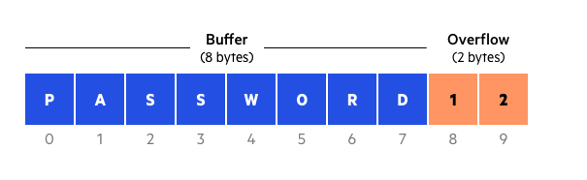
Vulnerability: buffer overflow
A buffer is a block of memory used to store some data.
A buffer overflow condition exists when a program writes or operates on a buffer without limit of its size.
A buffer overflow vulnerability is a flaw that enables an attacker to induce victim software to overflow a buffer.
Graphic from https://www.cloudflare.com/learning/security/threats/buffer-overflow/

Slide 5

vulnerable.c
Smashing the Stack for Fun and Profit
“At the code level, buffer overflow vulnerabilities usually involve the violation of a programmer’s assumptions. Many memory manipulation functions in C and C++ do not perform bounds checking and can easily overwrite the allocated bounds of the buffers they operate upon. Even bounded functions, such as strncpy(), can cause vulnerabilities when used incorrectly. The combination of memory manipulation and mistaken assumptions about the size or makeup of a piece of data is the root cause of most buffer overflows.”
https://owasp.org/www-community/vulnerabilities/Buffer_Overflow

Slide 6
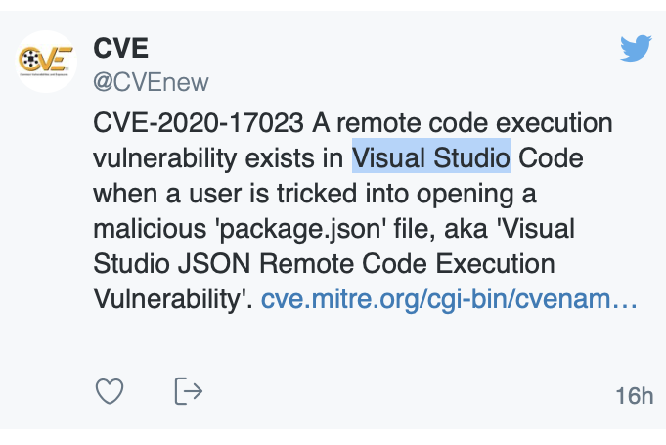
Vulnerability: remote execution
Remote code execution (RCE) vulnerability:
RCE: attacker injects/runs attack code in the victim.
Enables attacker to “take over” and reprogram the victim.
Some buffer overflow flaws are RCEs.
Example: stack smash.
RCE
stack smash
overflow

Slide 7
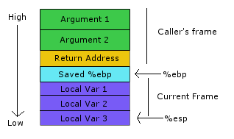
Stack buffer overflow
A stack smash is an RCE exploit based on overflow of a buffer on the victim’s stack.
Victim software calls procedure P.
The buffer B is a local var of P.
Attacker M supplies attack string S.
Victim writes S into B, overflows B.
S overwrites part of P’s stack frame.
Saved return address (RA)
M puts executable attack code in S and overwrites RA with address of attack code where it lands in B (guess).
On return from P, victim branches to attack code.

Slide 8
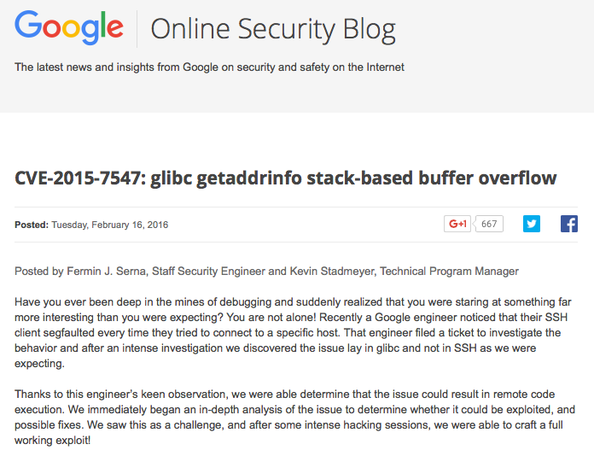

Slide 9

Buggyserver Lab (“p2”) Hack a simple IA32 web server
The software for the victim web server V is based on:
*/c-samples/buggyserver.c
It has a bug: a stack smash buffer overflow vulnerability.
Run web server process V.
Construct attack string S.
Send S to V over a socket.
Force V to run a shell.
Send commands to the shell.
Process V runs your commands: pwned.
Test your talents, but please do not abuse them.

Slide 10
Stack smash attack
Step 1. Attacker M connects to the vulnerable server V.
Step 2. M sends an attack string S through the socket to V.
Step 3. V reads the attack string from the socket.
The attack string overflows a buffer on V’s stack.
Say the buffer is defined in function f() in V.
String S overwrites the return address (RA) in the stack frame for f.
Step 4: V returns from f: it branches to the address that overwrote the “real” RA. M chooses this value to branch into the buffer.
Step 5: S executes instructions in the attack string: a shellcode.
Step 6: The shellcode takes over V and executes a shell for M’s use.
# V running at address 127.0.0.1, listening on port 9000
$ /bin/echo <attack string> | nc 127.0.0.1 9000

Slide 11
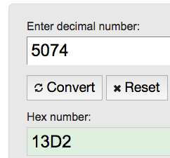
Shellcode357
/*
* s0t4ipv6@Shellcode.com.ar
* x86 portbind a shell in port 5074
* 92 bytes.
*/
char shellcode[] =
"\x31\xc0" // xorl %eax,%eax
"\x50" // pushl %eax
"\x40" // incl %eax
"\x89\xc3" // movl %eax,%ebx
"\x50" // pushl %eax
"\x40" // incl %eax
"\x50" // pushl %eax
"\x89\xe1" // movl %esp,%ecx
"\xb0\x66" // movb $0x66,%al
"\xcd\x80" // int $0x80
"\x31\xd2" // xorl %edx,%edx
"\x52" // pushl %edx
"\x66\x68\x13\xd2" // pushw $0xd213
"\x43" // incl %ebx
"\x66\x53" // pushw %bx
"\x89\xe1" // movl %esp,%ecx
"\x6a\x10" // pushl $0x10
"\x51" // pushl %ecx
"\x50" // pushl %eax
…
Pseudo-code
s = socket();
bind(s, 5074);
sd = accept(s);
dup2(sd, stdin);
dup2(sd, stdout);
exec*(“/bin/sh”);
http://shell-storm.org/shellcode/files/shellcode-357.php

Slide 12
Shellcode357
Shellcode: attack code that executes a shell for attacker.
Example portbind or bindshell code
If successful, this attack code binds a port (5074) to open a backdoor for the attacker M. When M connects to that port, the shellcode execs a shell with M’s socket as its stdin/stdout. The shell takes over the attacked process.
Pseudo-shellcode
s = socket();
bind(s, 5074);
sd = accept(s);
dup2(sd, stdin);
dup2(sd, stdout);
exec*(“/bin/sh”);
M may now enter arbitrary shell commands through the socket. The shell runs them with the userID of the process, and sends their output back to M through the socket.

Slide 13
OS defenses for stack smash
NX: no-execute
OS (exec) disables execute privilege on stack pages.
Any branch to code on the stack raises a fault.
ASLR: address space layout randomization
OS (exec) places the stack randomly in the VAS. Attacker must guess a branch target address of the injected code for the RA. With ASLR it changes on each program launch: harder to guess.
Stack canaries
Compiler generates instructions to place a random value on stack above RA, check/match before return.

Slide 14
IA32 stack
Caller pushes
Callee pushes
(prolog)
Fixed-size stack frame data area: size determined by compiler of the called procedure. The procedure’s compiled code addresses locals and arguments at fixed offsets from %ebp (frame pointer).
Note: callee code may push some callee-saved register values in here too.

Slide 15
Buffer overflow / stack smash
RA
Shellcode
Attacking client M sends attack string S in a request and forces server to branch to shellcode in S. Possible (easy!) if the server fails to check inputs carefully, copies inputs into local variables, and is undefended by {ASLR, NX, stack canaries…}.

Slide 16
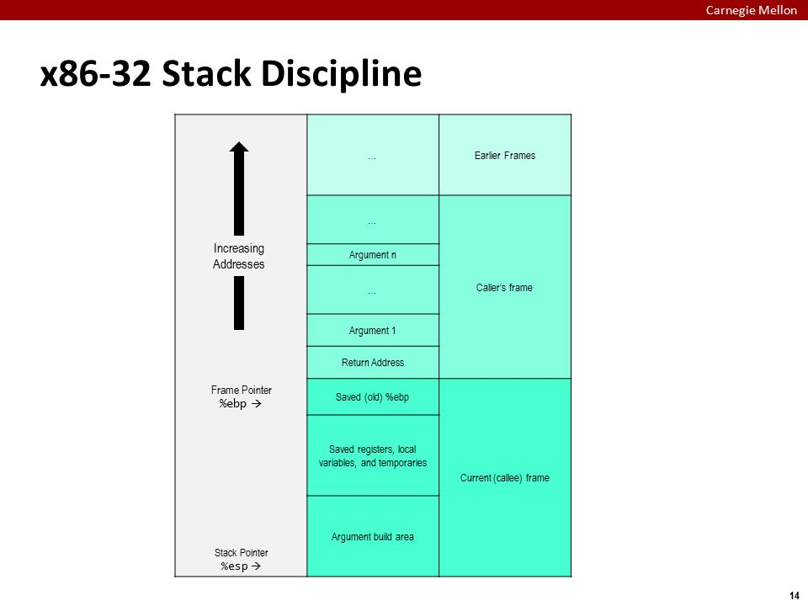

Slide 17

Upside down and backwards, part 1
Any block copy (or I/O) handles bytes in address order.
Lower addresses in source buffer are sent first; earlier arriving bytes are stored at lower addresses of the target buffer.
For numeric values, IA32 addresses/sends the least significant byte first (little-endian).
So: a numeric value in your shellcode (such as a smashing RA) appears backwards: little end first.
Except for the attack port number: it works to send the most significant byte first for a pushw operand.
So go with it.
Use the lsof command to see which port it binds.

Slide 18
Upside down and backwards, part 2
Attack string
strncpy
RA
String copy and I/O sweep toward higher addresses.
Code executes toward higher addresses.
Stack push grows stack toward lower addresses.
Shellcode
execution

Slide 19
Where is the shellcode, part 1
Attack string
Smashed frame
Be careful where you put your shellcode. Keep it out of the way of stack growth. When the shellcode runs, the smashed frame lies just beyond the new stack top. If the shellcode pushes values onto the stack (and shellcodes do, for scratch storage) it may overwrite its own instructions.
strncpy
RA
Drawing is not to scale.
NOP
NOP
NOP
NOP
NOP
Stack grows this way
Shellcode
execution
New stack top
after popping the smashed frame on the return-jump to shellcode.

Slide 20
Where is the shellcode, part 2
Attack string
Can you run your shellcode out of the smashed buffer? Sure, if it fits. But then it runs just beyond the post-smash stack top. If it pushes data onto the stack (as shellcodes do, for scratch storage) it may overwrite its own instructions.
This often results in a segv after the attacker connects to the attack port, before the exec.
Shellcode
execution
RA
Drawing is not to scale.
Stack grows this way
push
New stack top
after popping the smashed frame on the return-jump to shellcode.

Slide 21
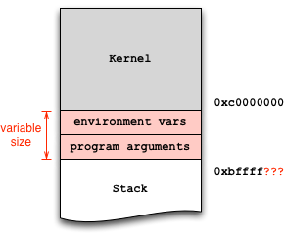
Don’t smash your args/env Or bump into the kernel
Note: use setarch –R -3
Assures this “classic” VAS layout
3GB VAS with mapped 1GB kernel
Else might get 0xffffxxxx stack under 32-bit emulation on 64-bit systems.
Or randomized addresses (ASLR).
No smashing up here.
Smash down here.
How big is the stack? 1KB? Less?
https://stackoverflow.com/questions/17775186/buffer-overflow-works-in-gdb-but-not-without-it

Slide 22
Endianness: memo
Big end: the most significant byte, i.e., the byte containing the most significant bit of a multi-byte value.
Little end: the least significant byte, e.g., the least significant bit determines if the value odd or even.
Big-endian: the big end of a multi-byte value is stored first (has the lowest address) or sent first on the network.
Little endian: addresses/sends/stores the little end first.
Intel x86 is little-endian; some machines are big-endian.
Network byte order: big-endian by Internet convention.
Network software must use machine-dependent “byte swapping” macros (htons, htonl, ntohl,…) in all the right places.

Slide 23
Notes on buggyserver lab (“p2”)
IA32 only. x64 is different. Build server for IA32.
Shields down. Disable all defenses.
Watch your layout. Where’s the stack?
Environment variables, running under gdb and/or under x64 emulation can move the stack.
We give you buggyserver.c code that maps the stack at a fixed address, wherever you happen to run it.
Null characters. Any zero bytes in the attack string caus the strcpy op to stop copying: end of string.
echo | nc. Use netcat (nc) to send your attack string and (after smash) connect to the backdoor shell port.

Slide 24
Stack layout when calling functions
void func(char *arg1, int arg2, int arg3)
{
char loc1[4]
int loc2;
int loc3;
}
old base pointer
low
return address
high(N)
…
loc2
loc1
%ebp
%eip
arg1
arg2
arg3
caller’s data
local variables pushed in the
same order as
they appear in the code
arguments pushed in reverse order
of code

