Slide 1
A Few of My Favorite CVEs
Jeff Chase
Duke University

Slide 2
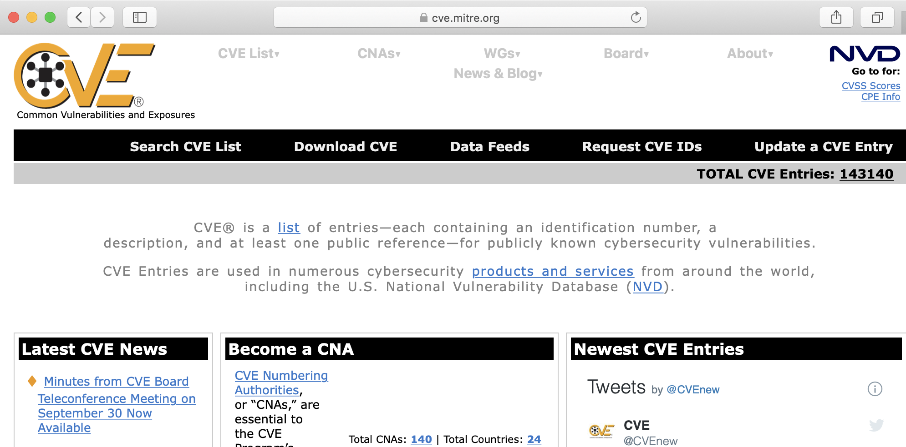
CVE database

Slide 3



Attack!
exploit
vulnerability
Each exploit has preconditions (e.g., network access to the target) and effects, which may enable further steps.
An attack chain is a sequence of steps to objective.
E.g., install a malware payload: ransomware, rootkit,…
Today’s CVEs: memory disclosure, drive-by installs

Slide 4
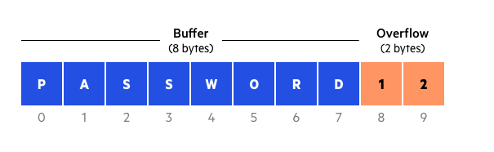
Stack buffer overflow RCE
A buffer is a block of memory used to store some data.
A buffer overflow condition exists when a program writes or operates on a buffer without limit of its size.
We examined in detail a buffer overflow exploit leading to remote code execution (RCE).
Buffer overruns also occur on reads!
Graphic from https://www.cloudflare.com/learning/security/threats/buffer-overflow/

Slide 5


Slide 6


Bleeds
The CloudFlare bug has been dubbed “cloudbleed”.
It is named after an earlier bug called “heartbleed” in a widely used SSL library (also discovered by Google).
These “bleed” bugs both result in the server exposing random data from its heap.
Code gets a pointer to a heap block.
Writes heap block contents to a socket.
Overruns: sends out data “past the end” of the block.
What is past the end? Other heap blocks.
What is in them? Anything. Everything.

Slide 7
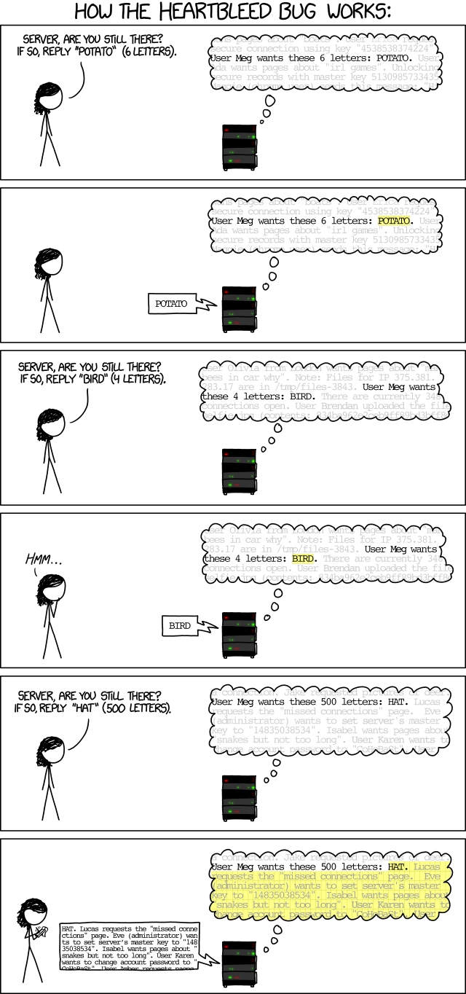

Slide 9

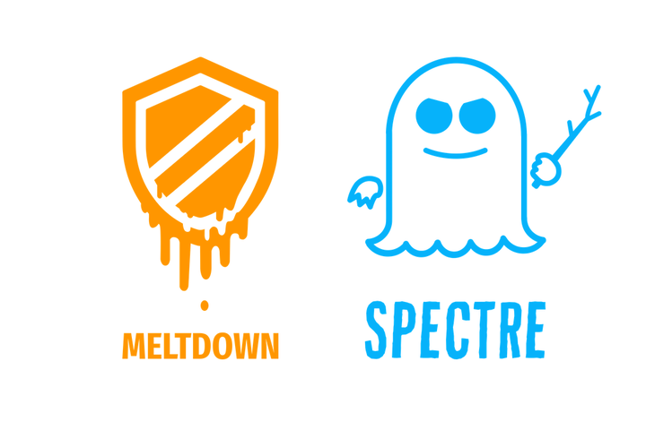
Memory disclosure
Bleeds. Memory disclosure resulting from buffer overruns that occur on reads, exposing data that resides past the end of the buffer.
Heartbleed (CVE-2014-0160) in OpenSSL
Cloudbleed (site-specific) in Cloudflare service
Side channels. Memory disclosure through side effects of operations.
Meltdown (CVE-2017-5754)
These vulnerabilities lead to complete compromise due to leakage of passwords and crypto keys.

Slide 10
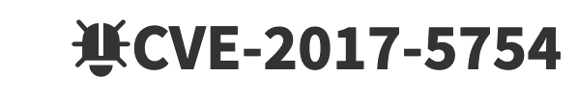
Meltdown
Meltdown is a security flaw in many existing CPUs.
Meltdown illustrates concept of a side channel that can leak information across “hard” protection boundaries.
Discovered concurrently by three groups in late 2017.
At that time, it enabled an untrusted user process on any standard OS to read all of machine memory.
Is that bad? Yes: it breaks process isolation.
“All bets are off.”
See lecture 2c-510

Slide 11
Anatomy of Meltdown
Can attacker run a process on the victim? Yes? Then can exploit Meltdown to read kernel space by loading one location at a time.
OS keeps kernel space mapped in user mode for fast syscalls.
It’s protected: user-mode load from kernel space → protection fault.
But a CPU with the vulnerability may speculatively execute an indirect load computed from loaded value before the fault. (Yikes!)
And that second indirect load pulls a line into the CPU cache.
Exploit pre-flushes cache and times post-accesses to recover the indirect address → value at kernel space location.
And the OS maps machine memory in kernel space!
→ Exploit can read any memory address.

Slide 12
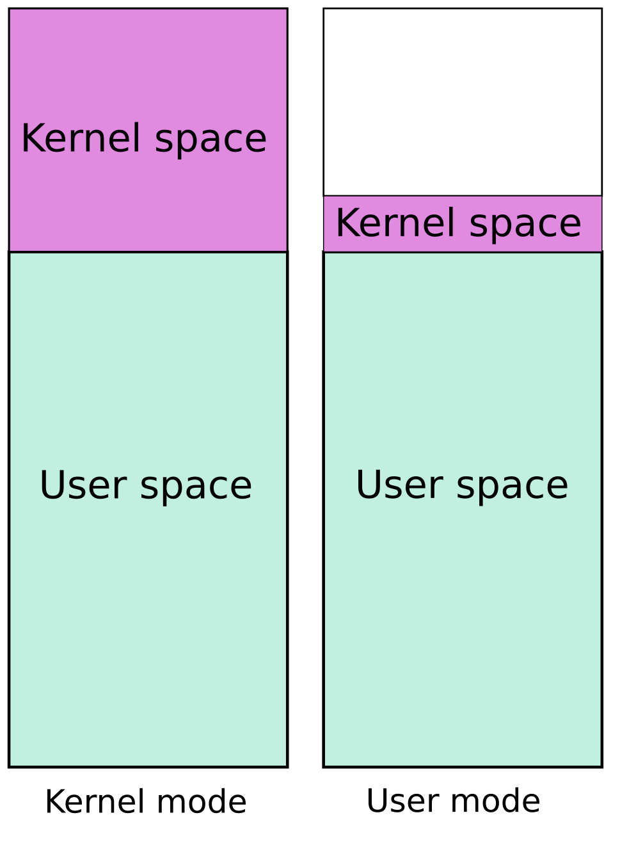
Meltdown defenses
Fix the hardware.
Maintain and use two complete page tables (pmaps) per VAS.
In kernel mode: activate (e.g., via CR3) the classic map, with both user space and kernel space.
In user mode: activate a stripped-down map with user space but only minimal portions of kernel space needed to enter kernel for traps, faults, and interrupts.
It is called Kernel Page Table Isolation (KPTI), formerly “KAISER”.
At what performance cost?
Graphic from KAISER: hiding the kernel from user space. By Jonathan Corbet LWN.net, 2018.

Slide 13
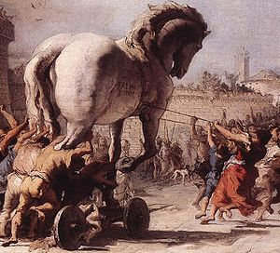
Any program you install or run can be a Trojan Horse vector for a malware payload.
[Domenico Tiepolo (1773) via wikipedia]

Slide 14
Trusting Programs
In Unix
Programs you run use your identity (process UID).
Maybe you even saved them with setuid so others who trust you can run them with your UID.
The programs that run your system run as root.
You trust these programs.
They can access your files
send mail, etc.
Or take over your system…
Where did you get them?

Slide 15
Malware payload: ransomware

Slide 16

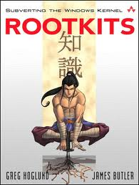
Malware payload: Rootkit
If an attacker obtains root or subverts/compromises the kernel (Trusted Computing Base), then all bets are off.
The machine is “rooted”: the attacker has full control.
Attacker may install a rootkit: software that maintains continuous and/or undetectable control.
A rootkit can:
Log keystrokes
Hook system APIs
Open attacker backdoor
Subvert (re)boot
Etc….

Slide 17
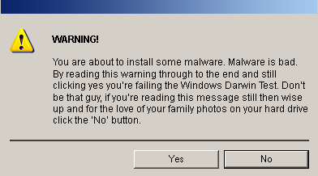
Malware: just say no
[Source: somewhere on the web.]

Slide 18
Drive-by installs
Must of us know to pay attention to the sources of our software and whether we trust them.
Most of us know to “just say no” to untrusted programs.
But we count on OS and trusted applications to ask us!
What if they don’t?
Problem: users trust documents, which may contain scripting. Sandbox! But what if it fails?
Pegasus: CVE-2016-4657 Safari on iOS/iPhone
Sandworm: CVE-2014-4114 Microsoft Office

Slide 19

Pegasus spyware
Pegasus is a spyware system marketed to intelligence services by Israeli company NSO Group.
Pegasys is the payload! Installed on iPhone through a “Trident” of zero-day exploits obtained by NSO.
A zero-day exploit is unknown to vendor of the targeted software and to the larger security community.
Alleged victims include:
Jamal Khashoggi
Jeff Bezos
Activists
Journalists

Slide 20
Facebook sues NSO over Pegasus
Filed: 10/29/19
“Between in and around April 2019 and May 2019, Defendants used WhatsApp servers, located in the United States and elsewhere, to send malware to approximately 1,400 mobile phones and devices (“Target Devices”). Defendants’ malware was designed to infect the Target Devices for the purpose of conducting surveillance of specific WhatsApp users (“Target Users”). Unable to break WhatsApp’s end-to-end encryption, Defendants developed their malware in order to access messages and other communications after they were decrypted on Target Devices. Defendants’ actions were not authorized by Plaintiffs and were in violation of WhatsApp’s Terms of Service. In May 2019, Plaintiffs detected and stopped Defendants’ unauthorized access and abuse of the WhatsApp Service and computers. “

Slide 21
NSO’s Trident exploit chain for iOS
A victim is socially engineered into clicking on a link, e.g., in a text message from a trusted party (stage 1)
The linked document launches Trident exploit chain:
CVE-2016-4657: WebKit corruption: Javascript downloads/runs stage 2 attack code within Safari.
Stage 2 attack code downloads/installs Pegasus.
CVE-2016-4655: map iOS kernel memory
CVE-2016-4656: jailbreak→disable kernel defenses against execution of unsigned binaries
See: https://citizenlab.ca/2016/08/million-dollar-dissident-iphone-zero-day-nso-group-uae/
https://info.lookout.com/rs/051-ESQ-475/images/lookout-pegasus-technical-analysis.pdf

Slide 22

Sandworm (CVE-2014-4114)
Sandworm is the code name of an advanced hacking group attributed to Russian intelligence (GRU).
Attacks on Ukraine in June 2014 used CVE-2014-4114.
Now called the “Sandworm exploit”.
Windows OLE Remote Code Execution Vulnerability
Microsoft: “An attacker can use this exploit to download and run malware on your PC.”
https://nakedsecurity.sophos.com/2014/10/15/the-sandworm-malware-what-you-need-to-know/

Slide 23
Sandworm powerpoint exploit
Office documents may have embedded scripting.
Opinion: unsafe scripting is Microsoft’s original sin.
Object Linking and Embedding (OLE) enables linkages among Office files, which may be external.
Sandworm powerpoint doc downloads/launches a malware payload from a remote untrusted location.
Can they do that?
No: remote fetches of executables are blocked.
But you can fetch Office scripts and .gifs!
Attack script renames .gif to .exe and launches.
Oops! CVE-2014-4114

Slide 24

Alex Stamos
Former chief of security at Yahoo and Facebook.
Consulting @Zoom for security as it scales up.
Now at Stanford teaching software safety/security.
“Security is about breaking the layers of abstraction in a system. Computers are so complex that the people that program them have to make basic assumptions about how they work. And it turns out those basic assumptions are often false: they’re good enough to go build something that works, but not to build something that works securely. So studying computers down to the lowest level can often be a really good skill.”

