Slide 1
Services and RSM Replication
Jeff Chase
Duke University
CPS 310
©Jeff Chase, feel free to use or incorporate with attribution

Slide 2

Datacenters!
A cluster of servers, each running one or more OS instances and application service stacks.

Slide 3
Service architecture (1) The story so far
client
server
Server process:
implements a service
serves client requests
via Remote Procedure Call (RPC)
and/or Web/HTTP (e.g., REST)
Service: module, object, component
API: methods with args
(or operations, commands)
internal state: data
request queue
wait
request
wait
handle request
reply
state
P1()
P2()
P3()

Slide 4

Service architecture (2) The story so far
Each server has a max request service rate λ_{max}
Saturates at λ_{max} requests per second.
Utilization 100%, unbounded queues.
How to serve more clients?
Horizontal scaling
Gang servers together
One service API/endpoint
Spread load over back-end cluster
Elastic provisioning and sharding
On-demand launch in cloud
networked server “cloud”

Slide 5
Service architecture (3)
Client
A server/service may call another:
Common sub-functions
E.g., storage or DB
Combine/compose them
Like SEDA stages
Make complex software stacks
Lots of dependencies
Called service tiers
Or Micro-services
Deploy and manage independently
Web Server
App Server
DB Server
Store

Slide 6
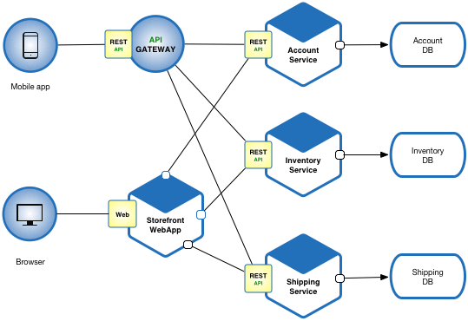
Microservices architecture
[microservices.io]

Slide 7

Scaling out services
Magic dispatcher
many
many
clients
Requests
Server cluster/farm/cloud/grid
Datacenter
Adding capacity. Add interchangeable server “bricks” to partition (“shard”) and/or replicate service functionality for scale and robustness. Rent virtual servers on the fly from a cloud infrastructure (IaaS) provider.

Slide 8
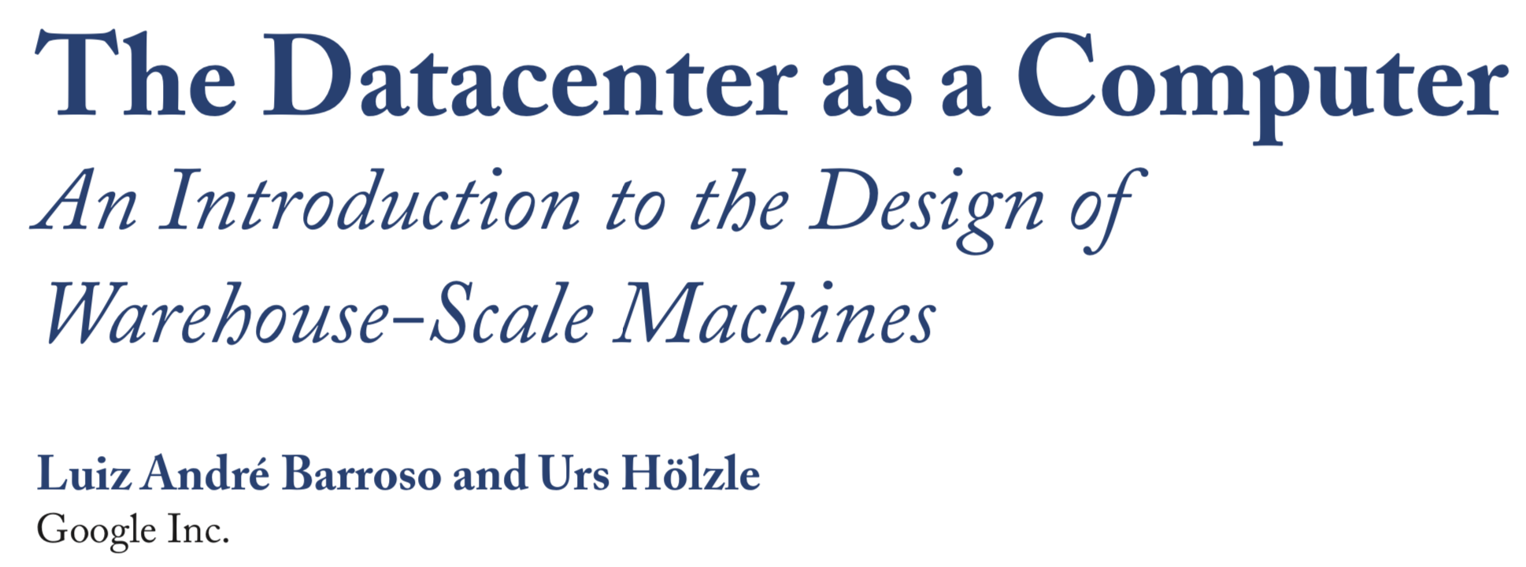
https://landing.google.com/sre/sre-book/chapters/production-environment

Slide 9


What about failures?
X
Nodes fail. Servers fail. Here’s a reasonable set of assumptions about failure properties:
Fail-stop or fail-fast fault model
Either function correctly or go silent
Either restart correctly or stay silent
A restarted node loses its memory state, and recovers its secondary (disk) state.
Alternative byzantine model: nodes may “go crazy”.
If failures are random/independent, the probability of some failure is linear with the number of units.
Higher scale → less reliable!

Slide 10
Replicating a service
Replicate the server functions and state.
Run multiple copies (replicas).
Each has the same state.
They comprise a replica group.
One replica is primary or leader.
The others are backup replicas.
(Or standby or secondary or follower.)
Replication → highly available services: “always up”.
How to make it work for “any” service application?
Abstraction: Replicated State Machine (RSM, or SMR)

Slide 11

Replicating an RSM service
Clients send their requests to one server (the leader).
Leader sequences the requests and pushes them to backup replicas (followers) before responding to clients.
clients
“Jump!”
“Kick first, then Jump.”
“Kick!”
“Done.”
Commit:
“Kick is done.”
Safety/consistency: ops commit in sequence and committed ops never revert.
“Jump is done.”

Slide 12
Failover: replace a failed leader
1. A leader (primary) server receives requests, sequences them, and passes them to one or more followers. All execute the requests in order, but only the leader responds to clients.
clients
???
???
2. If the leader fails, others detect the failure by timeout (a “lease” expires). A follower is designated as the new primary. It has “the same” state as the failed leader and is “indistinguishable”.
X
3. Each client finds and connects to the new leader, and retransmits any pending RPCs. The leader filters duplicates, and continues from where the old leader left off (failover).

Slide 13
Why “state machine”? Convergence!
If we are going to replicate servers, we want all the replicas to give the same responses: interchangeable.
And they will if they all have the same state….
And that will happen if they receive exactly the same input requests in exactly the same order….
If the effect of every request is deterministic: i.e., it is the same at all replicas.
The server program is a finite state machine (FSM).
The RSM model works to replicate any deterministic server program, whatever its function (we don’t care).
Abstraction in action!

Slide 14
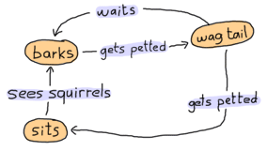

Deterministic server application as a finite state machine (FSM)
FSM: a useful formal model for thinking about programs.
Finite set of states and actions (inputs)
Deterministic transition function: F(state, input) → state
State determines behavior (e.g., also emit an output).
We can think of (some) server programs as FSMs.

Slide 15
Lock server as an FSM
acquire()
Free
Busy
release()
It’s an FSM, but we also have to represent waiters, and actions like waking up a waiter on a state transition.

Slide 16

RSM consensus
Replicas must agree on a sequence of actions.
A replicated log or ledger
of requests (commands, ops).
Strong ordering condition
Necessary for convergence.
→ “end up in the same state”
Sufficient for convergence.
For deterministic program
How to agree on a shared log?
Use a distributed consensus algorithm.
State Machine
Apply
API
Log
ops
add
jmp
mov
shl
[Graphic adapted from Raft]

Slide 17
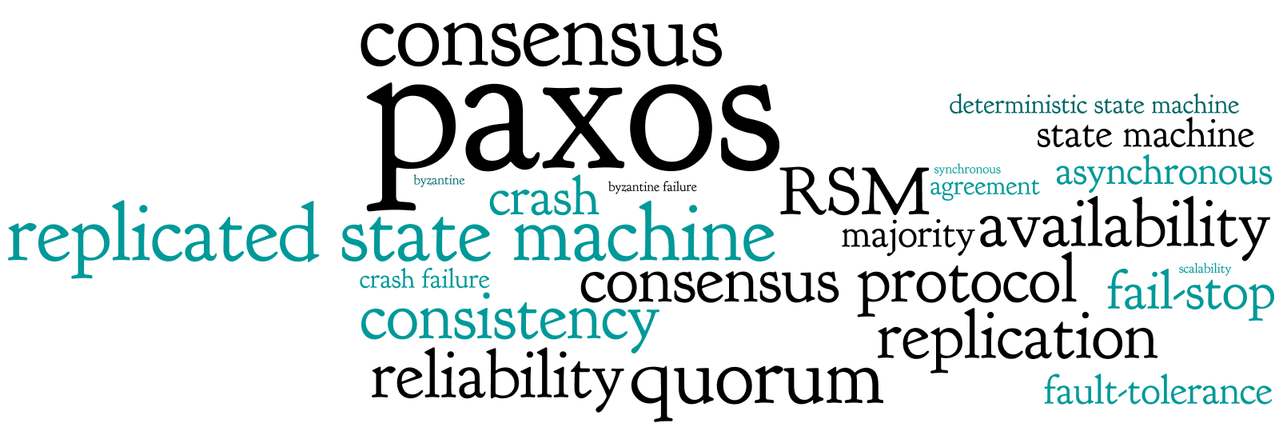
Consensus replication
From http://paxos.systems

Slide 18
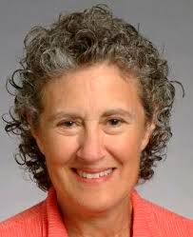
Early Consensus: VR
Viewstamped Replication (VR)
Barbara Liskov / Brian Oki 1988
VR presented Consensus in the context of a larger system. It was ahead of its time, and its significance was not immediately recognized. Concurrent with Paxos, the best-known variant.
VR was a key step in a sequence of innovations from her group at MIT that enabled us to specify and implement atomic data types and reliable distributed implementations. For this work she won computing’s highest award: the Turing Award.
“Everything I know about systems I learned from Barbara Liskov.”

Slide 19
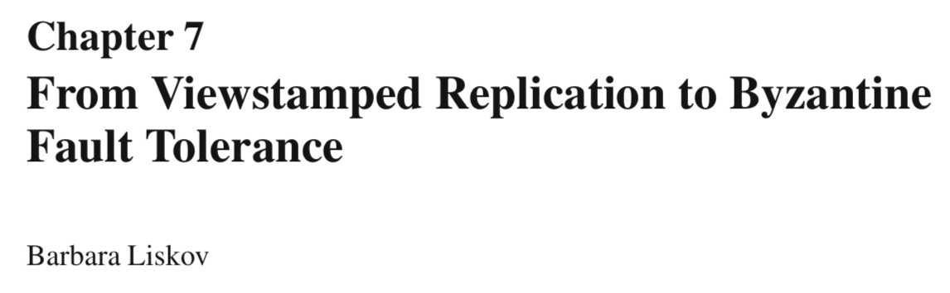
These slides incorporate content from Liskov’s 2010 book chapter summarizing her landmark work on VR (1988) and Practical Byzantine Fault Tolerance (PBFT, 1999), a foundation for modern blockchains.

Slide 20
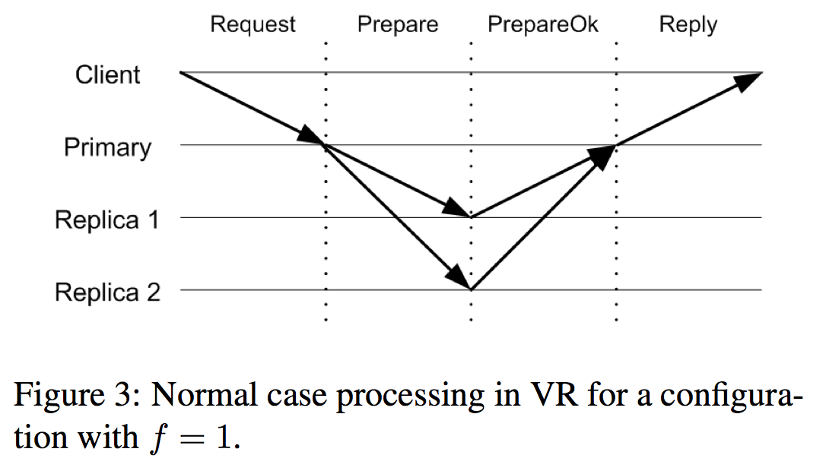
VR: an RSM replica group
(propose)
(accept)
Majority accepted? Commit!
Each replica is a copy of the application server, with all of its state. Replicas keep a log of operations (at least in memory) and apply them in order to their state. The consensus protocol ensures that their states converge. We assume only that the app is deterministic and that always some majority is functioning correctly; faulty replicas just stop, and may restart “empty” and resync.

Slide 21
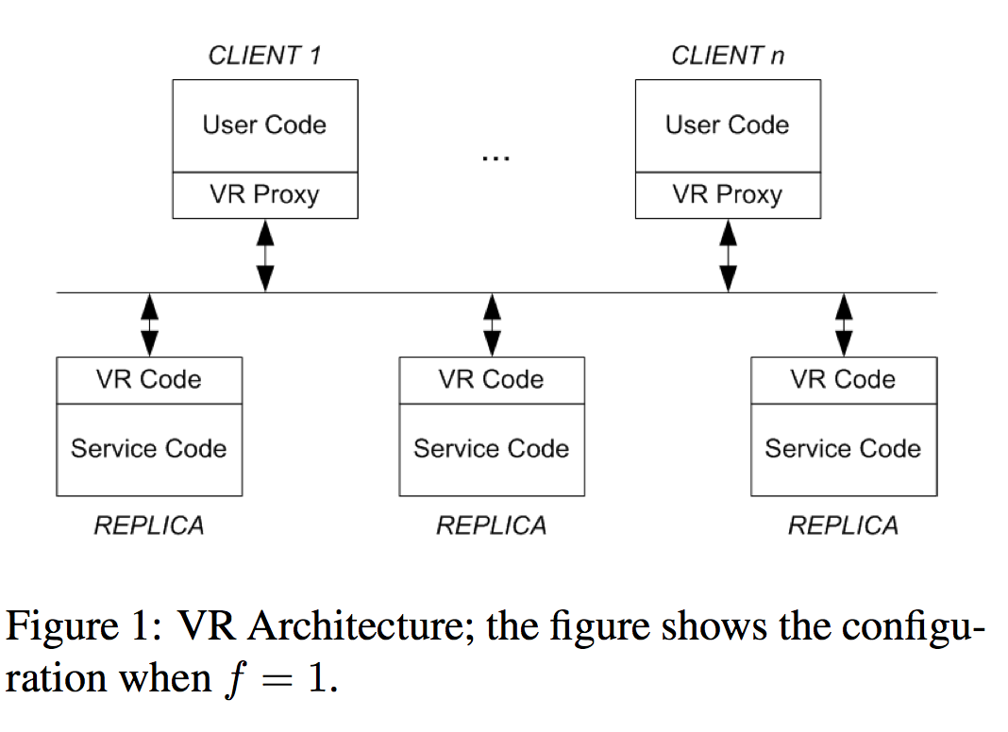
VR: the Pieces
The leader is chosen from among the replicas; the non-leader replicas (2f of them) serve as backup servers to tolerate up to f concurrent failures.

Slide 22
Client changes: the “proxy”
Service proxy code runs in each client: it “stands in” for the service from the point of view of the user code.
Discover/track the leader and send requests to it.
Tag requests with a monotonic sequence number.
Suppress duplicate replies.
The user code forms the requests: VR is independent of the application, so we say nothing more about it.

Slide 23
Service Code
Each replica runs a copy of the application-defined Service Code, which maintains the application state.
The Service Code receives a sequence of commands/operations and executes them in order (RSM).

Slide 24
VR Code
The VR code accepts requests and sequences them.
When a requested operation has committed, the VR code passes it to the Service Code (RSM) to execute.
Once the Service Code receives an operation, you can’t take it back! It is committed for all time!
It maintains operation history as an append-only log.

Slide 25
The easy part: a stable view
^{client}
^{commit!}
^{commit!}
^{commit!}
^{primary}
^{leader}
^{prepare}
^{notify}
^{prepare}
^{notify}
^{prepare}
^{notify}
A view (term) is a period of stable operation with a reliable leader. The leader/primary sends a sequence of operations with a prepare message followed by a commit notification if a majority of replicas accept the op.
Safety: All majority-accepted operations must survive , across failures into future views, even if no surviving replicas know if they committed.

Slide 26
VR: Learning of commitment
^{+notify}
^{commit!}
At some point after the operation has committed, the primary informs the other replicas about the commit. This need not be done immediately. A good time to send this information is on the next PREPARE message, as piggy-backed information; only the op-number of the most recent committed operation needs to be sent.
When a non-primary replica learns of a commit, it waits until it has executed all earlier operations and until it has the request in its log. Then it executes the operation.

Slide 27
Note on RSM
RSM is not the only replication model!
For some specific P we might be able to relax strict ordering, e.g., where API operations commute.
E.g., a partitionable/sharded service
But RSM works for any deterministic program.
What about performance? Scale?

Slide 28
RSM and scale
N can be very large. Blockchains use RSM, and they can be global! But they use more powerful consensus to handle Byzantine faults (lying, cheating, stealing).
Increasing N doesn’t help performance: it makes it worse. “The group works harder, but gets less work done.” Use RSM for reliability/availability, not performance.
Why so slow? Every non-failed replica executes every operation, plus coordination overhead grows with N.

Slide 29
What makes consensus hard?
Making Consensus work involves lots of complications:
View change → failover
Must keep exactly one functioning leader. Who?
How to know if the leader fails?
What if the network fails? Or partly fails?
Partition: some nodes cannot hear others.
How to bring recovered replicas up to date?
Consensus: establish clear rules for who the leader is, for every contingency. And vote: majority (quorum) rules.

