Slide 1
Consensus: Safety vs. Liveness
FLP, CAP and All That
Jeff Chase
Duke University
CPS 310
©Jeff Chase, feel free to use or incorporate with attribution

Slide 2
RSM replication: review
Given: deterministic server program (state machine).
How to keep it reliable/available? Nodes fail (stop) and lose their state. They might not recover.
Thus it becomes necessary to replicate the server.
Keep replicas consistent—“the same”— interchangeable.
Designated leader replica receives and sequences requests, adds to log, pushes to follower replicas.
Consensus: agree on a log prefix.
Failure? Adapt. Keep trying.

Slide 3

Consensus: abstraction
P₁
P₁
v₁
d₁
Unreliable multicast
Consensus algorithm
P₂
P₃
P₂
P₃
v₂
v₃
d₂
d₃
Step 1
Propose.
Step 2
Decide.
Some/all Ps propose a value to the others.
All nonfaulty P agree on a value in a bounded time (termination).
Coulouris and Dollimore

Slide 4
Correctness: safety and liveness
Agreement (consistency) is a safety property.
“Nothing bad ever happens.”
Termination is a liveness property.
“Something good eventually happens.”
Note that we can think of availability as a liveness property (unbounded response time → not available).
Can we get both? We want both.
No! Not in asynchronous networks with unbounded delay and/or partitions, even if servers are fail-stop.
Classic result: “It can be safe or live, but not both.” (FLP)

Slide 5
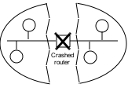

The problem of network partitions
Partitions cause “split brain syndrome”: part of the system can’t know what the other is doing.
A network partition is any event that blocks all message traffic between some subsets of nodes.

Slide 6

Corpus Callosum

Slide 7
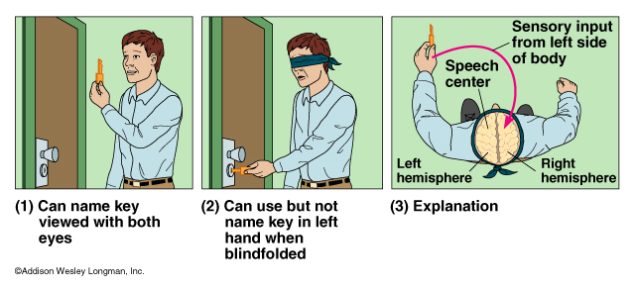
Split-brain syndrome
“The patients [with injured corpus collosum] were unable to process information from one hemisphere to the other, as though each hemisphere acted independently…. one hemisphere unfortunately has no idea what the other hemisphere has experienced or learned.”
[http://utpa-srodriguezz.blogspot.com/2012/10/split-brain.html]

Slide 8
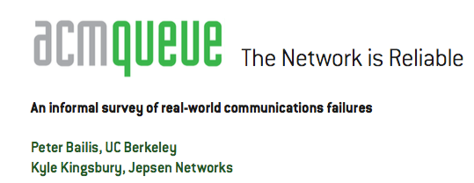
The celebrated FLP impossibility result demonstrates the inability to guarantee consensus in an asynchronous network (i.e., one facing indefinite communication partitions between processes) with one faulty process. This means that, in the presence of unreliable (untimely) message delivery, basic operations such as modifying the set of machines in a cluster (i.e., maintaining group membership, as systems such as Zookeeper are tasked with today) are not guaranteed to complete in the event of both network asynchrony and individual server failures.
…
Therefore, the degree of reliability in deployment environments is critical in robust systems design and directly determines the kinds of operations that systems can reliably perform without waiting. Unfortunately, the degree to which networks are actually reliable in the real world is the subject of considerable and evolving debate.
…
CONCLUSIONS: WHERE DO WE GO FROM HERE?
This article is meant as a reference point—to illustrate that, according to a wide range of (often informal) accounts, communication failures occur in many real-world environments. Processes, servers, NICs, switches, and local and wide area networks can all fail, with real economic consequences. Network outages can suddenly occur in systems that have been stable for months at a time, during routine upgrades, or as a result of emergency maintenance. The consequences of these outages range from increased latency and temporary unavailability to inconsistency, corruption, and data loss. Split-brain is not an academic concern: it happens to all kinds of systems—sometimes for days on end. Partitions deserve serious consideration.

Slide 9
Fischer-Lynch-Patterson (1985)
No consensus can be guaranteed in an asynchronous system in the presence of failures.
Intuition: a “failed” process might just be “slow”, and can rise from the dead at exactly the wrong time.
Consensus may occur recognizably, rarely or often.
Network partition
Split brain

Slide 10

“CAP theorem”
C
Consistency
C-A-P “choose two”
Dr. Eric Brewer
CA: available, and consistent, unless there is a partition.
CP: always consistent, even in a partition, but a reachable replica may deny service if it is unable to agree with the others (e.g., quorum).
A
P
Partition-resilience
AP: a reachable replica provides service even in a partition, but may be inconsistent.
Availability

Slide 11
The CAP/FLP dilemma
X
X
If servers fail, the survivors must take over to serve requests.
Required for availability.
X
L1
L2
C
But what if a partition?
Split brain!
Not consistent!
A
P
L1
L2
How can the system (L2) tell the difference?

Slide 12
CAP theorem restated
Theorem. It is impossible to implement an atomic data object that is available in all executions.
Proof. Partition the network. A write on one side is not seen by a read on the other side, but the read must return a response.
Corollary. Applies even if messages are delayed arbitrarily, but there is no failure or message loss.
Proof. The service cannot tell the difference.
X
X
X
???
Brewer’s Conjecture and the Feasibility of Consistent, Available, Partition-Tolerant Web Services. Seth Gilbert, Nancy Lynch. MIT manuscript.

Slide 13
Now what?
We must build practical, scalable, efficient distributed systems that really work in the real world.
But the theory says it is impossible to build reliable computer systems from unreliable components.
So what are we to do?
We do the best we can.
Stay safe!
Keep trying!

Slide 14
Consensus: Quorum rule
C
A
P
In order to lead and serve client requests, a leader L1 must continually receive votes from a majority of the group (a quorum).
The quorum rule protects consistency (C) in a network partition: at most one subgroup commits to the log, so it does not diverge.
But it sacrifices availability (A). If a majority of replicas fail, it would be safe for the survivors to serve clients. But they must not, because this case is indistinguishable from a network partition.
L1 and F1 do not have a quorum. So they cannot serve clients → no Availability if the majority had merely failed.
L2 can gain a quorum from the other followers, so they can continue to serve requests together in close cooperation.
F1
L1
L2
The quorum rule protects Consistency of the shared log in a Partition. At most one side of a partition makes progress: disjoint majorities cannot exist.

Slide 15


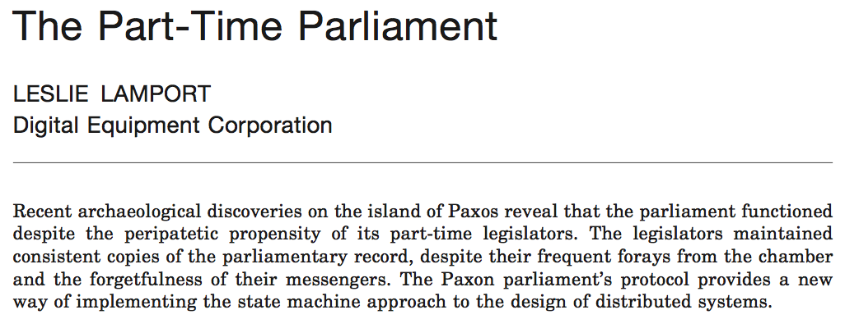
Consensus: the classic paper
ACM TOCS:
Transactions on Computer Systems
Submitted: 1990. Accepted: 1998
Introduced:

Slide 16
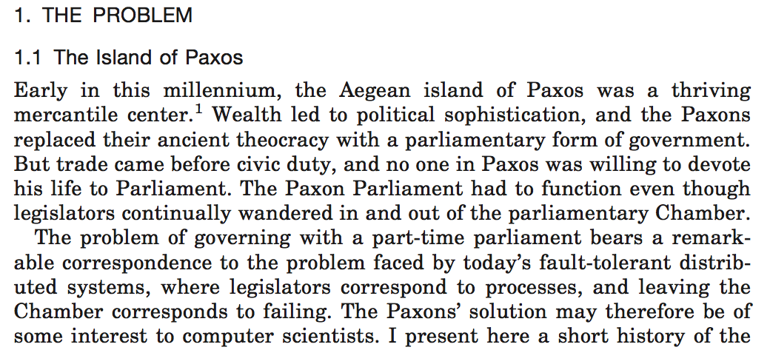



Slide 17
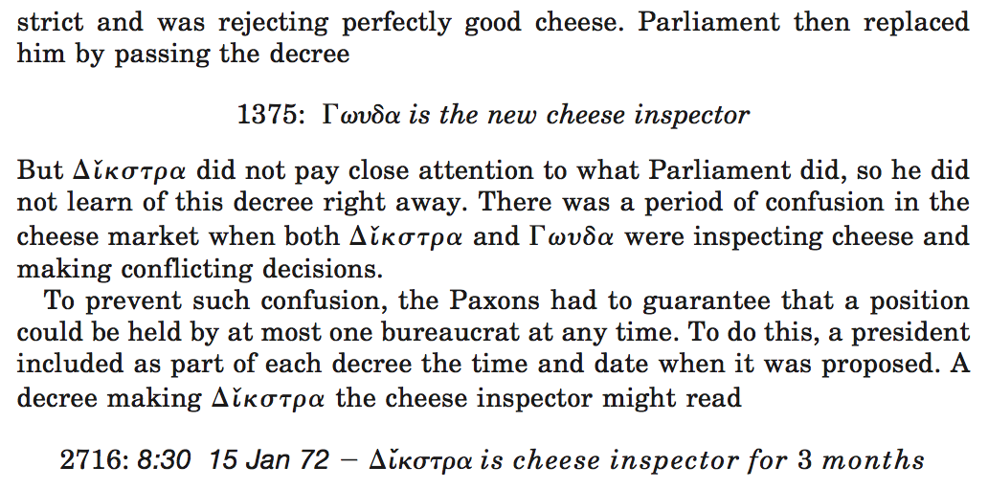
???

Slide 18
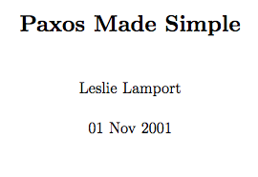
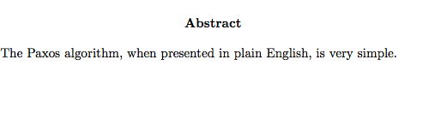
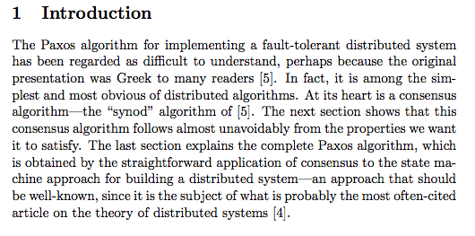
v2.0

Slide 19

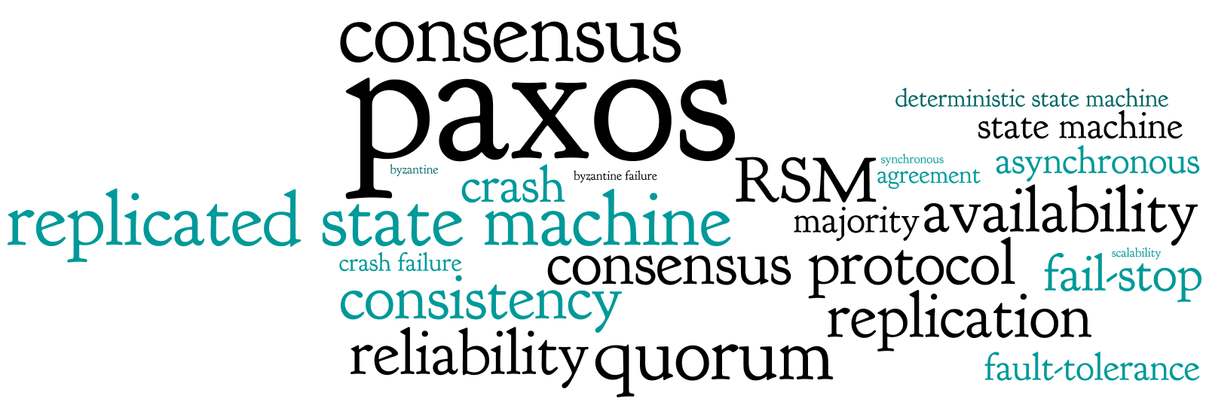
http://paxos.systems
“This website explains the infamously difficult to understand Paxos consensus protocol using easy to understand invariants and code.”

Slide 20
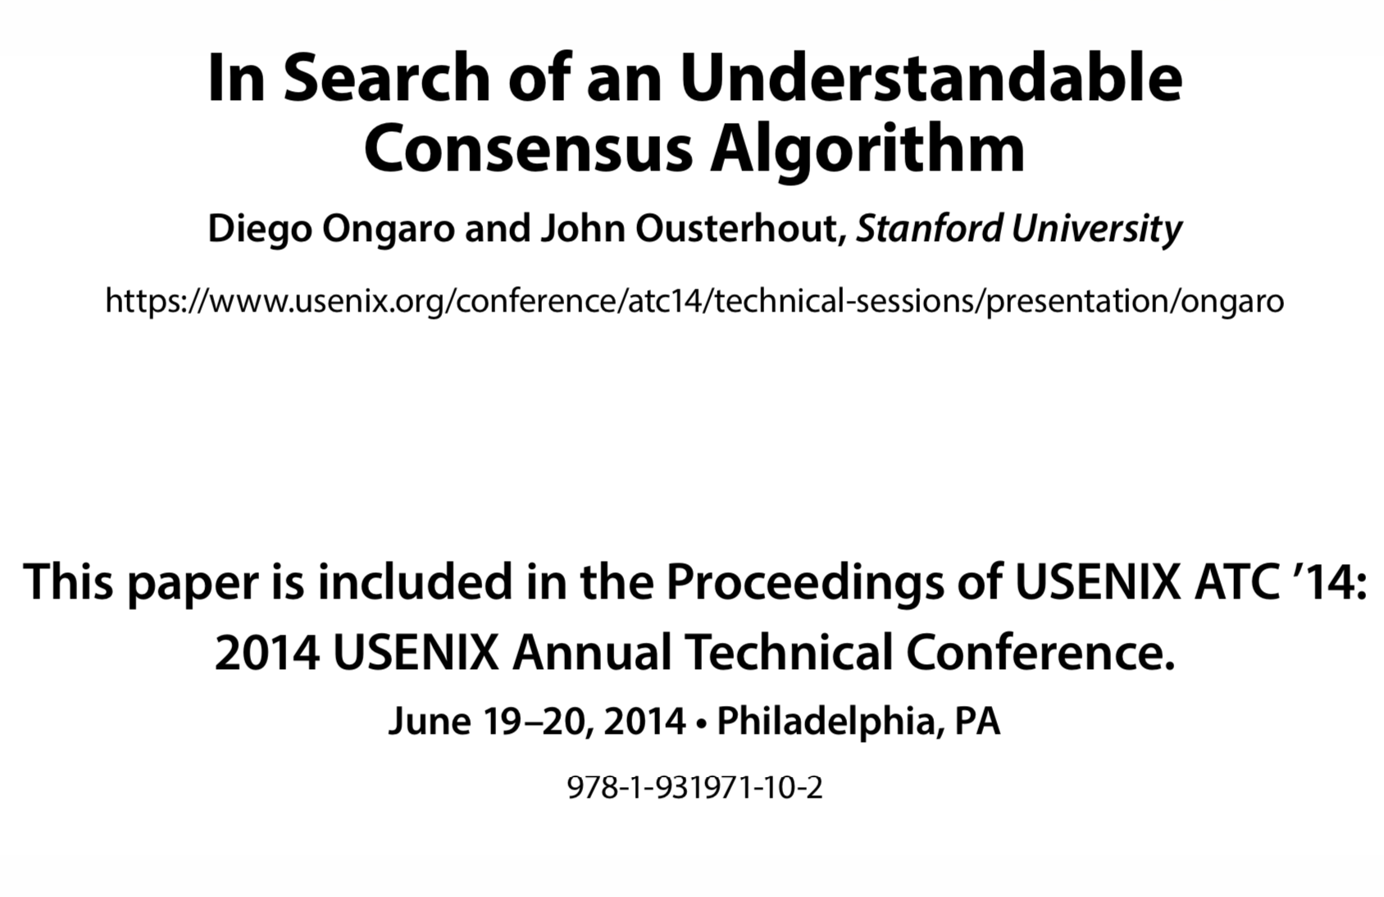
Raft

Slide 21


What is a distributed system?
"A distributed system is one in which the failure of a computer you didn't even know existed can render your own computer unusable." -- Leslie Lamport
Leslie Lamport

