Slide 1
Raft Consensus
(With Nods to VR)
Jeff Chase
Duke University
CPS 310
©Jeff Chase, feel free to use or incorporate with attribution

Slide 2
RSM Consensus: Five assumptions
Deterministic application service (whatever it is).
Known configuration: fixed group of N=2f+1 replicas.
Can change it through the protocol, but it is out of scope for us.
Stable quorum. At most a minority (f) of replicas fail at any given time. Group works only if a majority are up.
Fail-stop faults: a failed replica is silent. Replicas run the same program and are faithful to it. Net may delay.
5. Smart clients. On fail-over, clients switch and resync to the new leader. No lost/duplicate requests or responses.

Slide 3

Raft

Slide 4

Goal: Replicated Log
Clients
shl
Consensus Module
State Machine
Consensus Module
State Machine
Consensus Module
State Machine
Servers
Log
Log
Log
add
jmp
mov
shl
add
jmp
mov
shl
add
jmp
mov
shl
Replicated log => replicated state machine
All servers execute same commands in same order
Consensus module ensures proper log replication
System makes progress as long as any majority of servers are up
Failure model: fail-stop (not Byzantine), delayed/lost messages

Slide 5
The operation log
Each replica has a local log of accepted actions (ops).
Note: each replica might keep its log in memory, or on stable storage (“disk”), as it chooses. There is no requirement that any part of the log on any replica survives restarts—if our failure assumption is true: a majority of replicas are up, at any time, always, no matter what.
An operation log has a sequence of entries.
Raft: log entry / log index. (Paxos: slots, VR: op-numbers)
Each entry has a corresponding action/op/command.
Goal: agree on an action/op/command for each index, and recognize when it is safe to commit to the choice.
1 2 3 4 5 6 7 8…..
add
cmp
ret
mov
jmp
div
shl
sub

Slide 6
How to agree on log entries?
This is not rocket science: we can make it sound hard, but let’s try to make it sound easy.
Pick a leader (primary) from among the replicas.
The leader receives requests/commands/actions from clients.
The leader picks a sequence for the actions, and tells the other replicas (the followers). If they hear, they accept.
Once a majority of replicas have heard and agreed on an (index, action) pair, the action is committed for that index.
The leader responds to the clients after it sees commit.
All replicas apply committed actions in the agreed commit order.
→ All replicas converge to the same state.

Slide 7
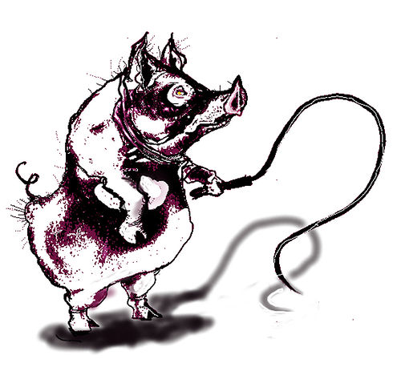

The players
Leader / primary
Become leader.
(Re)write history.
Dictate the future.
Stay leader forever.
If deposed goto step 1.
Follower / acceptor / secondary
Adopt leader.
Tell it your history.
Accept whatever the leader says.
Write it all down.
If a new leader appears, goto step 1.

Slide 8
Raft in normal operation (stable term)
AppendEntries @i
entries: [v1,v2]
committed=i
AppendEntries @i+2
entries: [v3,v4]
committed=i+2
“OK”
“OK”
Leader
Followers
log [v1,v2]
log [v3,v4]
commit [v1,v2]
Leaders propose new entries[] with the AppendEntries RPC call.
An AppendEntries RPC specifies the insertion index (@prevIndex).
Accept everything from valid leader, even if it overwrites log history.
Raft’s AppendEntries batches the ops and notifies of earlier commits.

Slide 9
Commits and notifications
AppendEntries @i
entries: [v1,v2]
committed=i
AppendEntries @i+2
entries: [v3,v4]
committed=i+2
“OK”
“OK”
Leader
Followers
log [v1,v2]
log [v3,v4]
commit [v1,v2]
Leader commits an entry after it hears a majority “OK” (f+1 quorum).
Apply the entry’s op to local state machine, respond to client.
Notify followers in a future AppendEntries RPC (“piggybacking”).
When followers learn an op committed, they apply to local SM.

Slide 10
Good enough for Consensus?
That’s really all there is to it, if we have good leaders:
Leaders rule only with consent of the governed: only if they control a majority.
Leaders don’t fight: if somebody else is leading, then they follow or get out of the way.
Leaders accept and promulgate the consensus view of history. They don’t try to change the past.
Leaders decide and apply their decisions consistently.
Trust in our leaders is crucial. (fail-stop model)
But: leader may fail or be partitioned from the followers.

Slide 11
Handling leader failure
Leader sends an AppendEntries at regular intervals, even if there are no new op requests.
Called heartbeat or ping or keepalive.
Followers set timers. If timer fires with no heartbeat, abandon the leader and initiate leader election.
X
???
L1
X
L2
A happy group of 5 replicas.
Suppose leader and another replica fail.
Time out!!!
Where is L1?
The group elects L2 as leader.
Fail over.
Keep going.

Slide 12
Consensus oversimplified
If leader appears failed and now is a good time to run, declare candidacy.
Become leader by majority vote.
Discover and affirm history.
Propose values for new log slots in order; notify others if majority accepts.
Adopt leader.
Tell it your history.
Accept whatever the leader says.
Write it all down.
If a new leader appears, goto step 1.

Slide 13
The importance of terms (views)
The protocol runs as a sequence of terms or views.
Failover? View change.
Advance to next term. Elect a new leader (by quorum).
Views/terms are numbered: monotonically increasing.
Every log entry is tagged with its view#.
(view, index) pair is called a viewstamp
Replica logs disagree on an entry? Highest viewstamp wins.
Term 1
Term 2
Term 3
add
cmp
ret
mov
jmp
div
shl
sub
1 2 3 4 5 6 7 8…..

Slide 14
Terms
Term 1
Term 2
Term 3
Term 4
Term 5
time
Elections
Split Vote
Normal Operation
Time divided into terms (views):
Election by majority (quorum)
Normal operation under a single leader
At most 1 functioning leader per term
Some terms have no leader (failed election)
Each server maintains current term value
Key role of terms: identify obsolete information
Note: replicas may disagree on the current term, but a majority must agree for normal operation.

Slide 15
The replicated log (Raft)
This Raft picture shows how the log replicas advance in a wavefront as leader appends.
At any given time the replicas agree on a common log prefix.
This picture applies to other Consensus variants.
Index ←→ slot ←→ op-number
Term ←→ ballot ←→ view

Slide 16
But partitions! A nasty scenario…
Network partition: L1 survives. Split brain?
How to make progress where we can do it safely?
How to avoid completing requests where it might be unsafe?
Partition heals → L1 and L2 both try to lead.
How to establish which leader is “current”, so L1 steps down?
How to reconcile/repair conflicting histories in the logs?
L1
L2
A happy group of 5 replicas.
Oops, network partition. Leader L1 survives on minority side.
L2 is elected on majority side; L1 struggles on.
Partition heals. L1 hears L2 and steps down.

Slide 17
Rejecting a leader from the past
A new view/term begins after some participant (e.g., L2) suspects leader failed (e.g., because L2 does not hear the old leader L1).
Quorum to select new leader → at most one leader per view/term.
Nobody pays attention to a leader/candidate L1 from the past, and L1 steps down if L1 learns of a term later than its own.
F2
F1
L1
L2
L1
L2
L2
During the partition, L2 declares candidacy in a new term and wins a quorum. When the partition heals, F2 rejects messages from L1, whose term has expired. F1 learns of the new term and defects to L2, also rejecting L1. L1 learns of the new term and steps down.

Slide 18
Handling stale views (terms)
Every message in the protocol carries the sender’s current view# (term).
If the receiver has a higher view# than the sender, it ignores and rejects the message.
Stale participants can do no damage.
If a participant learns of a view# v higher than its own, it sets its view# to v.
The view# is an example of a logical clock, a foundational concept in distributed systems.
When a participant learns it is stale, it comes up to date.
E.g., in the “nasty scenario” example, L1 steps down, and L1 and F1 accept updates from new leader L2 to repair their logs.

Slide 19
Server States
At any given time, each server is either:
Leader: handles all client interactions, log replication
At most 1 viable (functioning) leader at a time
Follower: completely passive (issues no RPCs, responds to incoming RPCs)
Candidate: used to elect a new leader
Normal operation: 1 leader, N-1 followers
timeout, new election
timeout, start election
receive votes from majority of servers
start
Follower
Candidate
Leader
“step down”
discover server with higher term
discover current leader or higher term

Slide 20
Review: the nasty scenario
F2
F1
L1
L2
L1
L2
L2
Network partition
Majority side: at most one
Minority side: at least one
Partition heals and leaders “duke it out”.

Slide 21
Nasty scenario: getting nastier
A bare majority of replicas commit new entries under L2.
The minority writes new uncommitted entries under L1.
Then L2 and a follower (F3) fail, and the minority rejoins.
Progress is possible, but the replicas have divergent logs. All committed updates must be preserved.
How to recognize the lone survivor (F2) who knows the committed history, and who can pass it to the others?
F2
F2
F1
F1
X
F3
???
L1
X
L2
L1
L2
L1

Slide 22
Nasty scenario: getting nastier
Answer: look at the terms in the log entries.
Every entry is tagged with a view#/term.
This is the key to the log repair protocol.
F2 rejects L1 because F2 knows a higher term than L1. L1 learns its term has expired, and L1 steps down.
A new election is declared → new term and new leader.
F2 has log entries from a higher term than the others. Higher terms dominate → the others accept F2’s entries.
F2
F2 rejects L1.
L1 steps down.
A new term begins.
An election starts.
In Raft, F2 wins because its log is most advanced (higher terms). F2’s log is used to repair the others. And the group continues.
L1

Slide 23
Safety: committed entries always survive
One replica (F2) survives to propagate log entries committed under L2’s bare quorum (after the partition) into a new term.
F2
F2
F1
X
X
L1
L2
L2
(1)
(2)
(3)
(4)

Slide 24
Safety: committed entries always survive
In fact: for any committed log entry e, at least one replica who knows of e survives into any new term, always.
Why? It requires a quorum to commit entries or elect a new leader, and any two quorums (quora?) must intersect.
It is not possible to have two disjoint majorities! This is the key to the proof that Consensus is safe and consistent even under partition.
F2
F2
F1
X
X
L1
L2
L2
(1)
(2)
(3)
(4)

Slide 25
Candidacy: how it works
Timeout from follower→transition to candidate.
Increment term.
Vote for yourself and send a round of vote requests.
Wait for responses, but watch out for races!
Competitor requests vote (same term)? Reject, stay the course.
Competitor requests vote (higher term)? Step down and vote.
Valid competitor declares victory? Concede and follow.
Voter rejects with higher term? Step down, follow, wait.
Timeout with no majority? Go to Step 2.
Majority? Declare victory: send a round of heartbeats. Congratulations: go lead!

Slide 26
Raft: leadership safety condition
Raft elections choose a sufficiently up-to-date leader:
Leader’s last(term) is at least as high as all of its voters.
Leader’s last(index) is at least as high as all of its voters with the same last(term).
Candidates/leaders step down when followers reject them and/or they see a better (more up-to-date) candidate/leader.
Safety property: any new leader has already seen (and remembers) at least all committed entries.
Proof. The new leader L won a majority, and so L is at least as up to date as a majority of replicas. Since any committed entry e was accepted by a majority of replicas, at least one of the voters v for L must have entry e, and since L is at least as up to date as v, L must have e as well.

Slide 27
Picking the Best Leader
Can’t tell which entries are committed!
During elections, choose candidate with log that contains all committed entries
Candidates include log info in RequestVote RPCs (index & term of last log entry)
Voting server V denies vote if its log is “more complete”: (lastTerm_{V} > lastTerm_{C}) || (lastTerm_{V} == lastTerm_{C}) && (lastIndex_{V} > lastIndex_{C})
1
2
3
4
5
1
1
1
2
2
committed?
1
1
1
2
1
1
1
2
2
unavailable during leader transition

Slide 28
Log Consistency
High level of consistency between logs:
If log entries on different servers have same index and term:
They store the same command
The logs are identical in all preceding entries
If a given entry is committed, all preceding entries are also committed
1
2
3
4
5
6
1 add
1 cmp
1 ret
2 mov
3 jmp
3 div
1 add
1 cmp
1 ret
2 mov
3 jmp
4 sub

Slide 29
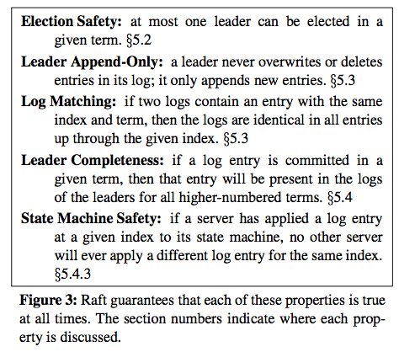

Slide 30
RSM consensus: stuff to know
At most one viable leader at at any given time.
There might be multiple nodes in LEADER state, but at most one has a functioning quorum that can commit entries.
Safety: the leader protects/preserves committed history.
Monotonic terms and quorum rules make it work, always.
Election and commitment require a majority/quorum of the full configured group, not just of those present.
Quorum is key to preserving consistency/safety under partition.
Not for scale. Adding replicas to an RSM group makes you do more work, but work doesn’t get done any faster.

Slide 31
Summary
Leader/master coordinates, dictates consensus
View the service as a deterministic state machine.
Master (also called “primary”) dictates order of client operations.
→ All non-faulty replicas reach the same state.
Remaining problem: who is the leader?
Leader itself might fail or be isolated by a network partition.
Requires a scheme for “leader election” to choose a new leader.
Consensus is safe but not live: in the worst case (multiple repeated failures) it might not terminate.
But in practice Consensus gets the job done…if it can be done.

Slide 32
Log Inconsistencies
Leader changes can result in log inconsistencies:
log index
1
2
3
4
5
6
7
8
9
10
11
12
leader for term 8
1
1
1
4
4
5
5
6
6
6
(a)
1
1
1
4
4
5
5
6
6
Missing Entries
(b)
1
1
1
4
(c)
1
1
1
4
4
5
5
6
6
6
6
possible followers
(d)
1
1
1
4
4
5
5
6
6
6
7
7
Extraneous Entries
(e)
1
1
1
4
4
4
4
(f)
1
1
1
2
2
2
3
3
3
3
3

Slide 33
The Raft paper on log repair
To bring a follower’s log into consistency with its own, the leader must find the latest log entry where the two logs agree, delete any entries in the follower’s log after that point, and send the follower all of the leader’s entries after that point.
All of these actions happen in response to the consistency check performed by AppendEntries RPCs. The leader maintains a nextIndex for each follower, which is the index of the next log entry the leader will send to that follower. When a leader first comes to power, it initializes all nextIndex values to the index just after the last one in its log (11 in Figure 7). If a follower’s log is inconsistent with the leader’s, the AppendEntries consistency check will fail in the next AppendEntries RPC.
After a rejection, the leader decrements nextIndex and retries the AppendEntries RPC. Eventually nextIndex reaches a point where the leader and follower logs match. When this happens, AppendEntries succeed, which removes conflicting entries in the follower’s log and appends entries from the leader’s log (if any).
Once AppendEntries succeeds, the follower’s log is consistent with the leader’s, and it will remain that way for the rest of the term.

Slide 34
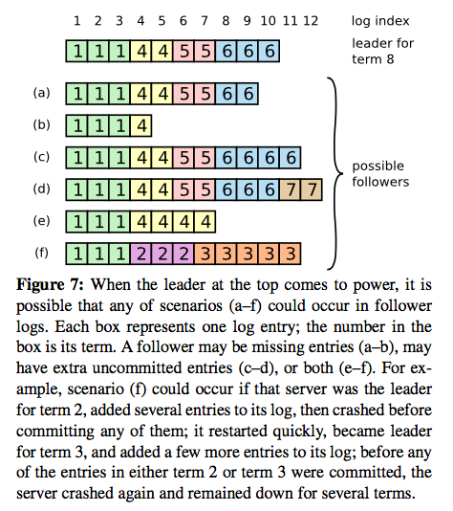

Slide 35
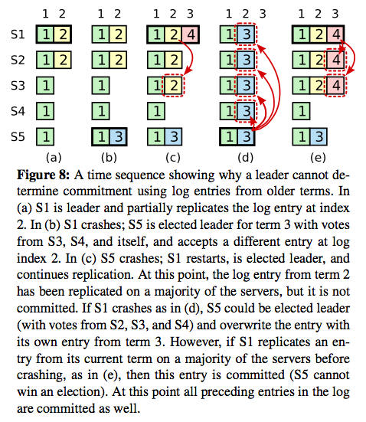

Slide 36
Spelling it out: views/terms
In general, a participant P may leave a group temporarily due to loss of connectivity or failure/restart.
The group moves on, and when P rejoins the group, P’s state is seen to be stale: P can’t participate correctly.
E.g., in Consensus, P’s log has diverged or has missing entries, P’s view of the identity of the group’s leader is no longer correct.
Consensus (and other distributed protocols) need some way to detect stale participants and reintegrate them.
Consensus uses view/term for this purpose.
Tag messages with the view/term, tag state with the view/term, and compare tags to detect staleness.

Slide 37
Spelling it out Commitment is a stable property
Safety property: All committed operations must survive into future views.
“Committed”: leader decided to commit and revealed its decision, i.e., replied to client and/or notified any replica of the commitment.
Key idea: since both commitment and leader election require a majority (f+1 votes), at least one server that votes for a leader saw every committed update.
Solution:
Piggyback history/summary on votes.
New leader learns history from this information.
New leader pushes authoritative history to followers.

Slide 38
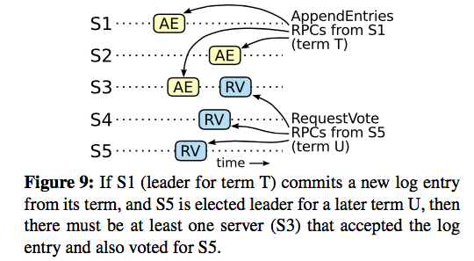
Raft: safety
Note: when a new leader L propagates older entries into a new term, L does not and cannot (always) know if those entries committed or not in the old term. But it does not matter: the set of “most up to date” entries is guaranteed to include all committed entries, so all committed entries survive into the new term. And once L propagates them to a quorum, they are known to have committed.

Slide 39
Liveness timeouts
All consensus systems rely on careful timeouts for liveness, because an election or view change disrupts any consensus in progress.
Contending leaders can “livelock” the consensus algorithm.
VR: “More generally liveness depends on properly setting the timeouts used to determine whether the primary is faulty so as to avoid unnecessary view changes.”
Note: also want fast failover times → tight timeouts!
Must balance these competing considerations.
Raft: randomized timeouts to avoid contending leaders.

Slide 40
Three consensus variants
VR (1988) → Paxos (1990) → Raft (2013)
They solve the same problem under similar assumptions.
Agree on an action log for RSM replication under fail-stop model.
Each replica log stores an indexed sequence of ops/entries.
Maintain a sequence of views/terms/ballots over time.
Each view/term has an indexed sequence of ops/entries pushed under the control of one leader.
Leader change→new view with monotonically increasing #.
Recover/repair: compare/merge logs of surviving replicas.
For each index, keep only the entry with the highest view/term (if any). An entry’s view || index is its viewstamp (VR).

Slide 41
Three consensus variants
Viewstamped Replication (VR) was combined with other tangential features, and was under-appreciated.
Paxos is configurable: the Multi-Paxos variant maintains continuity of a leader until it fails, like VR (and Raft).
During a view/term the leader forces its log suffix onto all follower replicas so that all logs agree.
Log grows with new ops, followers fail and recover: it’s all good.
If leader fails, start a new view/term. Here Raft differs.
VR and Multi-Paxos select an arbitrary new leader and then merge other replica logs into the new leader.
Raft selects the most up-to-date surviving replica L as the new leader, and avoids merging: L’s log dominates for all entries.

Slide 42
Raft vs. VR and Multi-Paxos
Raft is equivalent to Viewstamped Replication (VR) or Multi-Paxos, with some practical changes.
Raft’s leader election leads to a little more thrashing around to pick the most up-to-date leader.
VR picks replicas round-robin, Paxos races to win leadership.
But Raft avoids the need for new mechanisms to update the leader’s state, relative to VR and Multi-Paxos.
Raft log entries flow in only one direction: leader→followers.
Raft AppendEntries RPC shows how to batch updates and integrate repair with normal operation.

