Slide 1
The Raft Lab
(in Java)
Jeff Chase
Duke University
CPS 310
©Jeff Chase, feel free to use or incorporate with attribution

Slide 2

Replicating a service
Clients send their requests to one server (the leader).
Leader sequences the requests and pushes them to backup replicas (followers) before responding to clients.
clients
“Jump!”
“Kick first, then Jump.”
“Kick!”
“Done.”
Commit:
“Kick is done.”
“Jump is done.”

Slide 3
Failover: replace a failed leader
1. A leader (primary) server receives requests, sequences them, and passes them to one or more followers. All execute the requests in order, but only the leader responds to clients.
clients
???
???
2. If the leader fails, others detect the failure by timeout (a “lease” expires). A follower is designated as the new primary. It has “the same” state as the failed leader and is “indistinguishable”.
X
3. Each client finds and connects to the new leader, and retransmits any pending RPCs. The leader filters duplicates, and continues from where the old leader left off (failover).

Slide 4

Raft

Slide 5
Goal: Replicated Log
Clients
shl
Consensus Module
State Machine
Consensus Module
State Machine
Consensus Module
State Machine
Servers
Log
Log
Log
add
jmp
mov
shl
add
jmp
mov
shl
add
jmp
mov
shl
Replicated log => replicated state machine
All servers execute same commands in same order
Consensus module ensures proper log replication
System makes progress as long as any majority of servers are up
Failure model: fail-stop (not Byzantine), delayed/lost messages

Slide 6
Implement RaftNode!
This
Consensus Module
State Machine
This is the server application.
We don’t care.
Log
add
jmp
mov
shl
This is the replica’s local log copy.
There’s a class for that.

Slide 7

Implement three handlers
Followers
1. AppendEntries RPC
Leader
2. RequestVotes RPC
???
X
Candidate
3. Timer handler
See Figure 2.

Slide 8
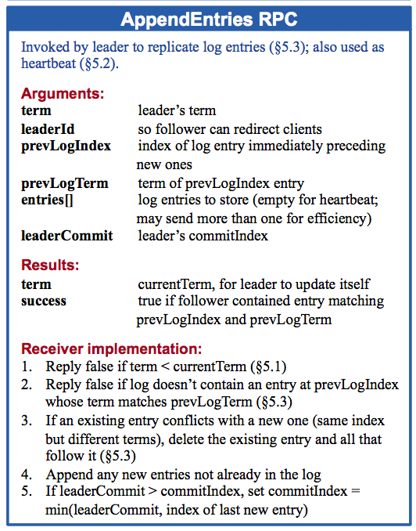
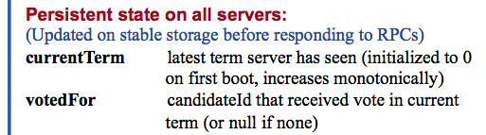
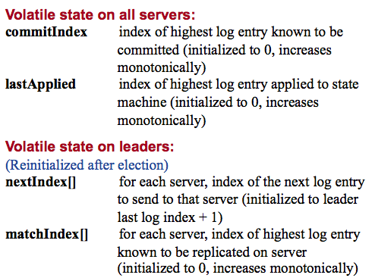
See Figure 2

Slide 10
P3: The Raft Lab
P3 focuses on leader election and log repair.
No clients, no new requests.
It is “just as if” the replicas restart after a failure(s): they must agree on a new leader and a history of actions.
A P3 replica is an event-driven Java object (RaftNode).
Events: timer fire, incoming RPC: AppendEntries, RequestVotes
P3 runs multiple RaftNode objects in a single-threaded test harness process.
The harness pokes them and checks their reflexes.
RPC requests/responses filter through the test harness, which may block them to simulate failures: fault injection.

Slide 11
P3 notes RaftNode represents a replica
Public methods called only by test harness. Knows:
Configuration: servers numbered [0..mNumServers-1]
Its own ID: mNodeServerNumber.
Its current term and mode (RaftMode): e.g., am I leader?
class RaftNode
public class RaftNode { private RaftLog mLog; private int mNumServers; private int mNodeServerNumber; private RaftMode mCurrentMode; private int mTerm; ….
}

Slide 12
P3 notes RaftLog and Entry
Each RaftNode has an object of class RaftLog.
RaftLog has an ArrayList of objects of class Entry.
public class Entry implements Serializable { public int action; public int term; …
}
class RaftLog
public Entry getEntry(int index)
public int insert(Entry[] entries, int prevIndex)
public int getLastEntryIndex()
public int getLastEntryTerm()

Slide 13
P3 notes Modes: RaftMode
All nodes run the same program (RaftNode.java).
Leadership can change on the fly (e.g., failover).
So: each node has a mode status that says what role it is playing. Leader or follower? Or candidate for leader?
The node program changes its mode in response to certain timer firings and incoming messages.
public enum RaftMode { FOLLOWER, CANDIDATE, LEADER
}

Slide 14
P3 notes Test harness: emulation
Test harness interposes on all RaftNode inputs/outputs.
Initial logs, modes, terms
test
“Timeout”
“AppendEntry heartbeat”
verify
“receive AppendEntry”
“accept”
verify
“receive AppendEntry”
“reject”
verify
“Timeout”
Mode = candidate
“RequestVotes”
verify

Slide 15
P3 notes Timer
Testing harness creates your RaftNode objects.
Harness passes a timer to you. You write the handler.
Timeout? Leader or candidate? Check responses to pending RPCs. Follower? Trigger an election.
…
public int handleTimeout() {
// Take action depending on mode.
…
// Don’t forget to reset the timer.
mTimer.resetTimer(); return …;
}

Slide 16
P3 notes RaftNode: incoming AppendEntries
Append n entries to log after prevIndex, overwriting whatever was there before.
For a heartbeat ping it can have {n==0, entries==null}
Check: Valid leader? Am I caught up? i.e., log[prevIndex] exists in my log and has same term as on leader?
/** * @param leaderTerm leader's term * @param leaderID current leader * @param prevLogIndex index of entry before first * @param prevLogTerm term of entry before first * @param entries entries to append * @param leaderCommit highest known-committed entry * @return 0 to accept; otherwise return term */ public int receiveAppendEntry(…)

Slide 17
The Raft paper on log repair
To bring a follower’s log into consistency with its own, the leader must find the latest log entry where the two logs agree, delete any entries in the follower’s log after that point, and send the follower all of the leader’s entries after that point.
All of these actions happen in response to the consistency check performed by AppendEntries RPCs. The leader maintains a nextIndex for each follower, which is the index of the next log entry the leader will send to that follower. When a leader first comes to power, it initializes all nextIndex values to the index just after the last one in its log (11 in Figure 7). If a follower’s log is inconsistent with the leader’s, the AppendEntries consistency check will fail in the next AppendEntries RPC.
After a rejection, the leader decrements nextIndex and retries the AppendEntries RPC. Eventually nextIndex reaches a point where the leader and follower logs match. When this happens, AppendEntries succeed, which removes conflicting entries in the follower’s log and appends entries from the leader’s log (if any).
Once AppendEntries succeeds, the follower’s log is consistent with the leader’s, and it will remain that way for the rest of the term.

Slide 18
P3 notes Sending a RequestVote RPC
Each RaftNode uses its mVoteRequester API.
Send RPC round to group with RaftNode.requestVotes().
Each node sends at most one RequestVote round per term.
mVoteRequester.send() sends RequestVote to all peers.
Other methods to retrieve/query responses to a round.
void send(int serverID,int candidateTerm, int candidateID,int lastLogIndex,int lastLogTerm);
/* After waiting one timeout for responses. */
int countYesResponses(mTerm);
int maxResponseTerm(mTerm);
ArrayList<VoteResponse> getResponses(int term);

Slide 19
P3 notes RaftNode: incoming RequestVote
This candidate proposes to lead a new term. OK?
Check: New term? Have not voted for another in this term? If new, then advance local term, else return term.
Check: Candidate’s log is at least as up to date as my log? Return 0 to vote yes, else return term.
/**
* @param candidateTerm candidate term
* @param candidateID candidate c requesting vote * @param lastLogIndex index of c’s last log entry * @param lastLogTerm term of c’s last log entry * @return 0 to vote yes; otherwise term */ public int receiveVoteRequest(…)

