Slide 1


CPS 310
Files, File Systems, and Filesystems
Jeff Chase
Duke University

Slide 2
The file abstraction
Program A
Program B
open
“/a/b”
write
(“abc”)
read
open
“/a/b”
read
write
(“def”)
Library
Library
system call trap/return
OS kernel

Slide 3
File syscalls: open, read, write, close
Pathnames may be relative to process current directory.
char buf[BUFSIZE];
int fd;
if ((fd = open(“../zot”, O_TRUNC | O_RDWR) == -1) {
perror(“open failed”);
exit(1);
}
while(read(0, buf, BUFSIZE)) {
if (write(fd, buf, BUFSIZE) != BUFSIZE) {
perror(“write failed”);
exit(1);
}
}
close(fd);
Process does not specify current file offset: the system remembers it.
Close() to release reference (automatic on exit).

Slide 4
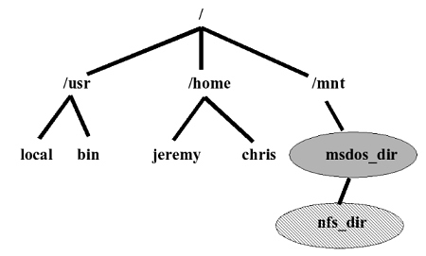

Files: hierarchical name space
root directory
applications etc.
mount point
user home directory
external media volume or network storage

Slide 5
Unix FS namespace ops
command | syscall
> | creat | Create a regular file node with a link (name).
ln | link | Create a link (name) for a node.
rm | unlink | Remove a link (name).
mkdir | mkdir | Make a directory node.
rmdir | rmdir | Remove a directory node.
mv | rename | Rename a link.
/home
juliet
romeo
capulet
montague
---

Slide 6
Names and layers
User
view
notes in notebook file
Application
fd
notefile: fd, byte range*
bytes
File System
block#
volume, block #
Block Storage
surface, cylinder, sector
Add more layers as needed.

Slide 7
Which block?
When an app requests to read/write a file at offset i, how to know which block contains that byte i on storage?
We know which logical block it is in the file (simple arithmetic), but how do we know which block it is on disk?
We need a map!
Where is the block map for the file whose name is “jack”?
We need a map!

Slide 8

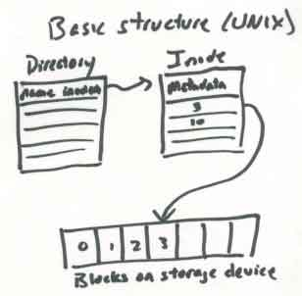
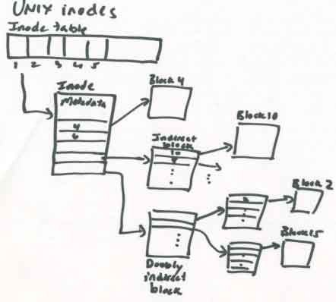

http://web.mit.edu/6.033/2001/wwwdocs/handouts/naming_review.html

Slide 9
Using block maps
Files are accessed through e.g. read/write syscalls: the kernel can chop them up, allocate space in pieces, and reassemble them.
Allocate in units of fixed-size logical blocks (e.g., 4KB, 8KB).
Each logical block in the object has an address (logical block number or logical blockID): a block offset within the object.
Use a block map data structure.
Index by logical blockID, return underlying address
Example: inode indexes file blocks on disk
Maps file+logical blockID to disk block #
Example: page table indexes pages in memory
Maps VAS+page VPN to machine frame PFN
Index map with name, e.g., logical blockID #.
Note: the addresses (block # or PFN) might themselves be blockIDs indexing another level of virtual map!
Read address of the block from map entry.

Slide 10
Representing files: inodes
There are many many file system implementations.
Most of them use a block map to represent each file.
Each file is represented by a corresponding data object, which is the root of its block map, and holds other information about the file (the file’s “metadata”).
In classical Unix and many other systems, this per-file object is called an inode. (“index node”)
The inode for a file is stored “on disk”: the OS/FS reads it in and keeps it in memory while the file is in active use.
When a file is modified, the OS/FS writes any changes to its inode/maps back to the disk.

Slide 11
Inodes
A file’s data blocks could be “anywhere” on disk. The file’s inode maps them. Each entry of the map gives the disk location for the corresponding logical block.
A fixed-size inode has a fixed-size block map.
How to represent large files that have more logical blocks than can fit in the inode’s map?
attributes
Once upo
n a time
/nin a l
block map
and far
far away
,/nlived t
he wise and sage
wizard.
inode
An inode could be “anywhere” on disk. How to find the inode for a given file? Assume: inodes are uniquely numbered: we can find an inode from its number.
data blocks on disk

Slide 12
Classical Unix inode
A classical Unix inode has a set of file attributes (below) in addition to the root of a hierarchical block map for the file. The inode structure size is fixed, e.g., total size is 128 bytes: 16 inodes fit in a 4KB block.
/* Metadata returned by the stat and fstat functions */
struct stat {
dev_t st_dev; /* device */
ino_t st_ino; /* inode */
mode_t st_mode; /* protection and file type */
nlink_t st_nlink; /* number of hard links */
uid_t st_uid; /* user ID of owner */
gid_t st_gid; /* group ID of owner */
dev_t st_rdev; /* device type (if inode device) */
off_t st_size; /* total size, in bytes */
unsigned long st_blksize; /* blocksize for filesystem I/O */
unsigned long st_blocks; /* number of blocks allocated */
time_t st_atime; /* time of last access */
time_t st_mtime; /* time of last modification */
time_t st_ctime; /* time of last change */
};
Not to be tested

Slide 13
Representing Large Files
inode
Classical Unix file systems
inode == 128 bytes
Each inode has 68 bytes of attributes and 15 block map entries that are the root of a tree-structured block map.
direct
block
map
indirect
block
double
indirect
block
Suppose block size = 8KB
12 direct block map entries: map 96KB of data.
One indirect block pointer in inode: + 16MB of data.
One double indirect pointer in inode: +2K indirects.
Maximum file size is 96KB + 16MB + (2K*16MB) + ...
indirect
blocks
The numbers on this slide are for illustration only.

Slide 14
Skewed tree block maps
Inodes are the root of a tree-structured block map.
Like hierarchical page tables, but
These maps are skewed.
Low branching factor at the root.
“The further you go, the bushier they get.”
Small files are cheap: just need the inode to map it.
…and most files are small.
Use indirect blocks for large files.
Requires another fetch for another level of map block
But the shift to a high branching factor covers most large files.
Double indirect blocks allow very large files.

Slide 15
Q: Can you characterize the difference between page table maps and inode maps?
A: Page tables and inode maps are similar in that they are both block maps for locating data given block offsets in a logical storage object. A VAS is a logical storage object: a space of sequentially numbered pages/blocks that could be stored anywhere in memory. A file is a logical storage object: a space of sequentially numbered blocks that could be stored anywhere on disk.
Both kinds of logical storage objects can be large, and both kinds can be sparse. And, no surprise, the data structures they use are almost identical: a tree-structured map. There are some differences too, and you should understand why they exist.
One key difference: the pointers in an inode block map are disk addresses. The map exists to find data on “disk”. Note: that is true for all of the file system metadata structures. File system code must read the metadata structures from disk into memory in order to find and access files, and then modify the metadata and write it back as files are created and destroyed and shrink and grow, to keep track of files and their names, locations, and properties.
In contrast, the pointers in a page table are "physical" memory addresses. The map exists to find data in memory.
Inode block maps are “skewed” because they are optimized for small files and dense files. Most files are written sequentially (they are “dense” with no “holes”), and most files are small. For small files the inode map is very compact, yet it can grow (by adding indirect blocks) as the file grows. Page tables are optimized for sparseness of VAS: a VAS is a collection of segments that may be widely separated, with empty regions (“holes”) between them. The tree structure is compact because we don’t need to allocate maps for the holes: just leave the branch empty.

Slide 16
Directories
A directory contains a set of entries. Each directory entry is a record mapping a symbolic name to an inode number. The inode can be found on disk from its number.
directory
inode
wind: 18
0
snow: 62
There can be no duplicate name entries: the name-to-inode mapping is a function.
0
rain: 32
hail: 48
A creat or mkdir operation must scan the directory to ensure that creates are exclusive.
Note: implementations vary. Large directories are problematic.
inode 32
Entries or free slots are typically found by a linear scan.

Slide 17
Filesystem layout on disk
inode 0
bitmap file
inode 1
root directory
inode 1
root directory
fixed locations on disk
wind: 18
11100010
00101101
10111101
11100010
00101101
10111101
0
snow: 62
0
once upo
n a time
/n in a l
rain: 32
10011010
00110001
00010101
hail: 48
file blocks
allocation
bitmap file
for disk blocks
bit is set iff the corresponding block is in use
00101110
00011001
01000100
and far
far away
, lived th
inode
This is a toy example (Nachos).

Slide 18
A Filesystem On Disk
sector 0
sector 1
allocation
bitmap file
directory
file
wind: 18
11100010
00101101
10111101
0
snow: 62
0
once upo
n a time
/n in a l
rain: 32
10011010
00110001
00010101
hail: 48
00101110
00011001
01000100
and far
far away
, lived th
Data

Slide 19
A Filesystem On Disk
sector 0
sector 1
allocation
bitmap file
directory
file
wind: 18
11100010
00101101
10111101
0
snow: 62
0
once upo
n a time
/n in a l
rain: 32
10011010
00110001
00010101
hail: 48
00101110
00011001
01000100
and far
far away
, lived th
Metadata

Slide 20
Unix file naming: links
usr
ln -s /usr/Marty/bar bar
Lynn
Marty
creat foo
creat bar
ln /usr/Lynn/foo bar
unlink foo
unlink bar
foo
bar

Slide 21
Unix file naming: hard links
directory A
directory B
A Unix file may have multiple names.
Each directory entry naming the file is called a hard link.
Each inode (internal file object) contains a reference count showing how many hard links name it.
0
wind: 18
rain: 32
0
hail: 48
sleet: 48
inode link
count = 2
data blocks
inode 48
link system call
link (existing name, new name)
create a new name for an existing file
increment inode link count
unlink system call (“remove”)
unlink(name)
destroy directory entry
decrement inode link count
if count == 0 and file is not in active use
free blocks (recursively) and on-disk inode
Illustrates: garbage collection by reference counting.

Slide 22
Unix file naming: soft links
A symbolic or “soft” link is a file whose contents is the pathname of another file. They are useful to customize the name tree, and also can be confusing and error-prone.
symlink system call
symlink (existing name, new name)
allocate a new file (inode) with type symlink
initialize file contents with existing name
create directory entry for new file with new name
directory A
directory B
0
wind: 18
rain: 32
0
hail: 48
sleet: 67
The target of the soft link may be removed at any time, leaving a dangling reference.
inode link
count = 1
../A/hail/0
inode 48
inode 67
How should the kernel handle recursive soft links?
See command “ln –s”.

Slide 23
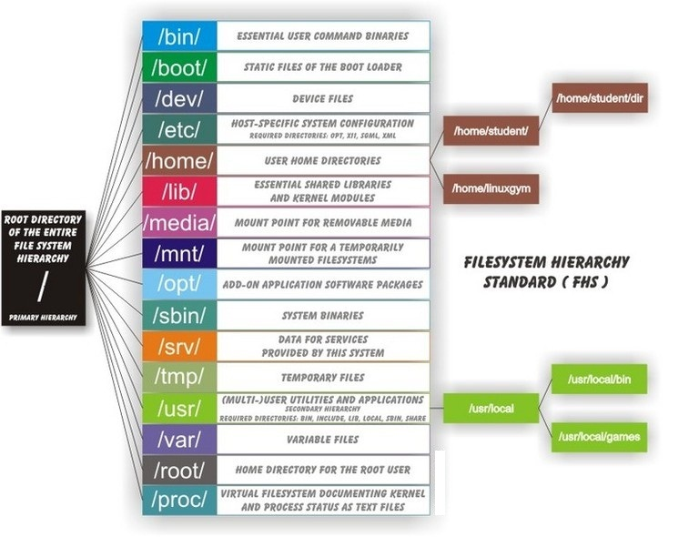

Slide 24
“Try to keep up”
chase$ cat >foo
asl;fjasklfjasf
chase$ ln foo bar
chase$ cat bar
asl;fjasklfjasf
chase$ ls -i foo bar
9036168 bar 9036168 foo
chase$ rm foo
chase$ cat bar
asl;fjasklfjasf
chase$ cat >foo
230984309453245
chase$ cat bar
asl;fjasklfjasf
chase$ ln -s bar sbar
chase$ cat sbar
asl;fjasklfjasf
Same inode number: two names, same file, refcount=2
dangling symlink
symlink
cycle
File still exists: refcount=1
chase$ rm -f bar
chase$ cat sbar
cat: sbar: No such file or directory
chase$ ln foo bar
chase$ cat sbar
230984309453245
chase$ rm -f bar
chase$ ln -s sbar bar
chase$ cat sbar
cat: sbar: Too many levels of symbolic links
chase$
Unchanged: (name binds at create time)
symlink
symlink target changed:
(name binds at resolve time)

