Slide 1


CPS 310
The Storage Stack
Jeff Chase
Duke University

Slide 2
Names and layers
User
view
notes in notebook file
Application
fd
notefile: fd, byte range*
bytes
File System
block#
volume, block #
Block Storage
surface, cylinder, sector
Add more layers as needed.

Slide 3
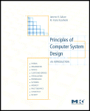
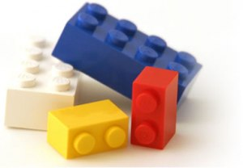

Managing complexity
System
Component
Component
Component
Component
System
Environment

Slide 4
Composing layered abstractions
Abstract interfaces
Mix and match implementations
“Stackable”: extend functions by adding layers of each class.
Nested virtual block devices
Use files as block devices
Etc.
Graft multiple filesystem volumes into system FS tree.
I/O object
(syscall layer)
Filesystem
Block Device (“disk”)

Slide 5
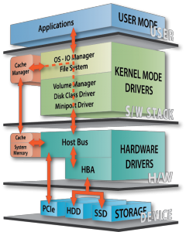
Storage stack
Databases, Hadoop, etc.
We care mostly about this stuff.
File system API. Generic, for use over many kinds of storage devices.
Device driver software is a huge part of the kernel, but we mostly ignore it.
Standard block I/O internal interface.
Block read/write on
numbered blocks on each device/partition.
For kernel use only: DMA + interrupts.
Many storage technologies, advancing rapidly with time.
Rotational disk (HDD): cheap, mechanical, high latency.
Solid-state “disk” (SSD): low latency/power, wear issues, getting cheaper.
[Calypso]

Slide 6
More (optional) layers of mapping
Files and their blocks
There could be many more layers!
map
Logical disk volumes or objects
For “storage virtualization”…
map
Physical disks
It’s turtles all the way down.

Slide 7
Composing the file tree
Each FS volume is a subtree of directories and files.
File trees are built by grafting
FS volumes from different storage
volumes or from network servers.
/
bin
etc
tmp
usr
kernel
In Unix, the graft operation is
a privileged mount system call,
and each volume is a filesystem.
ls
sh
project
users
packages
mount point
mount (coveredDir, volume)
coveredDir: directory pathname
volume: device or network volume
volume root dir visible at coveredDir
(volume root)
tex
emacs

Slide 8
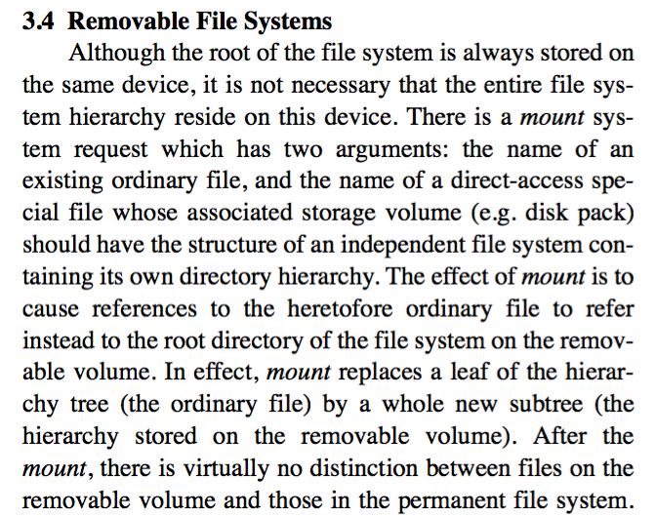
The UNIX Time-Sharing System*
D. M. Ritchie and K. Thompson,1974

Slide 9
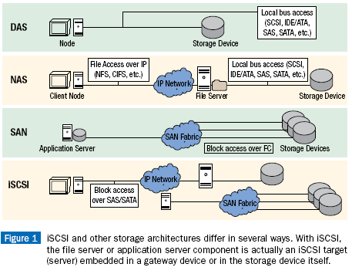
NAS, SAN, and all that
[rtcmagazine.com]

Slide 10
Network storage
NAS: Network-Attached Storage
File abstraction
Protocols: Network File System (NFS), Microsoft CIFS
Parallel I/O: pNFS, Lustre, etc.
SAN: Storage-Area Network
Block storage abstraction
Logical volumes
Attach volume to host, configure FS on it, mount
Key-value store
Small files with flat names, read/write in entirety
Used for datacenter services

Slide 11
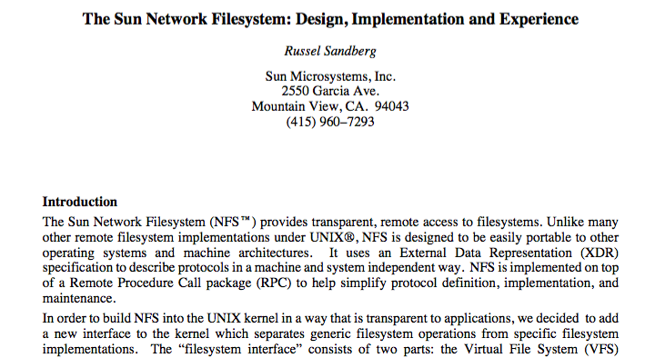

1985; 1750 cites (w/ original version)
NFS is still in wide use in enterprises.

Slide 12
VFS: the Filesystem Switch
Sun Microsystems introduced virtual file system (VFS).
VFS is an abstract object interface inside the kernel.
VFS allows diverse specific file systems (FS) to coexist.
Isolates FS-dependencies in pluggable FS modules.
user mode
vnode
syscall layer (file, uio, etc.)
network
protocol
stack
(TCP/IP)
Virtual File System (VFS)
inode
NFS
FFS
LFS
*FS
etc.
etc.
device drivers
VFS “wraps” inodes with generic vnodes.

Slide 13
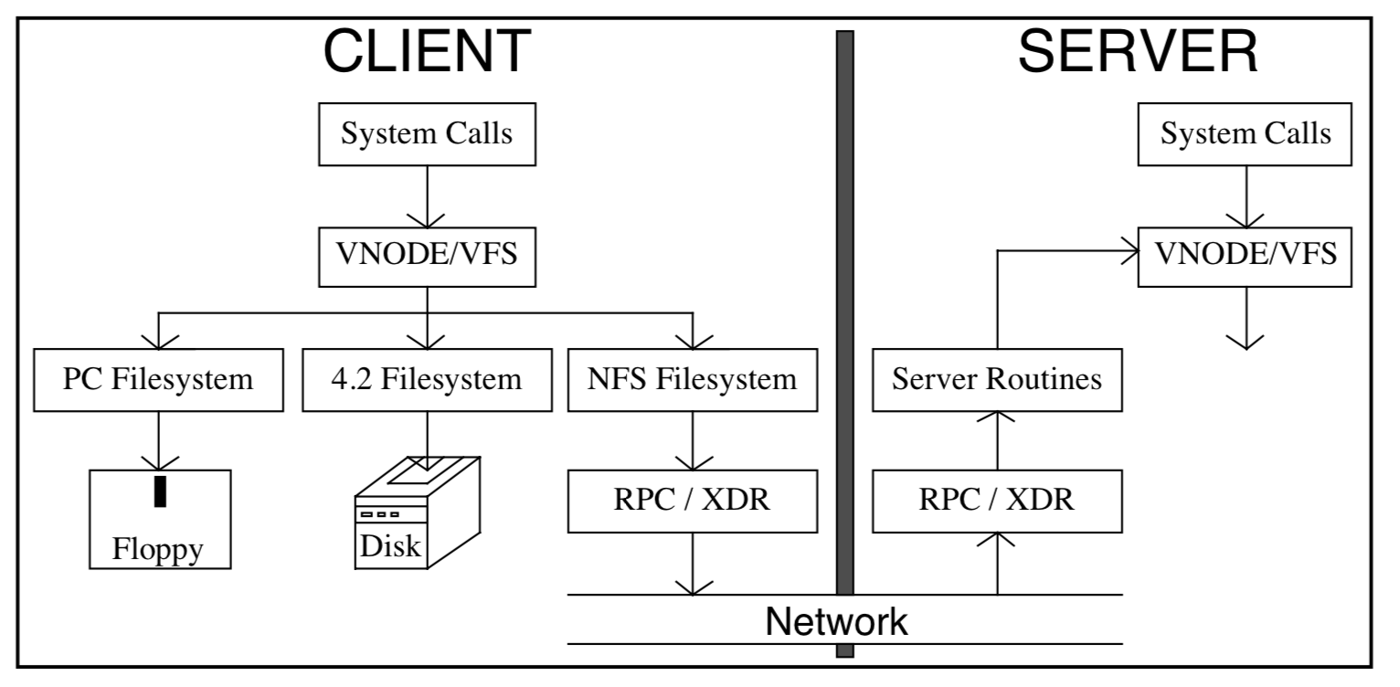
NFS: the pieces
XDR: External Data Representation (a Sun library for RPC stubs)
Image from The Sun Network Filesystem: Design, Implementation and Experience
By Rusty Sandberg

Slide 14
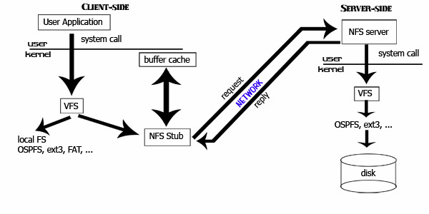
Network File System (NFS)
Remote Procedure Call (RPC)
External Data Representation (XDR)
[ucla.edu]

Slide 15
Network File System (NFS)
client
server
user programs
…
VFS
syscall layer
NFS
server
VFS
UFS
UFS
NFS
client
network
A depiction of how NFS support integrates with *x OS kernel and is “transparent” to applications. A Virtual Filesystem Switch (VFS) supports multiple FS types/instances through a common syscall API.

Slide 16
NFS simplified
NFS
client
NFS
server
“disk”
Network/RPC
I/O cache
rnodes
objects
(files/directories)
I/O cache
Client application API: open/close/read/write syscalls on named files.
Client implements syscall API by making RPC calls on NFS server(s).
Each RPC call operates on an object (file or directory) on the server.
Files are sequences of blocks: client RPCs read and write blocks.
Directory operations: create/remove/lookup name.
Various other RPC operations (setattr, rename,…).

Slide 17
NFS File Handles
Question: how does an NFS client tell the server which file or directory an RPC operation applies to?
Similarly, how does the server return the result of a lookup?
In NFS, the reference is a file handle or fhandle, a token/ticket whose value is determined by the server.
Opaque to client: includes all information needed to identify the file/object on the server, and get a pointer to it quickly.
“classic” NFS fhandle
volume ID
inode #
generation #
32-64 bytes
“which disk”
“which object”
“random” number, hard to guess

Slide 18
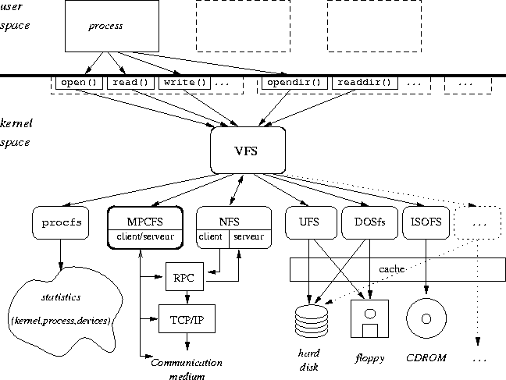
Big picture
inria.fr

Slide 19
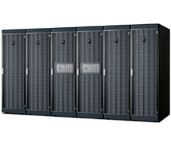
File systems today: “Filers”
Network-attached (IP)
RAID appliance
Multiple protocols
iSCSI, NFS, CIFS
Admin interfaces
Flexible configuration
Lots of virtualization: dynamic volumes
Volume cloning, mirroring, snapshots, etc.
NetApp technology leader since 1994 (WAFL)

Slide 20
The block storage abstraction
Read/write blocks of size b on a logical storage device (“disk”).
A disk is a numbered array of these basic blocks. Each block is named by a unique number (e.g., logical blockID).
CPU (typically executing kernel code) forms buffer in memory and issues read or write command to device queue/driver.
Device DMAs (direct memory access) data to/from memory buffer, then interrupts the CPU to signal completion of each request.
Device I/O is asynchronous: the CPU is free to do something else while I/O in progress.
Transfer size b may vary, but is always a multiple of some basic block size (e.g., sector size), which is a property of the device, and is always a power of 2.
Storage blocks containing data/metadata are cached in memory buffers while in active use: called buffer cache or block cache.

Slide 21
Filesystem abstraction: Vnode ops
vnode attributes (vattr)
type (VREG, VDIR, VLNK, etc.)
mode (9+ bits of permissions)
nlink (hard link count)
owner user ID
owner group ID
filesystem ID
unique file ID
file size (bytes and blocks)
access time
modify time
generation number
directories only
vop_lookup (OUT vpp, name)
vop_create (OUT vpp, name, vattr)
vop_remove (vp, name)
vop_link (vp, name)
vop_rename (vp, name, tdvp, tvp, name)
vop_mkdir (OUT vpp, name, vattr)
vop_rmdir (vp, name)
vop_symlink (OUT vpp, name, vattr)
vop_readdir (uio, cookie)
vop_readlink (uio)
files only
vop_getpages (page**, count, offset)
vop_putpages (page**, count, sync, offset)
vop_fsync ()
generic operations
vop_getattr (vattr)
vop_setattr (vattr)
vhold()
vholdrele()
Not to be tested

