Slide 1


CPS 310
I/O Caching
Jeff Chase
Duke University

Slide 2
Storage software stack
I/O object
(syscall layer)
Filesystem
Cache
Here?
Block Device (“disk”)

Slide 3
Anatomy of a read
3. Check to see if requested data (e.g., a block) is in memory. If not, figure where it is on disk, and start the I/O.
6. Return to user mode.
5. Copy data from kernel buffer to user buffer in read.
(kernel mode)
2. Enter kernel for read syscall.
1. Compute
(user mode)
4. sleep for I/O (stall)
Wakeup by interrupt.
CPU
seek
transfer (DMA)
Disk
Time

Slide 4
I/O caching
BlockID
Buffer headers
describe contents of buffers
BlockID = 12
5
Cache directory (hash table)
10
home
15
cached
20
read
fetch
write
push
app threads
Request read and write operations on byte ranges of files
memory
A set of available frames (buffers) for block I/O caching, whose use is controlled by the system
An array of numbered blocks on storage

Slide 5
Storage stack (rough idea)
System call interface for files
Related VM operations (mmap)
Generic FS layer (e.g., VFS)
+“file system drivers” for specific FS
getBlock(blockID)
releaseBlock(…)
startFetch(), startPush()
waitValid(), waitClean()
I/O buffering / cache layer
ioComplete()
startRequest(…)
VirtualDisk layer

Slide 6
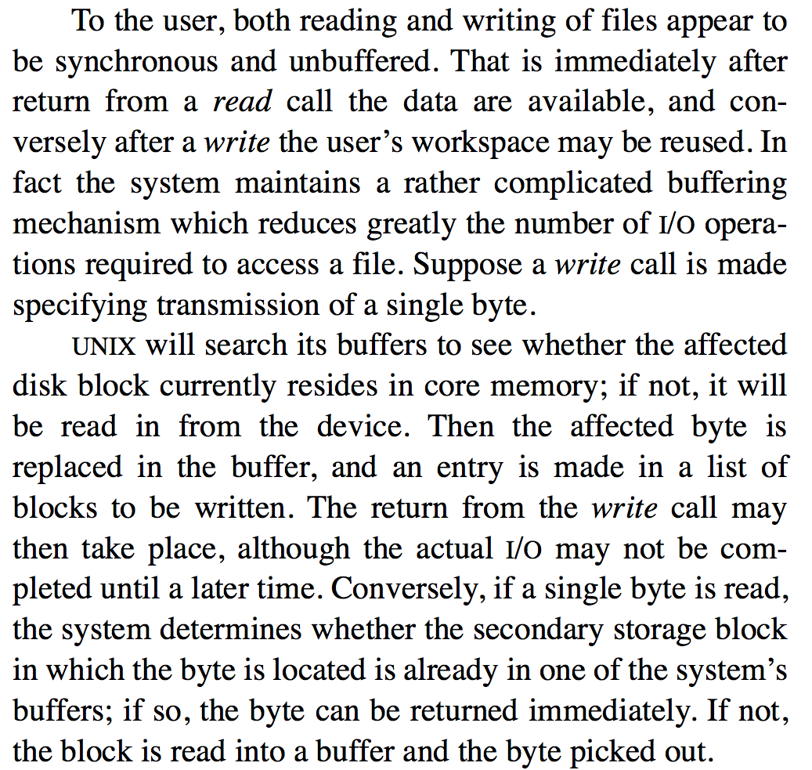
The Buffer Cache
Proc
Memory
File
cache
Ritchie and Thompson The UNIX Time-Sharing System, 1974

Slide 7
Editing Ritchie/Thompson
The system maintains a buffer cache (block cache, file cache) to reduce the number of I/O operations.
Suppose a process makes a system call to access a single byte of a file. UNIX determines the affected disk block, and finds the block if it is resident in the cache. If it is not resident, UNIX allocates a cache buffer and reads the block into the buffer from the disk.
Then, if the op is a write, it replaces the affected byte in the buffer. A buffer with modified data is marked dirty: an entry is made in a list of blocks to be written. The write call may then return. The actual write may not be completed until a later time.
If the op is a read, it picks the requested byte out of the buffer and returns it, leaving the block in the cache.
Proc
Memory
File
cache

Slide 8

Cache Concept (Read)

Slide 9
Cache Concept (Write)
Write through: changes sent
immediately to next level of storage
Write back: changes stored in cache
until cache block is replaced

Slide 10
Prefetching for high read throughput
Read-ahead (prefetching)
Fetch blocks into the cache in expectation that they will be used.
Requires prediction. Common for sequential access.
1. Detect access pattern.
Reduce I/O stalls
2. Start prefetching

Slide 11
Writes in the FS buffer cache
Delayed writes
Partial-block writes may be left dirty in the cache. The “push” to disk is deferred in expectation of later writes to the same block.
Write behind
Dirty blocks file are pushed to disk asynchronously; the write syscall may return before the disk write is complete.
May lose data!
Be sure you know the failure semantics of the file systems you use in your life. A classic UNIX file system may discard any subset of recent writes on failure.
Fsync syscall pushes dirty blocks and waits for them.
Fsync is for use by applications that really want to know their data is “safe”. Good file systems implicitly fsync-on-close.

Slide 12
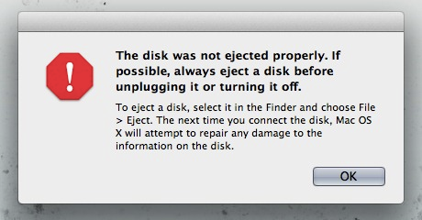


What about failures?
X

Slide 13
Metadata updates and recovery
Metadata updates may incur extra seek overhead.
E.g., extending a file requires writes to the inode, direct and/or indirect blocks, cylinder group bit maps and summaries, and the file block itself.
Metadata items are often updated repeatedly, so delayed writes help.
But delayed writes incur a higher risk of file system corruption in a crash.
Suppose the metadata structure is in an inconsistent state after a crash, and can’t be repaired? Then what?
If you lose your metadata, you are dead in the water.

Slide 14
Safety of metadata
How to protect integrity of the metadata structures?
Metadata is a complex linked data structure, e.g., a tree.
Must be “well-formed” after a crash/restart, even if writes are lost.
…or, must be possible to restore metadata to a consistent state with a scrub (file system check or “fsck”) on restart after a crash.
once upo
n a time
/n in a l
dir inode
wind: 18
0
and far
far away
, lived th
file inode
snow: 62
0
rain: 32
dir entries
file blocks
hail: 48

Slide 15
Atomic updates: the recovery problem
The safe metadata update problem in file systems is a simplified form of the atomic update and recovery problem for databases.
We want to make a group of related updates to a complex linked data structure, e.g., to create a new file. The updates could be all over the disk.
But we could crash at any time, e.g., in the middle of the group of updates.
We need some way to do atomic commit: either all of the updates in each group complete, or none of them do. And we want it to be fast.
The concern is similar to concurrency control: we don’t want software to “see” an inconsistent state that violates structural invariants.
once upo
n a time
/n in a l
dir inode
file blocks
wind: 18
0
and far
far away
, lived th
file inode
snow: 62
0
rain: 32
dir entries
hail: 48

Slide 16
Metadata write ordering
Option 1
A common approach to safety of file system metadata:
Order essential metadata writes carefully.
Various techniques to enforce a partial order of writes to the disk, i.e., ensure that write A completes before write B begins.
Maintain invariants! E.g., avoid dangling references.
Never recycle a structure (block or inode) before zeroing all pointers to it (truncate, unlink, rmdir).
Never point to a new structure before it has been initialized. E.g., sync inode on creat before filling directory entry, and sync a new block before writing the block map.
Traverse the metadata tree to rebuild derived structures.
Post-crash scrub can rebuild/repair other structures e.g., free block bitmaps, free inode bitmaps. (file system check: fsck)

Slide 17
Atomic commit: techniques
We consider three three techniques for atomic commit and recovery, in the context of file systems.
Option 1: careful write ordering, with scrub on recovery
Option 2: logging/journaling (also used in databases)
Option 3: shadowing (e.g., WAFL)

