Slide 1
The Ext2 Filesystem
Michael Hewner
Duke University

Slide 2
Blocks
All data is organized into blocks
All references to other parts of the disk are specified in block numbers
We store both data and metadata in blocks (so its usual to say that blockgroup X’s block bitmap is blocks x-y)
Data can only be allocated to files in block granularity – meaning internal fragmentation
Block size is variable, set in the superblock

Slide 3
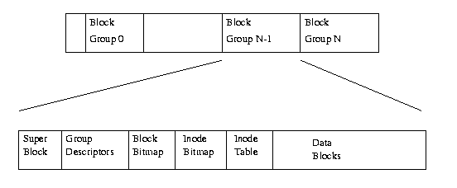
Block Groups
You might think of them as little self-sufficient “neighborhoods” on the disk. So rather than keep track of every inode in the system at the beginning say, block group 0 keeps track of one group of inodes and data blocks.
We try for good block group locality – e.g. hopefully block group 0’s inodes refer to data blocks that are also in block group 0. It’s not necessarily the case though – if block group 0 fills up I might have to go to other groups to let a file expand.
Filsystem-Wide Metadata
Group-Specific Metadata
File Blocks

Slide 4
Superblock
Stores a fixed-size chunk of global information about this disk – but this duplicated in many block groups (making our neighborhoods more self-sufficient)
A lot of fixed-at-format-time stuff like number of block groups, block size etc.
Number of free blocks and inodes on this disk which must be locked to be updated

Slide 5
Group Descriptors
Tracks the position of all the block groups on the disk
With this data, you can computer witch block on disk contains any inode or data block. First you figure out which block group it belongs to – then you find that block group here and see where it’s inode table or data blocks live (note ext2 assignment doers – these block numbers are absolute)

Slide 6
Block Bitmap/Inode Bitmap
A bitmap is just a big array of 0s and 1s…determining the true/false state of some big other thing
In this case, its determining which inodes are used/unused and which data blocks are used/unused. So for each inode in the group’s inode table, there’s a bit here. For each data block in the groups data blocks, there’s a bit here.

Slide 7
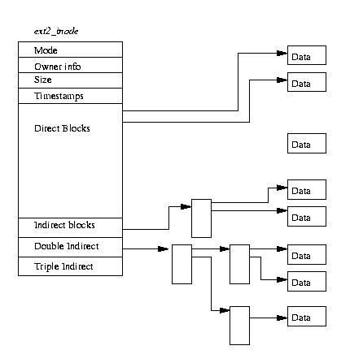
Inode table
Mostly what you expect
Does not contain the file name – that’s actually stored in the directory (and you can have multiple file names that refer to the same inode if you want)
15 entries for data ids
12 are direct
13th is indirect
14th is double indirect
15th is triple indirect
The block ids stored here are absolute. Usually an attempt would be made to allocate them in the same block group. But maybe not.

Slide 8
Data blocks
Here’s where the actual file data in your system is stored
Note that these blocks contain no metadata. So by looking in a block, you have no idea what file’s data is there (or maybe just unallocated, or maybe it an indirect block filled with block ids)

Slide 9
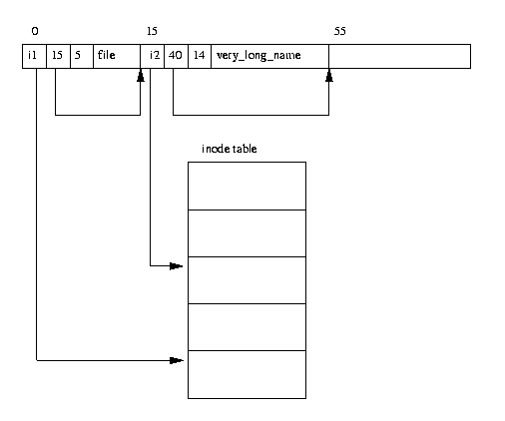
Directories
First entry
Second Entry
Really just a specially formatted file – a list of entries
First and most critical entry is the inode number
Is a linked list – includes a link called rec_len which is the amount to step forward to go to the next entry
Stores filename length and filename

