Slide 1
Atomic Update and Recovery
Basic Techniques for Recoverable Storage
Jeff Chase
Duke University

Slide 2
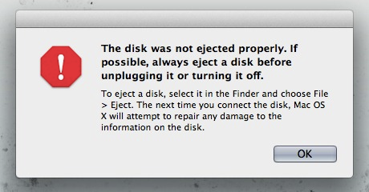


What about failures?
X

Slide 3
File system: just another service
Consensus ← replicate critical services for reliability.
Any service! (State machine.)
File service is an example!
Internal state (inodes, blocks, etc.)
A handful of ops/methods
Deterministic
State Machine
Revert
Apply
API
Log
ops
mkdir
creat
write
write
Failure? Recover consistent state (from disk) and restart.
What is consistent? Ideal: recovered state reflects exactly a prefix of ops up to a recovery point in the log.

Slide 4
Filesystem: service ops (VFS/NFS)
State-changing ops on a directory vnode
create (name, vattr) → vnode
remove (name)
link (vp, name)
rename (oldname, tdvp, tvp, newname)
mkdir (name, vattr) → vnode
rmdir (name)
symlink (name, vattr) → vnode
State-changing ops on a file vnode
putpage: block write
sync/commit
set attributes
vnode
e.g., inode
State Machine
Revert
Apply
API
Log
ops
Oversimplified, but not by much.
This is roughly the RPC API for NFS.
mkdir
creat
write
write

Slide 5
I/O caching
BlockID
Buffer headers
describe contents of buffers
BlockID = 12
5
Cache directory (hash table)
10
home
15
cached
20
read
fetch
write
push
FS op code operates on copies of disk blocks cached in memory (buffer cache).
Read/modify/write. Fetch, modify, push. Push may be delayed/asynchronous.
An array of numbered blocks on “disk”

Slide 6
Crash consistency: the problem
On a crash, any dirty blocks in buffer cache are “lost”.
For performance:
Delay disk writes→maybe lots of dirty blocks in the cache.
Write blocks to disk in a preferred order (like “deli p1d”).
So: what state is on disk after a crash?
And: some FS ops require modifying multiple blocks.
So: how to assure failure atomicity?
Each op is either completely done or has no effect on disk state.
How to recover a consistent state? (Which ops done.)
What consistency after a crash? How to formalize safety properties for crash consistency?

Slide 7
Crucial: safety of metadata
How to protect integrity of the metadata structures?
Metadata is a complex linked data structure, e.g., a tree.
Must be “well-formed” (consistent) after a crash/restart.
Can’t recover your metadata? Sad!
X
once upo
n a time
/n in a l
dir inode
wind: 18
0
and far
far away
, lived th
file inode
snow: 62
0
rain: 32
dir entries
file blocks
hail: 48

Slide 8
Disk write behavior (cartoon version)
Disk may reorder pending writes.
Limited ordering support (“do X before Y”) called barriers.
Host software can enforce ordering by writing X synchronously: wait for write of X to complete before issuing Y.
Writes at sector grain are atomic (512 bytes?).
Writes of larger blocks may fail “in the middle”.
Disk may itself have a writeback cache.
Even “complete” writes may be lost.
(The cache can be disabled.)

Slide 9
Atomic updates: the recovery problem
The safe metadata update problem in file systems is a simplified form of the atomic update and recovery problem for databases.
We want to make a group of related updates to a complex linked data structure, e.g., to create a new file. The updates could be all over the disk.
But we could crash at any time, e.g., in the middle of the group of updates.
We need some way to do atomic commit: either all of the updates in each group complete, or none of them do. And we want it to be fast.
The concern is similar to concurrency control: we don’t want software to “see” an inconsistent state that violates structural invariants.
once upo
n a time
/n in a l
dir inode
file blocks
wind: 18
0
and far
far away
, lived th
file inode
snow: 62
0
rain: 32
dir entries
hail: 48

Slide 10
FS failure atomicity: overview
Older file systems use lots of synchronous writes to try to control the order of writes to disk.
Safe but slow. Lengthy repair after crash.
Newer filesystems use journaling to track updates.
Concept is an on-disk log file—a database technique.
Fast recovery by scanning recent writes in log.
But makes writes more costly.
Example: Linux ext3, ext4.
Shadowing is a key technique for atomic snapshots that can be used alone or in combination with journaling.
Example: NetApp WAFL, still the state of the art.

Slide 11
On-disk logging
(old)
...
Suppose:
I can append operation records (entries) atomically to a log stored on disk.
In a crash, recent entries may be lost, but:
After a crash, I can always identify the maximal prefix of saved entries in the log.
Then:
I can always re-execute (“replay”) these logged operations to recover the state.
It’s a lot like consensus, but we save the log by writing it to disk. (Might also replicate.)
(new)

Slide 12
Using snapshots
(old)
...
Problem: on recovery, where to start?
Replay all ops ever for all time? Too costly.
Solution: periodic snapshot of state.
A snapshot is a complete (logical) copy of a consistent state at a point in time.
A consistent snapshot can be a starting point for recovery. Also called a checkpoint.
Recovery does not need any log entries from before the snapshot.
→ truncate old log prefix atomically at snapshot.
(new)

Slide 13
Commit records
(old)
...
Log entries may represent individual steps of a complex op (“transaction”) that is atomic.
In Raft, each entry describes a request/op.
Filesystems and databases have complex ops with many writes to on-disk state.
E.g., a group of writes that transition it from one consistent state to another.
Idea: log each step, and then log a commit entry to record that the op is complete.
On recovery: if commit record is present, replay all steps to redo the op, else ignore.
commit
(new)

Slide 14
Recovering commits
(old)
...
Imagine logging each entry in sequence.
If we crash here, then what?
If we crash here, then what?
commit
(new)

Slide 15
Call them transactions
Database systems and other systems use a programming construct called atomic transactions (“ACID”) to represent complex ops as a sequence of steps with atomic commit.
BEGIN T1
read X
read Y
…
write X
END
Atomic
Consistent
Independent
Durable
BEGIN T2
read X
write Y
…
write X
END
Transactions may be concurrent (e.g., run as threads), but they commit atomically in serial order.

Slide 16
Using an on-disk log
(old)
...
There are lots of ways to use on-disk logs. Here are some of the elements:
Operational logging. Entries represent steps to execute. Replay by re-executing.
Value logging. Append modified data values (e.g., inodes, entries, blocks). Replay by re-writing to “home” locations.
Undo logging. Apply operations in place to “home”, then use log to rollback steps of uncommitted ops after crash. (e.g., for updates to nonvolatile RAM)
commit
(new)

Slide 17
Recoverable in-memory data with a log
Your data structures in memory
Your program executes transactions that read or update the data structures in memory.
Volatile)
Persistent (e.g., “disk”)
Log operation steps as they occur. Discard after each snapshot (log truncation).
Save a checkpoint or snapshot of the entire structure periodically. Must be atomic.
snapshot
log
After a failure, replay the log into the last snapshot to recover the data structure.

Slide 18
Write-ahead logging (WAL)
Q. What if the structure is too large to fit in memory? Like a file system or database?
A: keep a partial copy in memory, e.g., the buffer cache. Update there, and push writes to full on-disk copy (“home”) later.
Volatile (e.g., buffer cache)
Persistent (e.g., “disk”)
Log operation steps as they occur. Make sure the commit is logged before pushing any writes to home—WAL.
Maintain full state on disk in the usual way; supplement with a log.
home
log
Uncommitted writes can corrupt the on-disk copy if crash occurs before commit point. Without the WAL guarantee, the log must also contain undo records.

Slide 19
Checkpointing with WAL
Suppose we are using WAL.
When can we truncate the log, i.e., discard old entries? Grow forever?
No. But must truncate carefully.
Discard entries only after their writes are pushed to home.
Option 1: continuous online checkpoint with undo: ARIES.
Option 2: take partial/incremental atomic snapshot/truncate; recover from the last snapshot.
home
log

Slide 20
Shadowing
Shadowing is a technique to take atomic snapshots of a storage object as it is modified. Elements:
Storage object is a space of blocks. E.g., it could be a file or a logical disk volume.
Tree-structured block map for the storage object.
E.g., a file mapped by a classic inode.
Copy on write. On updating a logical block (or map block), change its disk location and update the map.
No overwrite. COW leaves previous version in place!
Atomic map update. Update the root of the map tree on disk with a single disk write—atomic!

Slide 21
Shadowing
1. Starting point:
modify purple/grey blocks
2. Write new blocks to disk.
Prepare new block map
3. Write new block map
(atomic commit)
and free old blocks
(optional).
Shadowing is a basic technique for atomic commit and recovery.
Just to spell it out: if the system crashes before step 3, then the update fails, but the previous version is still intact. To abort the failed update we just need to free any blocks written in step 2. Step 3 completes the update: it replaces the old map with the new. Because it is a single disk write, the system cannot fail “in the middle”: it either completes or it does not: it is atomic. Once it is complete, the new data is safe.

Slide 22
WAFL
State-of-the-art industrial-strength file system.
Proprietary to NetApp Inc. filers. In use since 1995.
Entire on-disk file system is organized as a tree.
Any block can live anywhere: just branch the tree.
When writing a block, move it and update the tree.
Atomic updates to the root of the tree. (Shadowing)
Write Anywhere File Layout
Save snapshots frequently as directories, so that users or operators can recover data by “cd yesterday”.

Slide 23
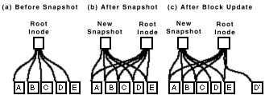
WAFL Snapshots
The snapshot mechanism is used for user-accessible snapshots and for transient “consistency points”.
[HLM94] “File System Design for an NFS File Server Appliance” by Dave Hitz, James Lau, Michael Malcolm. USENIX Winter 1994, San Francisco, California, 1994.

Slide 24
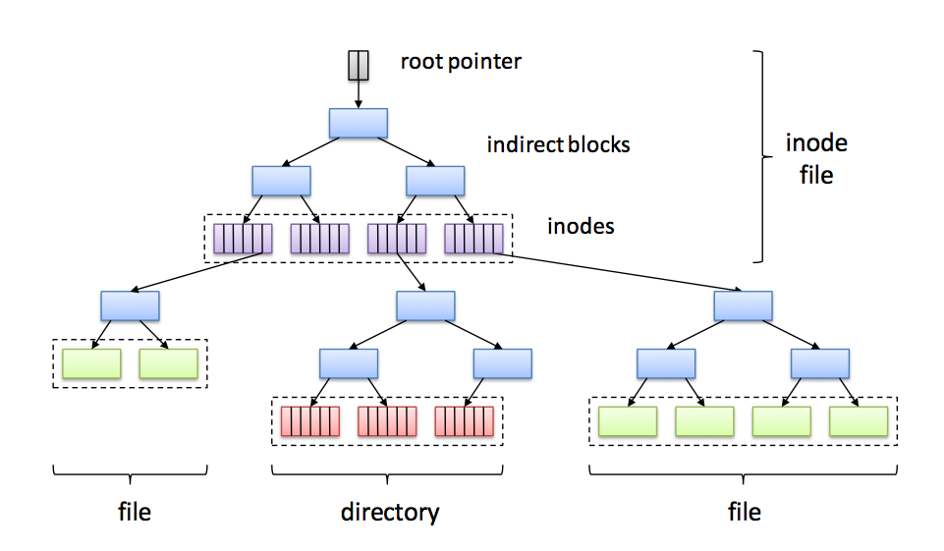

On-disk metadata structures Write Anywhere File Layout (WAFL)
Root inode
Inodes for user files and directories

Slide 25
Logging/Journaling
Logging is widely used for database systems, and for metadata writes in “journaling” file systems.
Key idea: record updates in a sequential log as they are made. The log is a file on disk.
Log records are written to the log synchronously and sequentially: no seeks, and preserves temporal ordering.
Each log record write is atomic: each log record is trailed by a marker (e.g., checksum) that says “this log record is complete”.
Commit each group g of related updates atomically by writing a single commit record to the log: “commit g”.
To recover: scan the log in order, reapply (“replay”) committed updates and/or cancel or roll back updates from any group g that did not commit before the crash.

Slide 26
Transactions: logging
Begin transaction
Append info about modifications to a log
Append “commit” to log to end x-action
Write new data to normal database
Single-sector write commits x-action (3)
Begin
Transaction Complete
Write1
…
WriteN
Commit

Slide 27
Transactions: logging
Begin transaction
Append info about modifications to a log
Append “commit” to log to end x-action
Write new data to normal database
Single-sector write commits x-action (3)
Begin
Write1
…
WriteN
Commit
What if we crash here (between 3,4)?
On reboot, reapply committed updates in log order.

Slide 28
Transactions: logging
Begin transaction
Append info about modifications to a log
Append “commit” to log to end x-action
Write new data to normal database
Single-sector write commits x-action (3)
Begin
Write1
…
WriteN
What if we crash here?
On reboot, discard uncommitted updates.

Slide 29
Atomic commit: shadowing
Shadowing is used in NetApp WAFL:
Write Anywhere File Layout
Write each modified block to a new location.
Copy/update block maps to point to the new locations.
3. Write the new map root to disk with a single disk write.
Shadowing presumes that the data is mapped by a block map on disk, that the disk is large enough to store both the old version and the modified data, and that we can update the block map on disk with a single (atomic) disk write. To grow the block map we can make it hierarchical.

Slide 30
Anatomy of a Log
(old)
...
A log is a sequence of records (entries) on recoverable storage.
Each entry has an index—Log Sequence Number (LSN).
Create log entries for T as T executes, to record progress of T.
Atomic operations:
Append/write entry to log
Truncate older entries up to time t
Read/scan entries
Log writes are atomic and durable, and complete detectably in order.
Log
Sequence
Number
(LSN)
LSN 11
XID 18
LSN 12
XID 18
Transaction
ID (XID)
LSN 13
XID 19
commit
record
LSN 14
XID 18
commit
(new)

Slide 31
Using a Log
(old)
...
Log
Sequence
Number
(LSN)
LSN 11
XID 18
Log entries for T record the writes by T (or operations in T).
Redo logging
To recover, read the checkpoint and replay committed log entries.
“Redo” by reissuing writes or reinvoking the methods.
Redo in order (old to new)
Skip the records of uncommitted Ts
No T can be allowed to affect the checkpoint until T commits.
Technique: write-ahead logging
LSN 12
XID 18
Transaction
ID (XID)
LSN 13
XID 19
commit
record
LSN 14
XID 18
commit
(new)

Slide 32
Managing a Log
(old)
...
Log
Sequence
Number
(LSN)
LSN 11
XID 18
On checkpoint, truncate the log
No longer need the entries to recover
Checkpoint how often? Tradeoff:
Checkpoints are expensive, BUT
Long logs take up space
Long logs increase recovery time
Checkpoint+truncate is “atomic”
Is it safe to redo/replay records whose effect is already in the checkpoint?
Checkpoint “between” transactions, so checkpoint records a consistent state.
Lots of approaches
LSN 12
XID 18
Transaction
ID (XID)
LSN 13
XID 19
commit
record
LSN 14
XID 18
commit
(new)

