Slide 1
Disks and RAID
Redundant Arrays of Independent Disks
Jeff Chase
Duke University

Slide 2
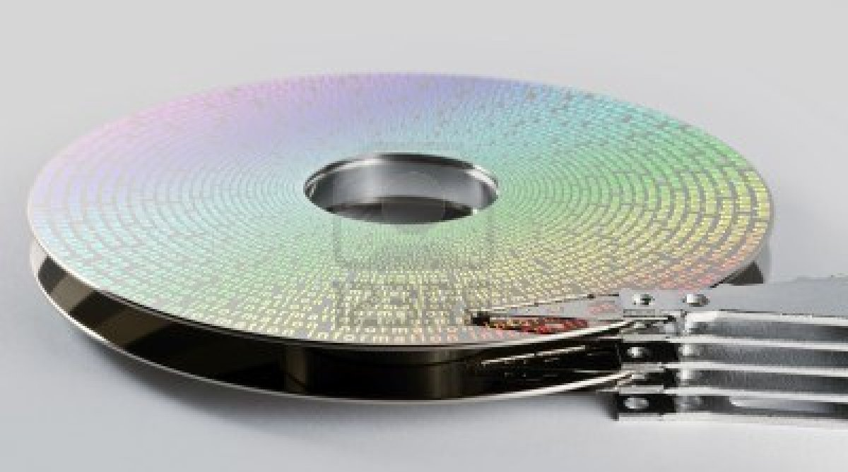
A disk

Slide 3
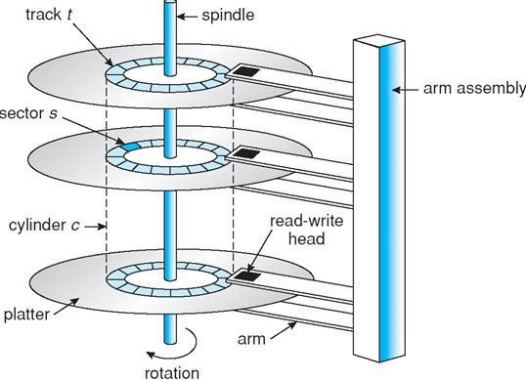
A disk

Slide 4
Access time
How long to access data on disk?
5-15 ms on average for access to random location
Includes seek time to move head to desired track
Roughly linear with radial distance
Includes rotational delay
Time for sector to rotate under head
These times depend on drive model:
platter width (e.g., 2.5 in vs. 3.5 in)
rotation rate (5400 RPM vs. 15K RPM).
Enterprise drives use more/smaller platters spinning faster.
These properties are mechanical and improve slowly as technology advances over time.
Track
Sector
Arm
Cylinder
Platter
Head

Slide 5

A few words about SSDs
Solid State Drives (e.g., Flash memory):
No spinning platter, no arm to move, no mechanicals.
Faster than disk (at least for reads), slower than DRAM.
No seek cost. But writes require slow block erase, and/or limited # of writes to each cell before it fails.
Technology is advancing rapidly; costs are dropping.
How should we use them? Are they just fast/expensive disks? Or can we use them like memory that is persistent? Open research question.
Trend: use them as block storage, and/or combine them with HDDs to make hybrids optimized for particular uses.

Slide 6
Logical disk volumes
I/O object
(syscall layer)
fd
bytes
block#
File System
FS blocks
push
fetch
“disk”
Block Storage
map
Logical Volume
May be mapped onto multiple physical drives: aggregate disks for capacity, bandwidth/throughput, and reliability.

Slide 7

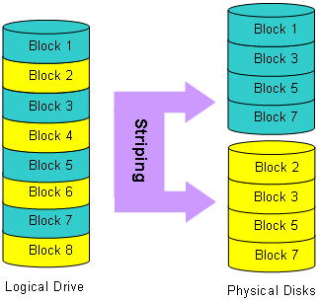
Example: disk arrays and striping
One way to grow:
Buy more disks
“Deal the blocks”
Keep track of them
Spread the I/O
How to keep track of the blocks? Given a request for block n in the “logical drive”, which disk to send it to? Which block on that disk?
4
6
8
pantherproducts.co.uk

Slide 8
Load spreading and performance
What effect does load spreading across N units have on performance, relative to 1 unit?
What effect does it have on throughput?
What effect does it have on response time?
How does the workload affect the answers?
E.g., what if striped file access is sequential?
What if accesses are random?
What if the accesses follow a skewed distribution, so some items are more “popular” than others?

Slide 9
RAID: the concept
Redundant Array of Inexpensive Disks
Reliable Array of Independent Disks
Stripe Data
Parity
(optional)
Lots of variations, with various redundancy approaches.
Including no redundancy (RAID0).

Slide 10
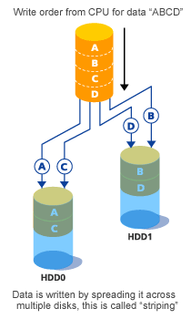
RAID 0: Striping
No Redundancy.
Sequential throughput?
Random throughput?
Random latency?
Read vs. write?
Cost per GB?
Pure declustering
Fujitsu

Slide 11


What about failures?
X
Systems fail. Here’s a reasonable set of assumptions about failure properties for servers/bricks (or disks)
Fail-stop or fail-fast fault model
Nodes either function correctly or remain silent
A failed node may restart, or not
A restarted node loses its memory state, and recovers its secondary (disk) state
If failures are random/independent, the probability of some failure is linear with the number of units.
Higher scale → less reliable!
If a disk in a striped storage system fails, we lose the entire file! (It’s no good with all those holes.)

Slide 12
What is the probability that a disk fails in an array of N disks at any given time?
Let's make some reasonable assumptions (not always true, but reasonable) about the disks in the array:
Disk failures are independent: a disk doesn't "know" what happens to other disks when it "decides" to fail.
Disks all have the same probability of failure in any given point in time (or any given interval): no disk is more or less prone to failing to any other.
Disk failures are evenly distributed in time: no interval in time is more prone to disk failures than any other interval.
So the probability of any given disk failing in any given interval (of some fixed length) is a constant. Let us call this constant F.
It is an axiom of elementary probability that:
- The probability of either A or B occurring (but not both) is P(A) + P(B) - P(A and B).
- The probability of both A and B occurring is P(A)*P(B).
Well, if F is a small number (it is), then the probability of two disks failing in the same interval is F-squared, a very small number. So forget about that.
So the probability that any one of N disks fails in some given interval is NF.

Slide 13
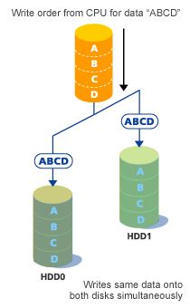
RAID 1
Mirroring
Sequential throughput?
Random throughput?
Random latency?
Read vs. write?
Cost per GB?
Pure replication
Fujitsu

Slide 14
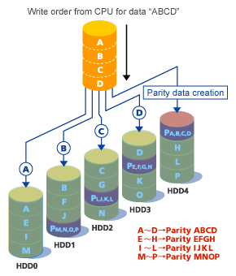
Building a better disk: RAID 5
Market standard
Striping for high throughput for pipelined/batched reads.
Data redundancy: parity
Parity enables recovery from one disk failure.
Cheaper than mirroring
Random block write must also update parity for stripe
Distributes parity: no“hot spot” for random writes
Fujitsu

Slide 15
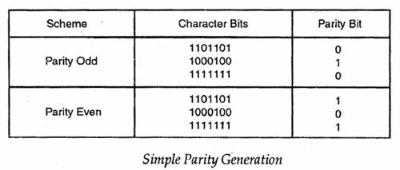
Parity
A parity bit (or parity block) is redundant information stored with a string of data bits (or a stripe of data blocks). Parity costs less than full replication (e.g., mirroring), but allows us to reconstruct the data string/stripe if any single bit/block is lost.

Slide 16
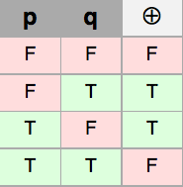
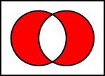
Parity example: XOR
Bitwise exclusive or: xor
“One or the other but not both”
Bit sum, with no carry
Commutative, associative
Sum up the 1s, and add another if needed to make the sum even.
“Even parity”
If any bit is lost, xor of the surviving bits gets it back.
If any bit flips, the parity flips.
What if two bits flip or are lost?

Slide 17
Example: striping in Lustre, a Parallel FS
The 1st stripe
The 2nd stripe
“chunk”
or block
A file
c₀
c₁
c₂
c₃
c₄
c₅
c₆
c₇
c₈
c₉
Example:
stripe width=4
c₀
c₄
c₅
c₆
c₇
c₈
Object₀
Object₁
Object₂
Object₃
Target₂₃
Target₂₄
Target₂₅
Target₂₆

Slide 18

Lustre
Lustre is an open-source parallel file system widely used in petascale supercomputers.
A Lustre file system contains a collection of many disk servers, each with multiple logical disks (“targets”).
Large bursts of reads/writes on large striped files use many targets in parallel.
OSS
(server)
OST
(target)
I/O Routers

Slide 19
Just to spell it out: a stripe is an array of blocks, one block per disk in the disk array. Each block is an array of bits ("memory/storage is fungible"). In RAID-5, one of the blocks of each stripe is a parity block. Each bit in the parity block contains parity over the corresponding bits in the data blocks (i.e., the result of a bitwise XOR, exclusive-or).
Q: If two bits/blocks are lost, your even/odd state may not be changed. Therefore, how do you recover from a failure in this situation?
A: A classic RAID 5 can survive only a single disk failure. That is why many deployments are using alternatives with more redundancy, e.g., "RAID-6" (two parity disks) or "RAID-10" (essentially a mirrored pair of RAID-5 units, 2x5=10).
Q: How do you know which bit/block was lost?
A: It is presumed that disk drive failure is detectable by external means. One possibility is that the disk drive is "fail stop": if it fails, it simply stops serving requests. Or the failed disk reports errors when you try to use it. It is presumed that a disk doesn't ever lie about the stored data (essentially a "byzantine" failure). Fortunately, this assumption is almost always true.
So: in a classic RAID-5, if you know which drive has failed, it is easy to rebuild each stripe from the contents of the remaining disks. For each stripe, the failed disk either contains the parity block of that stripe, or it contains some data block of the stripe. These cases are symmetric: either way the array can rebuild the contains of the missing block.
Note that recovery is very expensive. The recovery process must read the contents of all surviving disks, and write parity data to a replacement disk. That means that a disk failure must be repaired quickly: if a drive fails in your RAID, you should replace it right away.

Slide 20
Q: Can you specify the differences between read and write on that same slide for the different raids? I know you said in class that for raid 1 reads get faster and writes get slower? Could you explain that and also for the other raids?
A: Once you understand the RAID 0, 1, 5 patterns (striping, mirroring, and parity), all of these differences are "obvious". The differences stem from different levels of redundancy. Redundancy increases $$$ cost but it also improves reliability. And redundancy tends to make writes more expensive than reads: redundant data must be kept up to date in a write, but it may allow more copies to choose from for load-balancing reads.
Always be careful and precise about "faster" and "slower". For example, for random accesses, throughput goes up with RAIDs but latency (minimum response time, not counting queuing delays) is unchanged: you still have to reach out with a disk arm to get to that data. This example underscores that “faster” and “slower” also depend on characteristics of the workload.
Also, “faster” and “slower” are relative, so you must specify a baseline. Writes on RAID-1 are slower than for RAID-0, because writes in RAID-1 have to go to all disks. In RAID-0 or RAID-5 you can write different data to multiple disks in parallel, but not in RAID-1. But RAID-1 is no slower for writes than a single disk---just more expensive. Also, RAID-1s can load-balance better than RAID-0 or RAID-5 for random read workloads. For any given block, you have N disks to choose from that have a copy of the block, so you can choose the least loaded. So read throughput on a RAID-1 is N times better than a single disk.
RAID-5 suffers for random write throughput because any write of a data chunk that is smaller than a whole stripe must also write a parity block. For a stream of random single-block writes, that means RAID-5 is doing twice as much work as RAID-0. So throughput will be lower.

Slide 21
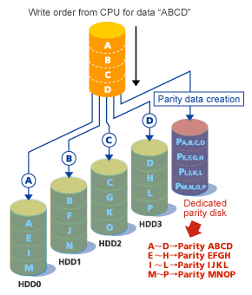
RAID 4
Behaves like striping
Survives one failure
Cost?
Drawbacks?
“Parity bottleneck”
Fujitsu

Slide 22
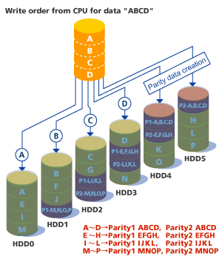
“RAID 6”
Like RAID 5.
Only more so.
More cost
More overhead
More reliability
Fujitsu

Slide 23
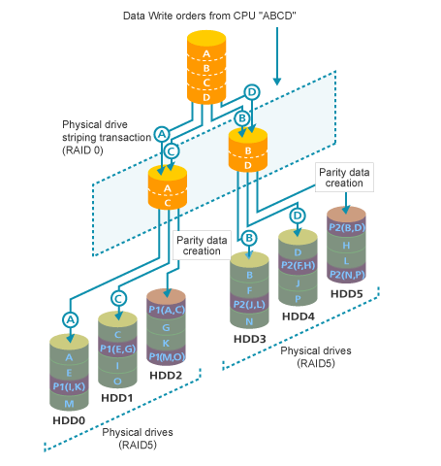
“RAID 5+0”
Stripe across RAIDs
Aka “parity groups”
Aka “aggregates”
Fujitsu

