Slide 1
CPS 310 / ECE 353
Introduction to Operating Systems
Jeff Chase
Duke University

Slide 2
What is this course about?
Programs
Platforms
Sharing
Concurrency
Storage
Protection and trust
Resource management
Virtualization
Scale and performance
Abstractions
Application Software
Operating System
Machine

Slide 3
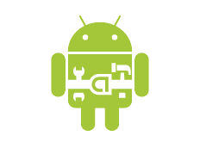

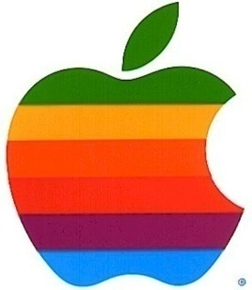
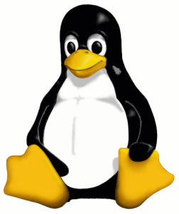


Slide 4
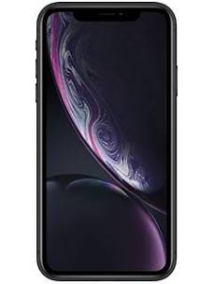

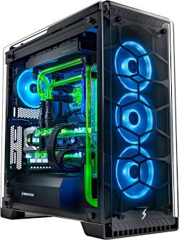
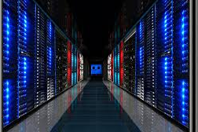
A broader view of OS
OS are platforms for running programs on machines.
Program: software packaged for the platform.
Platform: defines an environment for software and its data and interactions.
Machine: it runs software—may be virtual.
Examples
Mobile device
Embedded/IoT
Supercomputer
Cloud services
Web browser

Slide 5
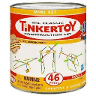
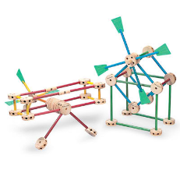

Platform abstractions
Platforms provide “building blocks”…
…and APIs to use them to construct software.
Instantiate/create/allocate
Manipulate/configure
Attach/detach
Combine in uniform ways
Release/destroy
Abstractions are layered.
Expose the power through APIs
Hide the details behind APIs
The choice of abstractions reflects a philosophy of how to build and organize software systems.

Slide 6
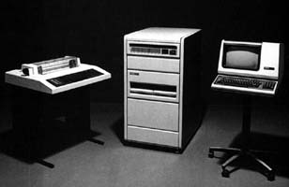
Unix: A lasting achievement?
“Perhaps the most important achievement of Unix is to demonstrate that a powerful operating system for interactive use need not be expensive…it can run on hardware costing as little as $40,000.”
DEC PDP-11/24
The UNIX Time-Sharing System*
D. M. Ritchie and K. Thompson
1974
terminal (tty)
“teletypewriter”
http://histoire.info.online.fr/pdp11.html

Slide 7
Let’s pause a moment to reflect...
From Hennessy and Patterson, Computer Architecture: A Quantitative Approach, 4th edition, 2006
Core Rate
(SPECint)
Note
log scale
Today Unix runs embedded in devices costing < $100.

Slide 8
OS Platform: a model
Applications/services. May interact and serve one another.
API
Libraries/frameworks: packaged code used by multiple applications
API
Protection boundary
OS platform: same for all applications on a system
E.g., classical OS kernel
OS mediates access to shared resources.
That requires trust, protection and isolation.
[RAD Lab]

Slide 9
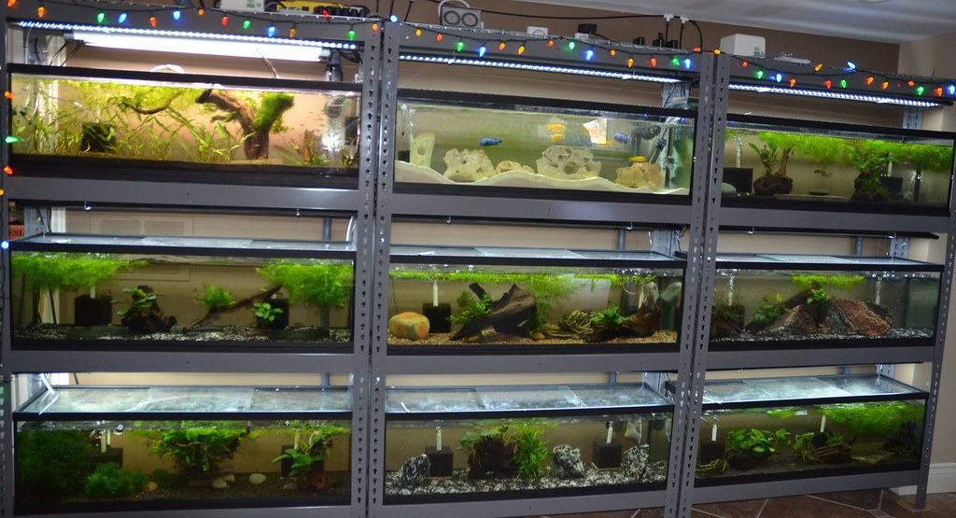
Isolated environments for programs

Slide 10
Processes and virtualization
In a (classical) OS programs run as processes.
A process is a running program instance.
A process has a thread (at least one) to run code.
OS multiplexes the computer among processes.
Processes are isolated from one another.
A process has one virtual address space.
VAS defines its view of machine’s memory.
It sees only what the kernel lets it see.
The OS kernel controls everything.
OS kernel creates/destroys processes.

Slide 11
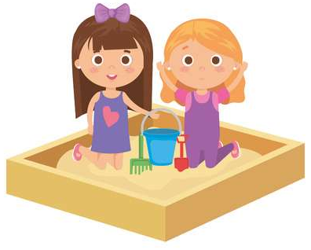

Virtual address spaces
A virtual address space (VAS) is a window on memory.
Defines what portions of memory a process can access.
Defines what names (addresses) to use.
The machine and kernel work together to support VAS.
Metaphors:
Sandbox: secure to play in; can’t get out.
Lockbox: nobody else can get in.

Slide 12
OS: classical view
Programs run as
independent processes.
Each process has a private virtual address space and one or more threads.
data
data
Protected system calls
...and upcalls (e.g., signals)
Protected OS kernel mediates access to shared resources.
Threads enter the kernel for OS services.
The kernel code and data are protected from untrusted processes.

Slide 13

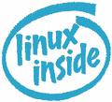
Platforms are layered/nested

Slide 14
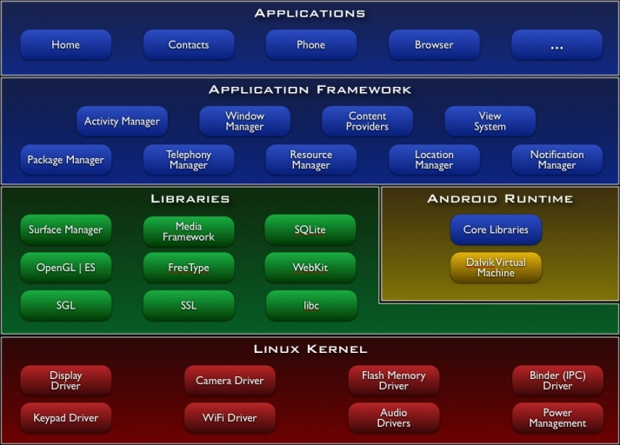
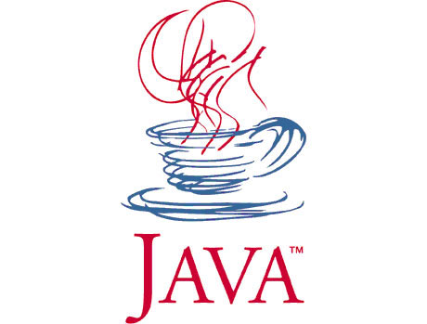
Virtual Machine
(JVM)
System libraries
(native C/C++)
“Classical OS kernel etc.
Reloaded with a few new kernel extensions (drivers).
[http://www.android.com]

Slide 15
Virtual machines (VMs)
Run a hypervisor on the “bare metal” physical machine.
New trusted layer!
Kernel and processes run in a virtual machine (VM).
Hypervisor manages multiple “instances” of the machine.
The VM “looks the same” to the OS as a physical machine.
Can run multiple OS on a shared computer.
guests
host
hypervisor

Slide 16
The p-p-paradigm
monitor / controller
configure
launch/restart
exception notify
machine
Machine runs according to its configuration. If it encounters a condition that requires controller to intervene, it suspends processing and generates an exception for the controller.

Slide 17



Summary: faces of your OS
Serving your requests
Directing traffic
Guarding your private property

