Slide 1
CPS 310 / ECE 353
Welcome to the Machine
Jeff Chase
Duke University

Slide 2
Hardware and software
OS is “all the code you don’t have to write” to create and run useful software programs on a computer.
OS mediates access to the machine and protects programs and users from one another.
Software is code.
Code runs on hardware.
Hardware executes code.
Applications / Software
Operating System
Machine / Hardware

Slide 3
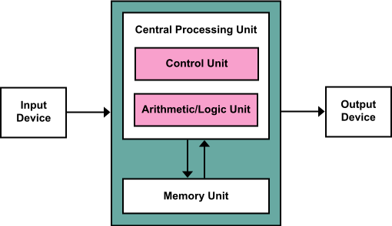
Von Neumann Architecture
There may be many processors/ cores in a CPU.
registers
instruction fetch/execute
I/O by DMA
read/load
write/store
i-fetch
Memory stores both code and data
https://commons.wikimedia.org/wiki/File:Von_Neumann_Architecture.svg

Slide 4


Slide 5
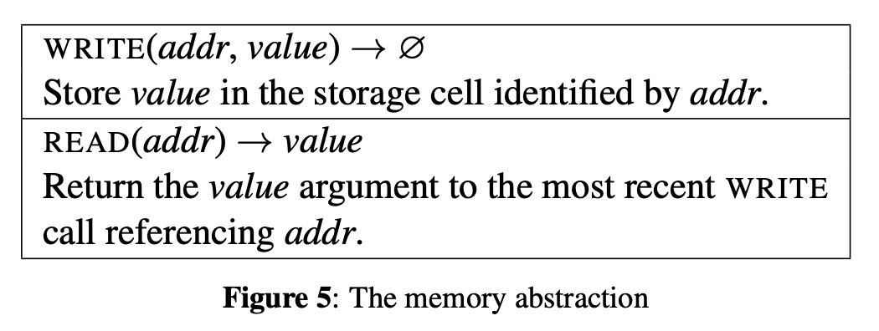
Memory/storage is an abstraction
Storage: an array of locations.
Locations are numbered: each has an address.
Each location stores a data value.
Graphic from Intel SGX Explained (Costan and Devadas, IACR Cryptology, 2016)

Slide 6
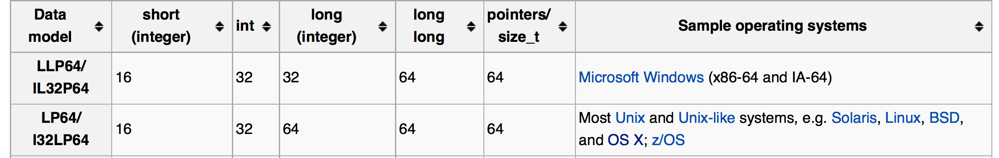
Data types
Basic data items often span multiple contiguous locations/cells.
On a typical 64-bit system: a char is one byte (8 bits), an address (pointer) is 64 bits, an integer is 32 bits, and “long” integer is 64 bits.
Details vary.
0x0
struct stuff {
int i;
long j;
char c[2];
};
24 bytes
(=0x18)
0x18

Slide 7
64 bytes: 3 ways
p + 0x0
Memory is “fungible”.
0x0
int p[16]
int* p
char p[64]
char *p
0x3f
p
char* p[8]
char** p
0x0
0x3f
We place data items at addresses that are aligned with (divisible by) the item size.
0x3f

Slide 8
Code
int j;
char* s = “hello\n”;
int p() {
j = write(1, s, 6);
return(j);
}
…..
p:
store this
store that
push
jsr _write
ret
etc.
translator
Source code
Instructions
Code has many representations.
Many tools/programs transform from one to another.
Each language has tools and steps to translate and combine subprograms and prepare them for execution.
Compilers, interpreters, assemblers, linkers, etc.
Notes:
Executable images are also built from separately developed components (modules)...
separate compilation
symbol tables
...linked together by system utilities.
cross-module procedure calls and data references
relocation records and linkage sections
static link-and-load in “traditional” Unix
DLLs and shared libraries
importance of calling conventions

Slide 9
Code: instructions in memory
_procedure1:
pushq %rbp
movq %rsp, %rbp
movl $1, %eax
movq %rdi, -8(%rbp)
popq %rbp
ret
Code is data!
Here is a sequence of x86-64 machine instructions in a human-readable (assembly) representation. Details depend on machine’s instruction set architecture (ISA).
Each instruction has an opcode and zero or more operands.
The CPU fetches the instruction from memory at some address.
Code and data locations correspond to symbols in the source program (e.g., procedure1).

Slide 10
Registers
Registers are fast memory inside the CPU/core.
Instructions may operate on registers by name.
How fast? Access at CPU clock speed.
Arithmetic instructions have register operands.
Load/store/branch instructions have address operands.
Register naming/layout/size is processor-dependent.
R0
R15
load x, R2 ; load global variable x
add R2, 1, R2 ; increment: x = x + 1
store R2, x ; store global variable x

Slide 11
Code stream
CPU executes a sequence or stream of instructions.
PC (program counter) or IP (instruction pointer) register →address of the current/next instruction to execute.
CPU repeats: fetch; execute; increment PC; loop
Branch instructions change PC.
E.g., call/return: control flow.
CPU core
Memory
A stream runs with a stack.
RAM region for its scratch use
SP (stack pointer) register
→address of stack top
program
R0
data
Rn
PC
x
SP
y
stack
registers

Slide 12
Threads and contexts
Register values contain the context of a code stream.
Including any pointers to memory it uses (e.g., its stack).
Contexts are data objects.
Context switch:
Stream executes instructions to:
Take a snapshot of the register values.
Save snapshot (context) in memory.
Load registers with another context.
Switch to another stream!
OS may manipulate saved contexts.
We call them threads.
R0
Rn
PC
x
SP
y
registers

Slide 13
Thread context switch
switch out
switch in
Memory (RAM)
x
program
T
data
R0
CPU
(core)
1. save registers
Rn
PC
x
y
T’s saved context
SP
y
stack
registers
2. load registers
stack
Running code can suspend current thread T by storing its register values in memory. Load them back to resume T at any time.

Slide 14
Two threads sharing a CPU/core
concept
reality
context switch
OS dispatches a thread to run on each core…
…and interleaves threads on the same core.

Slide 15
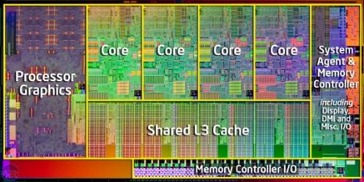
Modern computers are multi-core
Intel Xeon Platinum “Cooper Lake” (2020) has 28 cores @ two slots each.
A core with R register sets can run R threads in parallel.
Core has R slots — logical processors or hardware threads.
For simplicity, we suppose R=1: treat each slot as a separate core.
Left graphic from: How to implement any concurrent data structure for modern servers. By Calciu, Sen, Balakrishnan, Aguilera. CACM 2020.

Slide 16
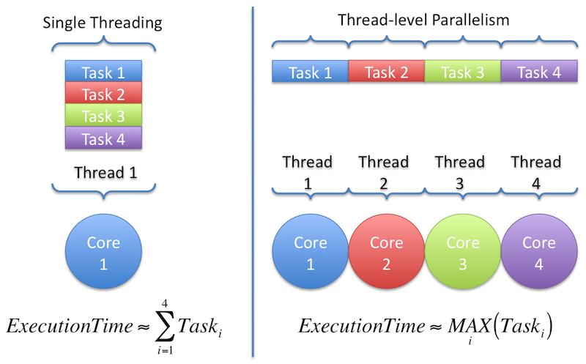
Multithreading for parallelism
work
“Because it’s faster.”
http://www.cse.wustl.edu/~jain/cse567-11/ftp/multcore

Slide 17
Reading Between the Lines of C
load x, R2 ; load global variable x
add R2, 1, R2 ; increment: x = x + 1
store R2, x ; store global variable x
Two threads execute this code section. x is a shared variable.
load
add
store
load
add
store
Two executions of this code, so:
x is incremented by two.
✔

Slide 18
Concurrency Interleaving matters
load x, R2 ; load global variable x
add R2, 1, R2 ; increment: x = x + 1
store R2, x ; store global variable x
Two threads execute this code section. x is a shared variable.
load
add
store
load
add
store
X
In this schedule, x is incremented only once: last writer wins.
The program breaks under this schedule. This bug is a race.

Slide 19
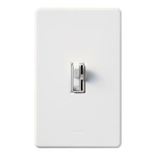
Protection: kernel mode
There is a switch in the processor (core) that gives it special powers.
We call it mode.
When a core is in kernel mode it can execute privileged instructions.
Else the core is in user mode: these functions are disabled.
How to turn it on?
kernel
user

Slide 20

Trusted OS code runs in kernel mode
User programs
runs in user mode
Also accessible to kernel
code+data in memory
kernel
runs in kernel mode
User programs reside in memory along with the OS.
But their code runs at different privilege levels.
Kernel mode enables OS code to control the machine.
User programs “cannot” access OS kernel memory.

Slide 21
The kernel
The OS kernel is a program that resides in a file.
On power-on/reset, the machine starts a bootloader program.
That loads the kernel into memory and transfers control to it (boot).
Once running, the kernel initializes certain machine functions.
Then the kernel can launch a user program: set up a context and execute a special instruction to switch into the context in user mode.
Control transfers back to the kernel to handle CPU exceptions.
Once booted, the kernel acts as one big event handler.
kernel

Slide 22
Mode: CPU privilege level
The current mode of a CPU core is given by a field (e.g., one bit) in a protected control register.
If the core is in kernel mode then it can:
access memory reserved to kernel;
access any machine memory;
access certain control registers;
command I/O devices;
execute certain special instructions;
control the entire machine.
If code running in user mode attempts such a privileged operation:
core raises a fault: a CPU exception;
transitions to handler code in kernel mode.
CPU core
mode
U/K
R0
Rn
PC
registers

Slide 23
Kernel mode
What turns it on? Exceptions
Trap: system call from user code
Fault: CPU needs kernel help
Interrupt: device needs attention
What turns it off?
Kernel code executes special instruction to enter user mode.
Kernel decides where to enter.
E.g., return to saved user context.
kernel
user

Slide 24
Protecting entry to the kernel
Kernel sets up a vector table in memory at boot time.
It writes the table address into a special protected control register.
Table entries point to handlers for each type of exception/interrupt.
Exception number
(x 8)
Code for
handler 0
Address of entry
for exception # k
Exception table
base register
Code for
handler 1
+
0
1
Code for
handler 2
2
...
Once booted, every entry to kernel mode starts in a registered handler.
n-1
...
Exception
table
Code for
handler n-1
[from CS:APP3e F8:2-3 combined/edited]

Slide 25
(1) Application
makes a
system call
(2) Control passes
to handler
Trap
syscall
_{next}
(3) Trap handler runs
(4) Handler returns
to instruction
following the syscall
(1) Current
instruction
causes a fault
(2) Control passes
to handler
Fault
_{curr}
(3) Fault
handler runs
abort
(4) Handler either reexecutes
current instruction or aborts.
(2) Control passes
to handler after current
instruction finishes
(1) Interrupt pin
goes high during
execution of
current instruction
Interrupt
_{curr}
_{next}
(3) Interrupt
handler runs
(4) Handler
returns to
next instruction
[from CS:APP3e F8:5-7 combined/edited]

Slide 26
Memory/storage hierarchy
Computing happens here, at the tip of the spear. The cores pull data up through the hierarchy into registers, and then push updates back down.
1-4 GHz
small and fast
(sub-ns)
registers
caches
L1/L2
In general, each layer is a cache over the layer below.
off-core
L3
Input/Output (I/O) is here. Requires OS help to set up.
off-chip
5-20 ns
main memory (RAM)
off-module
big and slow
(ms)
disk, other storage, network RAM
Cheap bulk storage

Slide 27
Anatomy of a disk read
3. Check to see if requested data (e.g., a block) is in memory. If not, figure where it is on disk, and start the I/O.
6. Return to user mode.
5. Copy data from kernel buffer to user buffer in read.
(kernel mode)
2. Enter kernel for read syscall (trap).
1. Compute
(user mode)
interrupt
CPU
wait
seek
transfer (DMA)
Disk
Time
DMA: Direct Memory Access: I/O device moves blocks of data to/from memory
Warning: drawing is not to scale.

Slide 28
Summary
Software is code (instructions) and typed data.
Hardware runs code on CPU and stores data in RAM.
Code executes as a sequential stream with its context in registers, and in the memory it uses (e.g., its stack).
CPU hardware can run one stream per register set (hardware thread). Suppose each CPU core has one.
Concurrency: streams execute “at the same time”.
Protection: each core executes in some privilege mode at any given time. OS runs in trusted kernel mode.
CPU exception (trap, fault, interrupt) switches the core to kernel mode to run a handler in the OS.

