Slide 1
CPS 310 / ECE 353
Programs and Processes
Jeff Chase
Duke University

Slide 2

What is a program?
Is it a stupid question?
A program is data that describes a process. ;-)
For our purposes today, the data is stored in a file, in a format that the operating system can execute.
An executable or “binary” file
Let’s suppose that it is statically linked (self-contained).
data
Program

Slide 3
Birth of a program (C/Ux)
myprogram.c
myprogram.o
int j;
char* s = “hello\n”;
int p() {
j = write(1, s, 6);
return(j);
}
object file
assembler
data
data
data
data
linker
libraries and other object
files or archives
…..
p:
store this
store that
push
jsr _write
ret
etc.
compiler
program
“binary”
myprogram.s
data
header files
myprogram
(executable file)
Notes:
Executable images are also built from separately developed components (modules)...
separate compilation
symbol tables
...linked together by system utilities.
cross-module procedure calls and data references
relocation records and linkage sections
static link-and-load in “traditional” Unix
DLLs and shared libraries
importance of calling conventions

Slide 4
Role of the linker in the build toolchain
What’s this all about?
Real programs are written in pieces by different people.
Their code is spread across multiple files.
They include “off the shelf” code used by other programs.
Libraries, e.g., the C standard library (libc, stdlib).
We can compile the pieces separately, at different times.
A piece might reference symbols defined in another.
The linker combines the pieces into a program.
C compiler also runs linker for you (unless –c), with stdlib.

Slide 5
Separate compilation and the linker
main.c
swap.c
Source files
Translators
(cpp, cc1, as)
Translators
(cpp, cc1, as)
compiler,
assembler
Relocatable
object files
main.o
swap.o
Linker (ld)
Fully linked
executable object file
p
[cs:app]

Slide 6
Static linking with libraries (archives)
main2.c
vector.h
Code for printf is in the C standard library (libc.a).
Translators
(cpp, cc1, as)
libvector.a
libc.a
Static libraries
main2.o
addvec.o
printf.o and any other
modules called by printf.o
Linker (ld)
Fully linked
executable object file
p2
[cs:app]

Slide 7
Where to start? main()
chase$ cc -c empty.c
chase$ file empty.o
empty.o: Mach-O 64-bit object x86_64
chase$ nm empty.o
0000000000000000 T _p
chase$ cc empty.c
Undefined symbols for architecture x86_64:
"_main", referenced from:
implicit entry/start for main executable
ld: symbol(s) not found…
clang: error: linker failed with exit code 1
chase$
empty.c
void
p() {}
This program compiles OK. It defines the procedure p: a symbol of type T for “text” (code). But it is not a complete program: the linker doesn’t know where to start! Programs start in main(), but it is missing.

Slide 8
Where to go? Calling out
empty.c
void
p() {}
chase$ cc –o nop nop.c
Undefined symbols…:
"_p", referenced from:
_main in nop-bbc335.o
ld: symbol(s) not found…
clang: error: linker command failed…
chase$ cc -o nop nop.c empty.o
chase$ ./nop
chase$
nop.c
void p();
int main()
{p();}
This program doesn’t do anything, but it is a complete program! It has a main(). But it also needs empty.o to define the symbol p, because main() calls p(). Given both files, the linker is happy. And we want the linker to be happy.

Slide 9
What’s a library?
A library is just a collection of object files bundled together into a single archive file…
…with an index for fast linking.
ar command utility creates/modifies archives.
No mystery; no magic!
chase$ ar cr empty.a empty.o
chase$ file empty.a
empty.a: current ar archive random library
chase$ cc -o nop nop.c empty.a
chase$ ./nop
chase$

Slide 10
What’s in an object file or executable?
e.g., an ELF or Mach-O file
Header “magic number”
indicates type of file/image.
header
text
program instructions
p
Section table an array
of (offset, len, startVA)
data
idata
immutable data (constants)
“hello\n”
sections
wdata
writable global/static data
j, s, sbuf
Metadata used by tools.
Options:
Remove after final link step and strip (compact).
Or: add more symbol info for debugger.
symbol
table
j, s, p, sbuf
int j = 327;
char* s = “hello\n”;
char sbuf[512];
int p() {
int k = 0;
j = write(1, s, 6);
return(j);
}
relocation
records
Sections are byte offset ranges within the file.

Slide 11

ELF: read it like a book
An executable/linkable file (e.g., ELF) is “like a book”.
Sections. They are “like chapters”, or…sections.
Each section has content of a given purpose/use, needed to link/run the program.
E.g., code, initial values of global data, constants.
Header. Cover page and table of contents (ToC).
Symbol table. Detailed ToC: all defined symbols.
Relocation records. Index: lists references to symbols.

Slide 12

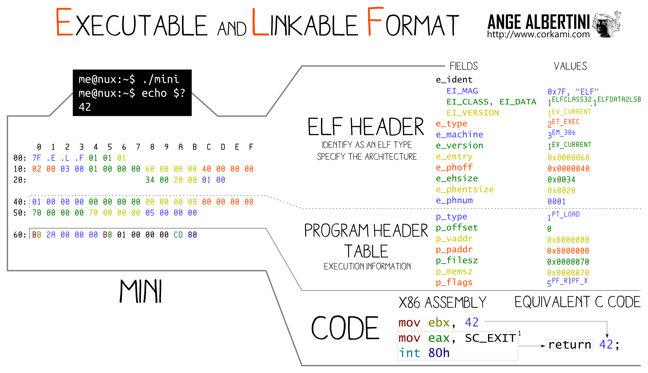
Inside ELF
Linux uses ELF.
MacOS uses Mach-O.

Slide 13
Birth of a program (C/Ux)
myprogram.c
myprogram.o
int j;
char* s = “hello\n”;
int p() {
j = write(1, s, 6);
return(j);
}
object file
assembler
data
data
data
data
linker
libraries and other object
files or archives
…..
p:
store this
store that
push
jsr _write
ret
etc.
compiler
program
“binary”
myprogram.s
data
header files
myprogram
(executable file)
Notes:
Executable images are also built from separately developed components (modules)...
separate compilation
symbol tables
...linked together by system utilities.
cross-module procedure calls and data references
relocation records and linkage sections
static link-and-load in “traditional” Unix
DLLs and shared libraries
importance of calling conventions

Slide 14
Building and running a program
chase:p0> make
gcc -I. -g3 -Wall -DNDEBUG -c dmm.c
…
1 warning generated.
gcc -I. -g -Wall -DNDEBUG -o basicdmmtest basicdmmtest.c dmm.o
gcc -I. -g -Wall -DNDEBUG -o test_basic test_basic.c dmm.o
gcc -I. -g -Wall -DNDEBUG -o test_coalesce test_coalesce.c dmm.o
gcc -I. -g -Wall -DNDEBUG -o test_stress1 test_stress1.c dmm.o
gcc -I. -g -Wall -DNDEBUG -o test_stress2 test_stress2.c dmm.o
chase:p0>./test_basic
calling malloc(10)
call to dmalloc() failed
chase:p0>

Slide 15
Running a program
code (“text”)
constants
initialized data
Process with virtual memory
sections
segments
data
Program
Load file sections into (virtual) memory to initialize.
heap
0
stack
When a program launches, the OS initializes a process with a virtual memory to store the running program’s code and data. Sections of the executable file initialize segments (regions) of the VM.

Slide 16
Process VM/VAS (32-bit example)
0x7fffffff
Reserved
The program uses virtual memory through its process’ Virtual Address Space:
An addressable array of bytes…
Containing every instruction it can execute…
And every piece of data those instructions can reference…
E.g., read/write == load/store on memory
Partitioned into logical segments (regions) with distinct purpose and use.
Every reference by a running program is interpreted in the context of its VAS.
Resolves to a location in machine memory
Stack
Dynamic data
(heap/BSS)
Static data
Text
(code)
0x0

Slide 17
VM segments: a view from C
Globals (static data):
Fixed-size segment
Writable by user program
May have initial values
Text (instructions)
Fixed-size segment
Executable
Not writable
Heap and stack
Variable-size segments
Writable
Zero-filled on demand
globals
text
heap
PC
x
SP
y
registers
stack
CPU core
segments

